Slide 1
19/10/23 Year 5/6 Homework
Math Antics - Long Division - YouTube

Slide 2
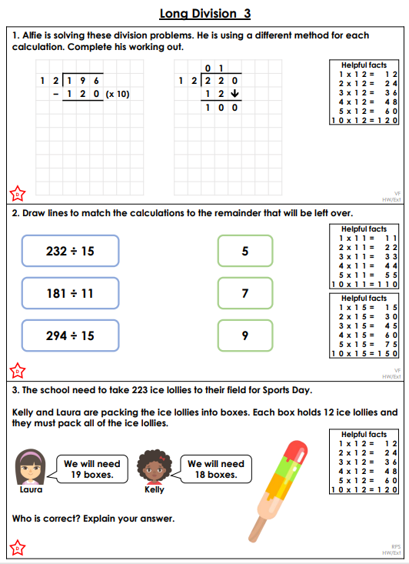
Year 5

Slide 3
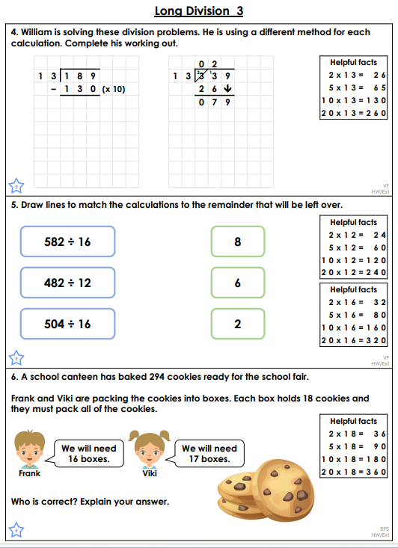
Year 6

