Slide 1
Detective stories
English homework Week 3

Slide 2
Read the extract from ‘The Falcon’s Malteser’ by Anthony Horowitz.
Think about…
How the author grabs the reader’s attention
The differences between the narrator and his older brother

Slide 3
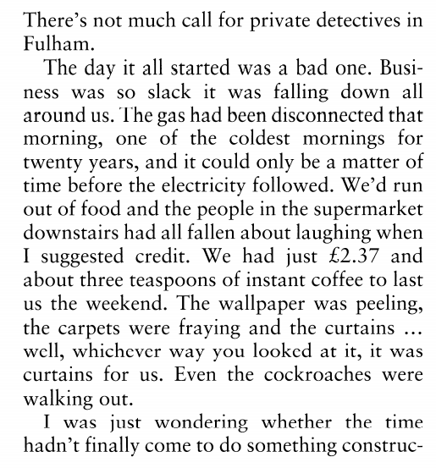
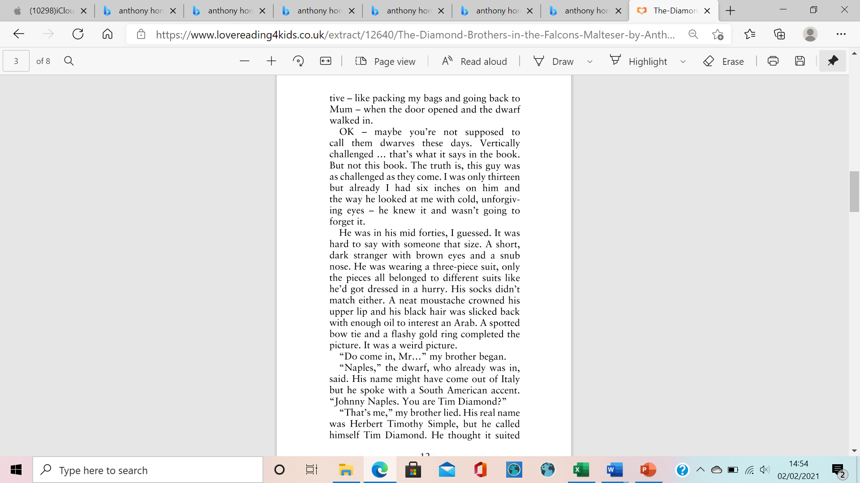
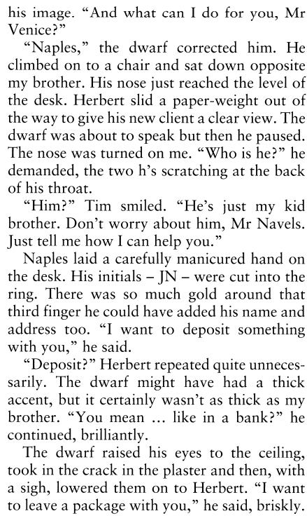

Slide 4
How does the author grab the reader’s attention?
How does the author use humour in this passage?
How are the narrator and his brother different?

Slide 5
Write the opening to a detective story.

Slide 6
THE DETECTIVE:
NAME
AGE
APPEARANCE
PERSONALITY
EXPERIENCE
SKILLS

Slide 7
Who is your main character?
Where is your story set?
When does your story take place?
What is the mystery?
How will the passage end?

