Slide 1
Flip Homework Autum 1 Week 1
English

Slide 2
Let’s watch the video
https://www.youtube.com/watch?v=d29zoF4X340&ab_channel=TwinklTeachesKS2

Slide 3
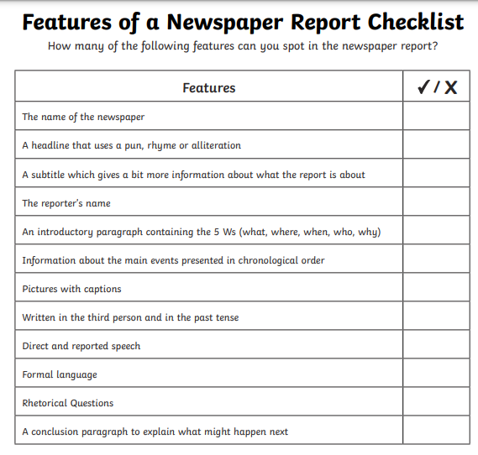
Now note down the features of a newspaper report.

