Slide 1
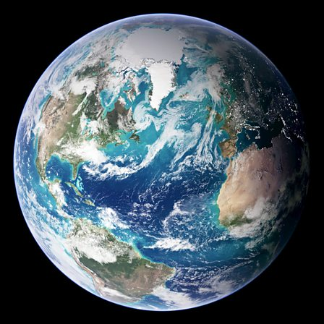
Geography – Flip Learning/ Homework

Slide 2
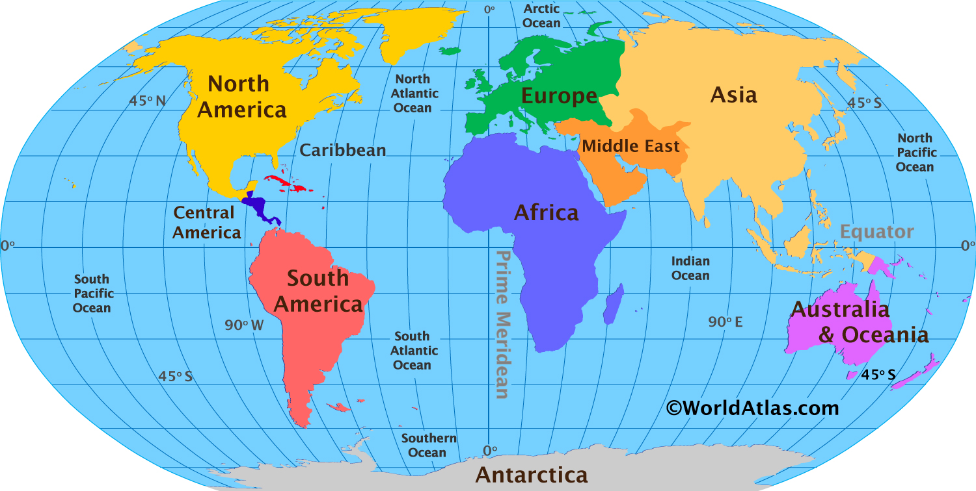
Next term
For Geography next term our topic will be ‘All Around the World. We will be learning about different continents and locating countries around the globe.
For KS1 Geography their homework is to research and make a poster about their home country and look for characteristics of that country. This could be the countries
-Population
-Prime misters name
-National favourite dish
-Famous landmarks!
Cant wait to see the posters!

