Slide 1
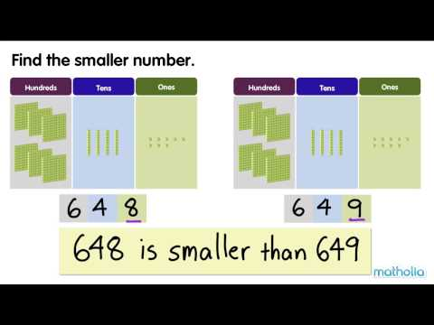
MATHS FLIP LEARNING
YEAR 3

Slide 2
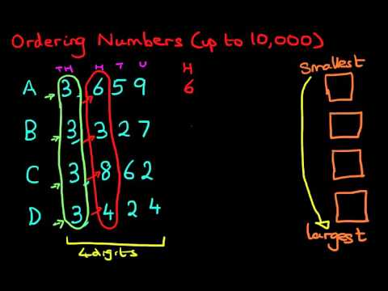
MATHS FLIP LEARNING
YEAR 4

