Slide 1
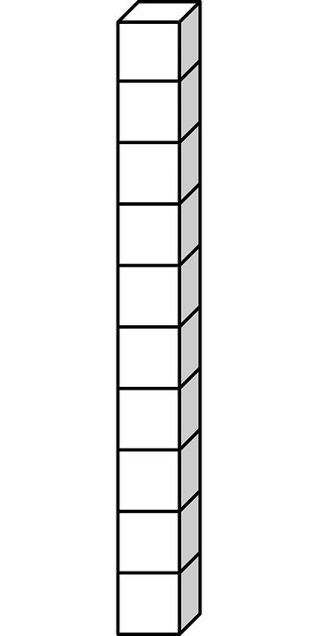
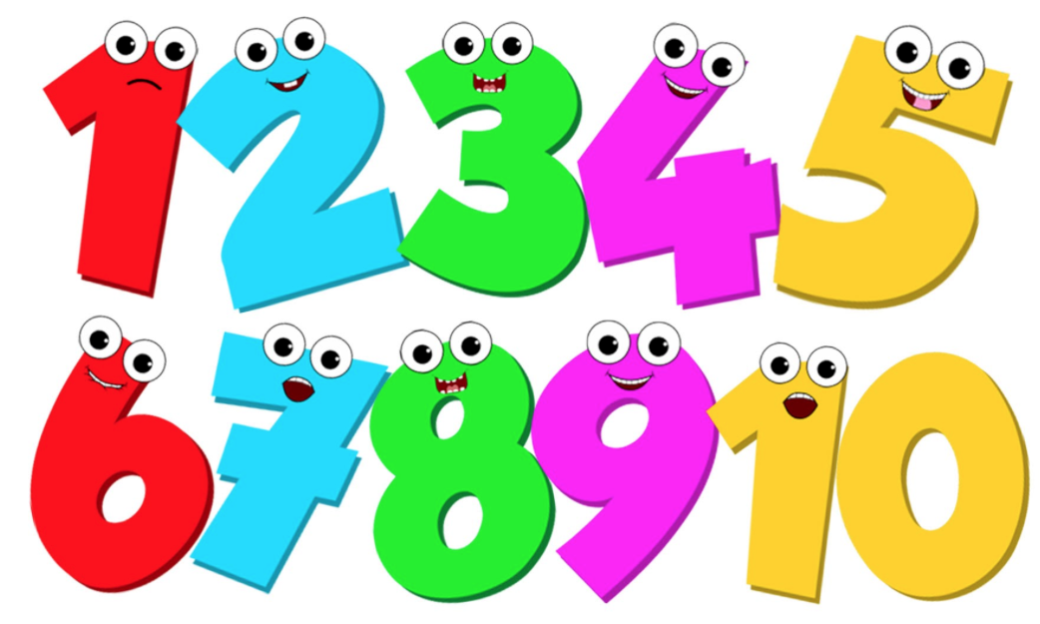
www.youtube.com/watch?v=RADC5kggaM4
FLIP LEARNING
Monday 12th September 2022
This week Year 3 and 4 will continue to learn about :
Partitioning Numbers
Please follow the link above and watch the video.
Try the PRACTICE QUESTIONS at the end of the video.

