Slide 1


W6 Homework
Due: Tuesday 20th April 2021

Slide 2
Spelling
TEST on Friday 23rd April 2021
Impossible
Frantically
Basically
Pleasure
Nature
Adventure
Dangerous
Tremendous
Decide
Different

Slide 3
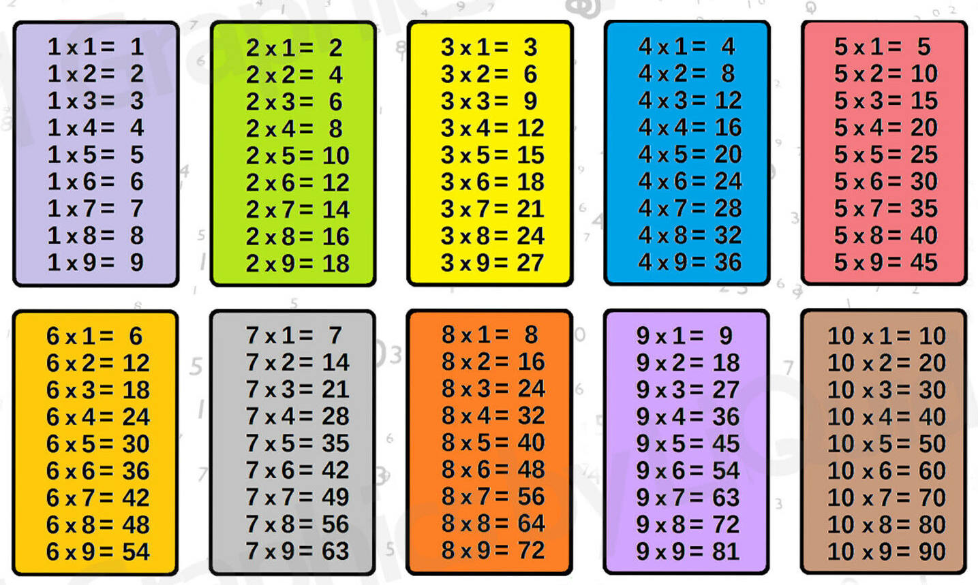
Times Table
Revise

Slide 4
Why was the River Nile so important?
Read the information on the PowerPoint
Create a poster on why the River Nile was so important to the ancient Egyptians.

