Slide 1


W3 English Flip learning
Due: Monday 22nd March 2021
Y3-4

Slide 2
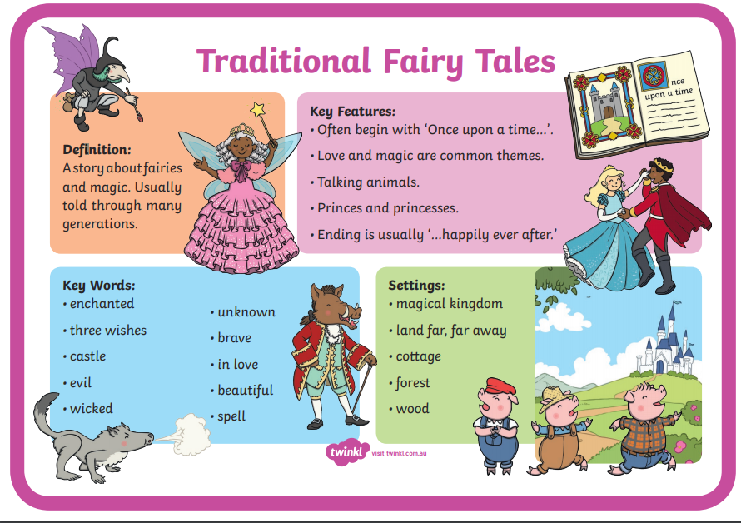
This week we will be writing our own version of a traditional tale
Please watch the video to remind yourself what to include in a story
https://www.youtube.com/watch?v=cYqmNO6gr2Y

Slide 3
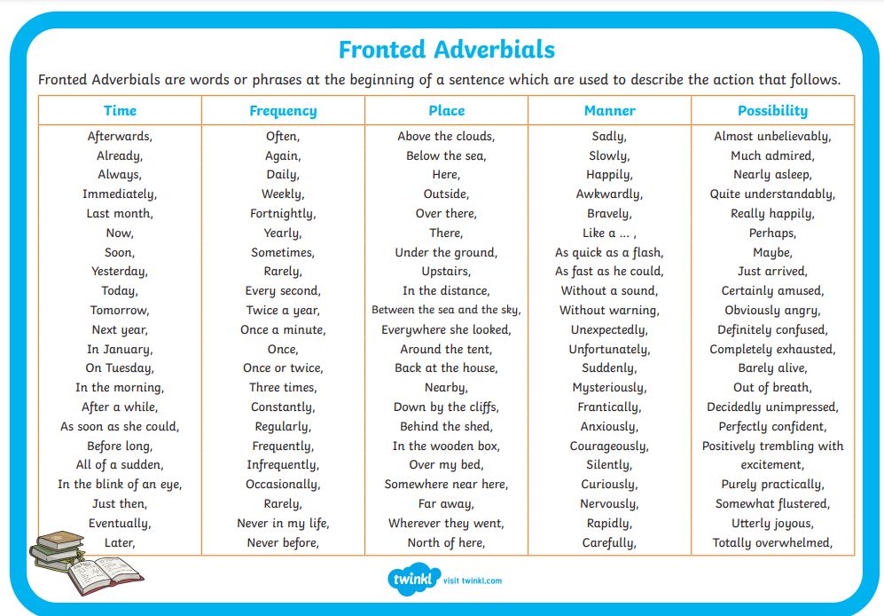
In our writing we will include adverbs and adverbial phrases. Please find out what they are...
https://www.youtube.com/watch?v=18sXFjb0TFc

Slide 4
Now I would like you to click onto this link https://storiestogrowby.org/story/cinderella-fairy-tale-english-story-for-kids/#Cinderella_Kids_Art_Video and listen to the Cinderella story.
Think: If you were the author of this book – How would you change the ending?

