Slide 1
W2 - Homework
Due: Tuesday 16th March 2021

Slide 2
Spelling
Spelling test on Tuesday
Health
Popular
Certain
Sentence
Strange
Positive
Negative
Although
Because
Therefore

Slide 3
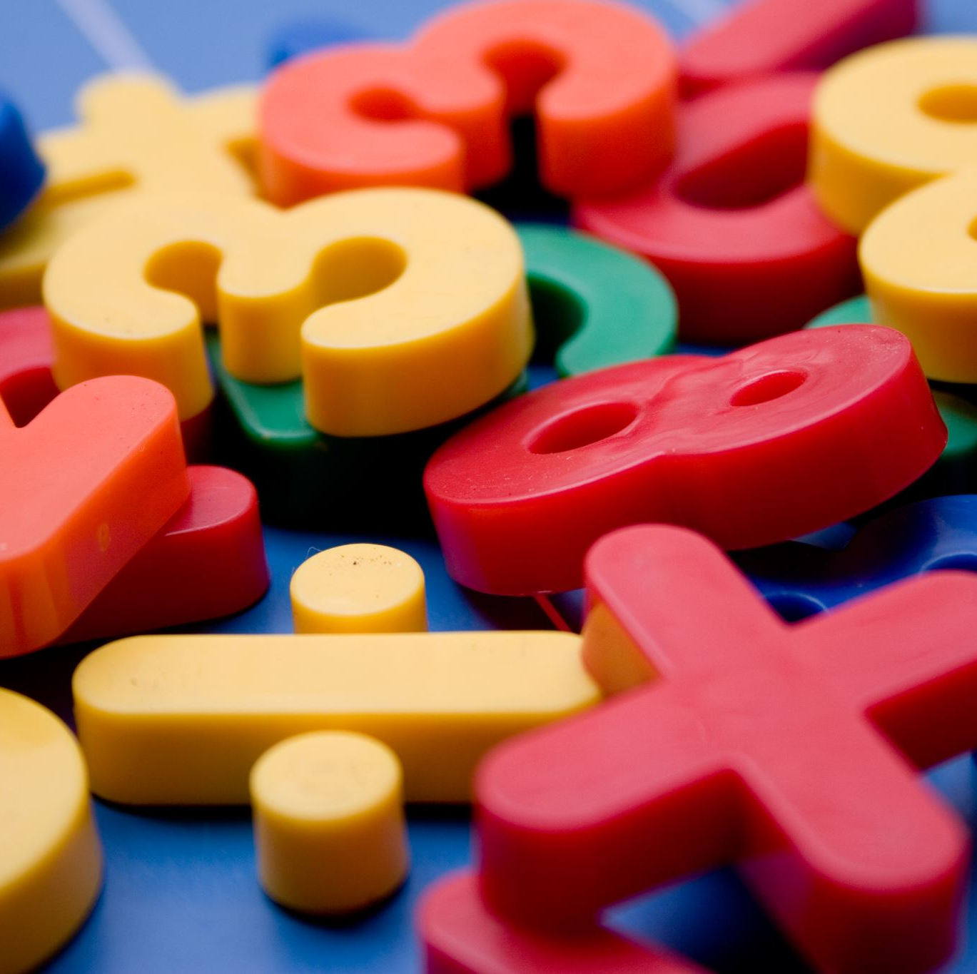
Maths y3/4
I would like you to practise some questions we did in our lessons this week on Multiplication and Division.
Answer the questions in your homework book.

Slide 4
Y3

Slide 5
Y3

Slide 6
Y3

Slide 7
Y3

Slide 8
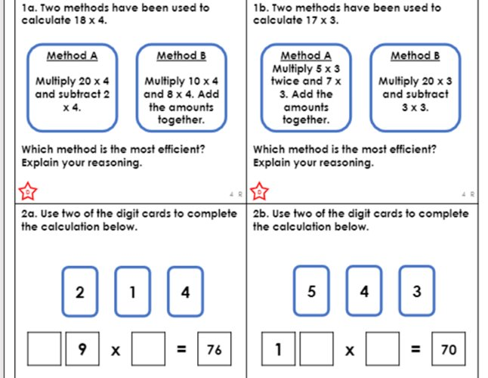
Y4

Slide 9
Y4

Slide 10
Y4

