Slide 1
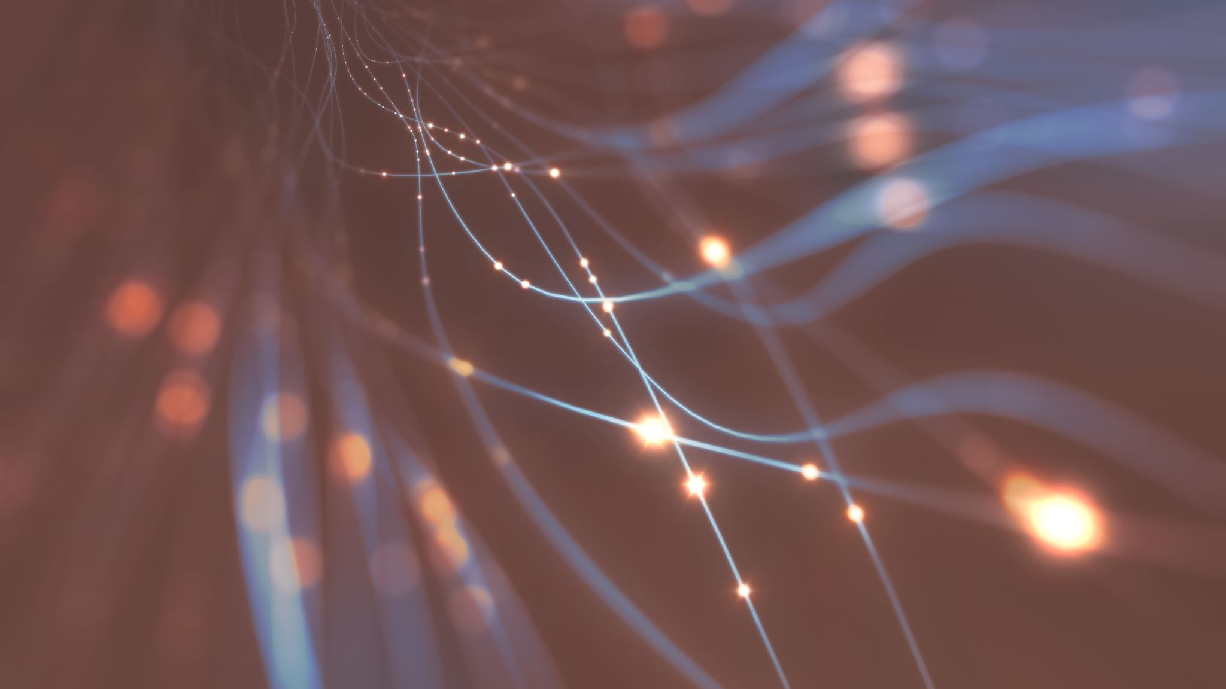
Flip learning
In Autumn 2 we will be reading 'The heart and the bottle'

Slide 2
Prediction Questions:
This is the front cover of the book we will be reading in the new term.
What do you think the story will be about?
Who is the main character?
Why is there a bottle?
What does the title mean?

Slide 3
Click the link and listen to the story
https://www.youtube.com/watch?v=Hrd-Wdxbg-Q

