Slide 1
Lesson 9
Write a newspaper article

Slide 2
Our Learning: Write a newspaper article
WALT: What I’m Learning Today
to write a newspaper article
Success Criteria
I can provide a catchy headline
I can use a range of adverbials of time
I can include formal vocabulary

Slide 3
Let’s read:
The final pages and the chronology

Slide 4
Talk Partners: discuss strong verbs
Discuss how good these words are for being strong verbs that are quite formal and that portray a sense of injustice, so they suit this theme

Slide 5
Analysing words
Misfortune
Mistreated
Distrust
Disgrace
Misunderstood
Disloyal
Mislead
Mislaid
Displace
Disappoint
Discovered

Slide 6
Heading
Otto Frank Returns Home to Find Long Lost Daughter’s Diary and Plans to Publish this for all to Read
Can we shorten?
Otto Returns
Diary Found
Diary Published
Lost Daughter Published

Slide 7
Adverbials Recap
Adverbs give us more information about:
Verbs (action or doing words/to show states of being)
Adjectives (describing words)
Other adverbs
Whole clauses
Let’s explore how…

Slide 8
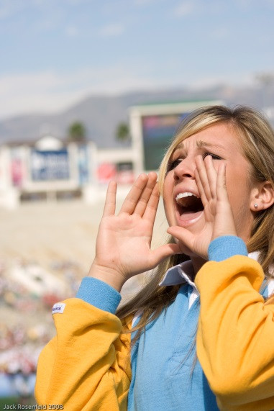
Starter
Adverbs can give us more information about verbs (an action, doing or state word).
Jessica shouted cheerfully.
What other adverbs could you use to say how Jessica shouted?
Jessica shouted ________.
Photo courtesy of JMR_Photography (@flickr.com) - granted under creative commons licence - attribution

Slide 9
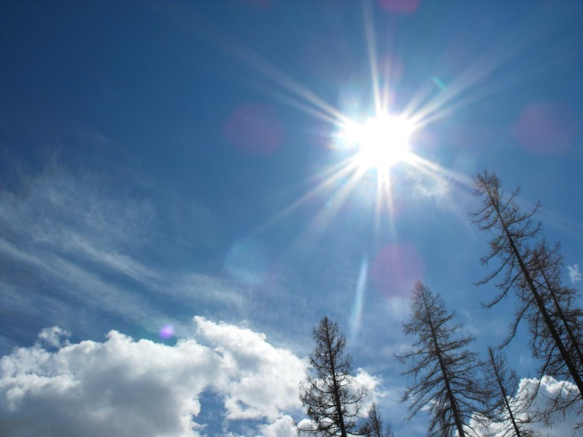
Starter
Adverbs can give us more information about adjectives
(describing words).
The Sun is extremely bright.
What other adverbs could you use to describe how bright the sun is?
The Sun is ________ bright.
Photo courtesy of gr33n3gg (@flickr.com) - granted under creative commons licence - attribution

Slide 10
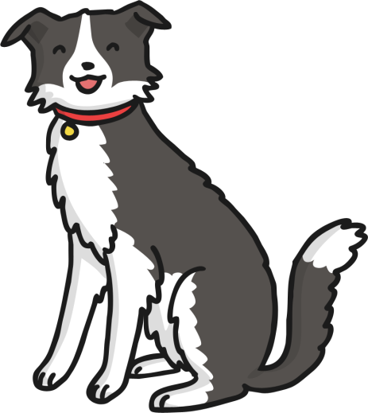
Starter
Adverbs can give us more information about other adverbs.
The dog sat very quietly.
Can you use ‘very’ to modify any other adverbs?

Slide 11
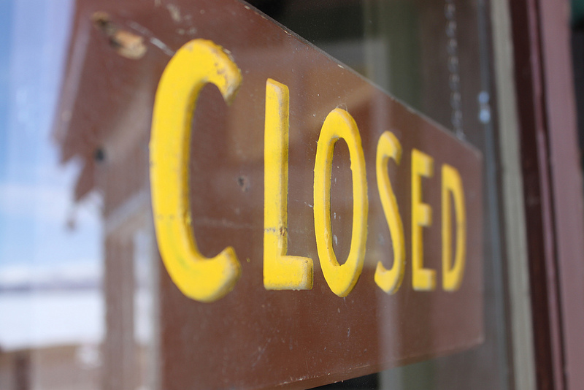
Starter
Adverbs can modify whole clauses.
Unfortunately, the school was closed.
What other adverbs could you use to modify the clause
‘the school was closed’?
Photo courtesy of bmills (@flickr.com) - granted under creative commons licence - attribution

Slide 12
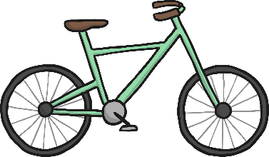
Adverbial Phrases
We can also use phrases rather than single adverbs to modify clauses. These are called adverbial phrases. Adverbial phrases do not usually contain a verb.
For example:
Zoe rode her bike with excitement.
Zoe rode her bike down the road.
Zoe rode her bike like an expert.
Can you make your own adverbial phrase to modify this clause?
‘Tom ate his lunch ________________________ .’

Slide 13
Fronted Adverbials
This is a complicated name for something very simple!
Sometimes an adverb or adverbial phrase can come before the verb instead of after.
For example:
Zoe rode her bike like an expert.
Could be changed to:
Like an expert, Zoe rode her bike.
A comma always comes after a fronted adverbial.

Slide 14
Activities
1st:
Can you use adverbs, adverbial phrases and fronted adverbials to modify the clauses?
2nd:
Using the ‘Fronted Adverbials Matching Game’, how many correct sentences can you make from matching the fronted adverbials (blue tiles) with the clauses (orange tiles)?
Extension:
Create your own clause (e.g. ‘The car roared’) and modify it using an adverb, an adverbial phrase and a fronted adverbial.

Slide 15
Plenary
Can you identify an adverb, an adverbial phrase and a fronted adverbial in this short story?
On Saturday, I woke up and went straight to tennis. My opponent played brilliantly, but I managed to win the match. Unfortunately, the café at the sports centre was closed, so we went home for hot chocolate. During the afternoon, I played in the garden with my sister. We built a den and hid quietly inside until tea time. That night, I drowsily ate my dinner. I was worn out.

Slide 16
Plenary
Can you identify an adverb, an adverbial phrase and a fronted adverbial in this short story?
On Saturday, I woke up and went straight to tennis. My opponent played brilliantly, but I managed to win the match. Unfortunately, the café at the sports centre was closed, so we went home for hot chocolate. During the afternoon, I played in the garden with my sister. We built a den and hid quietly inside until tea time. That night, I drowsily ate my dinner. I was worn out.

Slide 17
Talk Partners: Practice writing Adverbials

Slide 18
Adverbials of Time
An adverbial of time is a word or phrase which tells us when the sentence is taking place. Can you underline all of the adverbials of time in these sentences?
In the morning, my brain felt full of fog.
Sometimes, when I can’t sleep, listening to their songs magically helps.
After I’d finished my hot chocolate, I put on my favourite pyjamas and tried to get to sleep.
After a bit, I grabbed my phone, shoved my earphones into my ears, and played the latest Glitter Riot album on repeat.
Each of the words in the box below is an adverbial of time.

Slide 19
Each of the words in the box below is an adverbial of time.

Slide 20
Talk Partners: Practice your time adverbials

Slide 21
Newspapers have a range of features that attract the reader.
Can you think of any of these features?
Next
Next

Slide 22
the name of the newspaper at the top;
A newspaper report must include…
Next
an interesting headline and sub-headline;
an introductory paragraph that includes the five Ws;
Next
writing in the third person and past tense;
Next
Next
quotes written as direct speech;
captions for all pictures;
“
Next
”
Next
a conclusion paragraph to explain what might happen next.
facts about the main events;
Next
Next

Slide 23
A newspaper report must include…
write the name of the newspaper at the top?
HEADLINE
create an interesting headline and sub-headline?
Newspapers use the headline to try to grab the readers’ attention. It might even use a pun, rhyme or alliteration. Which one of these catchy headlines makes you want to read more?
start with an introductory paragraph that includes five Ws?
write in the third person and past tense?
Next
use quotes written as direct speech?
add captions to all pictures?
“
”
finish with a conclusion paragraph to explain what might happen next?
include facts about the main events?

Slide 24
Introductory Paragraph
A newspaper report begins with an introductory paragraph that includes the five Ws.
Next
What happened?
When did it happen?
Where did it happen?
Next
Next
Next
Who was involved?
Why did it happen?
Next
Next

Slide 25
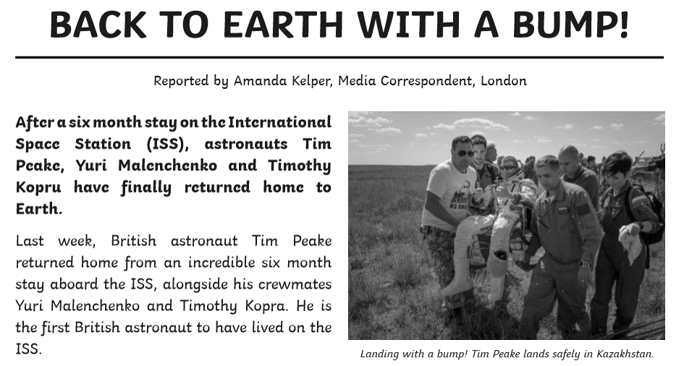
After a six month stay on the International Space Station (ISS), astronauts Tim Peake, Yuri Malenchenko and Timothy Kopra have finally returned home to Earth.
Last week, British astronaut Tim Peake returned home from an incredible six month stay aboard the ISS, alongside his crewmates Yuri Malenchenko and Timothy Kopra. He is the first British astronaut to have lived on the ISS.
Can you spot the five Ws in the start of this report?
Next

Slide 26
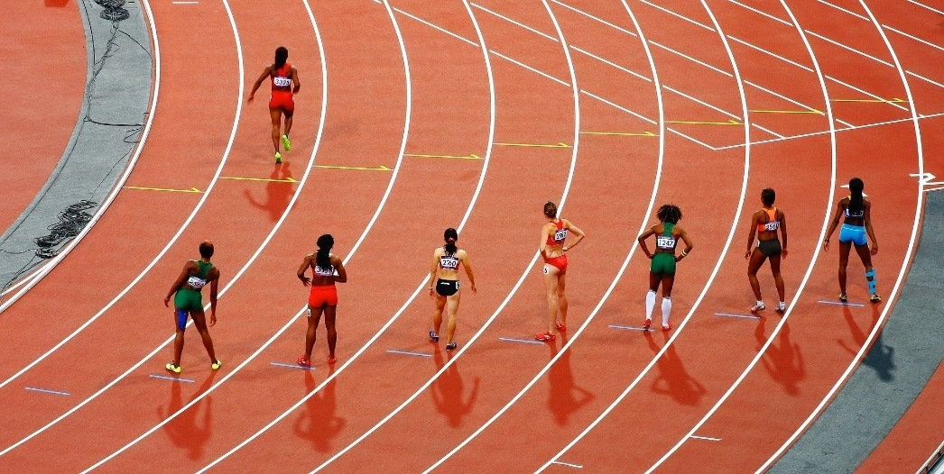
Captions and Pictures
Photos and captions will help to tell the story by giving the reader a snapshot of what has happened, where it happened or who it happened to.
A caption explains to the reader what is happening in a picture. The caption is usually placed underneath the picture.
Next
Next
What do you think a report using this
picture would be about?
Next

Slide 27
The man had a beard and wore a black coat.
I am the smartest person in the class.
Next
Next
Yellow is the best colour.
You shouldn’t go swimming in the sea.
Next
It took the runner 84 days to complete the extreme race.
Next
Mrs James lives at 103 Blake Drive.
Next
The truck arrived to pick up the jewels at 3 o’clock.
Next
Next

Slide 28
The man had a beard and wore a black coat.
Facts
Opinions
I am the smartest person in the class.
I am the smartest person in the class.
The man had a beard and wore a black coat.
Next
Next
Yellow is the best colour.
It took the runner 84 days to complete the extreme race.
Yellow is the best colour.
Next
Next
You shouldn’t go swimming in the sea.
You shouldn’t go swimming in the sea.
It took the runner 84 days to complete the extreme race.
Next
Mrs James lives at 103 Blake Drive.
Next
Mrs James lives at 103 Blake Drive.
Next
The truck arrived to pick up the jewels at 3 o’clock.
The truck arrived to pick up the jewels at 3 o’clock.
Next

Slide 29
Write in the Third Person and Past Tense
Facts
Opinions
The man had a beard and wore a black coat.
I am the smartest person in the class.
Third Person
Write about what happened to others (e.g. he, she, they, them, it), not from your own perspective.
It took the runner 84 days to complete the extreme race.
Yellow is the best colour.
Past Tense Newspaper articles are normally an example of a recount text. They are written in the past tense as the event has already taken place.
You shouldn’t go swimming in the sea.
Mrs James lives at 103 Blake Drive.
The truck arrived to pick up the jewels at 3 o’clock.
Next

Slide 30
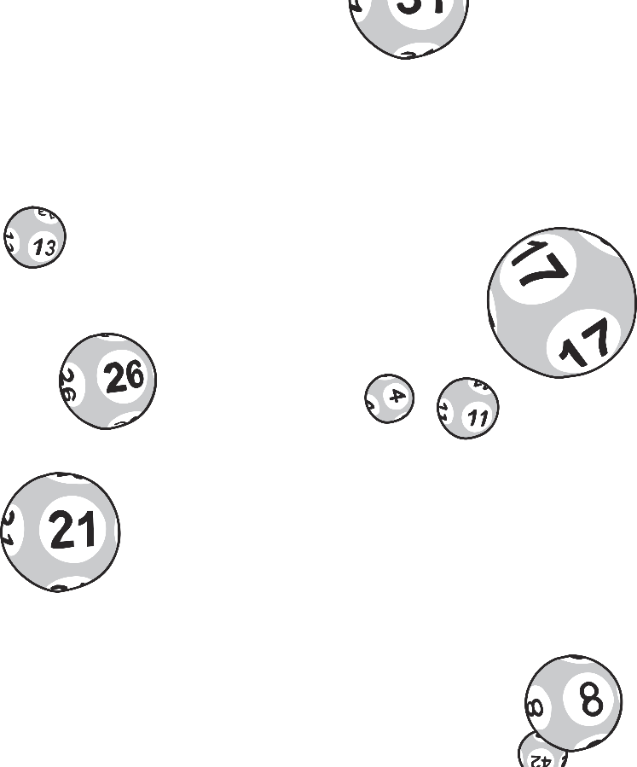
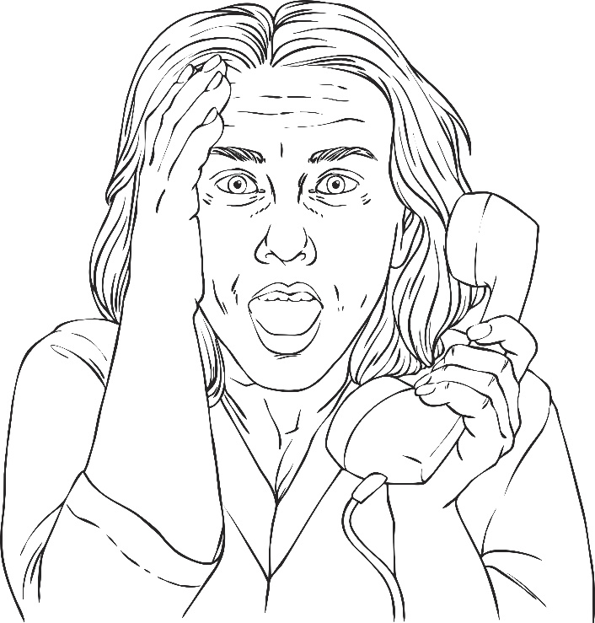
Quotes
Quotations tell us what has been said and who has said it. They can help to make the story credible by giving the reader the opinions of the people involved. Remember to use inverted commas!
“
”
Next

Slide 31
“We were all jumping around and dancing in the living room. We never believed it could happen again,” Alisha commented.
During these checks, Peake was asked how it felt to be home, “The smells of Earth are so strong and it’s wonderful to be back in the fresh air.”
Next
Next
“It’s a brilliant feeling. It’s been a long road. I’m happy, but I’m relieved. It’s great to be in the history books as one of the greatest. I’m proud of myself,” he told reporters.
“Sally asked me to stop working because I was about to hit whatever she’d seen. I hadn’t even spotted them,” commented builder Karl Webb.
Next
Next

Slide 32
Concluding Paragraph
A concluding paragraph is often used to tell the reader what might happen next.
Next

Slide 33
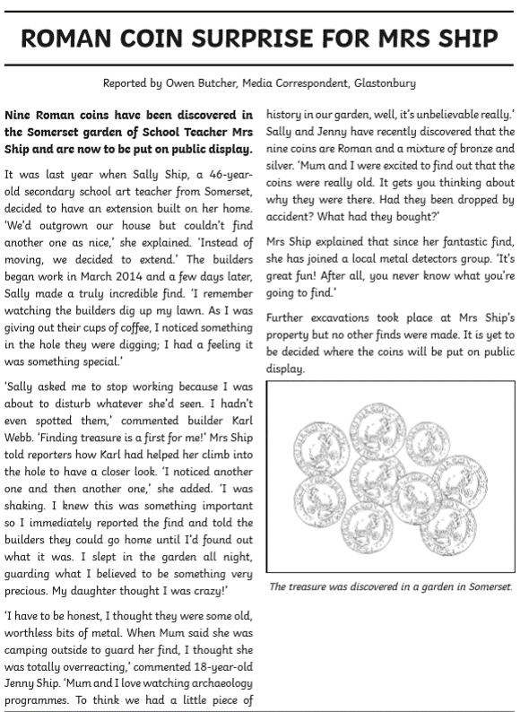
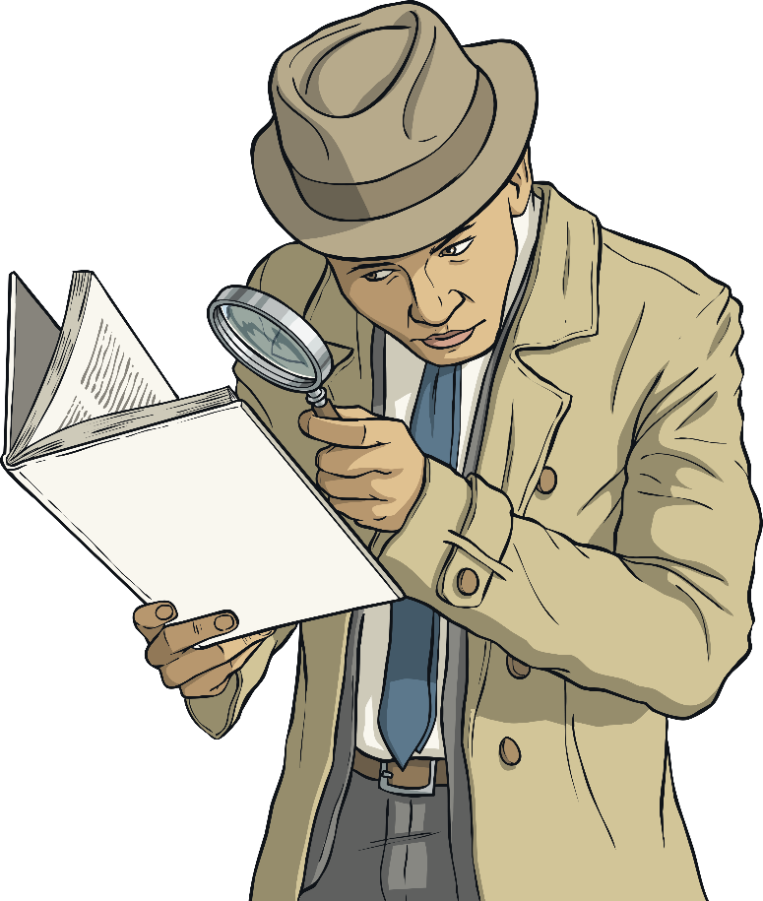
TWINKL TIMES
What features do you need to remember to include in your newspaper report?
Take a look at this example, how many features can you find?
Next

Slide 34
TWINKL TIMES
What features do you need to remember to include in your newspaper report?
TWINKL TIMES
The name of the newspaper at the top of the page.
An interesting headline.
Take a look at this example, how many features can you find?
Next
Next
Write in the third person and past tense.
An introductory paragraph
that includes the five Ws.
Next
Next
A final concluding paragraph explains what might happen next.
Facts about the main events.
Next
Next
Captions are added to pictures.
Quotes are written as direct speech.
Next
Next

Slide 35
write the name of the newspaper at the top?
A Newspaper Report Checklist
Use this checklist to help you write your own newspaper report.
Did I…
Next
create an interesting headline and sub-headline?
start with an introductory paragraph that includes the five Ws?
Next
write in the third person and past tense?
Next
Next
use quotes written as direct speech?
add captions to all pictures?
“
Next
”
Next
finish with a conclusion paragraph to explain what might happen next?
include facts about the main events?
Next
Next

Slide 36
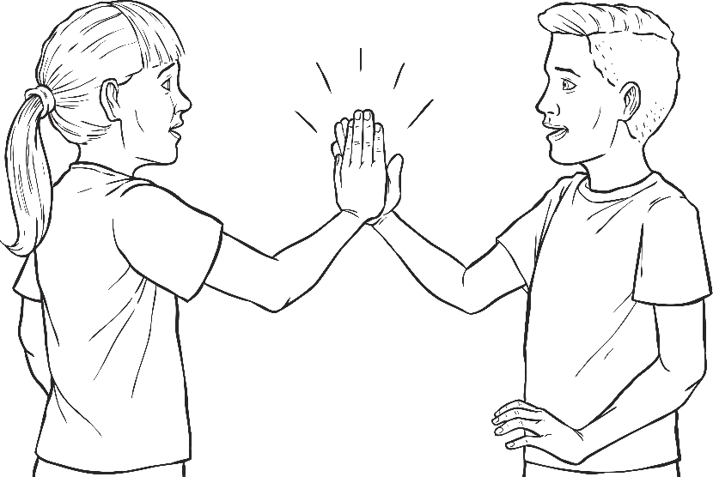
Celebrating Success
Share your newspaper report with a partner or the rest of the class. Have you managed to include everything from the checklist? What features have you used most effectively?

Slide 37
TASKS
Write up newspaper article with your new word banks of mis and dis words which you need to include in the article.
You can find facts and important dates in the Chronology at the back of the book.
You can also use the following website: https://www.annefrank.org/en/anne-frank/secret-annex/

Slide 39
Edit and improve
Edit, improve and redraft work as appropriate
Take particular care over cohesive devices: pronouns, paragraphs, tense, adverbials of time and structure.

