Slide 1
Monday 20th July 2020
L.O: to use the ratio symbol

Slide 2
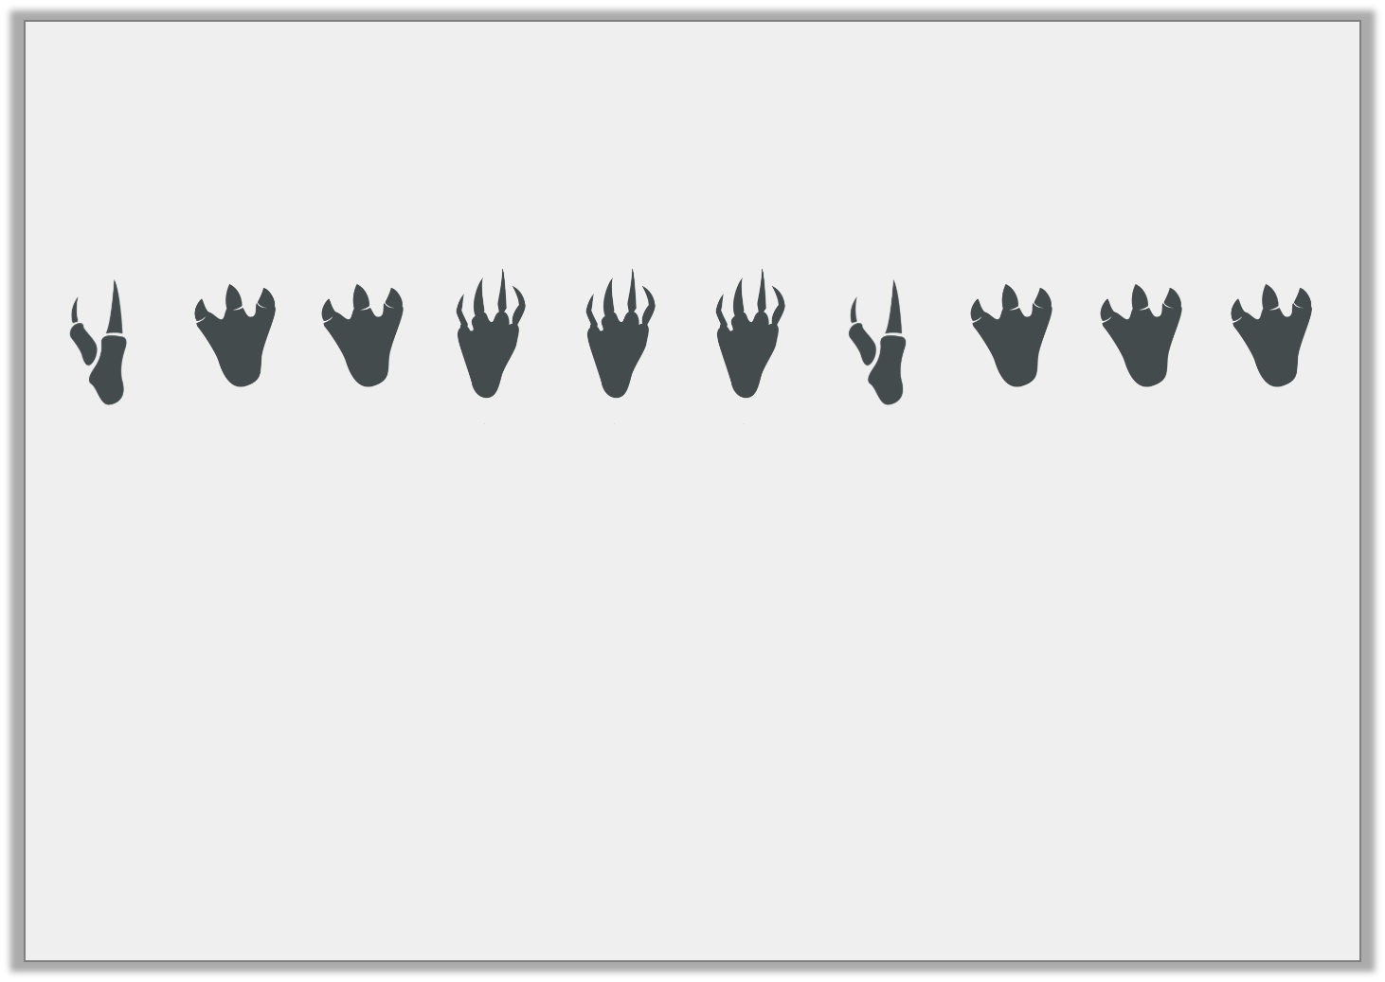
Introduction
Zack discovered these footprints in the forest.
Complete the statements.
For every three footprints with four toes, there are ____ footprints with three toes.
For every two footprints with two toes, there are three footprints with ____ toes.

Slide 3
Introduction
Zack discovered these footprints in the forest.
Complete the statements.
For every three footprints with four toes, there are five footprints with three toes.
For every two footprints with two toes, there are three footprints with four toes.

Slide 4
Varied Fluency 1
True or false? The ratio of cupcakes with sprinkles to cupcakes with a cherry is 3:1.

Slide 5
Varied Fluency 1
True or false? The ratio of cupcakes with sprinkles to cupcakes with a cherry is 3:1.
False; it is 2:3.

Slide 6
Varied Fluency 2
Match the statements that mean the same thing.
5:2 oranges to apples
2:5 oranges to apples
5:1 oranges to apples
For every 2 apples, there are 5 oranges.
For every 5 oranges, there is 1 apple.
For every 2 oranges, there are 5 apples.

Slide 7
Varied Fluency 2
Match the statements that mean the same thing.
5:2 oranges to apples
2:5 oranges to apples
5:1 oranges to apples
For every 2 apples, there are 5 oranges.
For every 5 oranges, there is 1 apple.
For every 2 oranges, there are 5 apples.

Slide 8
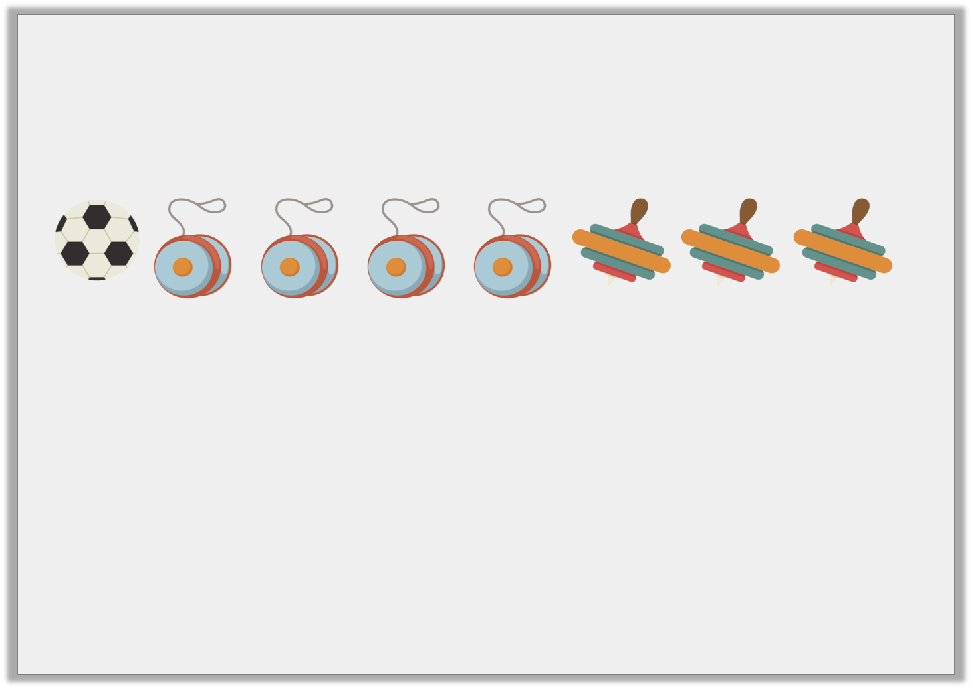
Varied Fluency 3
Write a statement to describe the ratio 4:1 shown below.

Slide 9
Varied Fluency 3
Write a statement to describe the ratio 4:1 shown below.
There are 4 yoyos for every football.

Slide 10
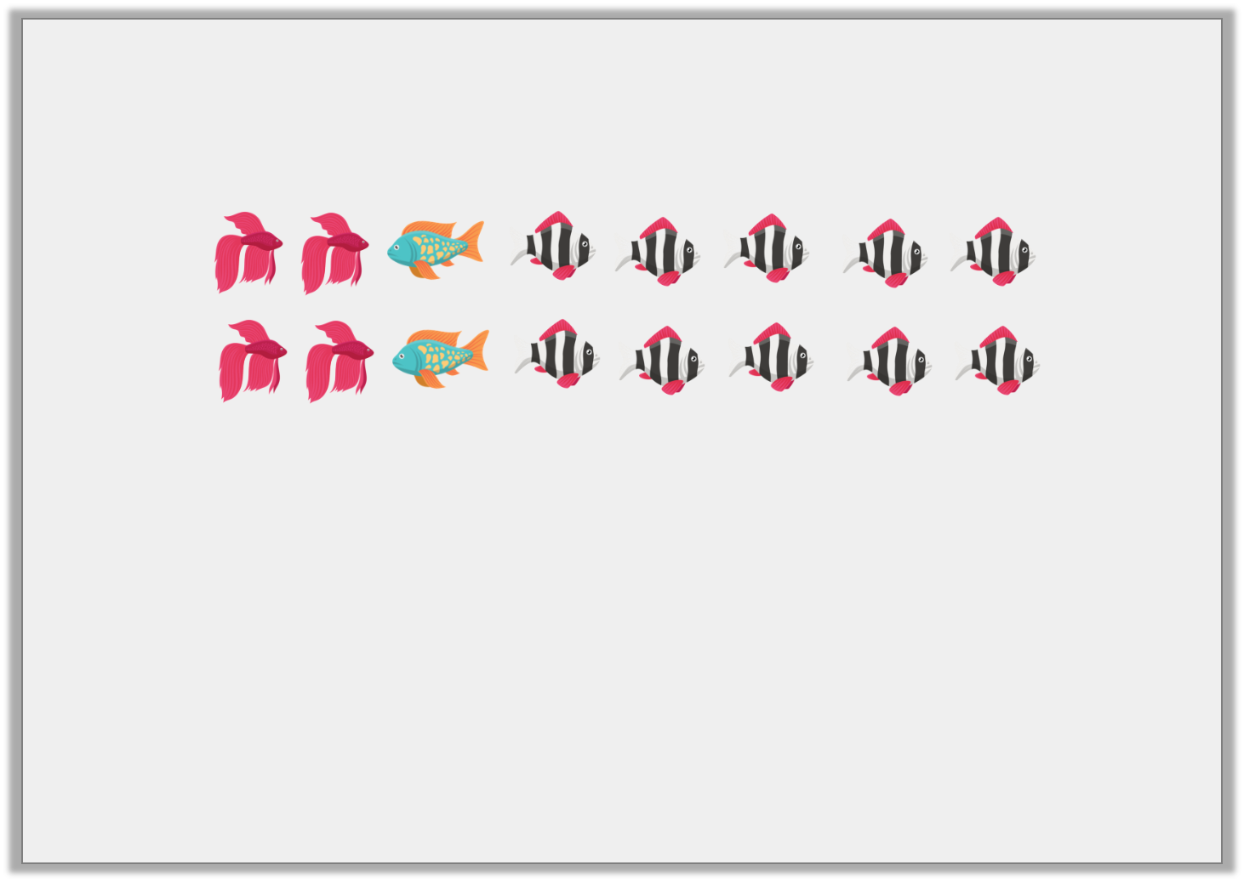
Varied Fluency 4
Circle the odd one out by matching the ratios to the description.
10:4
2:10:4
4:2:10
Speckled fish to striped fish to plain fish
Striped fish to plain fish

Slide 11
Varied Fluency 4
Circle the odd one out by matching the ratios to the description.
10:4
2:10:4
4:2:10
Speckled fish to striped fish to plain fish
Striped fish to plain fish

Slide 12
Tuesday 21st July 2020
L.O: to use the ratio symbol to solve problems

Slide 13
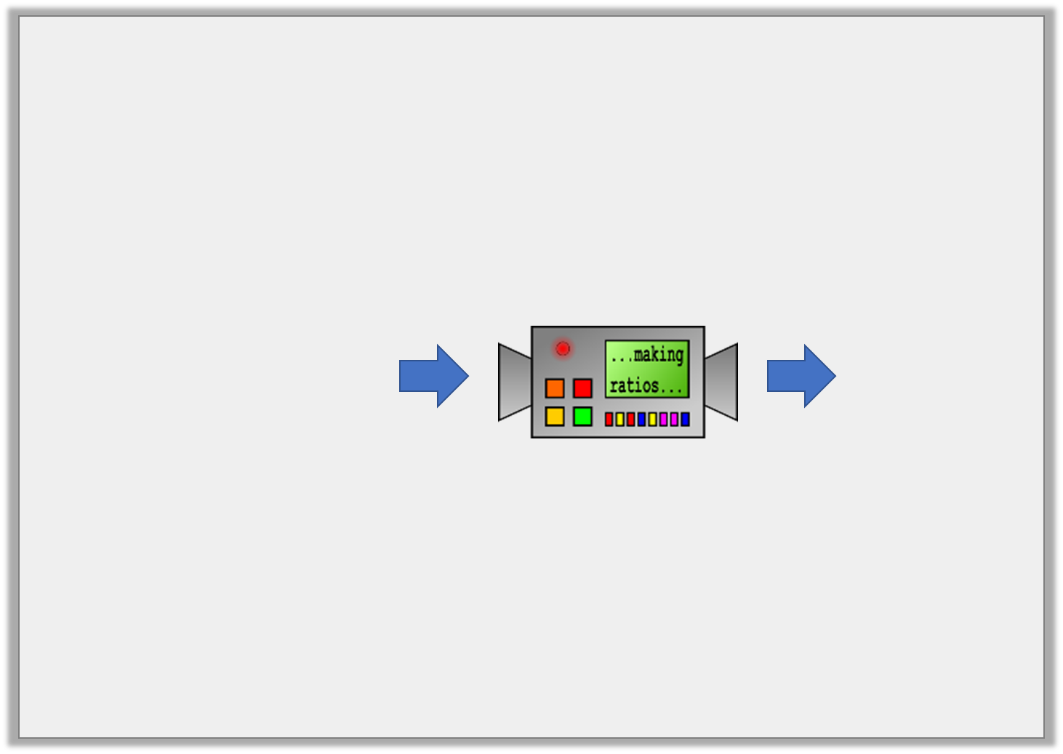
Reasoning 1
This machine turns sentences into ratios.
Could this ratio be correct? Convince me.
For every 5 red cars, there is 1 blue car. There are three times as many white cars as blue cars.
2:3:5

Slide 14
Reasoning 1
This machine turns sentences into ratios.
Could this ratio be correct? Convince me.
No because…
For every 5 red cars, there is 1 blue car. There are three times as many white cars as blue cars.
2:3:5

Slide 15
Reasoning 1
This machine turns sentences into ratios.
Could this ratio be correct? Convince me.
No because the ratio of red cars to blue cars to white cars would be 5:1:3.
For every 5 red cars, there is 1 blue car. There are three times as many white cars as blue cars.
2:3:5

Slide 16
Reasoning 2
Each child’s statement is correct.
Explain how this is possible.
The ratio is 4:3.
Kimiko
2
9
The fraction is .
Sasha

Slide 17
Reasoning 2
Each child’s statement is correct.
Explain how this is possible.
Kimiko is describing the ratio…
Sasha is describing what proportion…
The ratio is 4:3.
Kimiko
2
9
The fraction is .
Sasha

Slide 18
Reasoning 2
Each child’s statement is correct.
Explain how this is possible.
Kimiko is describing the ratio of cylinders to cubes.
Sasha is describing what proportion of the shapes are cones.
The ratio is 4:3.
Kimiko
2
9
The fraction is .
Sasha

Slide 19
Problem Solving 1
In a box of 15 chocolates, are milk chocolate. The rest are white or dark chocolate.
Write down three solutions for the possible ratio of white to milk to dark chocolate.
Draw counters to support your answers.
3
5

Slide 20
Problem Solving 1
In a box of 15 chocolates, are milk chocolate. The rest are white or dark chocolate.
Write down three solutions for the possible ratio of white to milk to dark chocolate.
Draw counters to support your answers.
Possible answers include: 1:9:5, 2:9:4, 3:9:3, 4:9:2, 5:9:1
3
5
D
M
M
M
M
M
M
M
M
M
W
W
W
W
W
Because 3/5 = 9/15 so 9 are definitely milk chocolate (M)
But the others will vary: if there is 1 dark then there will be 5 white →1:9:5
If there are 2 dark then there will be 4 white → 2:9:4
If there are 3 dark then there will be 3 white → 3:9:3

Slide 21
Wednesday 22nd July 2020
L.O: to calculate ratio

Slide 22
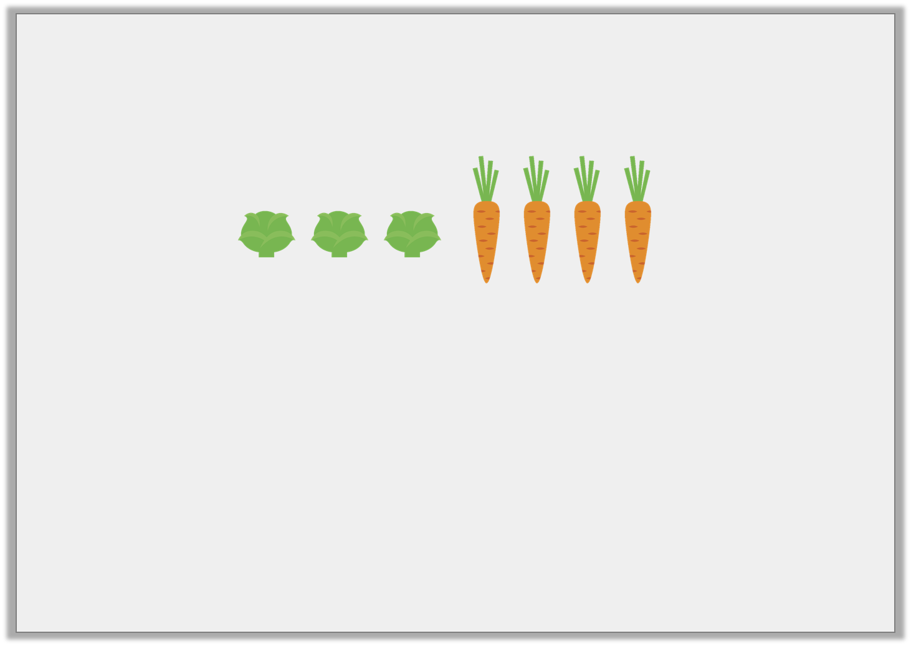
Introduction
Complete the sentences using the images below.
For every |  | sprouts there are |  | carrots.
 | of the vegetables are sprouts, |  | of the vegetables are carrots.
 | :

Slide 23
Introduction
Complete the sentences using the images below.
For every | 3 | sprouts there are | 4 | carrots.
3 | of the vegetables are sprouts, | 4 | of the vegetables are carrots.
 |  | 7
7
3 | : | 4
Because there are 7 vegetables altogether so the fraction is out of 7.
3/7 → sprouts and 4/7→ carrots

Slide 24
Varied Fluency 1
Use the image below to complete the ratio statements.
For every _____ teacher, there are _____ pupils.
If there are 12 teachers, how many pupils will there be?

Slide 25
Varied Fluency 1
Use the image below to complete the ratio statements.
For every _____ teacher, there are _____ pupils.
If there are 12 teachers, how many pupils will there be?
120
1
10
Because the ratio for teachers to pupils is 1:10, if we increase the teachers to 12 it will be 12 times more (1 x 12 = 12) so we would also have to increase the pupils by 12 times more → 10 x 12 = 120.

Slide 26
Varied Fluency 2
There are 35 animals on a farm. For every 5 cows there are 2 pigs. Use the bar model to help you calculate:
How many cows altogether?
How many pigs altogether?

Slide 27
Varied Fluency 2
There are 35 animals on a farm. For every 5 cows there are 2 pigs. Use the bar model to help you calculate:
How many cows altogether?
How many pigs altogether?
25
10
The ratio of cows to pigs is 5:2 (when it’s 5:2 there are 7 altogether), so you would have to increase each side until you get a total of 35 because there are 35 altogether → 5:2 = 7 → 10:4 = 14 → 15:6 = 21 → 20:8 = 28 → 25:10 = 35

Slide 28
Varied Fluency 3
What is the ratio of suns to rainclouds?
Use the ratio to calculate how many symbols there
will be altogether if there are 20 suns.
suns
rainclouds
symbols altogether
:
20

Slide 29
Varied Fluency 3
What is the ratio of suns to rainclouds?
Use the ratio to calculate how many symbols there
will be altogether if there are 20 suns.
suns
rainclouds
symbols altogether
5
:
3
20
12
32
The ratio of suns to rainclouds is 5:3, if we increase the suns to 20 it’s 4 times more (5x4 = 20),
so we would have to do the same to the rainclouds → 3 x 4 = 12.
When it was 5:3 there were 8 altogether but now that it’s 20:12 it’s 32 altogether.

Slide 30
Thursday 22nd July 2020
L.O: to calculate ratio to solve problems

Slide 31
Problem Solving 1
Mary is making buns for her birthday party.
For every 3 chocolate buns, she makes 2 vanilla buns.
There are 66 people at the party, of the people want
a vanilla bun.
How many buns does Mary need to make altogether? How many chocolate buns will she need to make?
1
3
Y6

Slide 32
Problem Solving 1
Mary is making buns for her birthday party.
For every 3 chocolate buns, she makes 2 vanilla buns.
There are 66 people at the party, of the people want
a vanilla bun.
How many buns does Mary need to make altogether? 55 How many chocolate buns will she need to make?
33
1
3
Y6

Slide 33
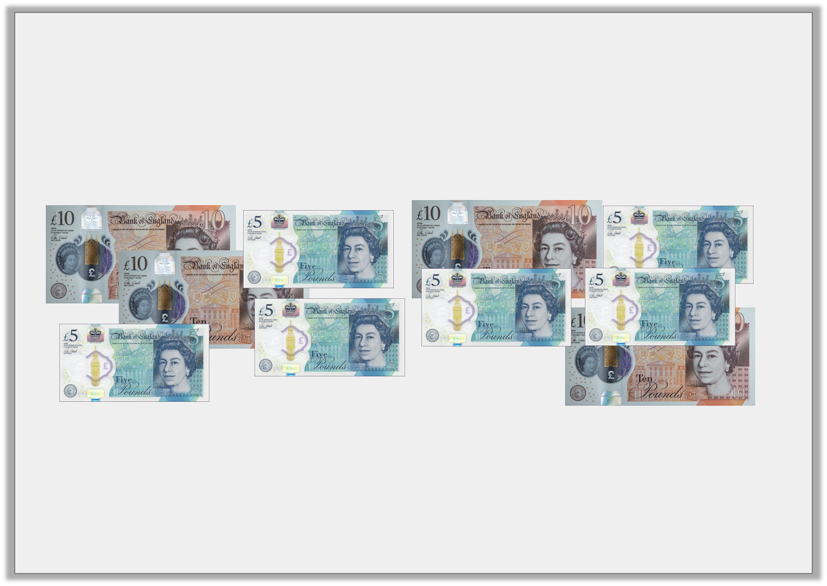
Reasoning 1
A cashier is sorting the money in the till.
He works out the ratio of £5 notes to £10 notes is 2:1
Have the notes been sorted correctly?
Explain your answer.
Y6

Slide 34
Reasoning 1
A cashier is sorting the money in the till.
He works out the ratio of £5 notes to £10 notes is 2:1
Have the notes been sorted correctly?
Explain your answer.
No because…
Y6

Slide 35
Reasoning 1
A cashier is sorting the money in the till.
He works out the ratio of £5 notes to £10 notes is 2:1
Have the notes been sorted correctly?
Explain your answer.
No because there are 1 too many £10 notes (or there needs to be 2 more £5 notes).
Y6

Slide 36
Problem Solving 2
For every blue front door on the row of terraces, there are 2 red doors. There are 12 blue doors altogether.
One third of the red doors are repainted blue.
What is the new ratio of blue doors to red doors?
How many red doors are there altogether?
Y6

Slide 37
Problem Solving 2
For every blue front door on the row of terraces, there are 2 red doors. There are 12 blue doors altogether.
So the ratio for blue to red door → 1:2
If there are 12 blue doors then there will be 24 red doors (1:2 → 12:24 because it’s 12 times more so 12 x 1 = 12 and 2 x 12 = 24)
So the new ratio for red to blue doors is 12:24 and 36 doors altogether.
One third of the red doors are repainted blue.
Because 1/3 are repainted blue we have calculate 1/3 of the 24 red doors
→ 24 x 1/3 = 24 x 1 ÷ 3 = 8 → so now we know 1/3 of the red doors is 8 we can take away those 8 from the 24 red because they are now painted blue
→ 24 – 8 = 16
What is the new ratio of blue doors to red doors?
20:16 (accept 5:4 → this is the same as 20:16 because it’s simplified using 4 as the common factor of 20 and 16 → 20 ÷ 4 = 5 and 16 ÷ 4 = 4)
So now that there are 16 red doors there will be 20 blue doors because there was altogether 36 doors.
How many red doors are there altogether?
16

