Slide 1

Monday 13th July 2020
L.O: to use two step equations
(*Varied Fluency for year 5 & 6)
*Today’s lesson has Varied Fluency for year 5 and 6; however, year 6 also has Reasoning and Problem Solving after the Varied Fluency slides

Slide 2
Introduction
Find the value of x using the equations below.
4x = 48
x – 8 = 4
x + 3 = 15

Slide 3
Introduction
Find the value of x using the equations below.
4x = 48
x – 8 = 4
x + 3 = 15
x = 12

Slide 4
Varied Fluency 1
Are the following statements true or false?
If x = 4, then 5x + 1 = 25
If y = 3, then 3y – y = 6
If z = 10, then 0.5z + 2 = 7

Slide 5
Varied Fluency 1
Are the following statements true or false?
If x = 4, then 5x + 1 = 25 False, 5x + 1 = 21
If y = 3, then 3y – y = 6 True
If z = 10, then 0.5z + 2 = 7 True

Slide 6
Varied Fluency 2
What is the correct value of c?
12c – 14 = 106
11
12
10

Slide 7
Varied Fluency 2
What is the correct value of c?
12c – 14 = 106
11
12
10

Slide 8
Varied Fluency 3
Match each equation to the correct value of a.
5a – 7 = 23 |  | a = 4
a + 10 = 12 |  | a = 6
7 = 6 + 4a |  | a = 0.25
1
2

Slide 9
Varied Fluency 3
Match each equation to the correct value of a.
5a – 7 = 23 |  | a = 4
a + 10 = 12 |  | a = 6
7 = 6 + 4a |  | a = 0.25
1
2

Slide 10
Varied Fluency 4
Fill in the missing operations to show how to solve the equation below.
4x | + | 3 | = | 15
 | 4x | = | 12
 | x | = | 3
A
B

Slide 11
Varied Fluency 4
Fill in the missing operations to show how to solve the equation below.
4x | + | 3 | = | 15
 | 4x | = | 12
 | x | = | 3
– 3
÷ 4

Slide 12
Continued
L.O: to use two step equations
(*Reasoning and Problem Solving for year 6)
* The slides from here are for the year 6 to complete - Reasoning and Problem Solving

Slide 13
Problem Solving 1
Using the cards below and any of the four operations, create three balanced equations where x = 10.
4
4
2x
5
3x
6
Y6

Slide 14
Problem Solving 1
Using the cards below and any of the four operations, create three balanced equations where x = 10.
Various possible answers, for example:
4 x 5 = 2x; 2x + 4 = 6 x 4; 3x = 5 x 6.
4
4
2x
5
3x
6
Y6

Slide 15
Problem Solving 2
Choose a value for c and find three possibilities to complete the following equation.
 | c | + |  | = | 24
Y6

Slide 16
Problem Solving 2
Choose a value for c and find three possibilities to complete the following equation.
Various possible answers, for example:
If c = 5 then, 2c + 14 = 24, 3c + 9 = 24 and 4c + 4 = 24.
 | c | + |  | = | 24
Y6

Slide 17
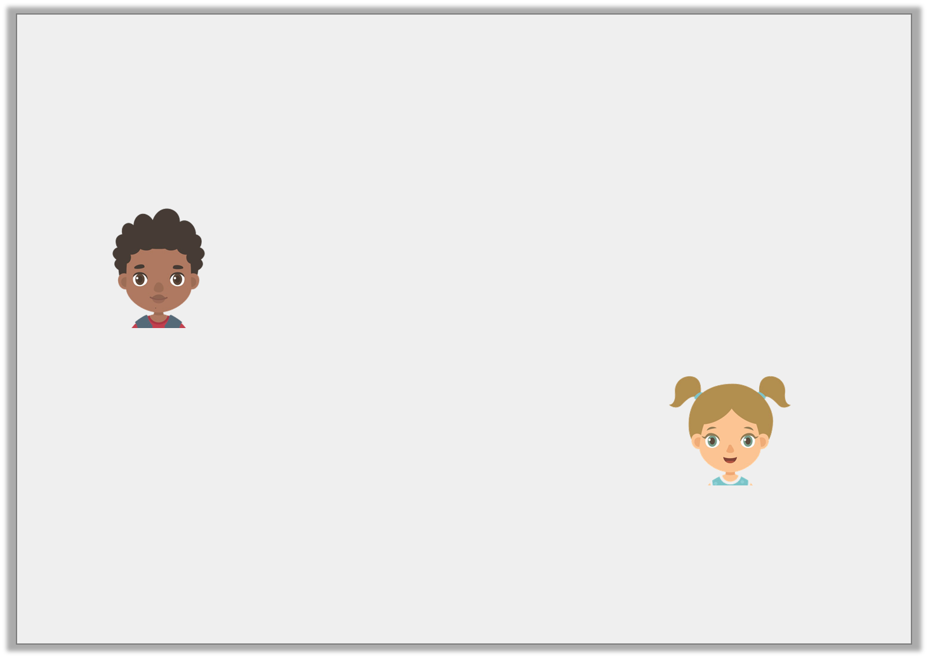
Reasoning 1
Paul and Vanessa are solving the following algebraic equation.
6 + 5x = 21
Who is correct? Prove it.
This equation is impossible because 5 isn’t a factor of 21.
Paul
x must be 3 for this equation
to be balanced.
Vanessa
Y6

Slide 18
Reasoning 1
Paul and Vanessa are solving the following algebraic equation.
6 + 5x = 21
Who is correct? Prove it.
Vanessa is correct because…
This equation is impossible because 5 isn’t a factor of 21.
Paul
x must be 3 for this equation
to be balanced.
Vanessa
Y6

Slide 19
Reasoning 1
Paul and Vanessa are solving the following algebraic equation.
6 + 5x = 21
Who is correct? Prove it.
Vanessa is correct because 5 x 3 = 15 and 15 + 6 = 21. Paul is incorrect because 5 does not need to be a factor of 21 because there is another step in the equation.
This equation is impossible because 5 isn’t a factor of 21.
Paul
x must be 3 for this equation
to be balanced.
Vanessa
Y6

Slide 20
Tuesday 14th July 2020
L.O: to understand and use ratio

Slide 21
Introduction
What would the 20th shape in the pattern be?

Slide 22
Introduction
What would the 20th shape in the pattern be?
A circle

Slide 23
Varied Fluency 1
Tick the statements which are correct.
For every triangle and 2 circles, there are 3 squares.
For every triangle there are 2 squares.
For every 2 circles there will be 1 triangle.

Slide 24
Varied Fluency 1
Tick the statements which are correct.
For every triangle and 2 circles, there are 3 squares.
For every triangle there are 2 squares.
For every 2 circles there is 1 triangle.



Slide 25
Varied Fluency 2
True or false?
For every triangle there are 2 circles.

Slide 26
Varied Fluency 2
True or false?
For every triangle there are 2 circles.
True

Slide 27
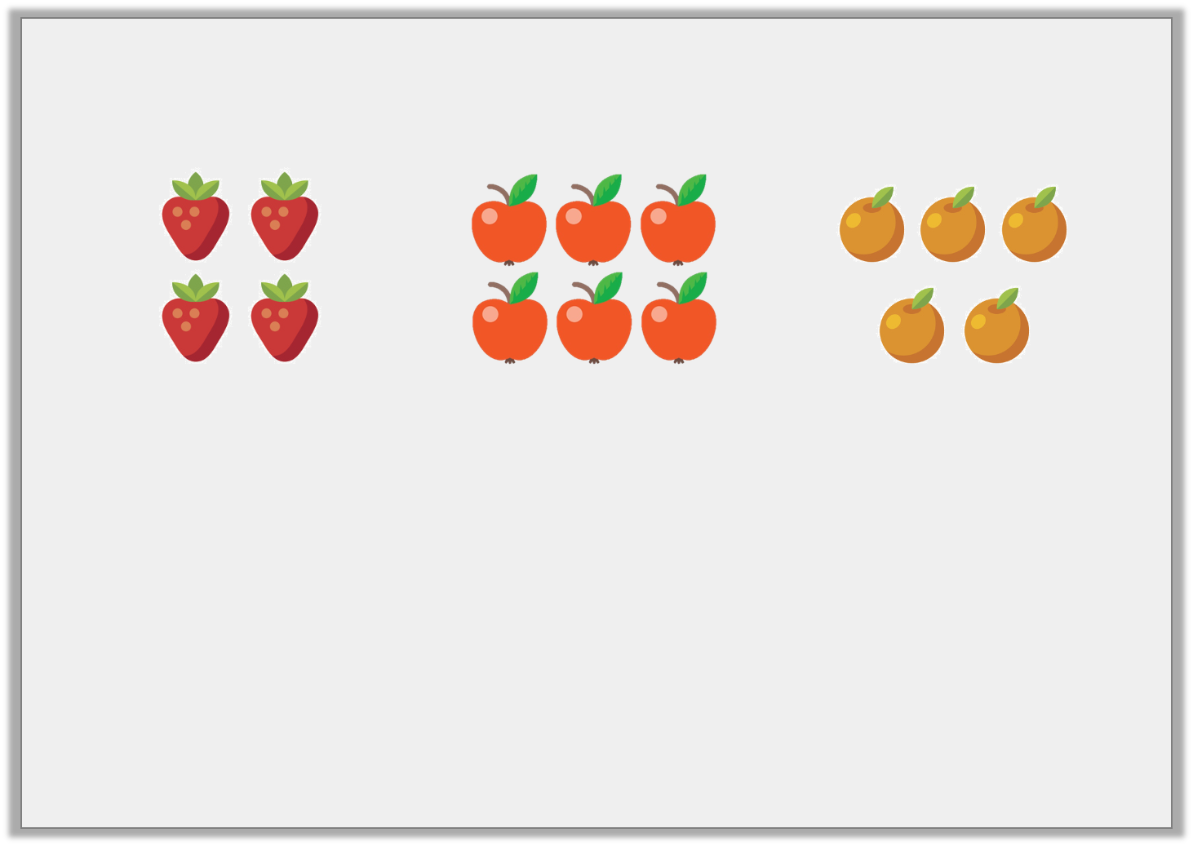
Varied Fluency 3
Complete the sentence.
There are 6 _____________ for every 5 _____________ .

Slide 28
Varied Fluency 3
Complete the sentence.
There are 6 _____________ for every 5 _____________ .
apples
oranges

Slide 29
Varied Fluency 4
Fill in the missing numbers.
There are 2 triangles for every 8 squares.
If there is 1 , there will be .

Slide 30
Varied Fluency 4
Fill in the missing numbers.
There are 2 triangles for every 8 squares.
If there is 1 , there will be .
4

Slide 31
Wednesday 15th July 2020
L.O: to use ratio to solve problems

Slide 32
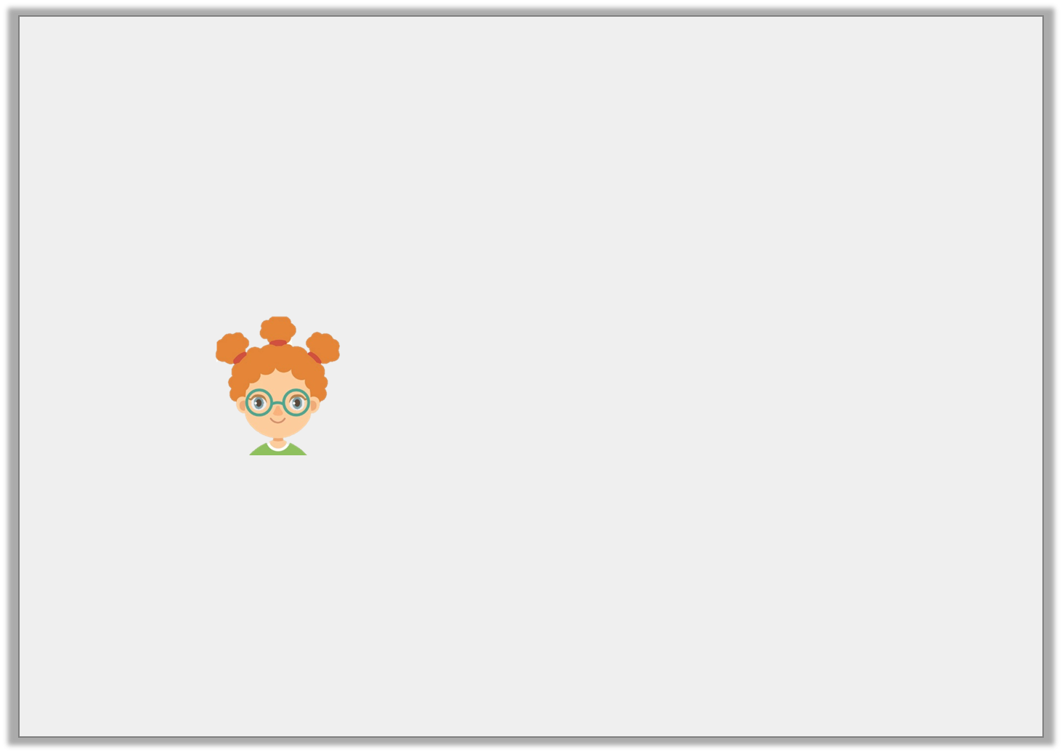
Reasoning 1
Becky has different coloured counters.
There are 2 blue counters for every 8 green counters.
Becky says,
Is she correct? Explain how you know.
If there were just 1 blue counter, there would be 6 counters in total.

Slide 33
Reasoning 1
Becky has different coloured counters.
There are 2 blue counters for every 8 green counters.
Becky says,
Is she correct? Explain how you know.
Becky is incorrect because…
If there were just 1 blue counter, there would be 6 counters in total.

Slide 34
Reasoning 1
Becky has different coloured counters.
There are 2 blue counters for every 8 green counters.
Becky says,
Is she correct? Explain how you know.
Becky is incorrect because if there was 1 blue counter, there would be 4 green counters. 1 + 4 = 5.
If there were just 1 blue counter, there would be 6 counters in total.

Slide 35
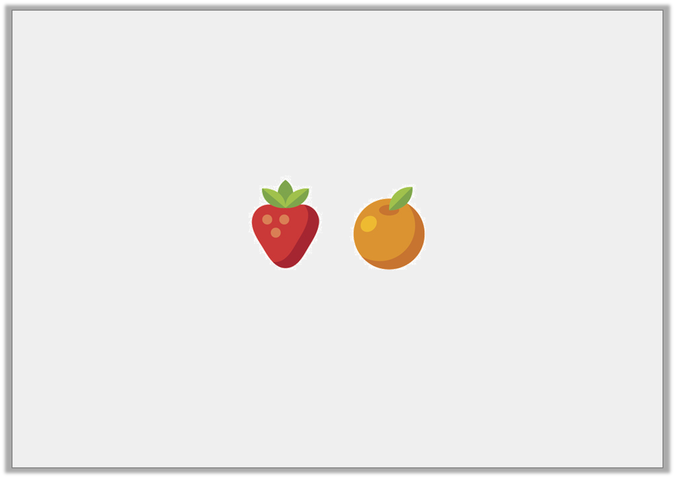
Problem Solving 1
Eesa has a bag of shopping containing strawberries and oranges.
There are 12 pieces of fruit altogether.
Write 3 different sentences which explain the possible ratios of the fruit.

Slide 36
Problem Solving 1
Eesa has a bag of shopping containing strawberries and oranges.
There are 12 pieces of fruit altogether.
Write 3 different sentences which explain the possible ratios of the fruit.
Various answers that add up to 12, for example:
1 and 11; 2 and 10; 3 and 9

Slide 37

Reasoning 2
Harrison and Tobias are looking at the relationship between strawberries and lemons.
Harrison thinks that if there was one strawberry, there would be 2 lemons.
Tobias thinks that if there was 1 strawberry, there would be 3 lemons.
Who is correct? Explain how you know.

Slide 38
Reasoning 2
Harrison and Tobias are looking at the relationship between strawberries and lemons.
Harrison thinks that if there was one strawberry, there would be 2 lemons.
Tobias thinks that if there was 1 strawberry, there would be 3 lemons.
Who is correct? Explain how you know.
Tobias is correct because…

Slide 39
Reasoning 2
Harrison and Tobias are looking at the relationship between strawberries and lemons.
Harrison thinks that if there was one strawberry, there would be 2 lemons.
Tobias thinks that if there was 1 strawberry, there would be 3 lemons.
Who is correct? Explain how you know.
Tobias is correct because there are 3 strawberries for every 9 lemons, so if there were 1 strawberry, there would be 3 lemons.
Because 3 ÷ 3 = 1 (strawberries) and 9 ÷ 3 = 3 (lemons).

Slide 40
Thursday 16th July 2020
L.O: to use ratio and fractions

Slide 41
Introduction
Complete the sentence to describe the objects below.
There are _____________________ for every ____________________ .

Slide 42
Introduction
Complete the sentence to describe the objects below.
There are 4 lightning bolts for every 3 squares.

Slide 43
Varied Fluency 1
Match the fraction of circles to the correct set of objects.
2
5
2
8
3
6

Slide 44
Varied Fluency 1
Match the fraction of circles to the correct set of objects.
2
5
2
8
3
6

Slide 45
Varied Fluency 2
True or false?
If there are 3 bananas for every 5 peaches, of the fruit are peaches.
3
8

Slide 46
Varied Fluency 2
True or false?
If there are 3 bananas for every 5 peaches, of the fruit are peaches.
False, of the fruit are bananas.
3
8
3
8

Slide 47
Varied Fluency 3
Complete the sentence below if are squares and are circles.
There are ________ squares for every ________ circles.
4
9
3
9

Slide 48
Varied Fluency 3
Complete the sentence below if are squares and are circles.
There are 4 squares for every 3 circles.
4
9
3
9

Slide 49
Varied Fluency 4
Use the statement below to complete the bar model.
There are 6 squares for every 2 circles.
Write a fraction showing each quantity.
 | 2
=
=

Slide 50
Varied Fluency 4
Use the statement below to complete the bar model.
There are 6 squares for every 2 circles.
Write a fraction showing each quantity.
8
6 | 2
6
8
2
8
=
=

Slide 51
Friday 17th July 2020
L.O: to use ratio and fractions to solve problems

Slide 52
Problem Solving 1
Gemma is making a bracelet using orange and blue beads.
Each bracelet contains 18 beads in total.
Write 5 pairs of fractions to show the possible ratio blue to orange beads.

Slide 53
Problem Solving 1
Gemma is making a bracelet using orange and blue beads.
Each bracelet contains 18 beads in total.
Write 5 pairs of fractions to show the possible ratio blue to orange beads.
Various answers, for example:
blue beads and orange beads
11
18
7
18

Slide 54
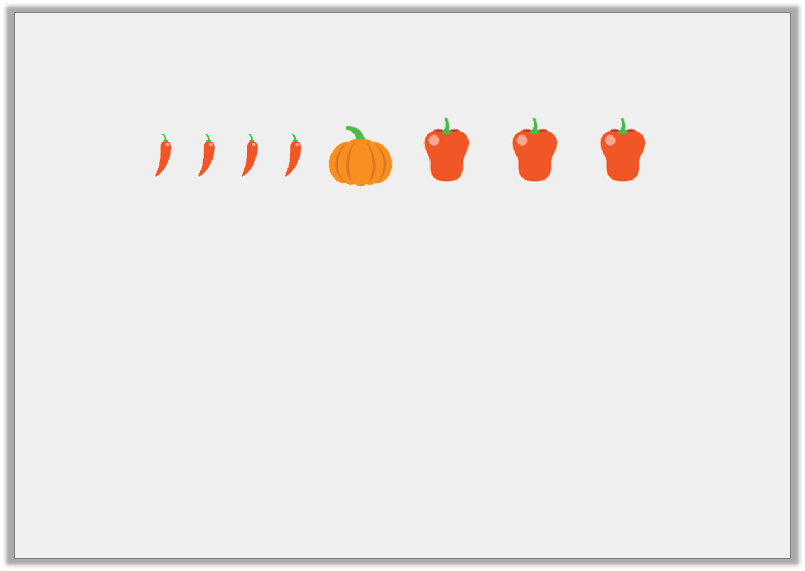
Reasoning 1
Which of the following statements match the image?
of the vegetables are pumpkins.
There are 3 chillies for every 4 peppers.
There are 8 items in total.
Explain how you know.
1
6

Slide 55
Reasoning 1
Which of the following statements match the image?
of the vegetables are pumpkins.
There are 3 chillies for every 4 peppers.
There are 8 items in total.
Explain how you know.
Statement C because…
1
6

Slide 56
Reasoning 1
Which of the following statements match the image?
of the vegetables are pumpkins.
There are 3 chillies for every 4 peppers.
There are 8 items in total.
Explain how you know.
Statement C because there are four chillies, one pumpkin and three peppers, which makes 8 in total.
1
6

Slide 57
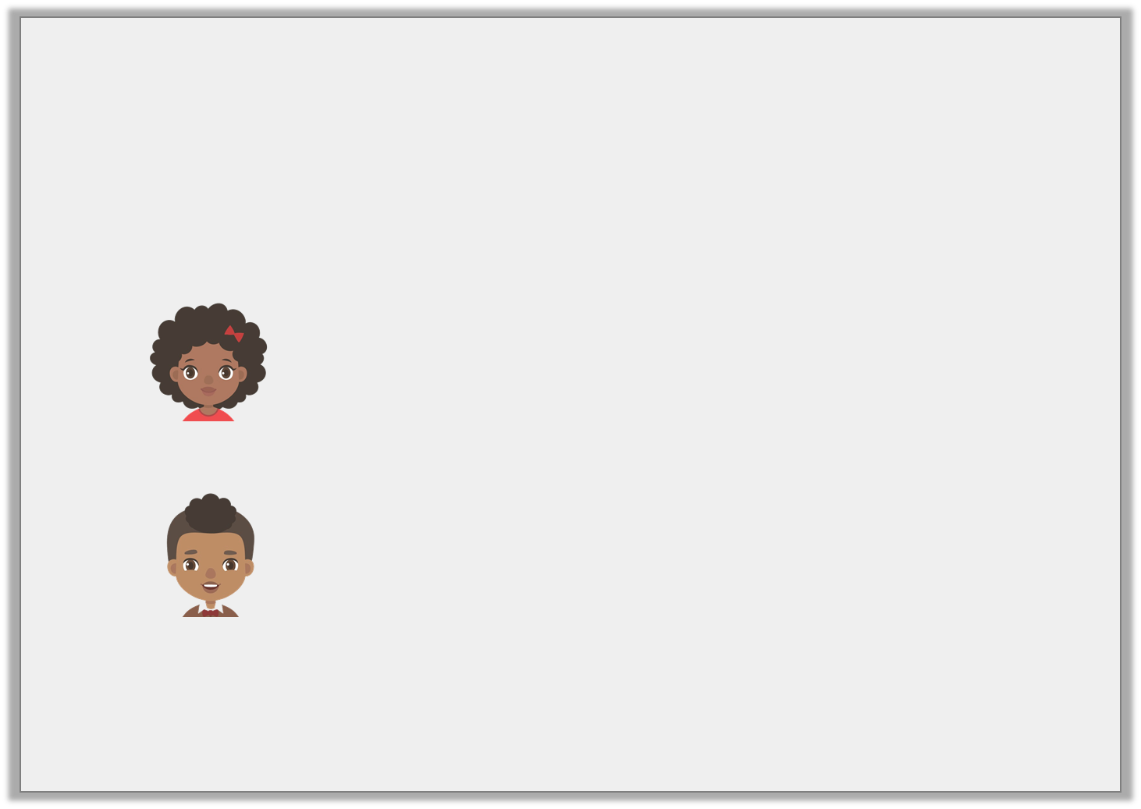
Reasoning 2
Emma has a bag of 1p and 2p coins.
of the coins are worth 1p.
Emma says:
Nick says:
Who is correct? Explain how you know.
9
13
There are more 2p coins than 1p coins.
There are four 2p coins.

Slide 58
Reasoning 2
Emma has a bag of 1p and 2p coins.
of the coins are worth 1p.
Emma says:
Nick says:
Who is correct? Explain how you know.
Nick is correct because…
9
13
There are more 2p coins than 1p coins.
There are four 2p coins.

Slide 59
Reasoning 2
Emma has a bag of 1p and 2p coins.
of the coins are worth 1p.
Emma says:
Nick says:
Who is correct? Explain how you know.
Nick is correct because there are 13 coins in total and if there are nine 1p coins, there must be four 2p coins.
9
13
There are more 2p coins than 1p coins.
There are four 2p coins.

