Slide 1
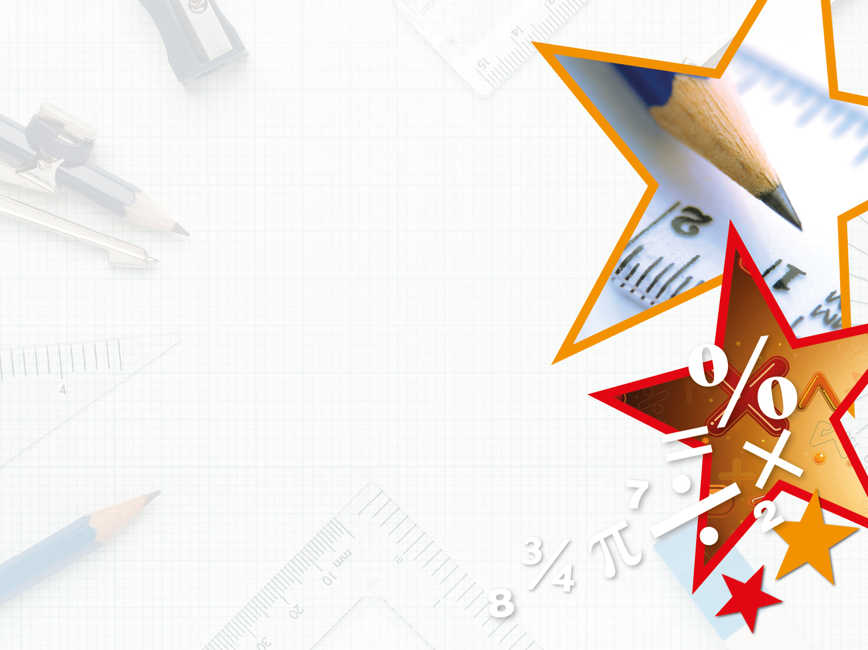
Year 3/4 – Summer Block 4 – Properties of Shape
Step 4
Tuesday 14th July 2020
Year 3: LO: I can draw and recognise 2D and 3D shapes accurately in different orientations and describe them

Slide 2
Introduction
Find items around your classroom
that match the following measurements:
3cm
5cm
12cm
20cm
30cm
Y3

Slide 3
Introduction
Find items around your classroom
that match the following measurements:
Answers will vary, some examples could include:
3cm: paperclip
5cm: crayon
12cm: scissors
20cm: paintbrush
30cm: lunchbox
Y3

Slide 4
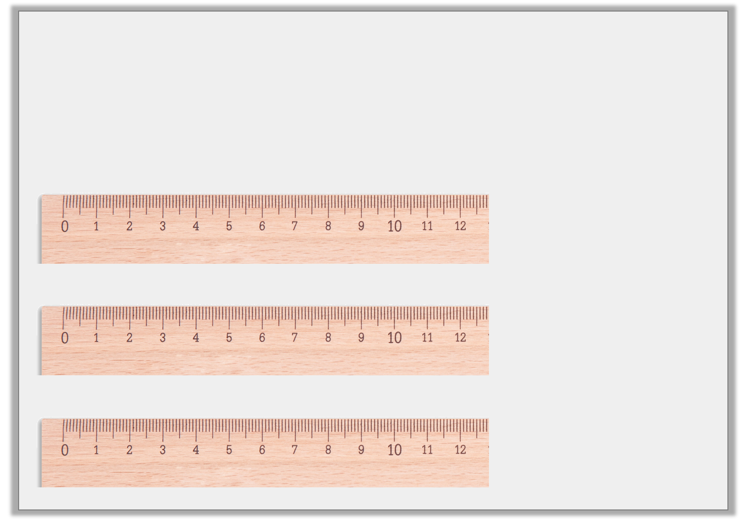
Varied Fluency 1
Measure these lines to the nearest cm and match them to their label.
12cm
11cm
10cm
Y3

Slide 5
Varied Fluency 1
Measure these lines to the nearest cm and match them to their label.
12cm
11cm
10cm
Y3

Slide 6
Varied Fluency 2
Round these lengths to the nearest cm.
 | 8cm 7mm |  |  | 1cm 8mm
 | 7cm 1mm
Y3

Slide 7
Varied Fluency 2
Round these lengths to the nearest cm.
 | 8cm 7mm |  |  | 1cm 8mm
9cm
2cm
 | 7cm 1mm
7cm
Y3

Slide 8
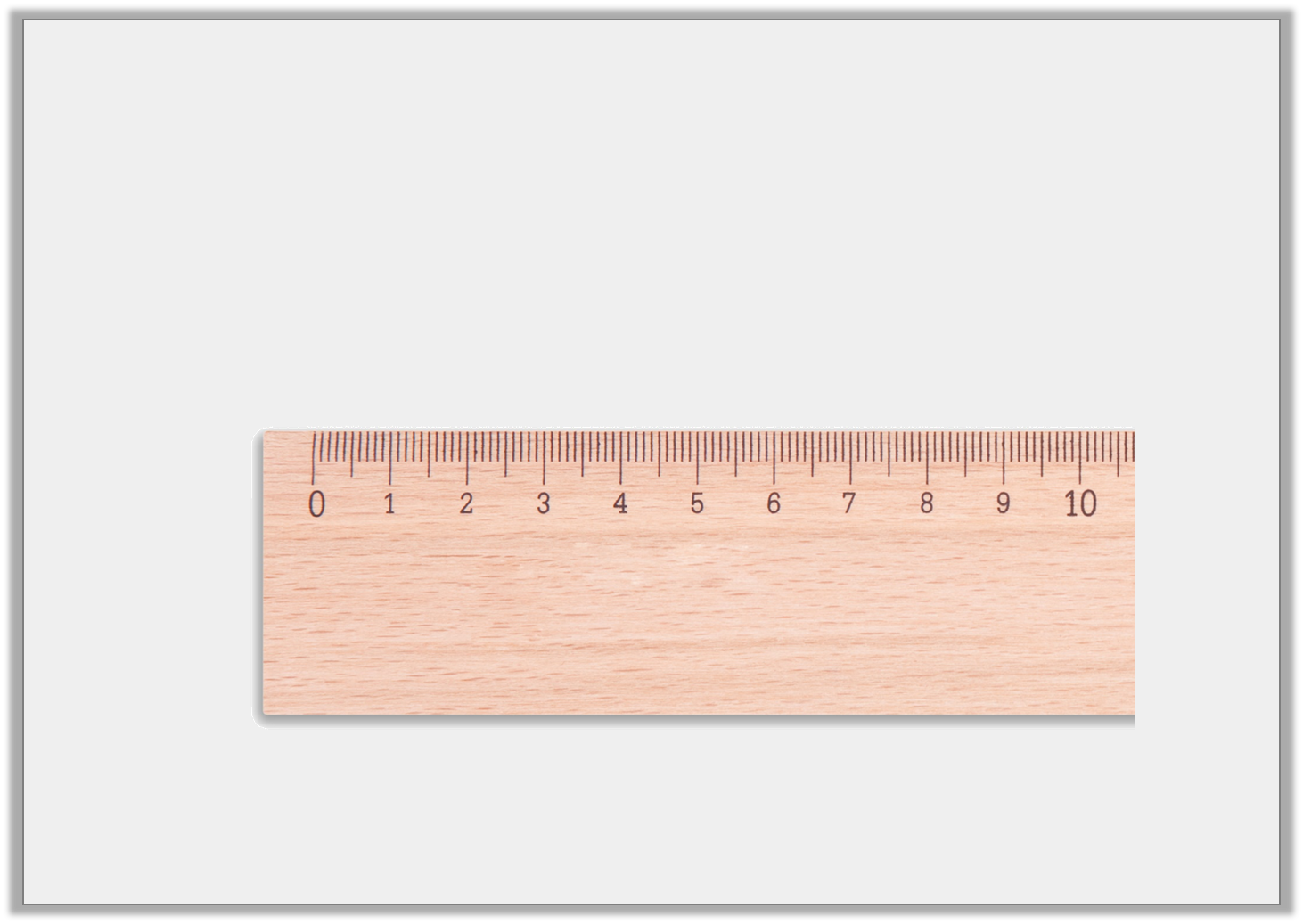
Varied Fluency 3
This line is 5cm long.
True or false?
Y3

Slide 9
Varied Fluency 3
This line is 5cm long.
True or false?
False, it is 5cm 4mm long.
Y3

Slide 10
Varied Fluency 4
Using a ruler, draw these measurements accurately.
 | 1cm 9mm |  |  | 4cm 1mm
 | 5cm 6mm
Y3

Slide 11
Varied Fluency 4
Using a ruler, draw these measurements accurately.
Lines drawn should be exact.
 | 1cm 9mm |  |  | 4cm 1mm
 | 5cm 6mm
Y3

Slide 12
Step 4
Wednesday 15th July 2020
Year 3: LO: I can draw and recognise 2D and 3D shapes accurately in different orientations and describe them

Slide 13
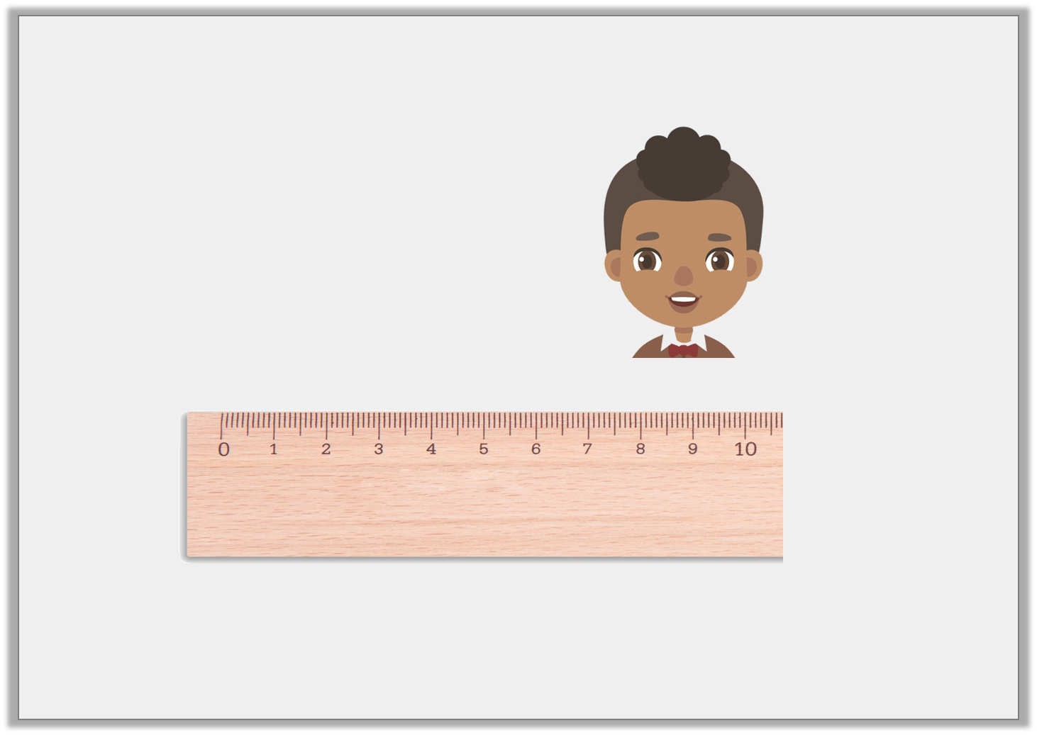
Reasoning 1
Simon has been measuring lines accurately.
Is he correct? Explain how you know.
My line is 9 cm 1mm long.
Y3

Slide 14
Reasoning 1
Simon has been measuring lines accurately.
Is he correct? Explain how you know.
No he is not correct because…
My line is 9 cm 1mm long.
Y3

Slide 15
Reasoning 1
Simon has been measuring lines accurately.
Is he correct? Explain how you know.
No he is not correct because his line is 9cm 6mm long.
My line is 9 cm 1mm long.
Y3

Slide 16
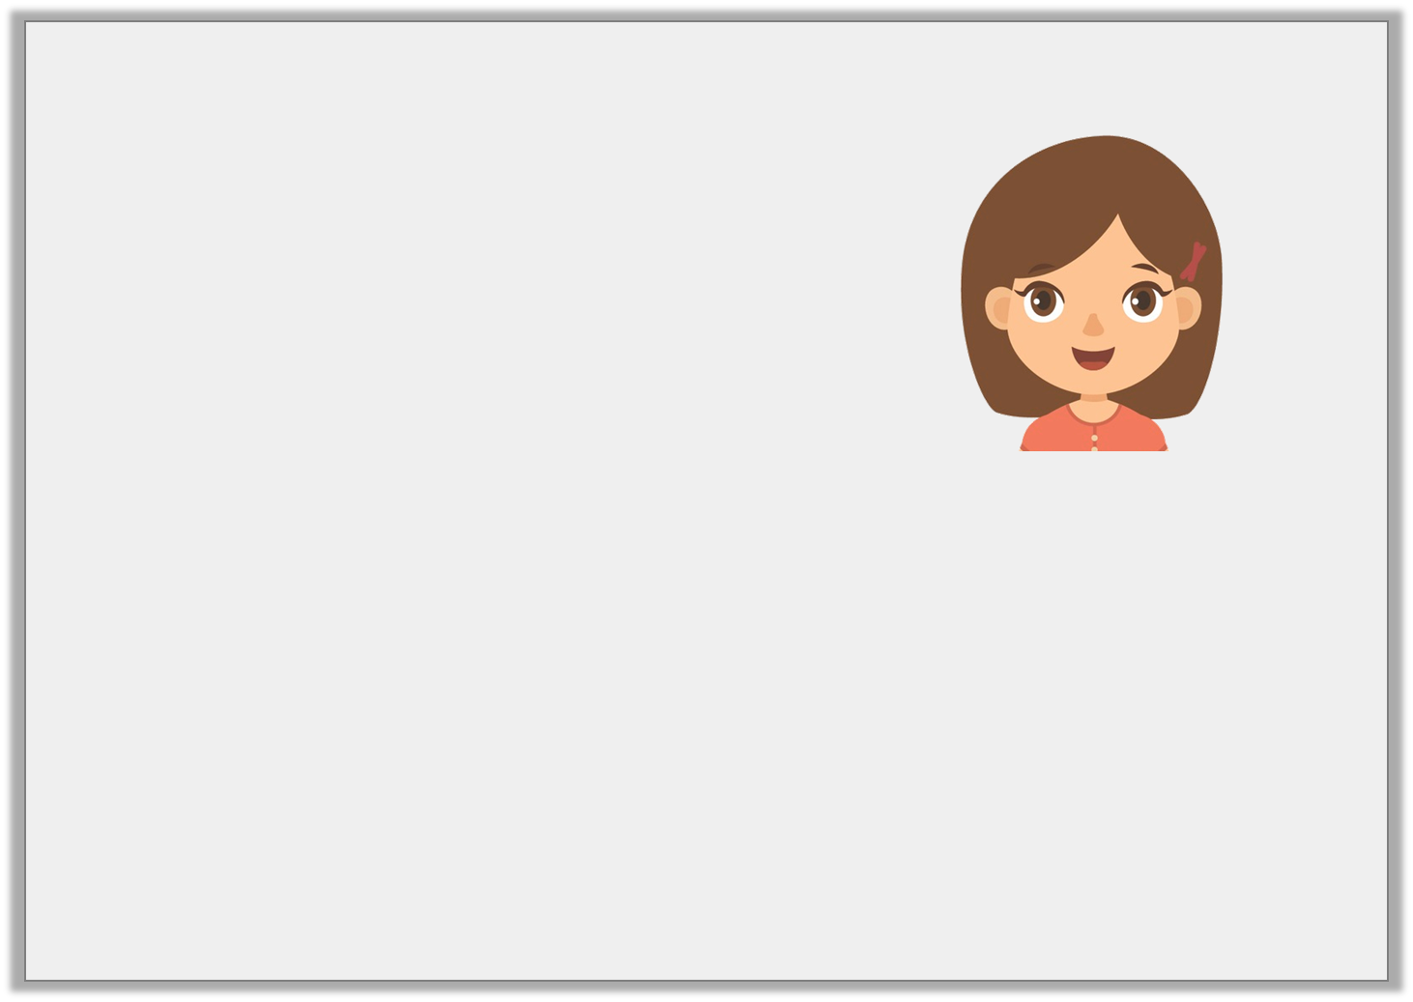
Problem Solving 1
Elsa has drawn some lines.
Draw and label 2 more possible sets of lines in cm and mm that Elsa could have drawn.
5cm 3mm | 3cm 3mm | 3 cm 4mm
My 3 lines make a total of 12cm.
Y3

Slide 17
Problem Solving 1
Elsa has drawn some lines.
Draw and label 2 more possible sets of lines in cm and mm that Elsa could have drawn.
Various possible answers,
for example:
5cm 3mm | 3cm 3mm | 3 cm 4mm
My 3 lines make a total of 12cm.
3cm 5mm | 4cm 4mm | 4 cm 1mm
Y3

Slide 18
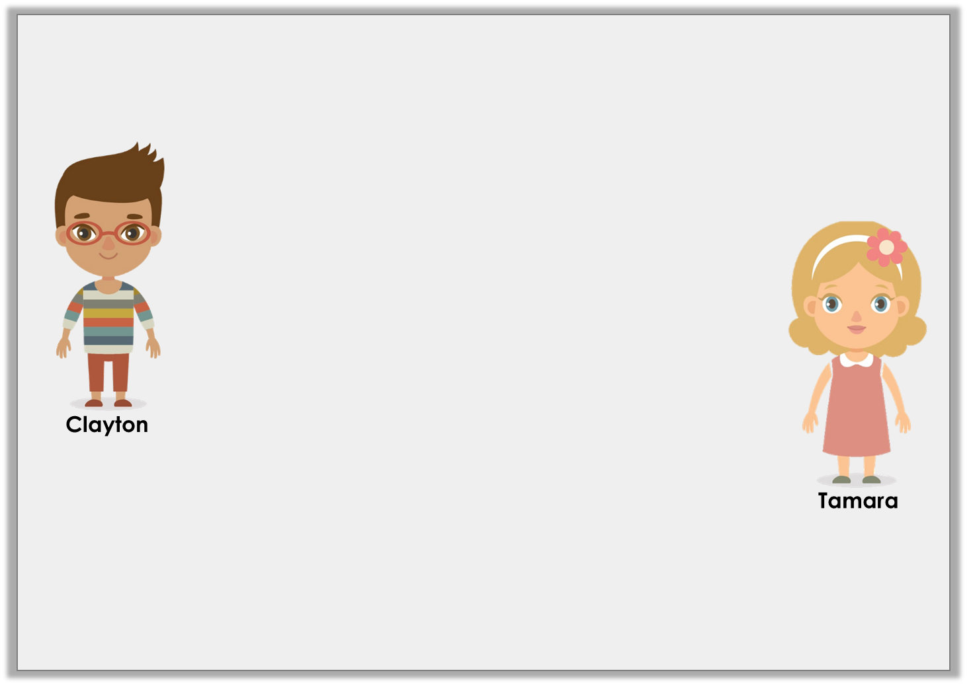
Reasoning 2
Clayton and Tamara are using a ruler to measure lines.
Who is correct? Why?
It doesn’t matter which side of the ruler you use to measure in centimetres, as long as you start on the ‘0’ line.
You have to make sure you are using the correct unit of measurement before you start measuring.
Y3

Slide 19
Reasoning 2
Clayton and Tamara are using a ruler to measure lines.
Who is correct? Why?
Tamara is correct as…
It doesn’t matter which side of the ruler you use to measure in centimetres, as long as you start on the ‘0’ line.
You have to make sure you are using the correct unit of measurement before you start measuring.
Y3

Slide 20
Reasoning 2
Clayton and Tamara are using a ruler to measure lines.
Who is correct? Why?
Tamara is correct as rulers generally measure in both inches and centimetres.
It doesn’t matter which side of the ruler you use to measure in centimetres, as long as you start on the ‘0’ line.
You have to make sure you are using the correct unit of measurement before you start measuring.
Y3

Slide 21
Year 3 – Summer Block 3 – Properties of Shapes
Step 5
Thursday 16th July 2021
Year 3/4: Lo: To identify horizontal and vertical lines

Slide 22
Introduction
How many horizontal lines are there?
How many vertical lines are there?
Y3

Slide 23
Introduction
How many horizontal lines are there?
How many vertical lines are there?
5 horizontal
Y3

Slide 24
Introduction
How many horizontal lines are there?
How many vertical lines are there?
6 vertical
Y3

Slide 25
Varied Fluency 1
Draw the vertical lines of symmetry in these objects.
W
Y3

Slide 26
Varied Fluency 1
Draw the vertical lines of symmetry in these objects.
W
Y3

Slide 27
Varied Fluency 2
Fill in the table below.
Object | Type of lines – horizontal, vertical or both?
Y3

Slide 28
Varied Fluency 2
Fill in the table below.
Object | Type of lines –horizontal, vertical or both?
 | both
 | vertical
 | horizontal
 | both
Y3

Slide 29


Varied Fluency 3
Which of the images below has a vertical line of symmetry?
Y3

Slide 30

Varied Fluency 3
Which of the images below has a vertical line of symmetry?

Y3

Slide 31
Step 5
Friday 17th July 2021
Year 3/4: Lo: To answer prob-solving and reasoning question to identify horizontal and vertical lines

Slide 32
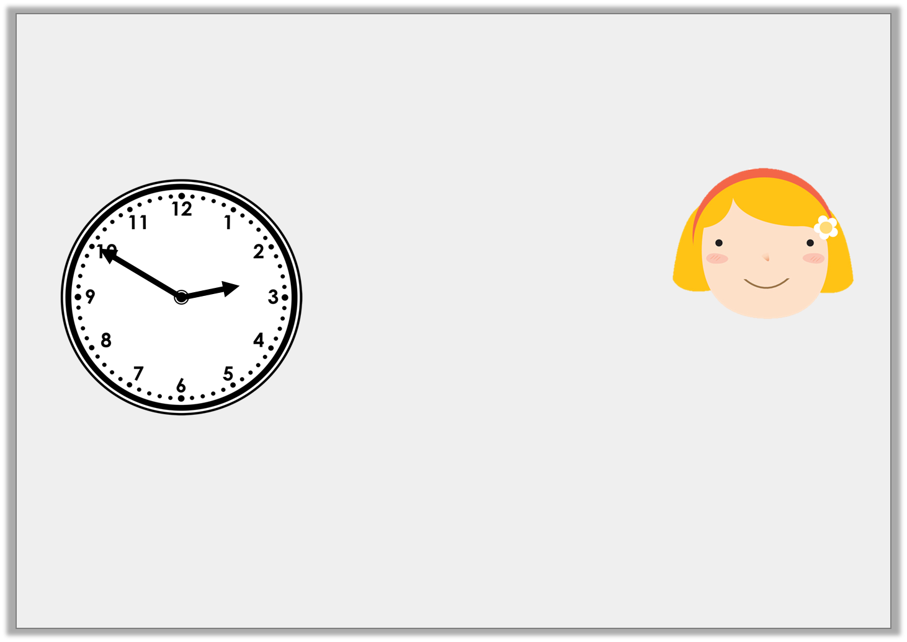
Reasoning 1
Ruby is looking for horizontal and vertical lines. The time is now:
Is she correct? Explain how you know.
In 10 minutes, one hand will be horizontal and one hand will be vertical.
Y3

Slide 33
Reasoning 1
Ruby is looking for horizontal and vertical lines. The time is now:
Is she correct? Explain how you know.
Ruby is correct because…
In 10 minutes, one hand will be horizontal and one hand will be vertical.
Y3

Slide 34
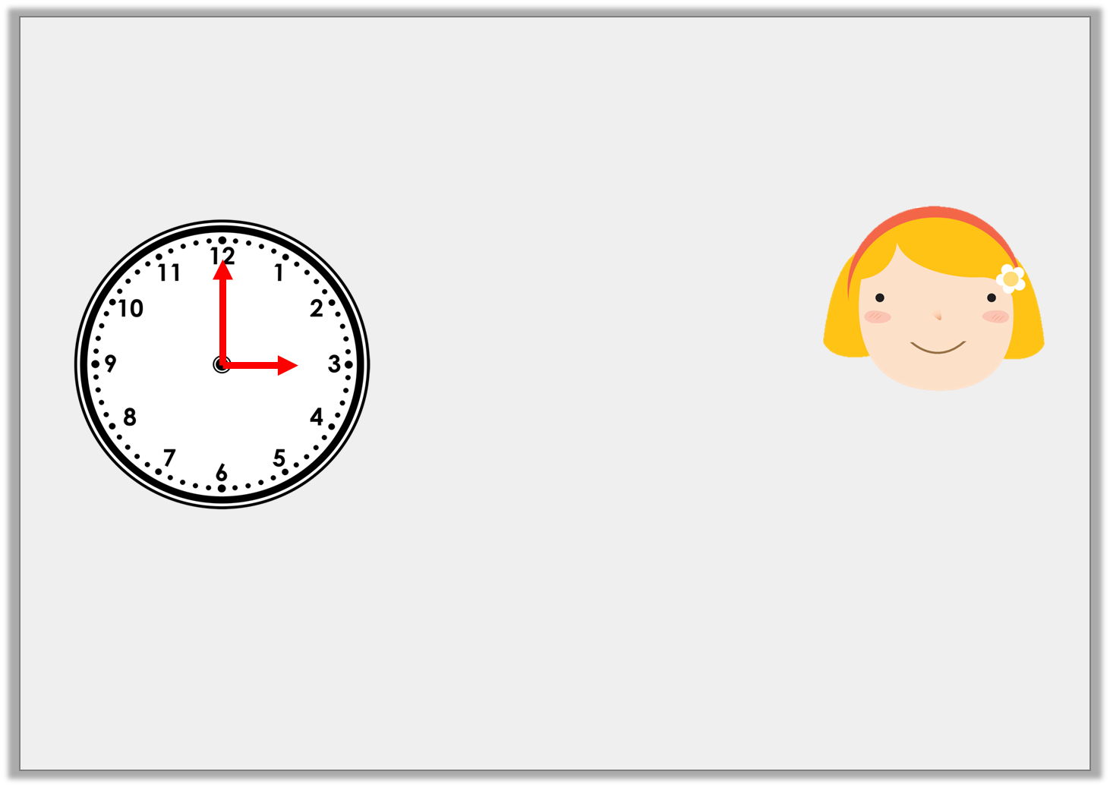
Reasoning 1
Ruby is looking for horizontal and vertical lines. The time is now:
Is she correct? Explain how you know.
Ruby is correct because at 3 o’clock the hour hand will be pointing to 3 so it will be horizontal and the minute hand will be pointing at 12 so it will be vertical.
In 10 minutes, one hand will be horizontal and one hand will be vertical.
Y3

Slide 35

Problem Solving 1
Anna and her friends are writing their names in capital letters.
Which friend has more vertical lines in the
letters of their name than Anna?
ANNA
BILL
TANYA
KYLIE
Y3

Slide 36
Problem Solving 1
Anna and her friends are writing their names in capital letters.
Which friend has more vertical lines in the
letters of their name than Anna?
4
ANNA
4
BILL
4
5
TANYA
KYLIE
Y3

Slide 37
Reasoning 2
Considering the lines of symmetry, which shape
is the odd one out?
Explain your answer.
T
+
Y3

Slide 38
Reasoning 2
Considering the lines of symmetry, which shape
is the odd one out?
Explain your answer.
The cross is the odd one out because…
T
+
Y3

Slide 39
Reasoning 2
Considering the lines of symmetry, which shape
is the odd one out?
Explain your answer.
The cross is the odd one out because it is the only shape with a horizontal and a vertical line of symmetry.
T
+
Y3

