Slide 1

Year 3/4 – Summer Block 3 – Properties of Shape
Tuesday 7th July 2020
Step 2
Year 4:
Lo: I can identify acute and obtuse angles and compare and order angles up to two right angles by size

Slide 2
Varied Fluency 1
Circle all the obtuse angles.
Y4

Slide 3
Varied Fluency 1
Circle all the obtuse angles.
Y4

Slide 4
Varied Fluency 2
Use the symbols < or > to make the statements correct.
obtuse angle
90°
Y4

Slide 5
Varied Fluency 2
Use the symbols < or > to make the statements correct.
>
obtuse angle
90°
Y4

Slide 6
Varied Fluency 3
Match the angle size to the correct label.
acute angle
obtuse angle
Y4

Slide 7
Varied Fluency 3
Match the angle size to the correct label.
acute angle
obtuse angle
Y4

Slide 8
Varied Fluency 4
Use the line to draw an acute angle.
Y4

Slide 9
Varied Fluency 4
Use the line to draw an acute angle.
Y4

Slide 10
I can identify acute and obtuse angles and compare and order angles up to two right angles by size
08.07.20

Slide 11
Problem Solving 1
Match the angles which will still be acute
when they are combined.
10°
12°
20°
79°
60°
65°
Y4

Slide 12
Problem Solving 1
Match the angles which will still be acute
when they are combined.
10°
12°
20°
79°
60°
65°
Y4

Slide 13
Reasoning 1
Which angle is the odd one out?
Explain your answer.
Y4

Slide 14
Reasoning 1
Which angle is the odd one out?
Explain your answer.
This angle is acute while all the others are right angles.
Y4

Slide 15
Problem Solving 2
Using the digits below, can you create
more obtuse or acute angles?
6
1
0
8
Y4

Slide 16
Problem Solving 2
Using the digits below, can you create
more obtuse or acute angles?
2-digit acute possibilities:
61°, 60°, 68°, 16°, 10°, 18°, 86°, 81°, 80°
3-digit obtuse possibilities:
108°, 106°, 160°, 168°
There are more acute than obtuse angles possible.
6
1
0
8
Y4

Slide 17
Y3/4 – Summer Block 4 – Shape
Step 3
Thursday 9th July 2020
Year 4: I can compare and order angles

Slide 18
Introduction
Label these angles as acute, right angle or obtuse.
Y4

Slide 19
Introduction
Label these angles as acute, right angle or obtuse.
Right Angle
Obtuse
Acute
Acute
Obtuse
Y4

Slide 20
Varied Fluency 1
Which angle is the largest?
B
A
C
Y4

Slide 21
Varied Fluency 1
Which angle is the largest?
B
A
C
Y4

Slide 22
Varied Fluency 2
Here are some segments with different sized angles at their points.
Put the angles in order from smallest to largest.
A
D
B
C
Y4

Slide 23
Varied Fluency 2
Here are some segments with different sized angles at their points.
Put the angles in order from smallest to largest.
A
D
B
C
A, C, D, B
Y4

Slide 24
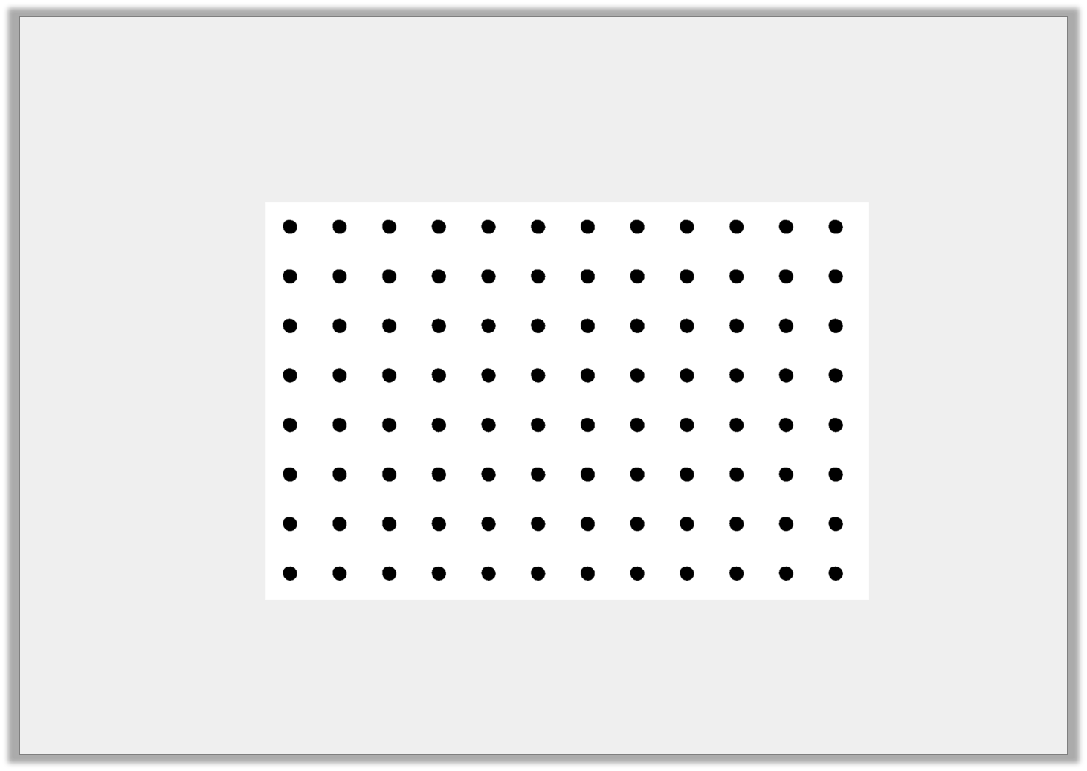
Varied Fluency 3
True or false?
Angle A is smaller than angle B. Angles B and C are the same size.
A
B
C
Y4

Slide 25
Varied Fluency 3
True or false?
Angle A is smaller than angle B. Angles B and C are the same size.
True
A
B
C
Y4

Slide 26
Problem Solving 1
Draw a shape with…
6 obtuse angles
90° angle cut out given for reference.
Y3

Slide 27
Problem Solving 1
Draw a shape with…
6 obtuse angles
Various possible answers, for example:
90° angle cut out given for reference.
Y3

Slide 28
Problem Solving 2
Make a table to show how many acute, obtuse and
right angles are in both of these shapes:
Y3

Slide 29
Problem Solving 2
Make a table to show how many acute, obtuse and
right angles are in both of these shapes:
Right angles | 2
Obtuse | 6
Acute | 2
Y3

Slide 30
Step 3
Friday 10th July 2020
Year 4: I can solve problems by comparing and ordering angles

Slide 31

Reasoning 1
Kaito is discussing angles.
Is Kaito correct? Explain your answer.
I have 3 angles. One angle is obtuse, one is 90° and the other is acute. I think that the 90° angle is the smallest angle.
Y4

Slide 32
Reasoning 1
Kaito is discussing angles.
Is Kaito correct? Explain your answer.
Kaito is incorrect because...
I have 3 angles. One angle is obtuse, one is 90° and the other is acute. I think that the 90° angle is the smallest angle.
Y4

Slide 33
Reasoning 1
Kaito is discussing angles.
Is Kaito correct? Explain your answer.
Kaito is incorrect because an acute angle is smaller than 90°.
I have 3 angles. One angle is obtuse, one is 90° and the other is acute. I think that the 90° angle is the smallest angle.
Y4

Slide 34
Problem Solving 2
If you join together the end points of the matching lines below, do they make 4 angles in order from smallest to largest?
Be sure to compare the smallest side of each angle created.
1
2
3
4
Y4

Slide 35
Problem Solving 2
If you join together the end points of the matching lines below, do they make 4 angles in order from smallest to largest?
Be sure to compare the smallest side of each angle created.
Yes
1
2
3
4
Y4

