Slide 1
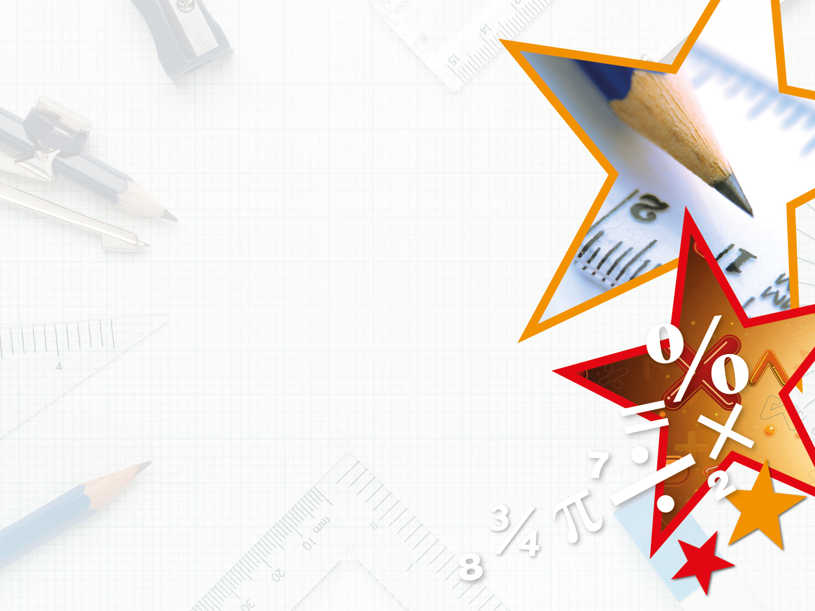
Year 3/4 – Summer Block 2 – Statistics – Step 5
30.07.20
Year 3/4: Lo: Introducing Line Graphs

Slide 2
Introduction
Which of the following can be represented on a line graph?
Your classmates’ birthdays
Your favourite books
The temperature throughout the day
How much money an ice cream stall makes in a week
The height of a plane throughout a flight
Y4

Slide 3
Introduction
Which of the following can be represented on a line graph?
Your classmates’ birthdays
Your favourite books
The temperature throughout the day
How much money an ice cream stall makes in a week
The height of a plane throughout a flight
Y4

Slide 4
Varied Fluency 1
What is missing?
Use the checklist to make sure the line graph has all these items:
2
0
 | Title
 | Axis Labels
 | Scales
Y4

Slide 5
Varied Fluency 1
What is missing?
Use the checklist to make sure the line graph has all these items:
10
8
6
4
2
0
Number of Cars
Time
✓ | Title
 | Axis Labels
✓ | Scales
Y4

Slide 6
Varied Fluency 2
Use the line graph to fill in the gaps.
At 10 years, the oak tree measured ______ m.
The quickest growth was between age _____ and _____ .
Y4

Slide 7
Varied Fluency 2
Use the line graph to fill in the gaps.
At 10 years, the oak tree measured 1 m.
The quickest growth was between age 20 and 30 .
Y4

Slide 8
Varied Fluency 3
Use the data to complete the line graph.
Minutes | 2 | 4 | 6 | 8 | 10
Temperature | 40º | 70º | 70º | 90º | 110º
Y4

Slide 9
Varied Fluency 3
Use the data to complete the line graph.
Minutes | 2 | 4 | 6 | 8 | 10
Temperature | 40º | 70º | 70º | 90º | 110º
Y4

Slide 10
Reasoning 1
A vet says that Paulina’s dog is too heavy and needs to lose weight. Paulina makes a line graph to show her dog’s weight loss over a month. Is it correct? Explain your answer.
Y4

Slide 11
Wednesday 1st July 2020

Slide 12
Reasoning 1
A vet says that Paulina’s dog is too heavy and needs to lose weight. Paulina makes a line graph to show her dog’s weight loss over a month. Is it correct? Explain your answer.
The line graph is not correct because ...
Y4

Slide 13
Reasoning 1
A vet says that Paulina’s dog is too heavy and needs to lose weight. Paulina makes a line graph to show her dog’s weight loss over a month. Is it correct? Explain your answer.
The line graph is not correct because a dog cannot weigh 0kg.
Y4

Slide 14
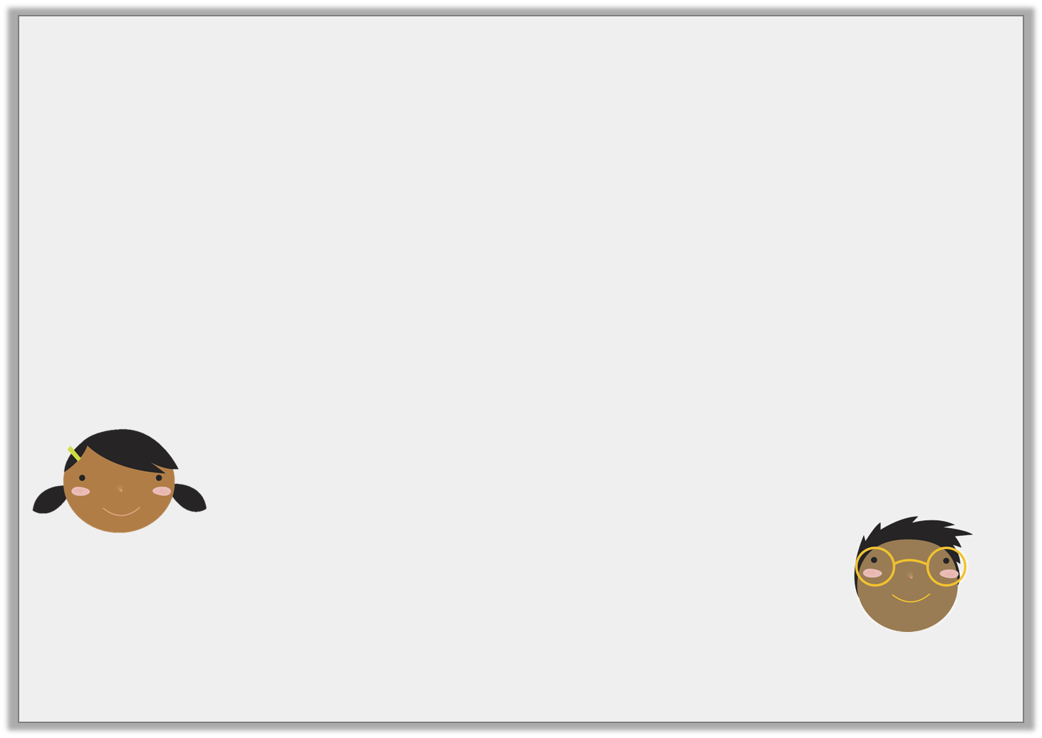
Reasoning 2
Explain who is correct.
Height of a Gymnast’s Head in Cartwheel
The gymnast had finished in 1 second.
Hajra
After 50 seconds her head was at its lowest point.
Ibrahim
Y4

Slide 15
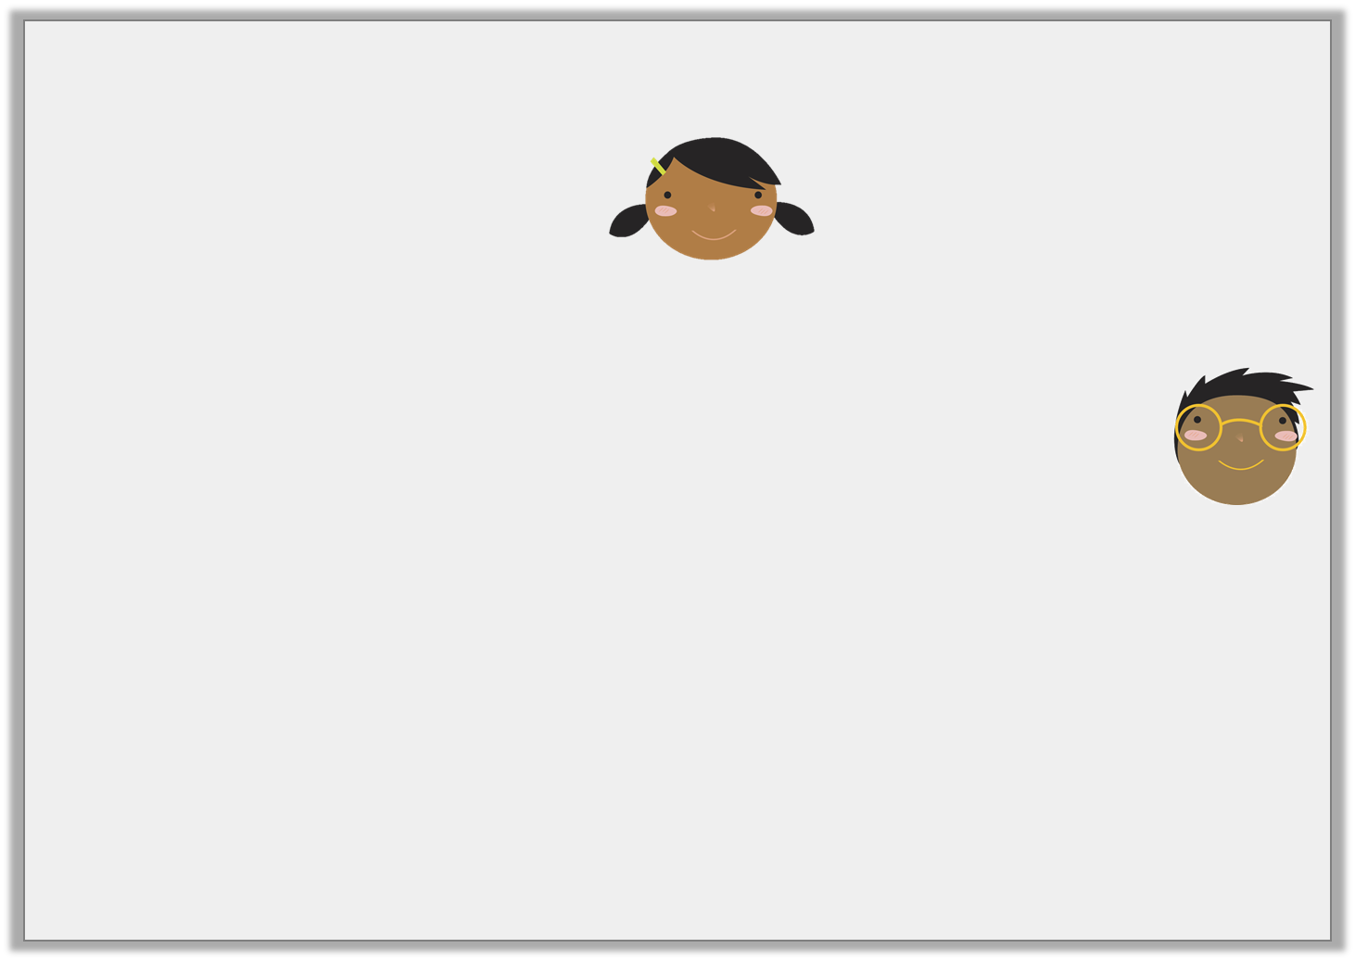
Reasoning 2
Explain who is correct.
Hajra is correct because …
Height of a Gymnast’s Head in Cartwheel
The gymnast had finished in 1 second.
Hajra
After 50 seconds her head was at its lowest point.
Ibrahim
Y4

Slide 16
Reasoning 2
Explain who is correct.
Hajra is correct because she has seen that the gymnast’s head has returned to its full height after 100 hundredths of a second (which is one full second).
Ibrahim has mistaken 50 hundredths of a second for 50 seconds.
Height of a Gymnast’s Head in Cartwheel
The gymnast had finished in 1 second.
Hajra
After 50 seconds her head was at its lowest point.
Ibrahim
Y4

Slide 17
Problem Solving 1
The graph below tracks the flight of two birds. One shows a bird beginning a flight and the other is already in flight.
Which line below shows the bird beginning its flight?
Y4

Slide 18
Problem Solving 1
The graph below tracks the flight of two birds. One shows a bird beginning a flight and the other is already in flight.
Which line below shows the bird beginning its flight?
The blue line shows the correct data for this scenario. It shows an increase in speed between 0 and 3 minutes which is then maintained as the bird continues flying.
Y4

Slide 19
Thursday 2nd July 2020

Slide 20
Y3/4 – Summer Block 4 –Shape
Step 1
Year 3: I can recognise turns and angles

Slide 21
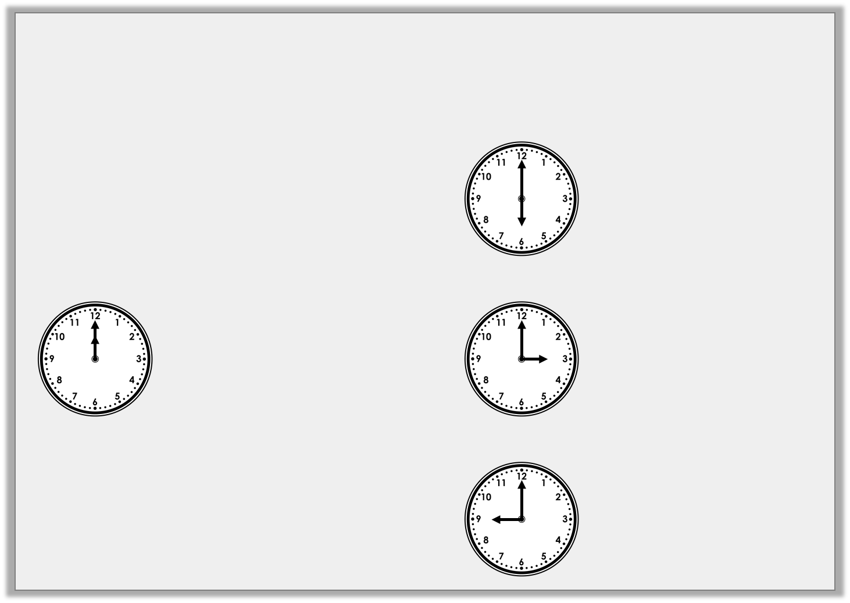
Introduction
Match the starting clock to the durations and the turns
that it has made.
Half turn clockwise
+ 30 mins
Start
Quarter turn clockwise
+ 45 mins
Three- quarter turn clockwise
+ 15 mins
Y3

Slide 22
Introduction
Match the starting clock to the durations and the turns
that it has made.
Half turn clockwise
+ 30 mins
Start
Quarter turn clockwise
+ 45 mins
Three- quarter turn clockwise
+ 15 mins
Y3

Slide 23
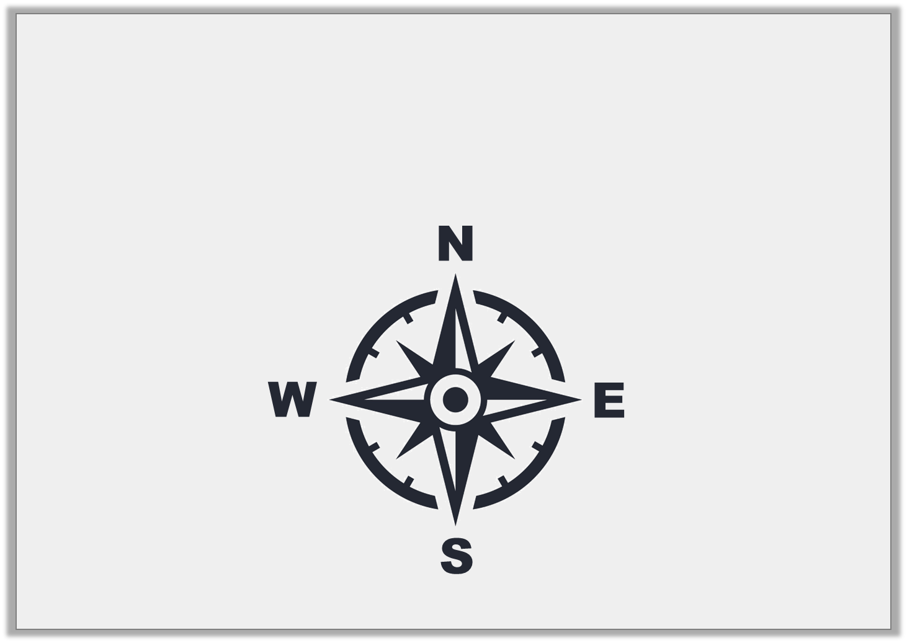
Varied Fluency 1
Start at east.
Turn three quarters clockwise.
Which direction are you now facing?
Y3

Slide 24
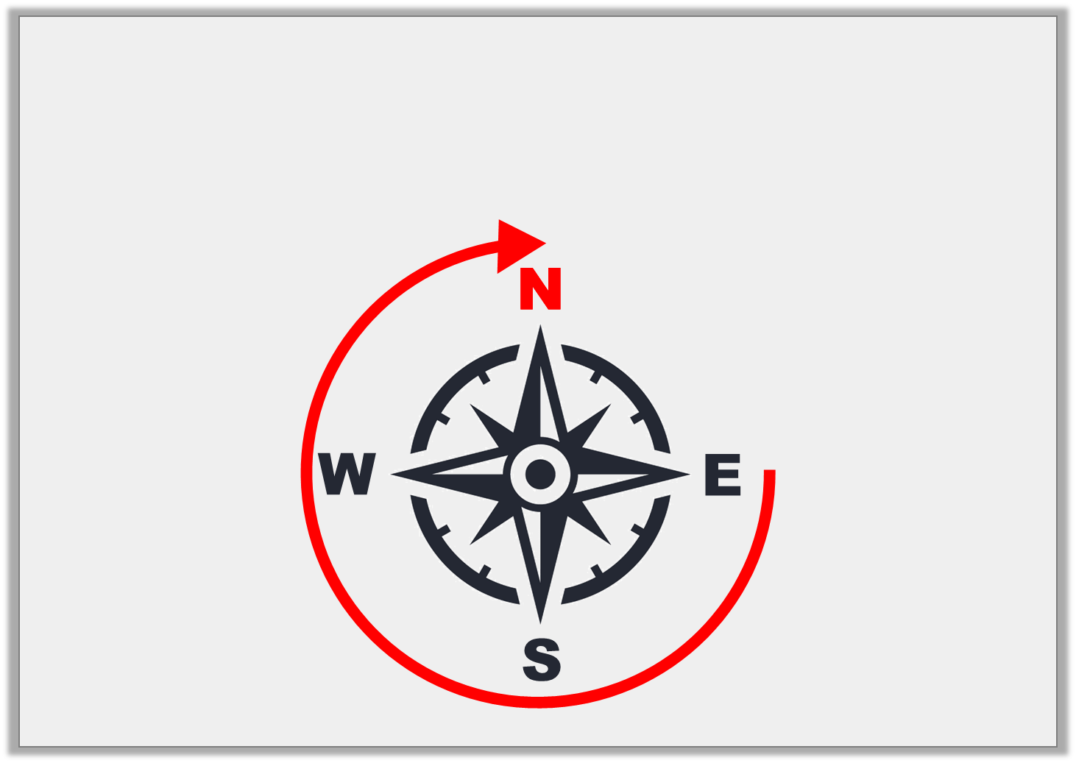
Varied Fluency 1
Start at east.
Turn three quarters clockwise.
Which direction are you now facing?
Y3

Slide 25
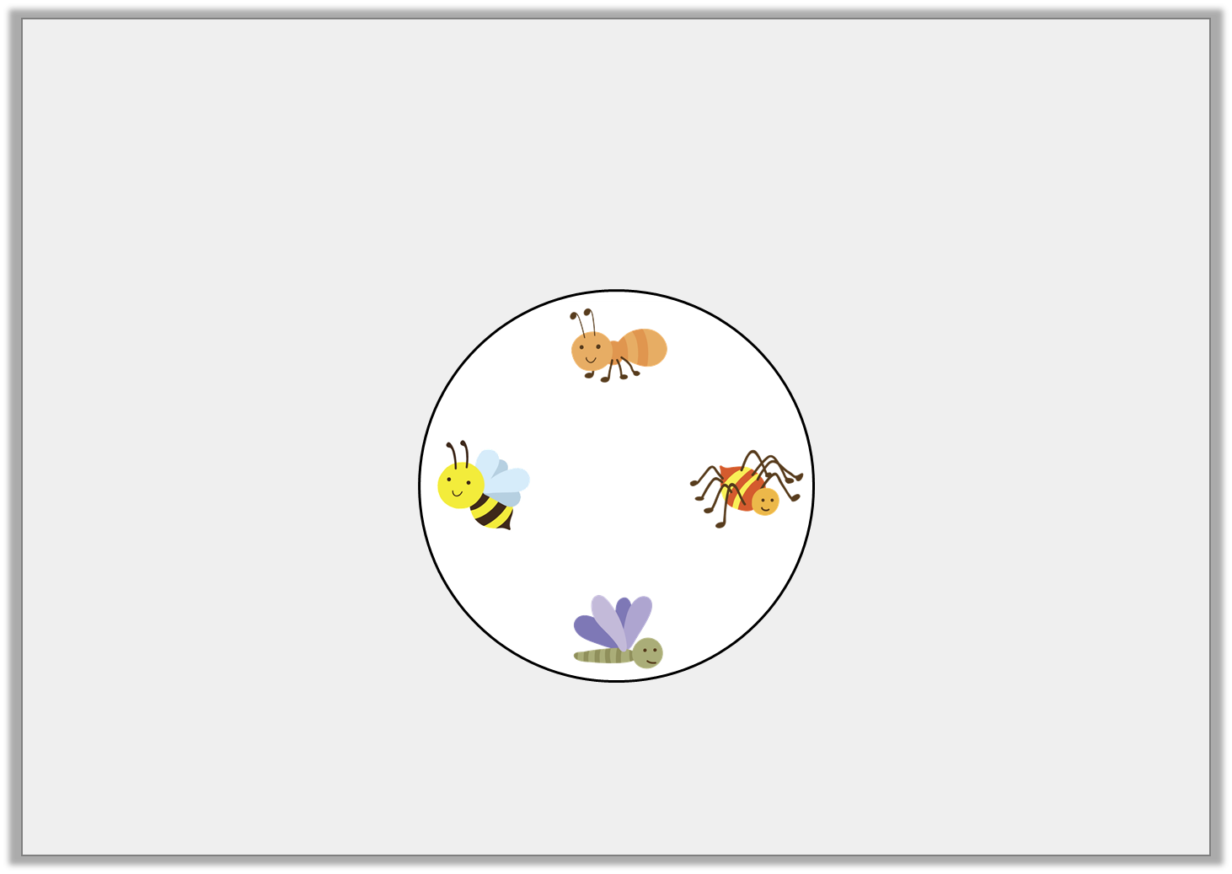
Varied Fluency 2
What turn does the spinner need to make to get
from the dragonfly to the spider?
Y3

Slide 26
Varied Fluency 2
What turn does the spinner need to make to get
from the dragonfly to the spider?
A quarter turn anti-clockwise or a three-quarter turn clockwise.
Y3

Slide 27
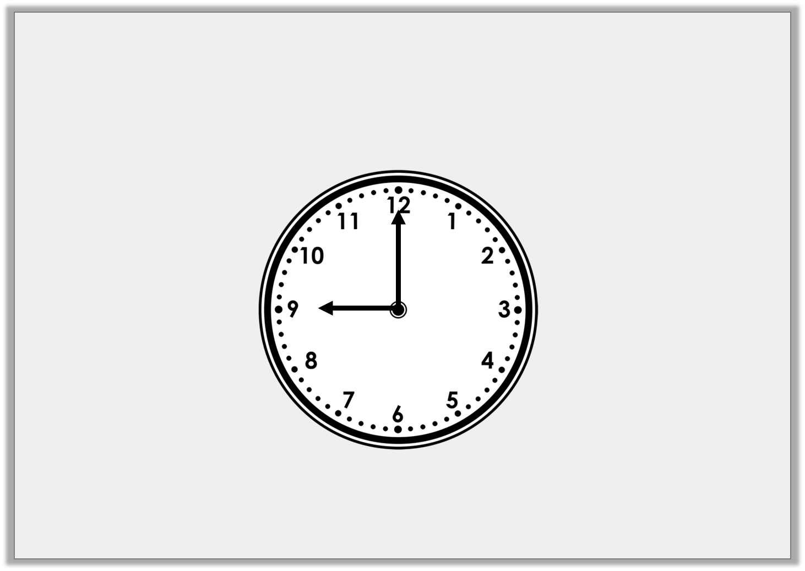
Varied Fluency 3
If the hour hand is turned a turn, what time will it be?
1
4
Y3

Slide 28
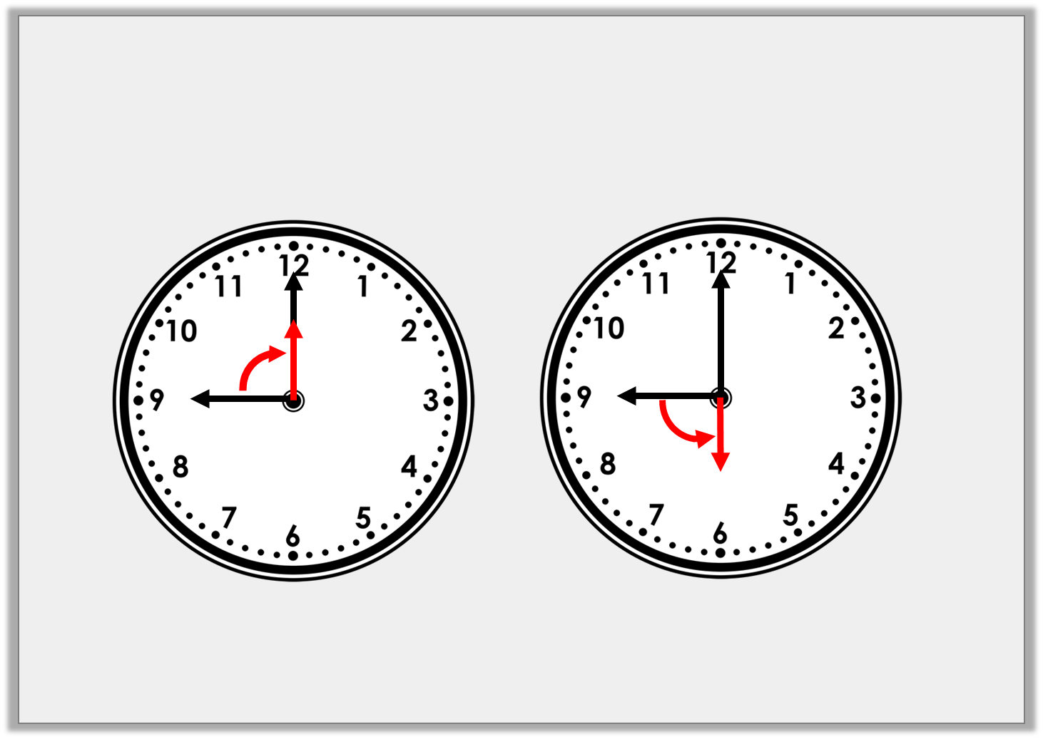
Varied Fluency 3
If the hour hand is turned a turn, what time will it be?
1
4
12 o’clock
6 o’clock
Y3

Slide 29
Varied Fluency 4
Sort these images into the table.
All lines make angles | Not all lines make angles
Y3

Slide 30
Varied Fluency 4
Sort these images into the table.
All lines make angles | Not all lines make angles
Y3

Slide 31
Year 3: I can recognise turns and angles using reasoning and problem-solving
Friday 3rd 2020

Slide 32
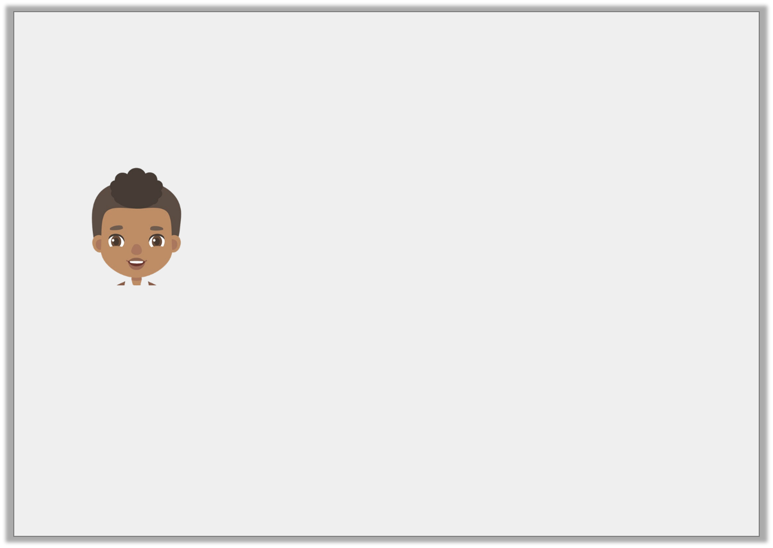
Problem Solving 1
Iqbal is thinking of a shape.
He says,
Draw the shape that he is thinking of.
The shape has 6 angles that are the same size.
Y3

Slide 33
Problem Solving 1
Iqbal is thinking of a shape.
He says,
Draw the shape that he is thinking of.
The shape has 6 angles that are the same size.
Y3

Slide 34
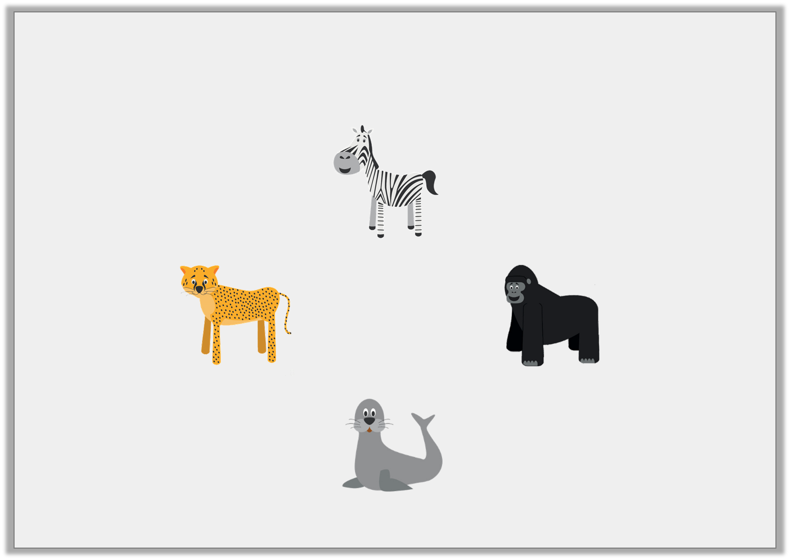
Problem Solving 2
After a three quarter turn anti-clockwise, you are now facing the zebra. Which animal were you facing when you started?
Y3

Slide 35
Problem Solving 2
After a three quarter turn anti-clockwise, you are now facing the zebra. Which animal were you facing when you started?
Leopard
Y3

Slide 36
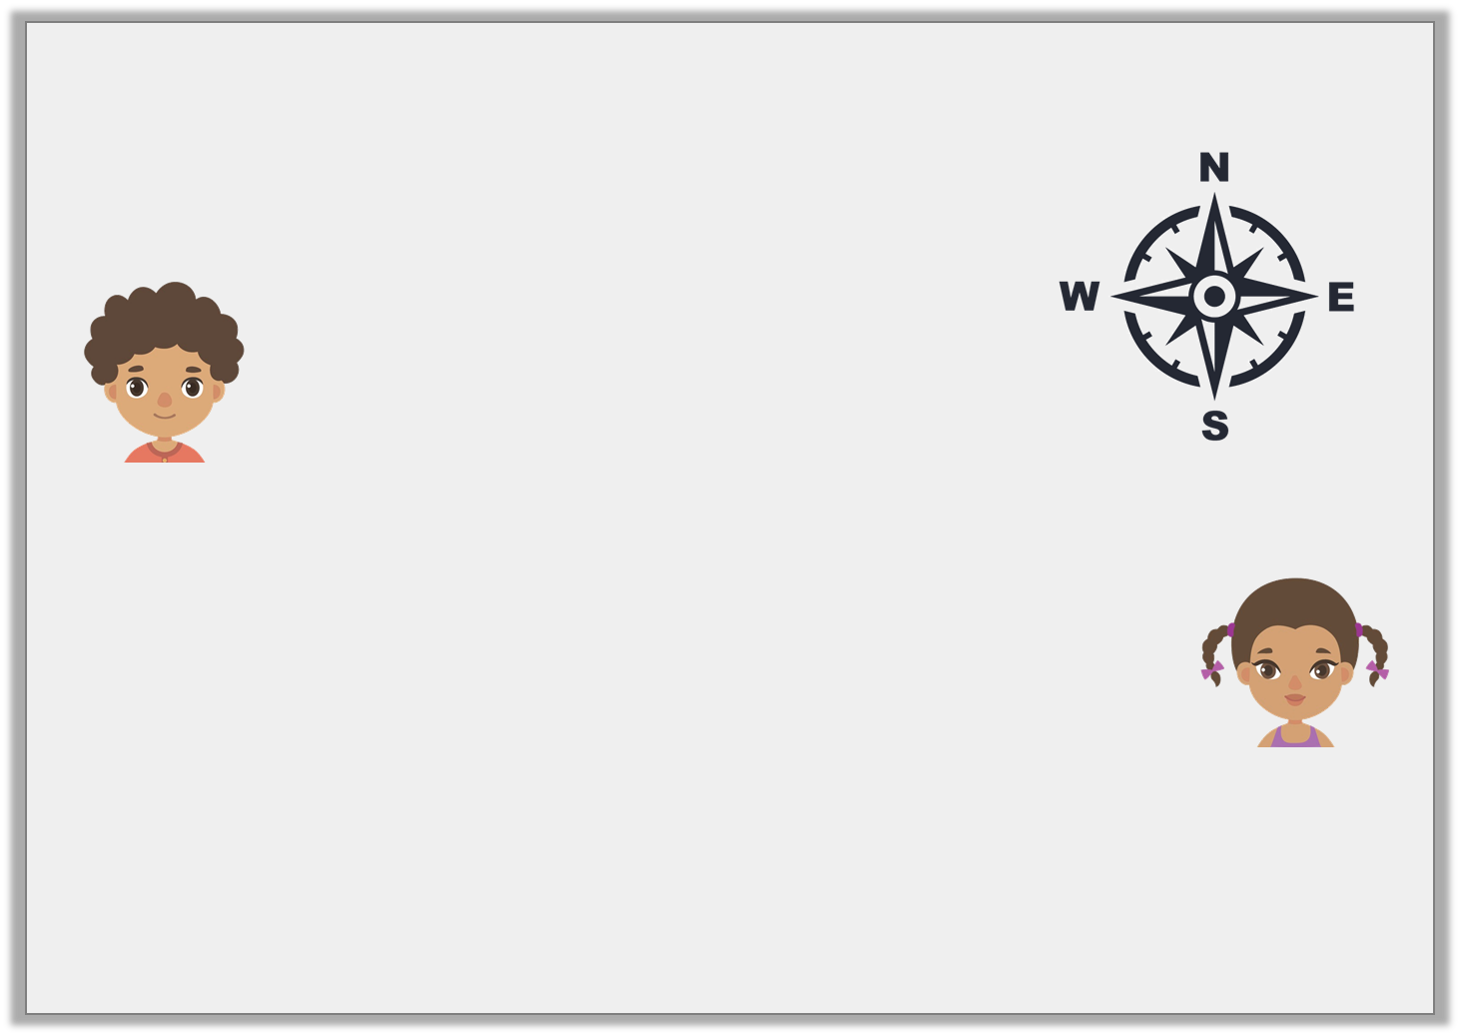
Reasoning 1
A compass needle has moved from south to north.
Jon says,
Fiona says,
Who is correct? Explain how you know.
It has moved a half turn clockwise.
It has moved a half turn anti-clockwise.
Y3

Slide 37
Reasoning 1
A compass needle has moved from south to north.
Jon says,
Fiona says,
Who is correct? Explain how you know.
Both Jon and Fiona could be correct because…
It has moved a half turn clockwise.
It has moved a half turn anti-clockwise.
Y3

Slide 38
Reasoning 1
A compass needle has moved from south to north.
Jon says,
Fiona says,
Who is correct? Explain how you know.
Both Jon and Fiona could be correct because a half turn in either direction from the same starting point will end up at north.
It has moved a half turn clockwise.
It has moved a half turn anti-clockwise.
Y3

