Slide 1
Year 1/2 – Autumn Block 4 – Money
Step 1
Year 1: Recognising Coins
Year 2: Count Money – Pence
Classroom Secrets Limited 2018

Slide 2
Introduction
Show me a 5p coin.
Show me a 20p coin.
Show me a £2 coin.
Show me a 1p coin.
Show me a 50p coin.
Show me a 2p coin.
Show me a £1 coin.
Show me a 10p coin.
Y1

Slide 3
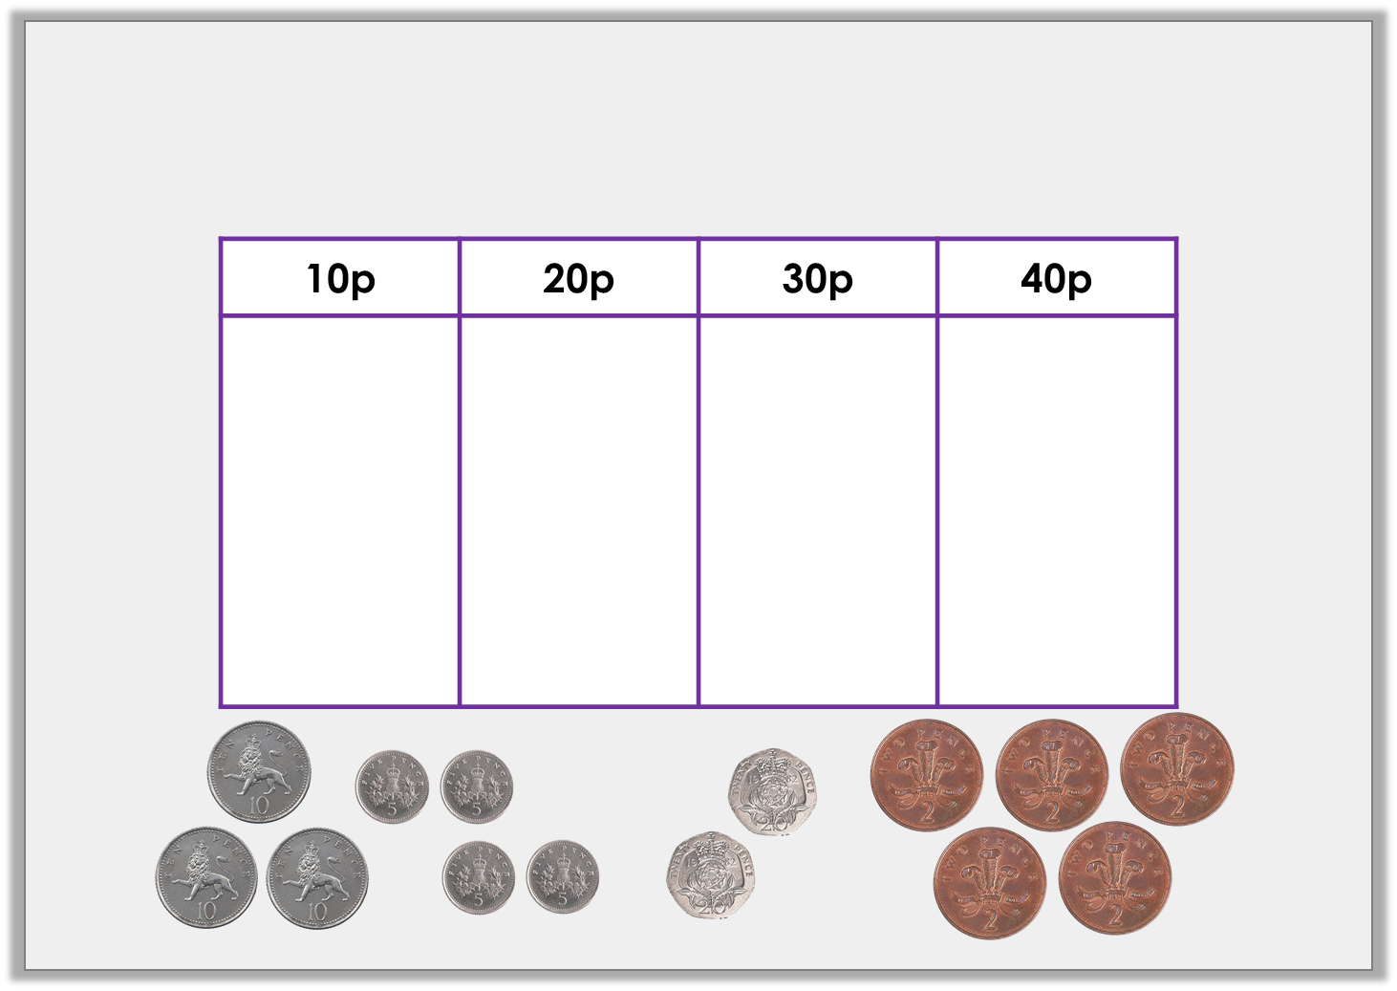
Introduction
Sort the coins into the table to make the correct total.
Y2

Slide 4
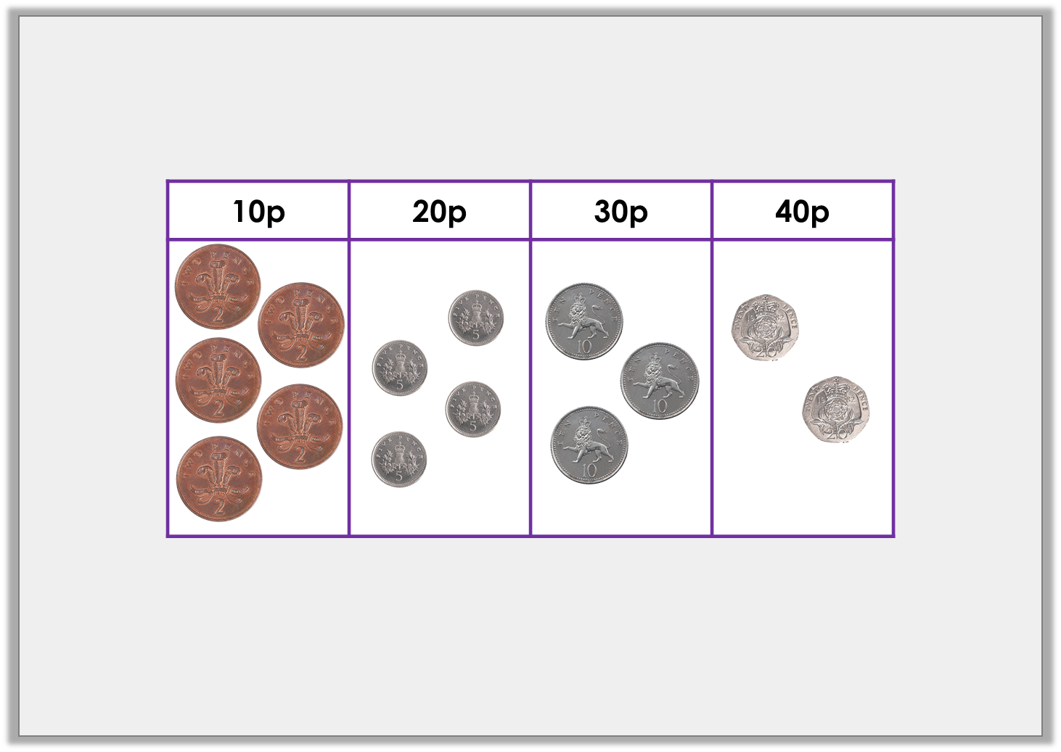
Introduction
Sort the coins into the table to make the correct total.
Example answer:
Y2

Slide 5
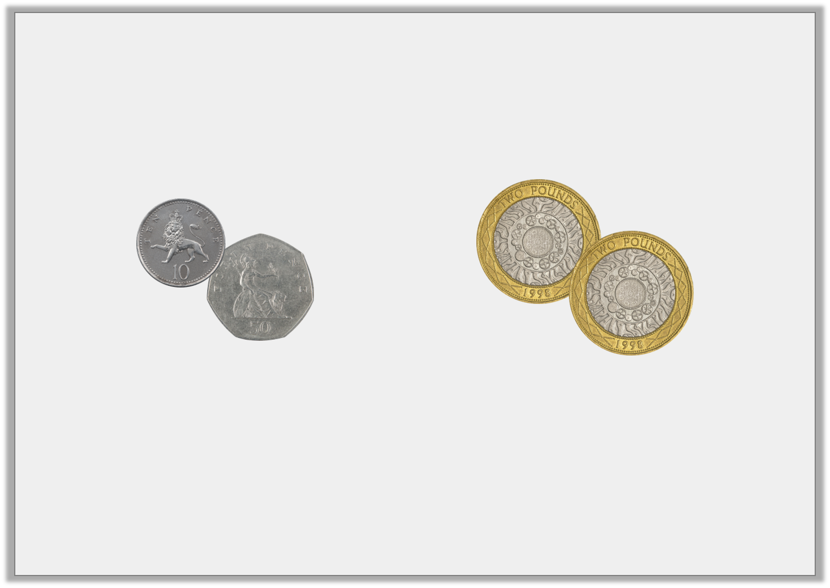
Varied Fluency 1
What is the value of each set?
Y1

Slide 6
Varied Fluency 1
What is the value of each set?
60p
£4
Y1

Slide 7
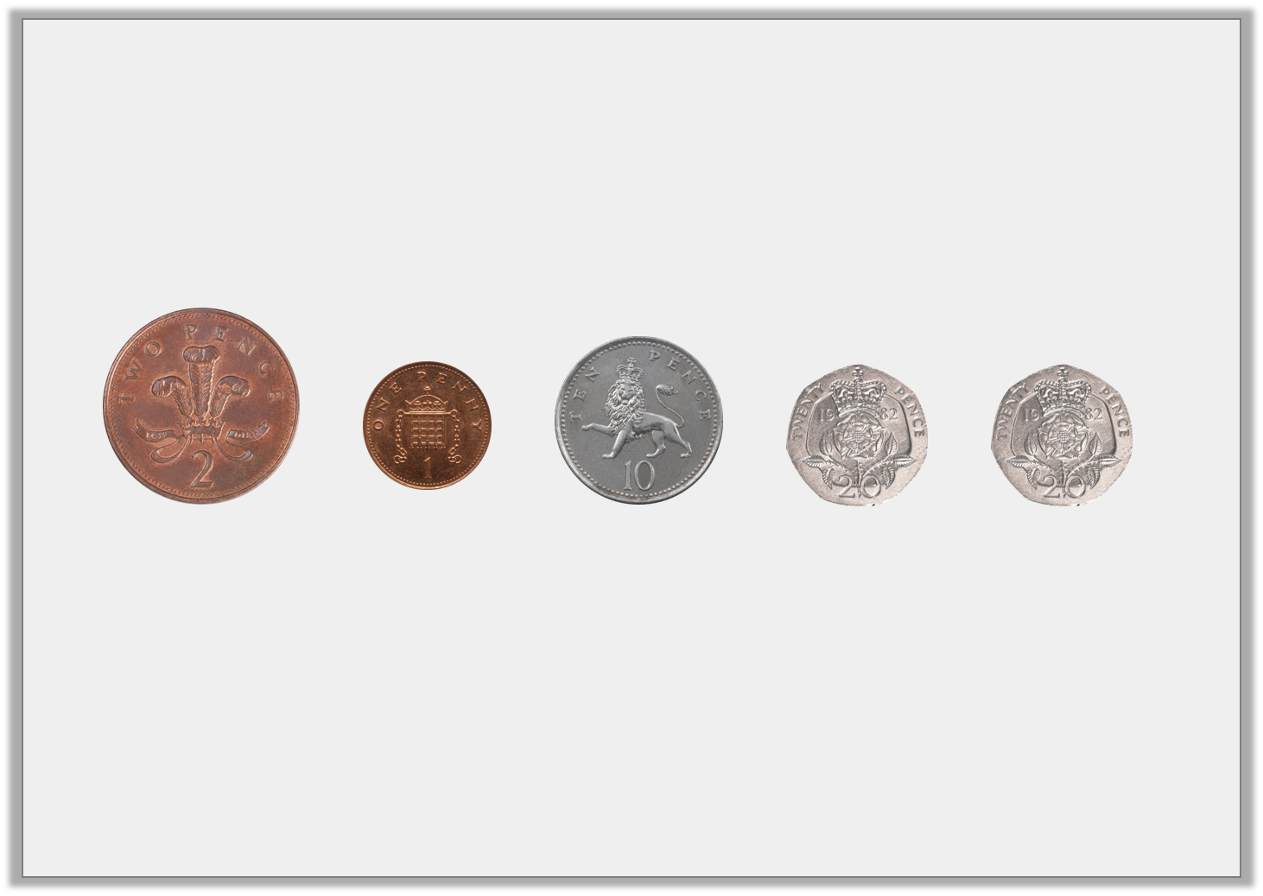
Varied Fluency 2
Circle the coins that total 40p.
Y1

Slide 8
Varied Fluency 2
Circle the coins that total 40p.
20p + 20p = 40p
Y1

