Slide 1
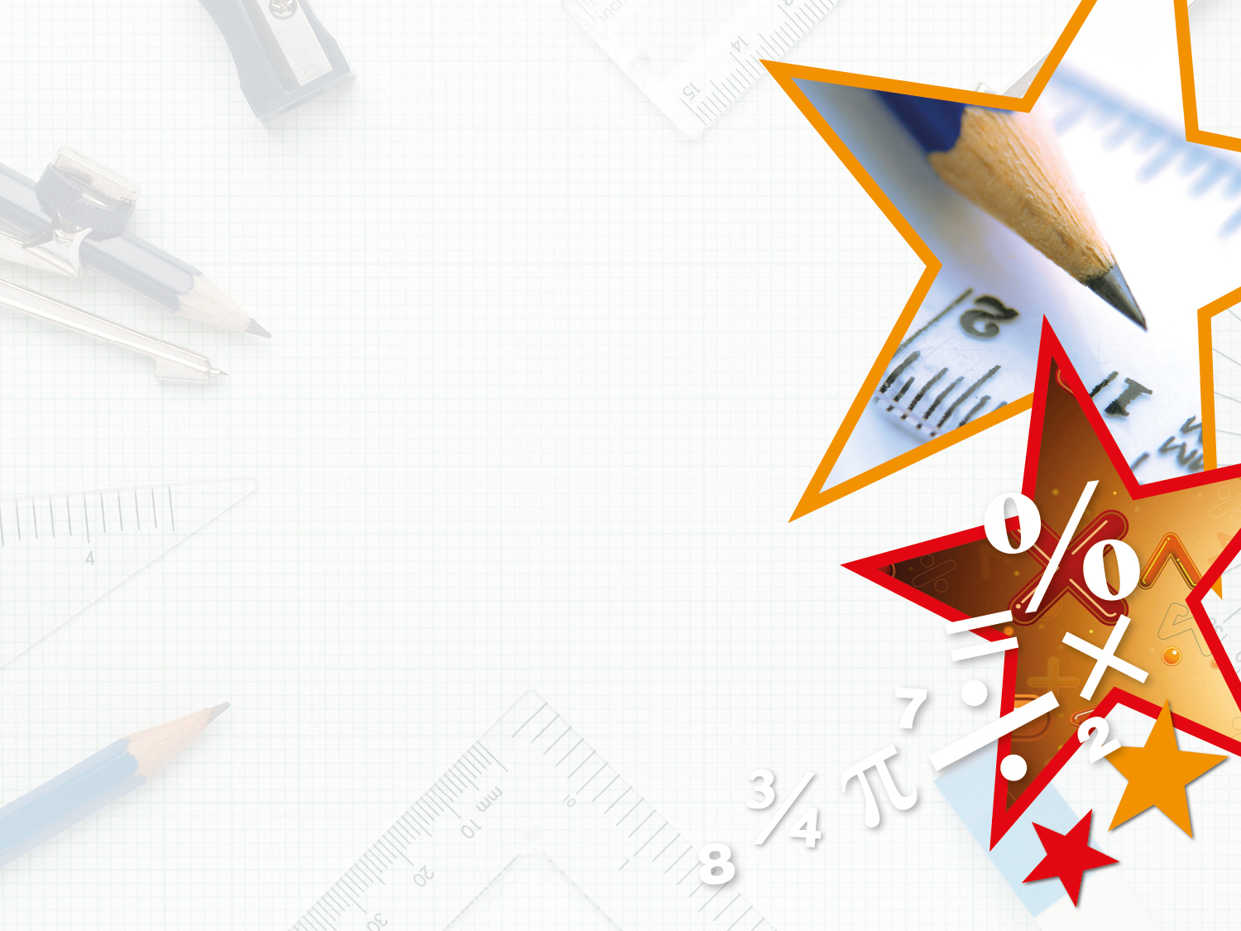
Week 14 – w.b 22.06.20 - Year 5 & 6 Maths
This week, Year 5 and 6 are sharing the same slides as we are starting a new topic in Maths that we did not have a chance to visit – Algebra!
For the first few days, you will notice that the slides both have Varied Fluency and Reasoning & Problem Solving for the same day, as we need to review topics in Maths that relate to Algebra (Prime, Square and Cube numbers) before we move on to Algebra later in the week. Please do click on the links at the beginning of the slides to review and help you to complete the activities. At the end of most activities (especially the first few days), there is one or more challenge(s).

Slide 2
Monday 22nd June 2020
L.O: to identify and use prime and composite numbers
Please watch the video before going trough the slides:
https://www.youtube.com/watch?v=3h4UK62Qrbo

Slide 3
Introduction
What are prime numbers? What are composite numbers?
Sort the numbers under the correct headings.
Prime Numbers | Composite Numbers
11
2
29
14
33

Slide 4
Introduction
What are prime numbers? What are composite numbers?
Sort the numbers under the correct headings.
Prime numbers have only two factors.
Composite numbers have more than two factors.
Prime Numbers | Composite Numbers
2
11
14
29
33

Slide 5
Varied Fluency 1
Circle the prime numbers.
3 |  | 6 |  | 11 |  | 19 |  | 21 |  | 41

Slide 6
Varied Fluency 1
Circle the prime numbers.
3 |  | 6 |  | 11 |  | 19 |  | 21 |  | 41

Slide 7
Varied Fluency 2
Which of the following numbers are composite numbers?
8
67
17
21
23
5

Slide 8
Varied Fluency 2
Which of the following numbers are composite numbers?
8
67
17
21
23
5

Slide 9
Varied Fluency 3
Which numbers are in the wrong place?
Prime Numbers | Composite Numbers
33
83
35
84
12
56
13
97

Slide 10
Varied Fluency 3
Which numbers are in the wrong place?
Prime Numbers | Composite Numbers
33
83
35
84
12
56
13
97

Slide 11
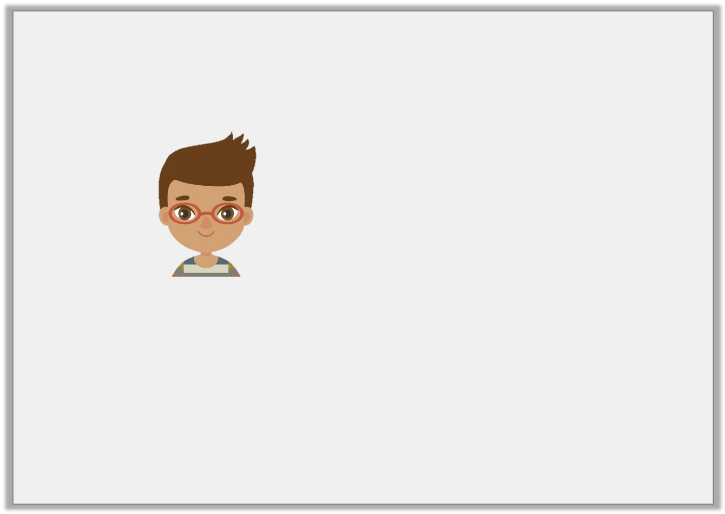
Varied Fluency 4
True or false?
Twenty nine is a prime number.

Slide 12
Varied Fluency 4
True or false?
True, its only factors are 1 and 29.
Twenty nine is a prime number.

Slide 13
Problem Solving 1
Use the digit cards to make prime numbers which are less than 100.
Find all the possibilities.
7
2
9
3

Slide 14
Problem Solving 1
Use the digit cards to make prime numbers which are less than 100.
Find all the possibilities.
2, 3, 7, 23, 29, 37, 73, 79 and 97
7
2
9
3

Slide 15
Problem Solving 2
Choose the numbers from the selection below and add them to the table.
What do you notice?
Prime Numbers | Composite Numbers
15 |  | 27 |  | 11 |  | 31 |  | 18 |  | 2 |  | 23

Slide 16
Problem Solving 2
Choose the numbers from the selection below and add them to the table.
What do you notice?
2 is the only prime number which is not an odd number.
Prime Numbers | Composite Numbers
11
23
15
27
2
31
18
15 |  | 27 |  | 11 |  | 31 |  | 18 |  | 2 |  | 23

Slide 17
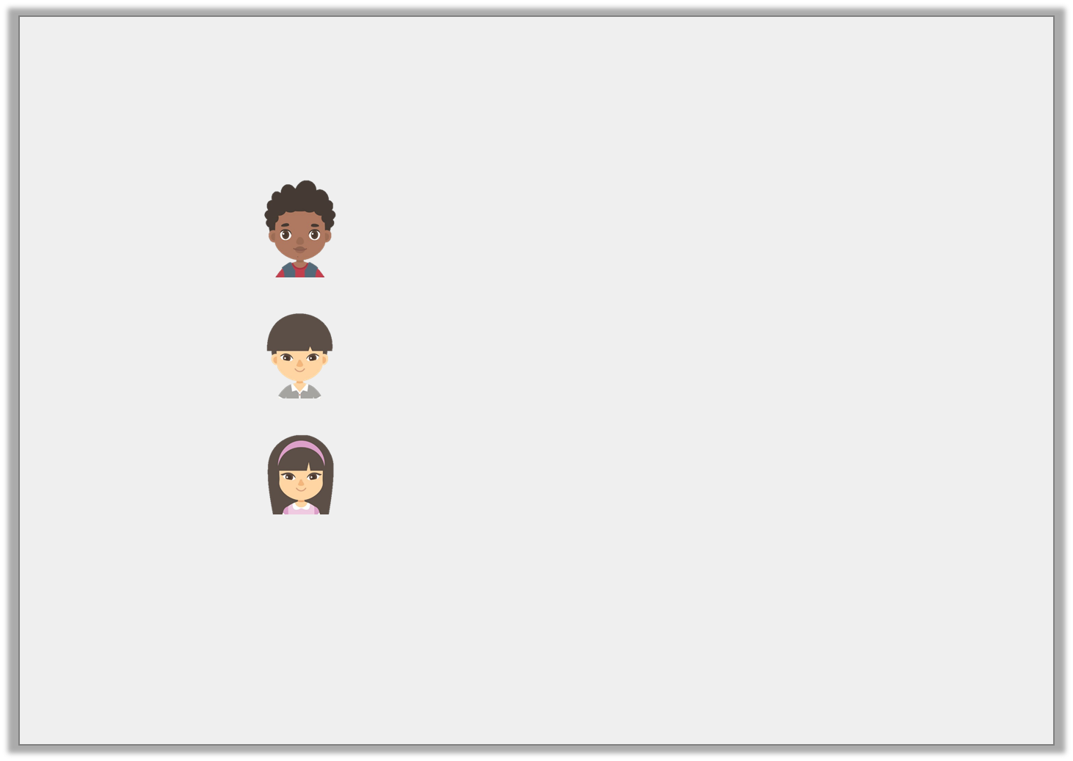
Reasoning 1
Are the following statements true or false?
The smallest prime number is 1
Teddy
43 is a prime number.
Jaxon
No prime number greater than 5 ends in 5.
Eliza

Slide 18
Reasoning 1
Are the following statements true or false?
False, 1 is not a prime number.
True, the only factors of 43 are 1 and 43.
True, any number ending in 5, other than 5, can be divided by 5 as well as itself.
The smallest prime number is 1
Teddy
43 is a prime number.
Jaxon
No prime number greater than 5 ends in 5.
Eliza

Slide 19
Tuesday 23rd June 2020
L.O: to recognise and use square numbers
Please revise square numbers before going through the slides:
https://www.youtube.com/watch?v=PDyyvPdi1tI

Slide 20
Introduction
What are the next 3 numbers in this pattern?

Slide 21
Introduction
What are the next 3 numbers in this pattern?
The next three square numbers in the pattern are:
25 (5 x 5), 36 (6 x 6) and 49 (7 x 7)
1 x 1 = 1
2 x 2 = 4
3 x 3 = 9
4 x 4 = 16

Slide 22
Varied Fluency 1
Which squared number does this diagram represent?

Slide 23
Varied Fluency 1
Which squared number does this diagram represent?
8² = 64

Slide 24
Varied Fluency 2
Calculate:
2 squared
8²
7 squared
5²
6 squared

Slide 25
Varied Fluency 2
Calculate:
2 squared
4
8²
64
7 squared
49
5²
25
6 squared
36

Slide 26
Varied Fluency 3
Circle the square numbers.
100 | 16 | 21 | 27 | 36
121 | 1 | 10 | 30 | 46
80 | 81 | 82 | 83 | 84

Slide 27
Varied Fluency 3
Circle the square numbers.
100 | 16 | 21 | 27 | 36
121 | 1 | 10 | 30 | 46
80 | 81 | 82 | 83 | 84

Slide 28
Varied Fluency 4
Complete the table below.
____ ² | 4 x 4 | 16
 | 8 x 8
9² |  | 81
 | 10 x 10

Slide 29
Varied Fluency 4
Complete the table below.
4 ² | 4 x 4 | 16
8 ² | 8 x 8 | 64
9² | 9 x 9 | 81
10 ² | 10 x 10 | 100

Slide 30
Problem Solving 1
25 is the sum of two square numbers.
Using the example above, complete the following:
34 is the sum of two squared numbers. What could they be?
45 is the sum of two squared numbers. What could they be?
25 = 4² + 3²

Slide 31
Problem Solving 1
25 is the sum of two square numbers.
Using the example above, complete the following:
34 is the sum of two squared numbers. What could they be?
5² and 3²
45 is the sum of two squared numbers. What could they be?
6² and 3²
25 = 4² + 3²

Slide 32
Problem Solving 2
Solve the following problems.
I think of a number. I square it and take away 10. The answer is 54. What was my number?
I think of another number. I square it and add 15. The answer is 115. What was my number?

Slide 33
Problem Solving 2
Solve the following problems.
I think of a number. I square it and take away 10. The answer is 54. What was my number?
8
I think of another number. I square it and add 15. The answer is 115. What was my number?
10

Slide 34
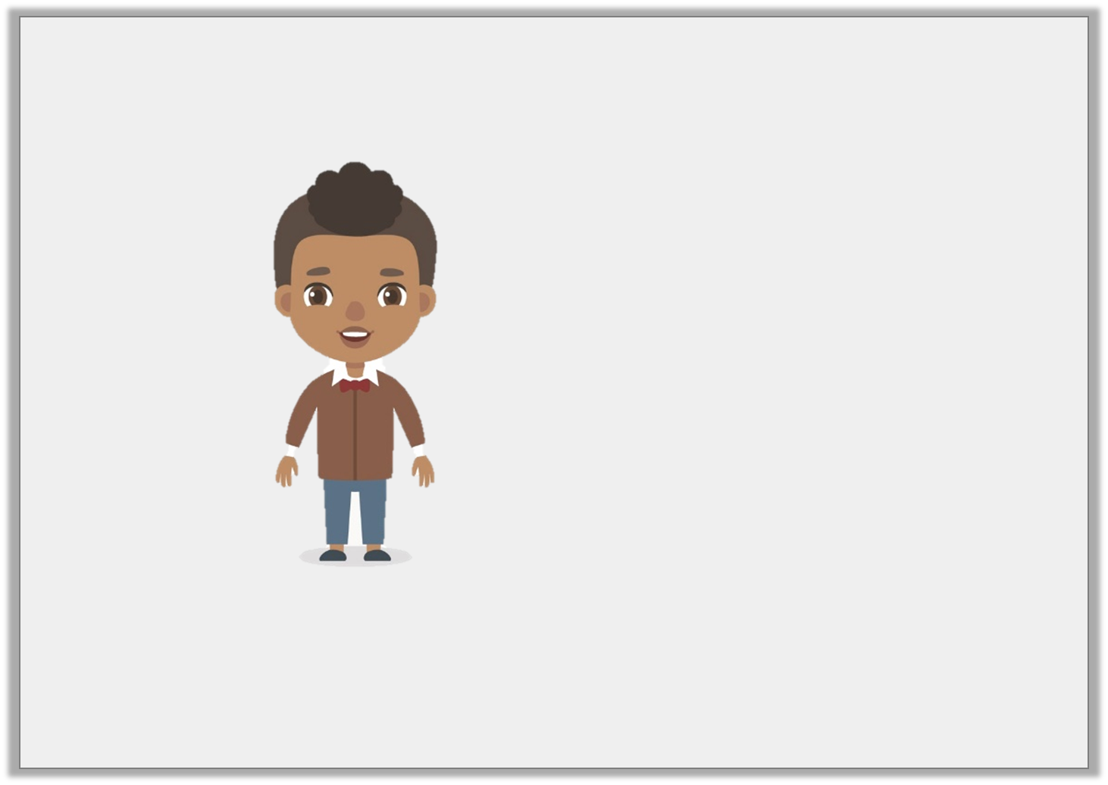
Reasoning 1
Josh says,
Is Josh right? Convince me.
All square numbers are odd.

Slide 35
Reasoning 1
Josh says,
Is Josh right? Convince me.
Josh is not correct because…
All square numbers are odd.

Slide 36
Reasoning 1
Josh says,
Is Josh right? Convince me.
Josh is not correct because there are square numbers which are even. For example, 4² = 16.
All square numbers are odd.

Slide 37
Wednesday 24th June 2020
L.O: to recognise and use cube numbers
Revise cube numbers before going through the slides:
https://www.youtube.com/watch?v=BIuJv-WDR_w

Slide 38
Introduction
Sort the numbers into the correct place in the chart.
Square number | Not a square number
4 | 12 | 9 | 14 | 40 | 1
81 | 49 | 88 | 144 | 90 | 121

Slide 39
Introduction
Sort the numbers into the correct place in the chart.
Square number | Not a square number
4, 9, 1, 81, 49, 144, 121 | 12, 14, 40, 88, 90
4 | 12 | 9 | 14 | 40 | 1
81 | 49 | 88 | 144 | 90 | 121

Slide 40
Varied Fluency 1
Match the numbers to their cube numbers.
7³ |  | 1,331
11³ |  | 64
4³ |  | 343

Slide 41
Varied Fluency 1
Match the numbers to their cube numbers.
7³ |  | 1,331
11³ |  | 64
4³ |  | 343

Slide 42
Varied Fluency 2
Use <, > or = to complete the statements below.
6³ |  | 343
730 |  | 9³

Slide 43
Varied Fluency 2
Use <, > or = to complete the statements below.
6³ | < | 343
730 | > | 9³

Slide 44
Varied Fluency 3
Circle the cube numbers.
123 | 333 | 99
342 | 218 | 125
512 | 33 | 513

Slide 45
Varied Fluency 3
Circle the cube numbers.
123 | 333 | 99
342 | 218 | 125
512 | 33 | 513

Slide 46
Varied Fluency 4
Solve the calculations below.
5³ | + | 6³ | =
12³ | – | 3³ | =

Slide 47
Varied Fluency 4
Solve the calculations below.
5³ | + | 6³ | = | 341
12³ | – | 3³ | = | 1,701

Slide 48
Reasoning 1
Circle the odd one out.
6³ + 146
8³ – 150
12³ + 235
Explain your reasoning.

Slide 49
Reasoning 1
Circle the odd one out.
6³ + 146
8³ – 150
12³ + 235
Explain your reasoning.
12³ + 235 is the odd one out because…

Slide 50
Reasoning 1
Circle the odd one out.
6³ + 146
8³ – 150
12³ + 235
Explain your reasoning.
12³ + 235 is the odd one out because the answer is 1,963. The answer to the other calculations is 362.
=
362
=
362
=
1,963

Slide 51
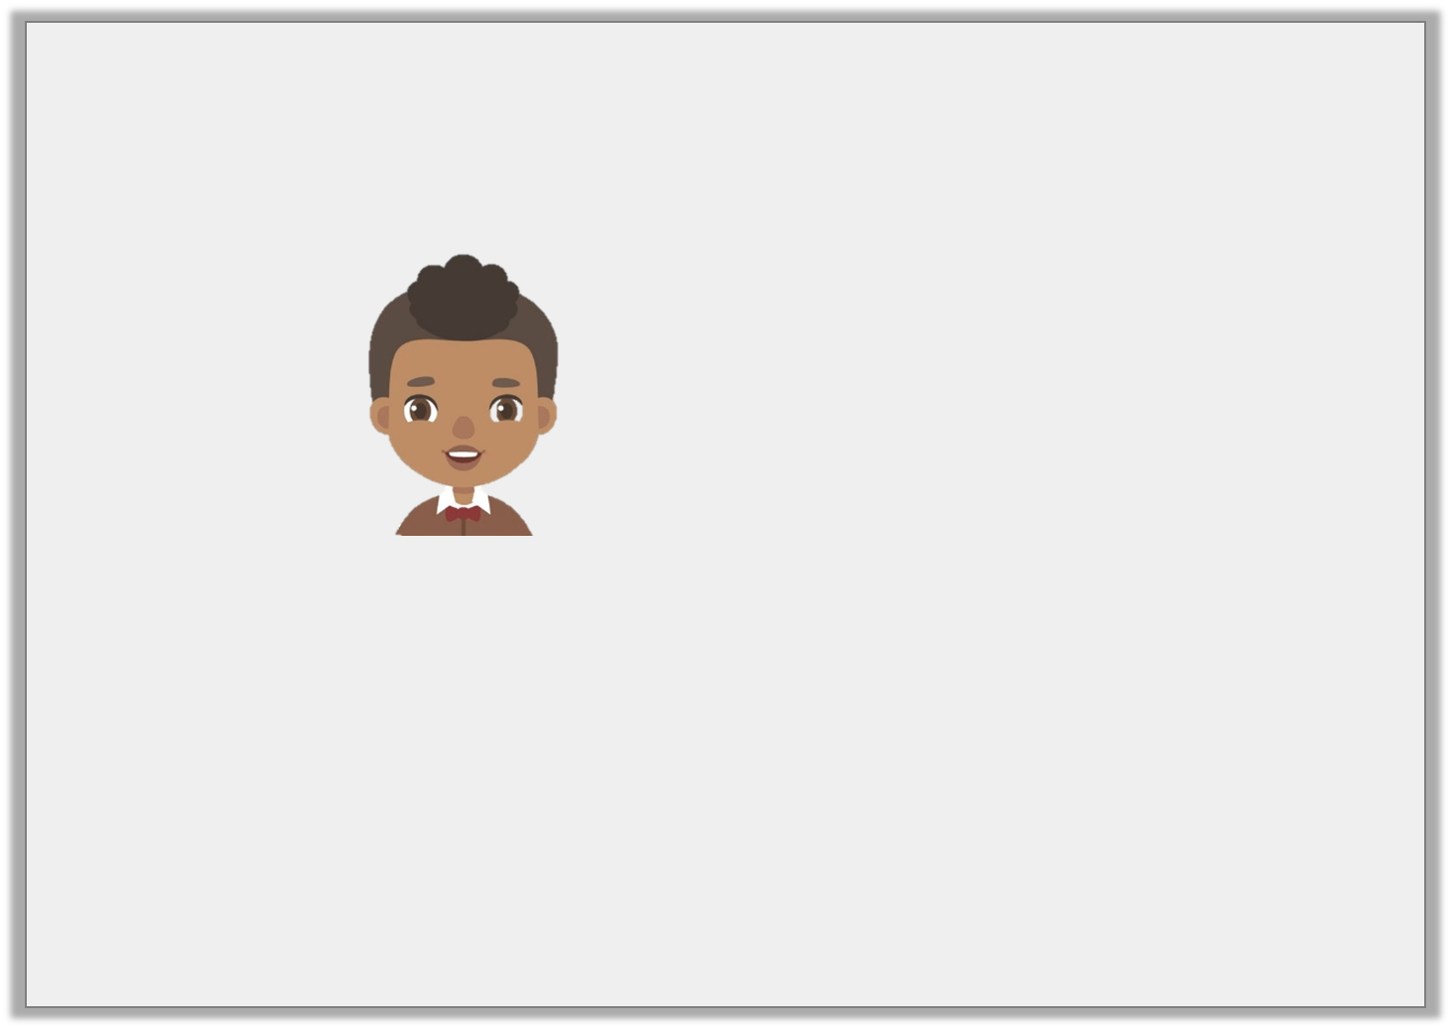
Reasoning 2
Jamal says,
Is he correct? Prove it.
The number 343 is a cube number.

Slide 52
Reasoning 2
Jamal says,
Is he correct? Prove it.
Jamal is correct because…
The number 343 is a cube number.

Slide 53
Reasoning 2
Jamal says,
Is he correct? Prove it.
Jamal is correct because when the number 7 is multiplied by itself and then by itself again, the product is 343.
The number 343 is a cube number.

Slide 54
Problem Solving 1
Solve the word problem below.
I am thinking of a number.
If I cube my number, then take away 331, I get another cube number.
What number am I thinking of?

Slide 55
Problem Solving 1
Solve the word problem below.
I am thinking of the number 11.
11³ = 1,331
1,331 – 331 = 1,000
I am thinking of a number.
If I cube my number, then take away 331, I get another cube number.
What number am I thinking of?

Slide 56
Thursday 25th June 2020
L.O: to identify simple algebraic rules
Watch the short presentation on introduction to algebra:
https://www.youtube.com/watch?v=I1JTiWmPHFM

Slide 57
Introduction
Match the starting number with the number that is 11 more.
3
73
622
118
89
35
84
129
633
100
14
46

Slide 58
Introduction
Match the starting number with the number that is 11 more.
3
73
622
118
89
35
84
129
633
100
14
46

Slide 59
Varied Fluency 1
Match the function to its equivalent algebraic rule.
Triple g
5g
Multiply g by 5
3g
Negative g
-g
2.1 less than g
g – 2.1

Slide 60
Varied Fluency 1
Match the function to its equivalent algebraic rule.
Triple g
5g
Multiply g by 5
3g
Negative g
-g
2.1 less than g
g – 2.1

Slide 61
Varied Fluency 2
Circle the function being used here.
7
49
3
?
9
2.5
6.25
2y |  | y² |  | 3y

Slide 62
Varied Fluency 2
Circle the function being used here.
7
49
3
?
9
2.5
6.25
2y |  | y² |  | 3y

Slide 63
Varied Fluency 3
Work out the missing inputs and outputs for this function machine.
11
- 2
?
?
45.2
g
?

Slide 64
Varied Fluency 3
Work out the missing inputs and outputs for this function machine.
11
- 2
9
47.2
45.2
g
g – 2

Slide 65
Varied Fluency 4
Match the equation to its answer if k = 12.5
3k
6.25
k – 9
37.5
19 – k
6.5
k ÷ 2
3.5

Slide 66
Varied Fluency 4
Match the equation to its answer if k = 12.5
3k
6.25
k – 9
37.5
19 – k
6.5
k ÷ 2
3.5

Slide 67
Friday 25th June 2020
L.O: to use simple algebraic rules
Watch the short presentation on how to solve a one-step algebraic equation:
https://www.youtube.com/watch?v=L0_K89UJfJY

Slide 68
Problem Solving 1
Janet has 3 times as many marbles as Luke.
If Luke has z marbles, which of these are true?
If Luke has 10 marbles, Janet has 30
Janet has z + 3 marbles
Janet has z ÷ 3 marbles

Slide 69
Problem Solving 1
Janet has 3 times as many marbles as Luke.
If Luke has z marbles, which of these are true?
If Luke has 10 marbles, Janet has 30
Janet has z + 3 marbles
Janet has z ÷ 3 marbles

Slide 70
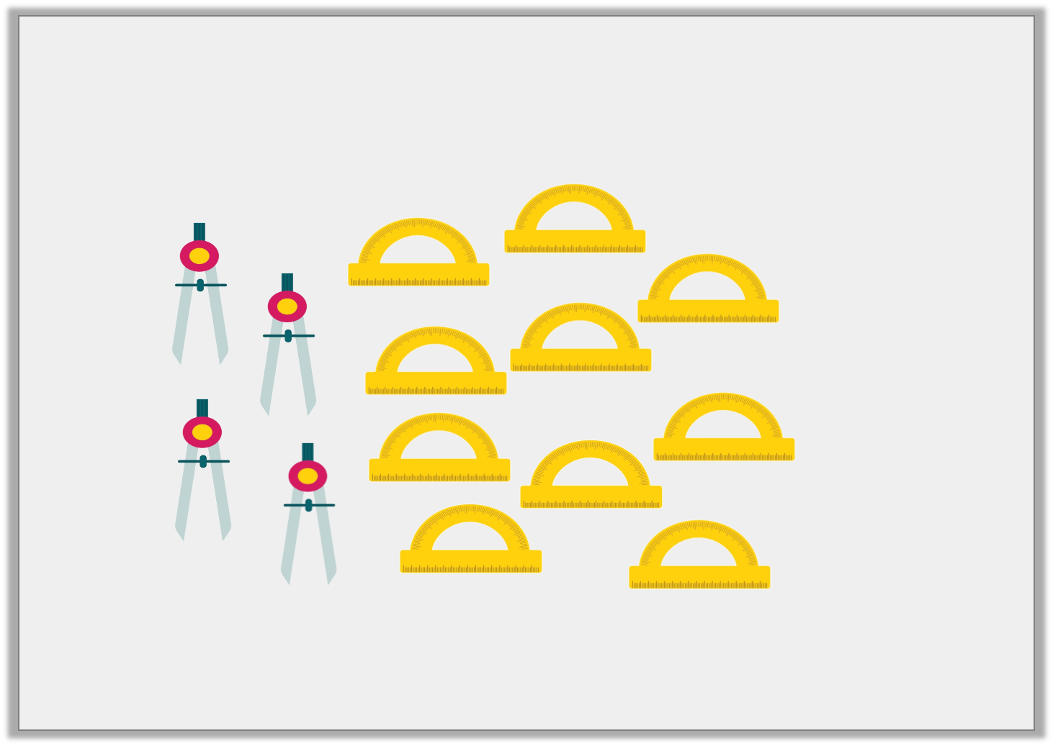
Problem Solving 2
Write an algebraic expression to show how many protractors there are if compasses equals c.

Slide 71
Problem Solving 2
Write an algebraic expression to show how many protractors there are if compasses equals c.
Various possible answers; for example: c + 6, 2.5c, c x .
5
2

Slide 72
Reasoning 1
Four of the cards are inputs or outputs of the function machine.
Circle the odd one out.
Explain your reasoning.
6.2
27
12
18.6
9
?
÷ 3
?

Slide 73
Reasoning 1
Four of the cards are inputs or outputs of the function machine.
Circle the odd one out.
Explain your reasoning.
12 is the odd one out because…
6.2
27
12
18.6
9
?
÷ 3
?

Slide 74
Reasoning 1
Four of the cards are inputs or outputs of the function machine.
Circle the odd one out.
Explain your reasoning.
12 is the odd one out because 18.6 ÷ 3 = 6.2 and 27 ÷ 3 = 9.
12 ÷ 3 = 4 and 36 ÷ 3 = 12 but there is not a number card for 4 or 36.
6.2
27
12
18.6
9
?
÷ 3
?

