Slide 1

Year 3/4 – Summer Block 2 – Statistics
Step 3 Tuesday 23rd June 20
Year 3/4
Lo: I can solve comparison, sum and difference problems using information presented in bar charts, pictograms, tables and other graphs

Slide 2
Introduction
 | A full circle represents 20 children.
 | Three quarters of a circle represents _____ children.
 | Half of a circle represents _____ children.
 | A quarter of a circle represents _____ children.
Y4

Slide 3
Introduction
 | A full circle represents 20 children.
 | Three quarters of a circle represents 15 children.
 | Half of a circle represents 10 children.
 | A quarter of a circle represents 5 children.
Y4

Slide 4
Varied Fluency 1
Use the table to calculate the number of tickets bought altogether.
Sort the films in order from the most to least popular.
Monday’s Cinema Ticket Sales
Film | Tickets
Attack of the Robots | 60
Frostbite | 30
True Love | 40
The Great Adventure | 70
Y4

Slide 5
Varied Fluency 1
Use the table to calculate the number of tickets bought altogether.
200
Sort the films in order from the most to least popular.
The Great Adventure, Attack of the Robots, True Love, Frostbite
Monday’s Cinema Ticket Sales
Film | Tickets
Attack of the Robots | 60
Frostbite | 30
True Love | 40
The Great Adventure | 70
Y4

Slide 6
Varied Fluency 2
Complete the sentences below.
On average, Tom drinks _______ ml more water than Ali.
Jess drinks _______ ml less water than Fay.
Average Water Intake During PE
Tom |  |  | Jess |  |  | Ali |  |  | Fay
80
60
40
20
ml
Y4

Slide 7
Varied Fluency 2
Complete the sentences below.
On average, Tom drinks 20 ml more water than Ali.
Jess drinks 20 ml less water than Fay.
Average Water Intake During PE
Tom |  |  | Jess |  |  | Ali |  |  | Fay
80
60
40
20
ml
Y4

Slide 8
Varied Fluency 3
Calculate the difference between the
number of pears and apples grown.
Which two fruits total 55?
Fruits Grown at Farley Farm Each Year
Strawberries | Pears | Oranges | Apples
= 10 fruits
Y4

Slide 9
Varied Fluency 3
Calculate the difference between the
number of pears and apples grown.
10
Which two fruits total 55?
Oranges and apples
Fruits Grown at Farley Farm Each Year
Strawberries | Pears | Oranges | Apples
= 10 fruits
Y4

Slide 10
Lo: I can solve problem solving using using information presented in bar charts, pictograms, tables and other graphs
Wednesday 24th June 2020

Slide 11

Reasoning 1
Kate says,
Is she correct? Convince me.
There were 20 more votes for consoles than phones.
KS2’s Favourite Gadgets
Laptop
Console
Tablet
Phone
0 | 20 | 40 | 60 | 80 | 100 | 120
Y4

Slide 12
Reasoning 1
Kate says,
Is she correct? Convince me.
Kate is not correct because…
There were 20 more votes for consoles than phones.
KS2’s Favourite Gadgets
Laptop
Console
Tablet
Phone
0 | 20 | 40 | 60 | 80 | 100 | 120
Y4

Slide 13
Reasoning 1
Kate says,
Is she correct? Convince me.
Kate is not correct because there were 90 votes for consoles and 80 votes for phones, so there were 10 more votes for consoles than phones.
There were 20 more votes for consoles than phones.
KS2’s Favourite Gadgets
Laptop
Console
Tablet
Phone
0 | 20 | 40 | 60 | 80 | 100 | 120
Y4

Slide 14
Reasoning 2
Circle the odd one out of A, B and C.
A. 250 people voted for their favourite treats.
B. Crisps received the highest number of votes.
C. 60 people voted for sweets.
Explain your reasoning.
Favourite Treats | Votes
Chocolate | 80
Sweets | 60
Biscuits | 30
Crisps | 90
Y4

Slide 15
Reasoning 2
Circle the odd one out of A, B and C.
A. 250 people voted for their favourite treats.
B. Crisps received the highest number of votes.
C. 60 people voted for sweets.
Explain your reasoning.
A is the odd one out because…
Favourite Treats | Votes
Chocolate | 80
Sweets | 60
Biscuits | 30
Crisps | 90
Y4

Slide 16
Reasoning 2
Circle the odd one out of A, B and C.
A. 250 people voted for their favourite treats.
B. Crisps received the highest number of votes.
C. 60 people voted for sweets.
Explain your reasoning.
A is the odd one out because it is incorrect. 260 people voted for their favourite treats.
Favourite Treats | Votes
Chocolate | 80
Sweets | 60
Biscuits | 30
Crisps | 90
Y4

Slide 17
Problem Solving 1
Fill in the missing data.
There were more donkeys than llamas, but fewer donkeys than goats.
There were 20 more ponies than llamas.
Animals at the Petting Zoo
Ponies | Llamas | Donkeys | Goats
= 10 animals
Y4

Slide 18
Problem Solving 1
Fill in the missing data.
There were more donkeys than llamas, but fewer donkeys than goats.
There were 20 more ponies than llamas.
Animals at the Petting Zoo
Ponies | Llamas | Donkeys | Goats
= 10 animals
Y4

Slide 19
Thursday 25th June 2020

Slide 20
Year 3 – Spring Block 3 –Statistics
Step 4
Year 3/4: I can interpret and present data using bar charts, pictograms and tables

Slide 21
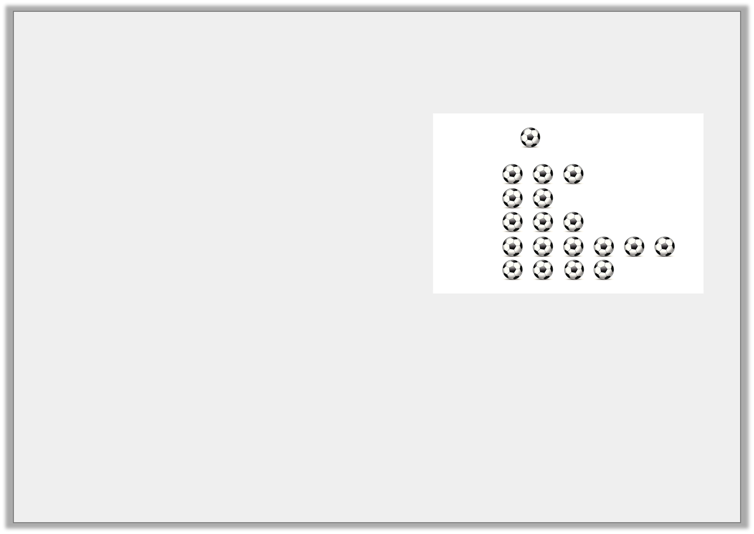
Introduction
Which two show the same data?
12
10
8
6
4
2
0
= 2 people
netball
hockey
rugby
swimming
tennis
tennis | swimming | rugby | hockey | netball
 | Men | Women | Total
Running | 11 | 42 | 53
Gym | 48 | 55 | 103
Swimming | 16 | 32 | 48
No exercise | 25 | 12 | 37
Y3

Slide 22
Introduction
Which two show the same data?
12
10
8
6
4
2
0
= 2 people
netball
hockey
rugby
swimming
tennis
tennis | swimming | rugby | hockey | netball
tennis | swimming | rugby | hockey | netball
 | Men | Women | Total
Running | 11 | 42 | 53
Gym | 48 | 55 | 103
Swimming | 16 | 32 | 48
No exercise | 25 | 12 | 37
Y3

Slide 23
Varied Fluency 1
Use the table to answer the questions about favourite colours.
a. Which was the most popular colour?
b. Which colours do the girls prefer?
c. Is purple a boy’s favourite?
d. Which is the most unpopular colour?
 | Green | Red | Yellow | Blue | Purple
Jane | ●
Mark |  |  |  | ●
Michael |  |  |  | ●
Charlotte |  | ●
Emily |  |  |  |  | ●
Y3

Slide 24
Varied Fluency 1
Use the table to answer the questions about favourite colours.
a. Which was the most popular colour?
Blue
b. Which colours do the girls prefer?
Green, red and purple
c. Is purple a boy’s favourite?
No
d. Which is the most unpopular colour?
yellow
 | Green | Red | Yellow | Blue | Purple
Jane | ●
Mark |  |  |  | ●
Michael |  |  |  | ●
Charlotte |  | ●
Emily |  |  |  |  | ●
Y3

Slide 25
Varied Fluency 2
The table below shows the results of football matches.
a. Which two teams have won the most matches?
b. Which team is the least successful?
c. What is the most common result of the matches?
 | win | draw | lose
Northfield AFC | 6 | 2 | 1
Wetherton Juniors | 4 | 1 | 4
Jumpleby Town | 3 | 2 | 4
Y3

Slide 26
Varied Fluency 2
The table below shows the results of football matches.
a. Which two teams have won the most matches?
Northfield AFC and Wetherton Juniors
b. Which team is the least successful?
Jumpleby Town
c. What is the most common result of the matches?
Win
 | win | draw | lose
Northfield AFC | 6 | 2 | 1
Wetherton Juniors | 4 | 1 | 4
Jumpleby Town | 3 | 2 | 4
Y3

Slide 27
Varied Fluency 3
The table shows the results of a breakfast survey.
a. How many males eat toast?
b. Which was the second least popular breakfast amongst females?
c. How many people have nothing for breakfast?
d. What was the most popular breakfast for both boys and girls?
 | toast | cereal | porridge | fruit | nothing
Boys | 3 | 13 | 6 | 4 | 6
Girls | 2 | 14 | 8 | 6 | 2
Men | 12 | 5 | 7 | 3 | 10
Women | 3 | 9 | 17 | 11 | 0
Y3

Slide 28
Varied Fluency 3
The table shows the results of a breakfast survey.
a. How many males eat toast?
15
b. Which was the second least popular breakfast amongst females?
Toast
c. How many people have nothing for breakfast?
18
d. What was the most popular breakfast for both boys and girls?
Cereal
 | toast | cereal | porridge | fruit | nothing
Boys | 3 | 13 | 6 | 4 | 6
Girls | 2 | 14 | 8 | 6 | 2
Men | 12 | 5 | 7 | 3 | 10
Women | 3 | 9 | 17 | 11 | 0
Y3

Slide 29
Lo: I can interpret and present data using bar charts, pictograms and tables
Friday 26th June 2020

Slide 30
Problem Solving 1
The table shows how many house points each pupil receives each time they do well at school. The number of points increase each time by 4 each time. They have a maximum of ten rewards.
Complete the table and answer the questions.
a. How many house points will a child have if they get the reward 5 times?
b. The maximum number of house points a child could receive is higher than 200. True or false?
Rewards | 1 | 2 | 3 | 4 | 5 | 6 | 7 | 8 | 9 | 10
Number of House points | 1 | 5
Y3

Slide 31
Problem Solving 1
The table shows how many house points each pupil receives each time they do well at school. The number of points increase each time by 4 each time. They have a maximum of ten rewards.
Complete the table and answer the questions.
a. How many house points will a child have if they get the reward 5 times? 45
b. The maximum number of house points a child could receive is higher than 200. True or false? False.
Rewards | 1 | 2 | 3 | 4 | 5 | 6 | 7 | 8 | 9 | 10
Number of House points | 1 | 5 | 9 | 13 | 17 | 21 | 25 | 29 | 33 | 37
Y3

Slide 32
Problem Solving 2
Liberty writes the following statements using the information in the table, spot three mistakes she has made.
There are 80 animals in the two addresses.
There is an even number of cats in both addresses.
There are more dogs than cats.
There is one even and one odd number of dogs.
 | Lowdale Avenue | Sunnyvale Drive | Total animals
Dogs | 13 | 31 | 44
Cats | 23 | 15 | 38
Y3

Slide 33
Problem Solving 2
Liberty writes the following statements using the information in the table, spot three mistakes she has made.
There are 80 animals in the two addresses.
There is an even number of cats in both addresses.
There are more dogs than cats.
There is one even and one odd number of dogs.
Error 1: There are 82 animals in total.
Error 2: There are an odd number of cats at both addresses.
Error 3: There are two odd numbers of dogs.
 | Lowdale Avenue | Sunnyvale Drive | Total animals
Dogs | 13 | 31 | 44
Cats | 23 | 15 | 38
Y3

Slide 34
Reasoning 1
Olly creates some questions about the table below.
How many people support Eastlee?
How many supporters go to every game?
How many more people support Northend than Southam?
Which of Olly’s questions cannot be answered using the table? Explain why not.
 | Eastlee | Southham | Westprom | Northend
Children | 19 | 12 | 28 | 30
Adults | 20 | 45 | 52 | 54
Y3

Slide 35
Reasoning 1
Olly creates some questions about the table below.
How many people support Eastlee?
How many supporters go to every game?
How many more people support Northend than Southam?
Which of Olly’s questions cannot be answered using the table? Explain why not.
This cannot be answered because...
 | Eastlee | Southham | Westprom | Northend
Children | 19 | 12 | 28 | 30
Adults | 20 | 45 | 52 | 54
Y3

Slide 36
Reasoning 1
Olly creates some questions about the table below.
How many people support Eastlee?
How many supporters go to every game?
How many more people support Northend than Southam?
Which of Olly’s questions cannot be answered using the table? Explain why not.
This cannot be answered because the table does not include that information.
 | Eastlee | Southham | Westprom | Northend
Children | 19 | 12 | 28 | 30
Adults | 20 | 45 | 52 | 54
Y3

