Slide 1
Year 3 – Summer Block 2 – Statistics
16th June 2020
Step 1
Year 3/4: I can interpret data on pictograms

Slide 2
Introduction
Jack has used this tally chart to draw the pictogram.
Has he interpreted the tally chart correctly? What errors can you find?
Pizzas Sold | Number of Pizzas
Cheese
Pepperoni
Chicken
Veggie
Pizzas Sold | Number of Pizzas
Cheese
Pepperoni
Chicken
Veggie
Key: = 10 children
Y3

Slide 3
Introduction
Jack has used this tally chart to draw the pictogram.
Has he interpreted the tally chart correctly? What errors can you find?
No, Jack has not interpreted the tally chart correctly.
He should have drawn 3 circles for cheese, 2 circles for pepperoni, 2 and a half circles for chicken and 4 circles for veggie.
Pizzas Sold | Number of Pizzas
Cheese
Pepperoni
Chicken
Veggie
Pizzas Sold | Number of Pizzas
Cheese
Pepperoni
Chicken
Veggie
Key: = 10 children
Y3

Slide 4
Varied Fluency 1
Complete the missing sections using the information below.
Favourite Subject | Number of Children
Maths
English
Science
Art
PE
Key: 1 picture = 2 children
A. | 5 more children like science than maths.
B. | Half as many children like art than science.
C. | Twice as many children like PE than art.
Y3

Slide 5
Varied Fluency 1
Complete the missing sections using the information below.
Favourite Subject | Number of Children
Maths
English
Science
Art
PE
Key: 1 picture = 2 children
A. | 5 more children like science than maths.
B. | Half as many children like art than science.
C. | Twice as many children like PE than art.
A. | 8 pictures for science
B. | 4 pictures for art
C. | 8 pictures for PE
Y3

Slide 6
Varied Fluency 2
Answer the questions about the pints of milk sold.
Day | Number of pints of milk sold
Monday
Tuesday
Wednesday
Thursday
Friday
Key: 1 picture = 5 pints
A. | How many pints were sold on Monday?
B. | How many more pints were sold on Thursday than on Tuesday?
C. | How many pints were sold in total?
D. | How many fewer pints were sold on Wednesday than on Monday?
Y3

Slide 7
Varied Fluency 2
Answer the questions about the pints of milk sold.
Day | Number of pints of milk sold
Monday
Tuesday
Wednesday
Thursday
Friday
Key: 1 picture = 5 pints
A. | How many pints were sold on Monday? 42.5
B. | How many more pints were sold on Thursday than on Tuesday? 7.5
C. | How many pints were sold in total?107.5
D. | How many fewer pints were sold on Wednesday than on Monday? 12.5
Y3

Slide 8
Wednesday 17th June 20 Year 3/4: I can interpret data on pictograms

Slide 9
Reasoning 1
True or false? The pictogram below shows the results
of the tally chart.
Explain your answer.
Drink | Number of Drinks Sold
Juice
Water
Milk
Lemonade
Drink | Number of Drinks Sold
Juice
Water
Milk
Lemonade
Key: = 2 drinks
Y3

Slide 10
Reasoning 1
True or false? The pictogram below shows the results
of the tally chart.
Explain your answer.
False because…
Drink | Number of Drinks Sold
Juice
Water
Milk
Lemonade
Drink | Number of Drinks Sold
Juice
Water
Milk
Lemonade
Key: = 2 drinks
Y3

Slide 11
Reasoning 1
True or false? The pictogram below shows the results
of the tally chart.
Explain your answer.
False because there should be 1 more picture for juice, 4 more pictures for water, 4 more pictures for milk and 2 and a half fewer pictures for lemonade.
Drink | Number of Drinks Sold
Juice
Water
Milk
Lemonade
Drink | Number of Drinks Sold
Juice
Water
Milk
Lemonade
Key: = 2 drinks
Y3

Slide 12
Problem Solving 1
Anika is drawing a pictogram where one picture = 5 children.
Anika knows more children have a birthday in winter than spring, but fewer children have a birthday in winter than autumn.
Complete the pictogram showing one of the possibilities.
Season | Number of Birthdays
Spring
Summer
Autumn
Winter
Y3

Slide 13
Problem Solving 1
Anika is drawing a pictogram where one picture = 5 children.
Anika knows more children have a birthday in winter than spring, but fewer children have a birthday in winter than autumn.
Complete the pictogram showing one of the possibilities.
Various answers, for example: 2 pictures for winter and 1 picture for spring
Season | Number of Birthdays
Spring
Summer
Autumn
Winter
Y3

Slide 14
Reasoning 1
Archie draws a pictogram to show KS2’s favourite playground games. Each child voted once.
Is he correct? Explain your answer.
Games | Number of Children 1 picture = 10 children
Tig
Skipping
Hopscotch
Football
A quarter of the number of children that voted tig, voted football.
Y3

Slide 15
Reasoning 1
Archie draws a pictogram to show KS2’s favourite playground games. Each child voted once.
Is he correct? Explain your answer.
Archie is incorrect because…
Games | Number of Children 1 picture = 10 children
Tig
Skipping
Hopscotch
Football
A quarter of the number of children that voted tig, voted football.
Y3

Slide 16
Reasoning 1
Archie draws a pictogram to show KS2’s favourite playground games. Each child voted once.
Is he correct? Explain your answer.
Archie is incorrect because 30 is not a quarter of 80.
Games | Number of Children 1 picture = 10 children
Tig
Skipping
Hopscotch
Football
A quarter of the number of children that voted tig, voted football.
Y3

Slide 17
Year 4: I can present and interpret data using charts
Thursday 18th June 2020

Slide 18
Introduction
What is each increment worth on these scales?
0 |  |  |  |  | 10 |  |  |  |  | 20
0 |  |  |  |  |  |  |  |  |  | 100
0 |  |  |  |  | 25 |  |  |  |  | 50
0 |  |  |  |  | 20 |  |  |  |  | 40
Y4

Slide 19
Introduction
What is each increment worth on these scales?
0 | 2 | 4 | 6 | 8 | 10 | 12 | 14 | 16 | 18 | 20
0 | 10 | 20 | 30 | 40 | 50 | 60 | 70 | 80 | 90 | 100
0 | 5 | 10 | 15 | 20 | 25 | 30 | 35 | 40 | 45 | 50
0 | 4 | 8 | 12 | 16 | 20 | 24 | 28 | 32 | 36 | 40
Y4

Slide 20
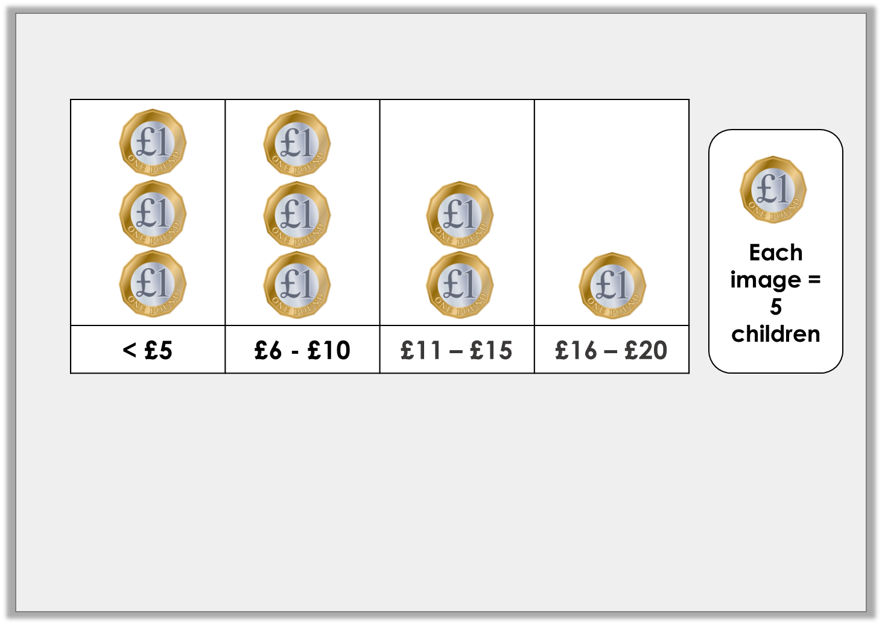
Varied Fluency 1
Look at this pictogram.
Complete the missing information in the table.
Pocket Money
< £5 | £6 – £10 | £11 – £15 | £16 – £20
 |  | 10
Y4

Slide 21
Varied Fluency 1
Look at this pictogram.
Complete the missing information in the table.
Pocket Money
< £5 | £6 – £10 | £11 – £15 | £16 – £20
15 | 15 | 10 | 5
Y4

Slide 22
Varied Fluency 2
Think of one question to ask about the information in this tally chart:
Holiday Destinations
UK
Europe
Rest of the World
Y4

Slide 23
Varied Fluency 2
Think of one question to ask about the information in this tally chart:
Example answers:
How many people stayed in the UK for their holiday?
Which is the least popular destination?
How many people were asked in total?
How many more people stayed in the UK than travelled to Europe?
Holiday Destinations
UK
Europe
Rest of the World
Y4

Slide 24
Varied Fluency 3
Use the information in the table to create a bar chart.
Colour of Cars Passing the School
Silver | 35
Red | 40
Blue | 55
 | Silver |  | Red |  | Blue
Y4

Slide 25
Varied Fluency 3
Use the information in the table to create a bar chart.
Colour of Cars Passing the School
Silver | 35
Red | 40
Blue | 55
 | Silver |  | Red |  | Blue
Discuss which scale to use: 1s, 2s, 5s, 10s, 20s
How will you
show 35? 55?
Y4

Slide 26
Varied Fluency 3
Use the information in the table to create a bar chart.
Silver | 35
Red | 40
Blue | 55
Colour of Cars Passing the School
60
40
20
0
 | Silver |  | Red |  | Blue
Number of Trains
Time
Y4

Slide 27
Varied Fluency 4
Use the bar chart to answer the questions.
60
45
30
15
0
Cake Sales
How many cakes were sold on Monday?
What is the most cakes sold in one day?
On which day were the least amount of cakes sold?
Mon | Tues | Wed | Thurs | Fri
Y4

Slide 28
Varied Fluency 4
Use the bar chart to answer the questions.
60
45
30
15
0
Cake Sales
How many cakes were sold on Monday? 45
What is the most cakes sold in one day? 60 on Wednesday
On which day were the least amount of cakes sold? Tuesday and Thursday
Mon | Tues | Wed | Thurs | Fri
Y4

Slide 29
Year 4: I can interpret charts using reasoning and problem solving
Friday 19th June 2020

Slide 30
Reasoning 1
The school kitchen are collecting ideas for recipes by asking the children their favourite food.
Who do you agree with and why?
I want to use a pictogram to draw each meal.
Jayden
I think a choice of 4 meals and a bar chart would work best.
Hakeem
Y4

Slide 31
Reasoning 1
The school kitchen are collecting ideas for recipes by asking the children their favourite food.
Who do you agree with and why?
Hakeem has the best idea because…
I want to use a pictogram to draw each meal.
Jayden
I think a choice of 4 meals and a bar chart would work best.
Hakeem
Y4

Slide 32
Reasoning 1
The school kitchen are collecting ideas for recipes by asking the children their favourite food.
Who do you agree with and why?
Hakeem has the best idea; it will be quick and simple to collect the data and make people’s decision making much easier.
I want to use a pictogram to draw each meal.
Jayden
I think a choice of 4 meals and a bar chart would work best.
Hakeem
Y4

Slide 33
Reasoning 2
True or false?
Explain your answer.
The lines on a chart are called axels.
Y4

Slide 34
Reasoning 2
True or false?
Explain your answer.
False, the lines are called the y-axis and the x-axis
(or axes).
The lines on a chart are called axels.
Y4

Slide 35
Problem Solving 1
Mr Thompson says this tally chart is not easy to interpret.
Find 2 ways in which you could make the chart easier to interpret.
Height of Pupils in Oak Class
< 1 metre
> 1 metre
Y4

Slide 36
Problem Solving 1
Mr Thompson says this tally chart is not easy to interpret.
Find 2 ways in which you could make the chart easier to interpret.
The tally should be 5 strokes so counting is easier.
The options could be broken into smaller steps e.g. 90cm to 1m, 1m to 1.5m, 1.5 to 2m as the data is not very useful with such a large range.
Height of Pupils in Oak Class
< 1 metre
> 1 metre
Y4

