Slide 1
Year 3 – Summer Block 2 – Statistics
16th June 2020
Step 1
Year 3/4: I can interpret data on pictograms

Slide 2
Introduction
Jack has used this tally chart to draw the pictogram.
Has he interpreted the tally chart correctly? What errors can you find?
Pizzas Sold | Number of Pizzas
Cheese
Pepperoni
Chicken
Veggie
Pizzas Sold | Number of Pizzas
Cheese
Pepperoni
Chicken
Veggie
Key: = 10 children
Y3

Slide 3
Introduction
Jack has used this tally chart to draw the pictogram.
Has he interpreted the tally chart correctly? What errors can you find?
No, Jack has not interpreted the tally chart correctly.
He should have drawn 3 circles for cheese, 2 circles for pepperoni, 2 and a half circles for chicken and 4 circles for veggie.
Pizzas Sold | Number of Pizzas
Cheese
Pepperoni
Chicken
Veggie
Pizzas Sold | Number of Pizzas
Cheese
Pepperoni
Chicken
Veggie
Key: = 10 children
Y3

Slide 4
Varied Fluency 1
Complete the missing sections using the information below.
Favourite Subject | Number of Children
Maths
English
Science
Art
PE
Key: 1 picture = 2 children
A. | 5 more children like science than maths.
B. | Half as many children like art than science.
C. | Twice as many children like PE than art.
Y3

Slide 5
Varied Fluency 1
Complete the missing sections using the information below.
Favourite Subject | Number of Children
Maths
English
Science
Art
PE
Key: 1 picture = 2 children
A. | 5 more children like science than maths.
B. | Half as many children like art than science.
C. | Twice as many children like PE than art.
A. | 8 pictures for science
B. | 4 pictures for art
C. | 8 pictures for PE
Y3

Slide 6
Varied Fluency 2
Answer the questions about the pints of milk sold.
Day | Number of pints of milk sold
Monday
Tuesday
Wednesday
Thursday
Friday
Key: 1 picture = 5 pints
A. | How many pints were sold on Monday?
B. | How many more pints were sold on Thursday than on Tuesday?
C. | How many pints were sold in total?
D. | How many fewer pints were sold on Wednesday than on Monday?
Y3

Slide 7
Varied Fluency 2
Answer the questions about the pints of milk sold.
Day | Number of pints of milk sold
Monday
Tuesday
Wednesday
Thursday
Friday
Key: 1 picture = 5 pints
A. | How many pints were sold on Monday? 42.5
B. | How many more pints were sold on Thursday than on Tuesday? 7.5
C. | How many pints were sold in total?107.5
D. | How many fewer pints were sold on Wednesday than on Monday? 12.5
Y3

Slide 8
Wednesday 17th June 20 Year 3/4: I can interpret data on pictograms

Slide 9
Reasoning 1
True or false? The pictogram below shows the results
of the tally chart.
Explain your answer.
Drink | Number of Drinks Sold
Juice
Water
Milk
Lemonade
Drink | Number of Drinks Sold
Juice
Water
Milk
Lemonade
Key: = 2 drinks
Y3

Slide 10
Reasoning 1
True or false? The pictogram below shows the results
of the tally chart.
Explain your answer.
False because…
Drink | Number of Drinks Sold
Juice
Water
Milk
Lemonade
Drink | Number of Drinks Sold
Juice
Water
Milk
Lemonade
Key: = 2 drinks
Y3

Slide 11
Reasoning 1
True or false? The pictogram below shows the results
of the tally chart.
Explain your answer.
False because there should be 1 more picture for juice, 4 more pictures for water, 4 more pictures for milk and 2 and a half fewer pictures for lemonade.
Drink | Number of Drinks Sold
Juice
Water
Milk
Lemonade
Drink | Number of Drinks Sold
Juice
Water
Milk
Lemonade
Key: = 2 drinks
Y3

Slide 12
Problem Solving 1
Anika is drawing a pictogram where one picture = 5 children.
Anika knows more children have a birthday in winter than spring, but fewer children have a birthday in winter than autumn.
Complete the pictogram showing one of the possibilities.
Season | Number of Birthdays
Spring
Summer
Autumn
Winter
Y3

Slide 13
Problem Solving 1
Anika is drawing a pictogram where one picture = 5 children.
Anika knows more children have a birthday in winter than spring, but fewer children have a birthday in winter than autumn.
Complete the pictogram showing one of the possibilities.
Various answers, for example: 2 pictures for winter and 1 picture for spring
Season | Number of Birthdays
Spring
Summer
Autumn
Winter
Y3

Slide 14
Reasoning 1
Archie draws a pictogram to show KS2’s favourite playground games. Each child voted once.
Is he correct? Explain your answer.
Games | Number of Children 1 picture = 10 children
Tig
Skipping
Hopscotch
Football
A quarter of the number of children that voted tig, voted football.
Y3

Slide 15
Reasoning 1
Archie draws a pictogram to show KS2’s favourite playground games. Each child voted once.
Is he correct? Explain your answer.
Archie is incorrect because…
Games | Number of Children 1 picture = 10 children
Tig
Skipping
Hopscotch
Football
A quarter of the number of children that voted tig, voted football.
Y3

Slide 16
Reasoning 1
Archie draws a pictogram to show KS2’s favourite playground games. Each child voted once.
Is he correct? Explain your answer.
Archie is incorrect because 30 is not a quarter of 80.
Games | Number of Children 1 picture = 10 children
Tig
Skipping
Hopscotch
Football
A quarter of the number of children that voted tig, voted football.
Y3

Slide 17
Year 3/4 – Summer Block 2 – Statistics – Step 2
Thursday 18th June 2020
Step 2
Year 3: I can interpret and present data using bar charts

Slide 18
Introduction
How many blocks should be coloured on the bar chart for each house?
Key: = 10 points House Points
50
45
40
35
30
25
20
15
10
5
0
Red | Blue | Green | Yellow | Orange
 | House Points
Red House
Blue House
Green House
Yellow House
Orange House
Y3

Slide 19
Introduction
How many blocks should be coloured on the bar chart for each house?
Key: = 10 points House Points
50
45
40
35
30
25
20
15
10
5
0
Red | Blue | Green | Yellow | Orange
 | House Points
Red House
Blue House
Green House
Yellow House
Orange House
Y3
© Classroom Secrets Limited 2019

Slide 20
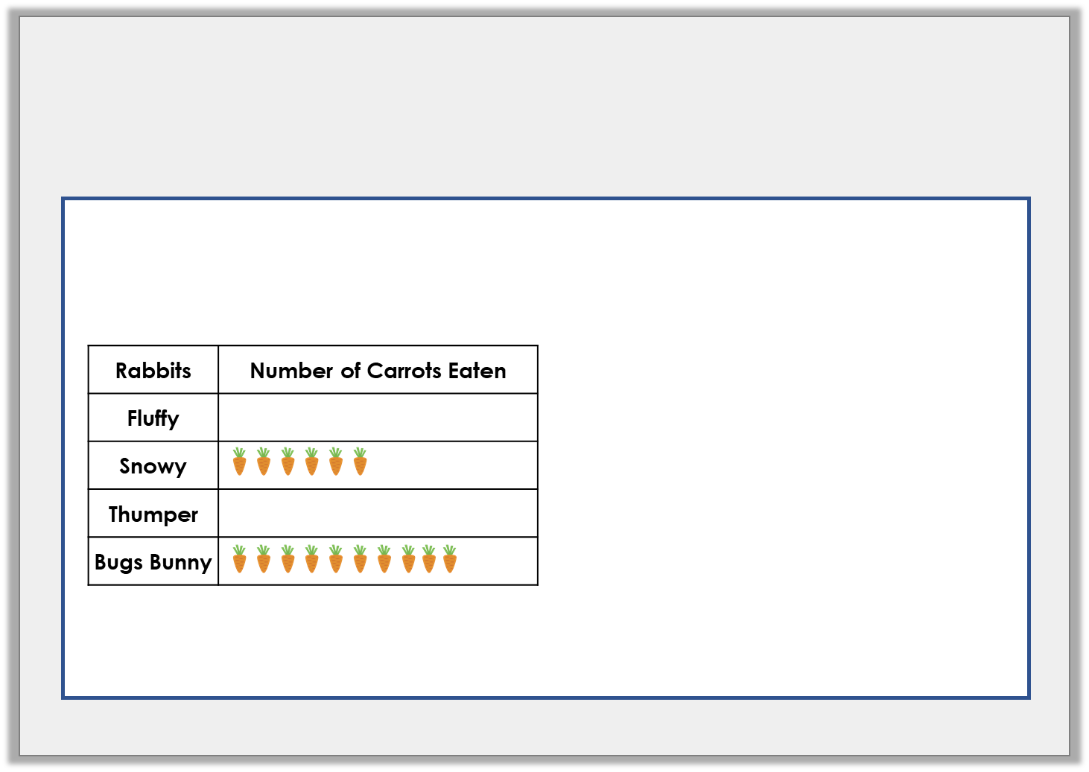
Varied Fluency 1
Use the information to complete the pictogram and the bar chart.
80
70
60
50
40
30
20
10
0
Fluffy | Snowy | Thumper | Bugs Bunny
1 picture = 5 carrots
Y3

Slide 21
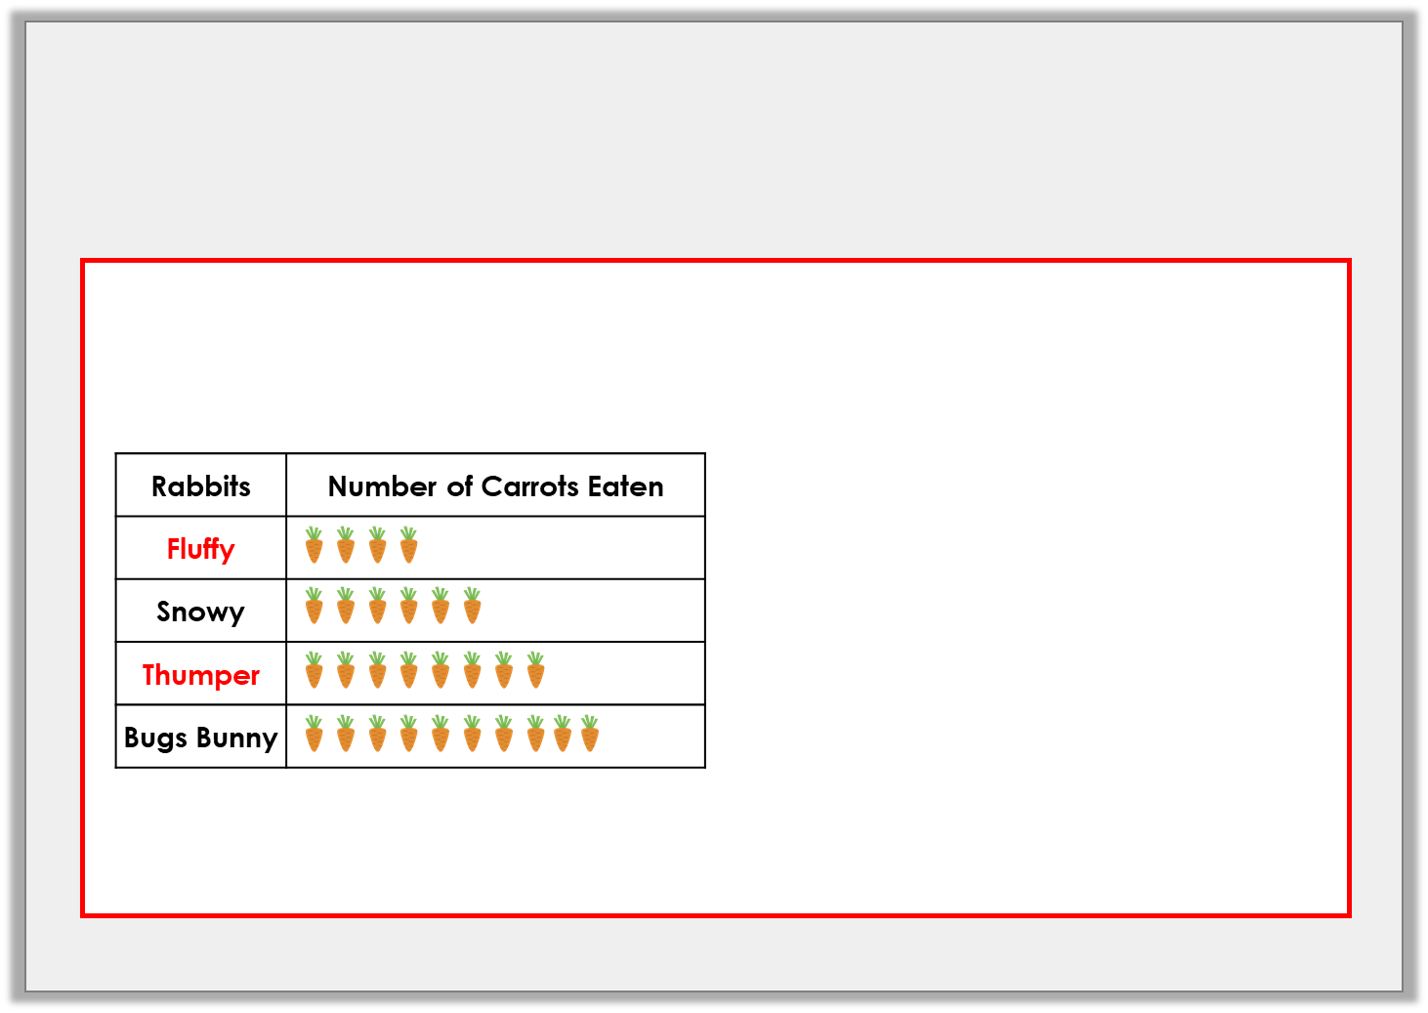
Varied Fluency 1
Use the information to complete the pictogram and the bar chart.
80
70
60
50
40
30
20
10
0
Fluffy | Snowy | Thumper | Bugs Bunny
1 picture = 5 carrots
Y3

Slide 22
Varied Fluency 2
Use this bar chart to answer the questions about goals scored in a tournament.
Which team scored the most goals?
B. How many more goals did Team A score than Team D?
C. How many goals did Teams C and E score altogether?
D. How many goals were scored in total?
35
30
25
20
15
10
5
0
Team A | Team B | Team C | Team D | Team E
Y3

Slide 23
Varied Fluency 2
Use this bar chart to answer the questions about goals scored in a tournament.
Which team scored the most goals?
B. How many more goals did Team A score than Team D?
C. How many goals did Teams C and E score altogether?
D. How many goals were scored in total?
35
30
25
20
15
10
5
0
Team A | Team B | Team C | Team D | Team E
Team E
15
45
85
Y3

Slide 24
Varied Fluency 3
Create a bar chart using this tally chart.
Write on the correct scale and labels.
Favourite Dinosaur | Number of Children
T-Rex
Triceratops
Raptor
Diplodocus
Y3

Slide 25
Varied Fluency 3
Create a bar chart using this tally chart.
Write on the correct scale and labels.
35
30
25
20
15
10
5
0
T-Rex | Tri | Raptor | Dip
Favourite Dinosaur | Number of Children
T-Rex
Triceratops
Raptor
Diplodocus
Y3

Slide 26
Year 3: I can interpret and present data using bar using reasoning and problem solving

Slide 27
Problem Solving 1
Here is a bar chart to show Year 3’s favourite drinks.
More children like juice than tea, but fewer like juice than milk. Complete the bar chart showing how many children could like tea and juice?
14
12
10
8
6
4
2
0
Water | Milk | Tea | Juice | Cola
Y3

Slide 28
Problem Solving 1
Here is a bar chart to show Year 3’s favourite drinks.
More children like juice than tea, but fewer like juice than milk. Complete the bar chart showing how many children could like tea and juice?
Various answers, for example:
2-10 children could like juice and tea must be fewer than juice.
14
12
10
8
6
4
2
0
Water | Milk | Tea | Juice | Cola
Y3

Slide 29
Reasoning 1
Ben draws a bar chart to show the Year 3 children's favourite type of PE lesson.
Ben says,
Is he correct? Explain your answer.
14
12
10
8
6
4
2
0
Gym | Dance | Games | Athletics
2 children like athletics.
Y3

Slide 30
Reasoning 1
Ben draws a bar chart to show the Year 3 children's favourite type of PE lesson.
Ben says,
Is he correct? Explain your answer.
Ben is not correct because…
14
12
10
8
6
4
2
0
Gym | Dance | Games | Athletics
2 children like athletics.
Y3

Slide 31
Reasoning 1
Ben draws a bar chart to show the Year 3 children's favourite type of PE lesson.
Ben says,
Is he correct? Explain your answer.
Ben is not correct because the scale goes up in 2s. 4 children like athletics.
14
12
10
8
6
4
2
0
Gym | Dance | Games | Athletics
2 children like athletics.
Y3

Slide 32
Problem Solving 2
A class collects data about houses.
Draw a bar chart to display this information. Choose a suitable scale.
5 more children live in a flat than in a terraced house.
5 children live in a detached house.
10 fewer children live in a terraced house than a semi.
20 children live in a semi-detached house.
Y3

Slide 33
Problem Solving 2
An accurate bar chart. The scale should go up in 5s.
35
30
25
20
15
10
5
0
Flat | Terraced | Semi | Detached
Y3

