Slide 1
Year 3/4 – Summer Block 3 – Time
Tuesday 9th June 2020
Step 5
Year 4: I can read, write and convert time between analogue and digital 12 – and 24-hour

Slide 2
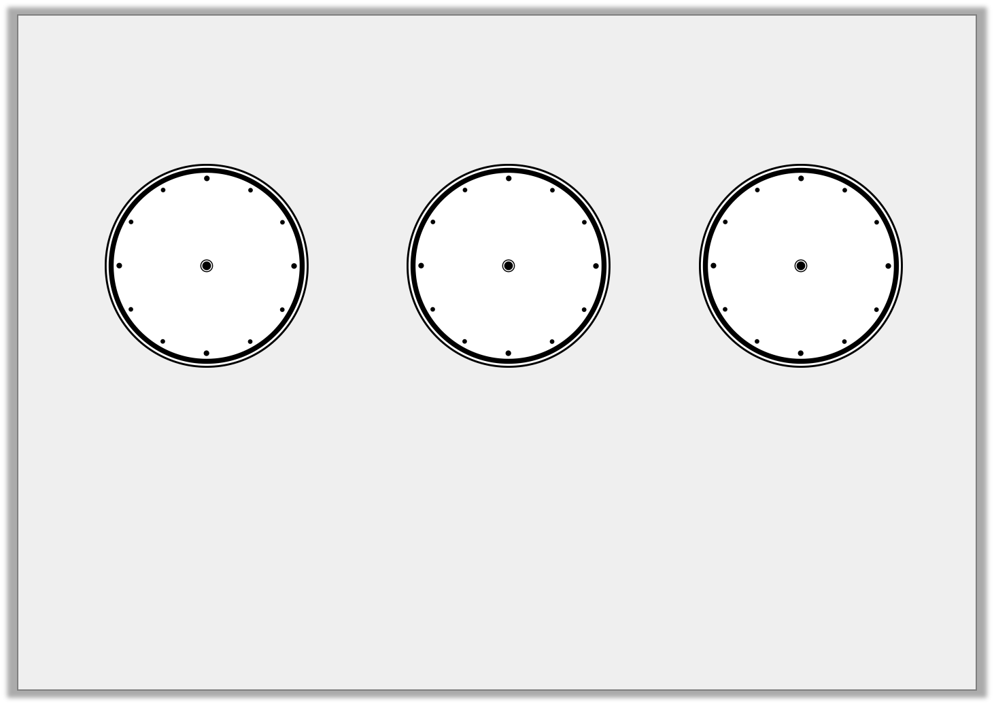
Introduction
Match the times.
9:17
12:21
3:46
Y4

Slide 3
Introduction
Match the times.
9:17
12:21
3:46
Y4

Slide 4
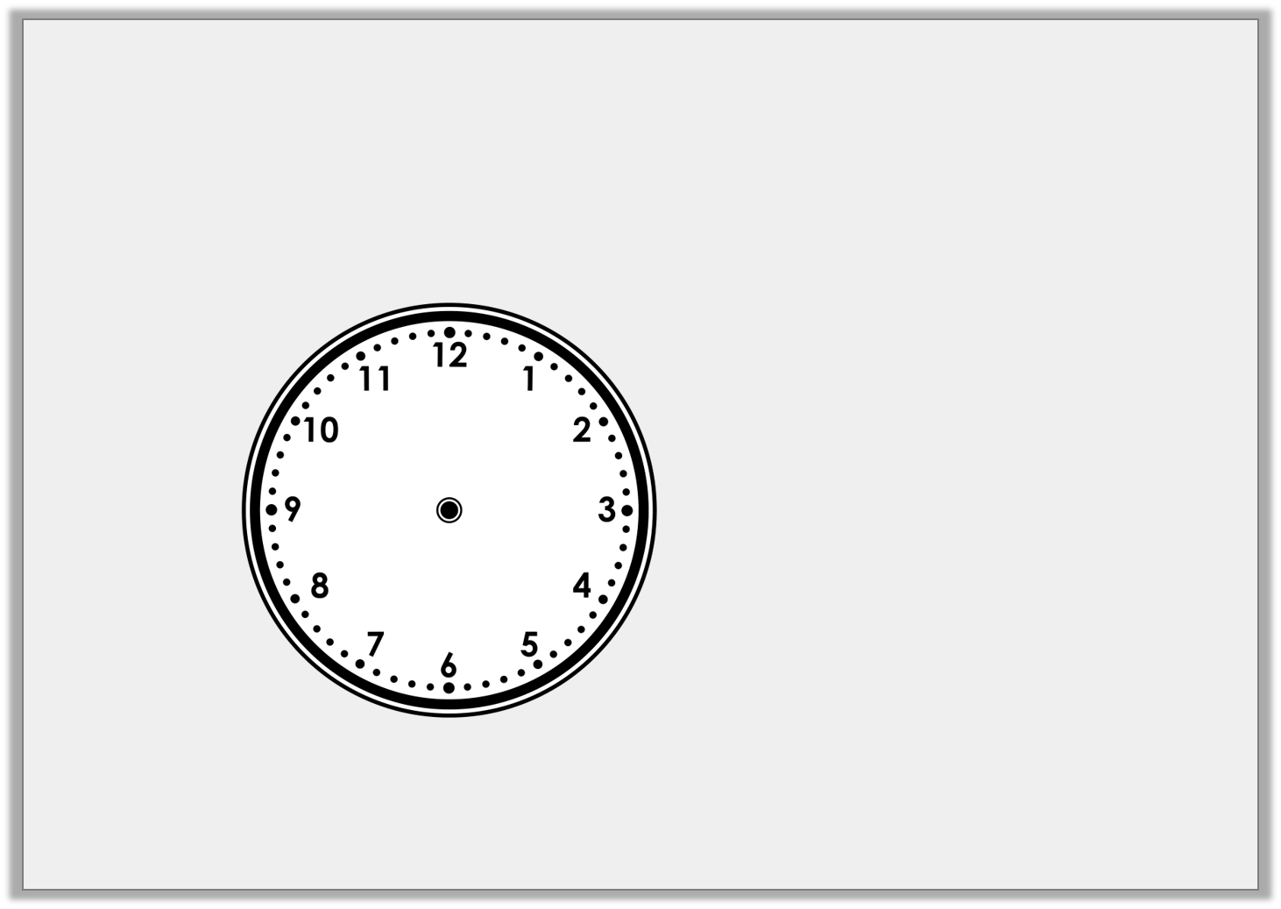
Varied Fluency 1
Convert this to digital time.
:
Y4

Slide 5
Varied Fluency 1
Convert this to digital time.
04:55
Y4

Slide 6
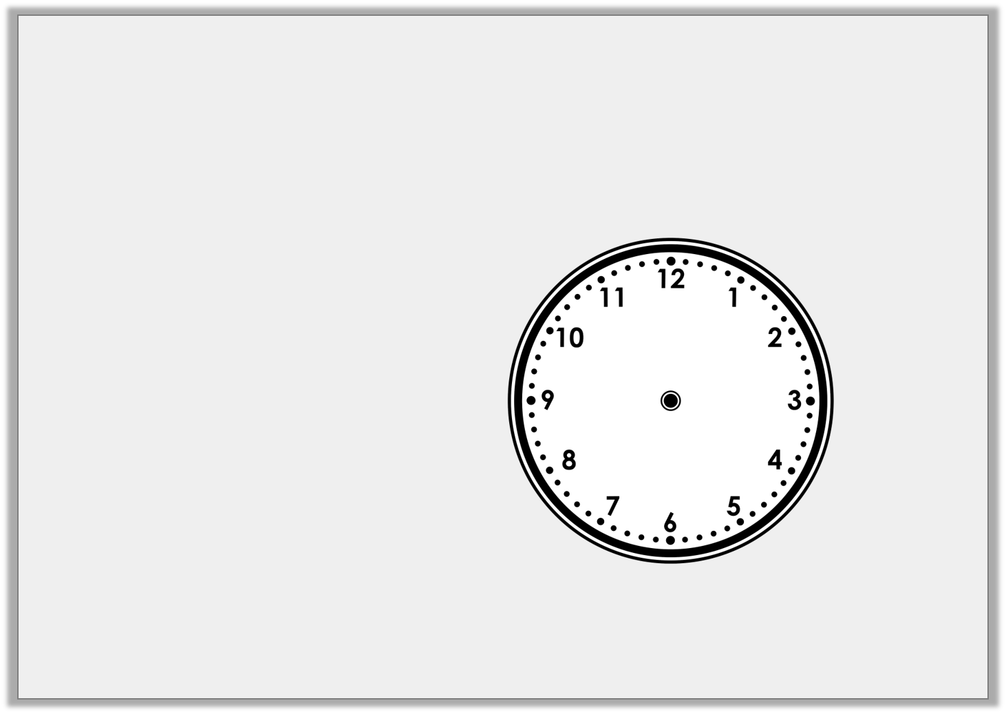
Varied Fluency 2
Draw the hands on the clock face to represent the digital time.
12:19
Y4

Slide 7
Varied Fluency 2
Draw the hands on the clock face to represent the digital time.
12:19
Y4

Slide 8
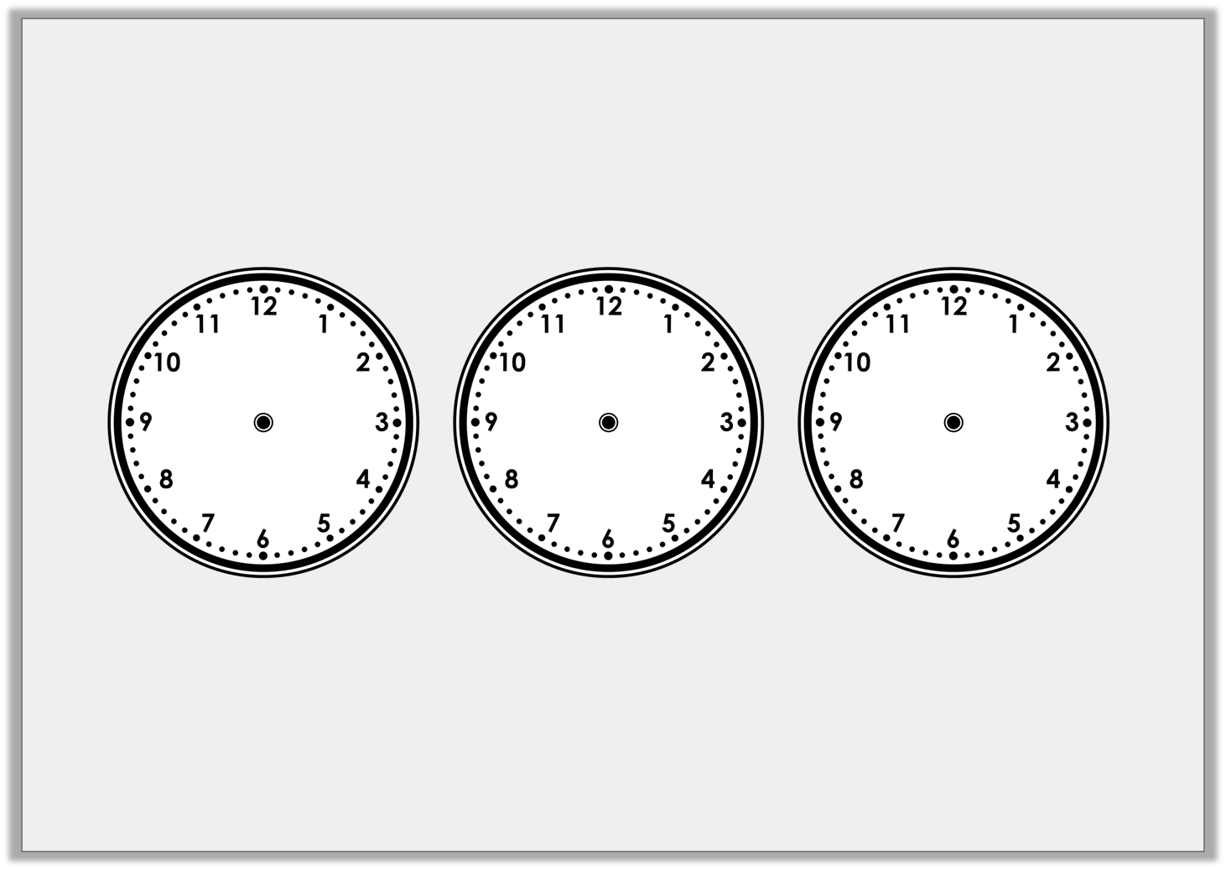
Varied Fluency 3
Convert these AM times to digital and order them from earliest to latest.
:
:
:
Y4

Slide 9
Varied Fluency 3
Convert these AM times to digital and order them from earliest to latest.
01:30am
05:44am
07:15am
Y4

Slide 10
Varied Fluency 4
What would the digital time be if it was 14 minutes later than the time shown on the clock?
:
Y4

Slide 11
Varied Fluency 4
What would the digital time be if it was 14 minutes later than the time shown on the clock?
04:55
Y4

Slide 12
Wednesday 10th June 20
Year 4: I can read, write and convert time between analogue and digital 12 and 24-hour using reasoning

Slide 13
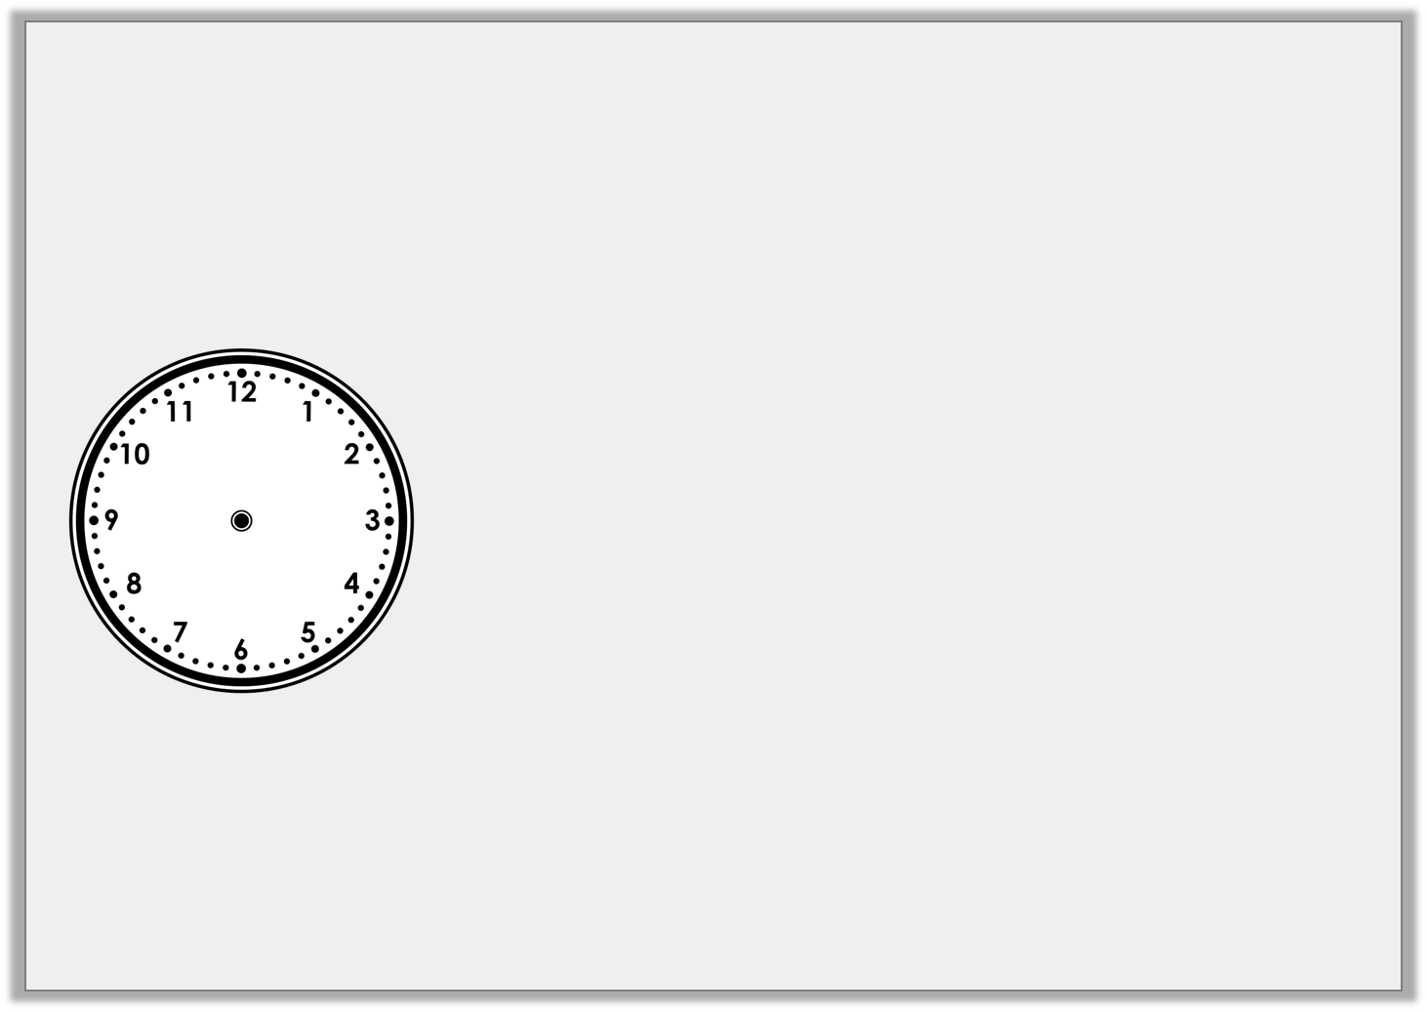
Reasoning 1
Grayson arrives at the dog show at the time shown on the analogue clock. He thinks he’s on time to watch agility.
Is he correct? Explain why.
Event | Start Time
Agility | 10:33am
Best in show | 10:52am
Obedience | 11:16am
Y4

Slide 14
Reasoning 1
Grayson arrives at the dog show at the time shown on the analogue clock. He thinks he’s on time to watch agility.
Is he correct? Explain why.
Grayson is on time to watch the agility as…
Event | Start Time
Agility | 10:33am
Best in show | 10:52am
Obedience | 11:16am
Y4

Slide 15
Reasoning 1
Grayson arrives at the dog show at the time shown on the analogue clock. He thinks he’s on time to watch agility.
Is he correct? Explain why.
Grayson is on time to watch the agility as he is 10 minutes early.
Event | Start Time
Agility | 10:33am
Best in show | 10:52am
Obedience | 11:16am
Y4

Slide 16
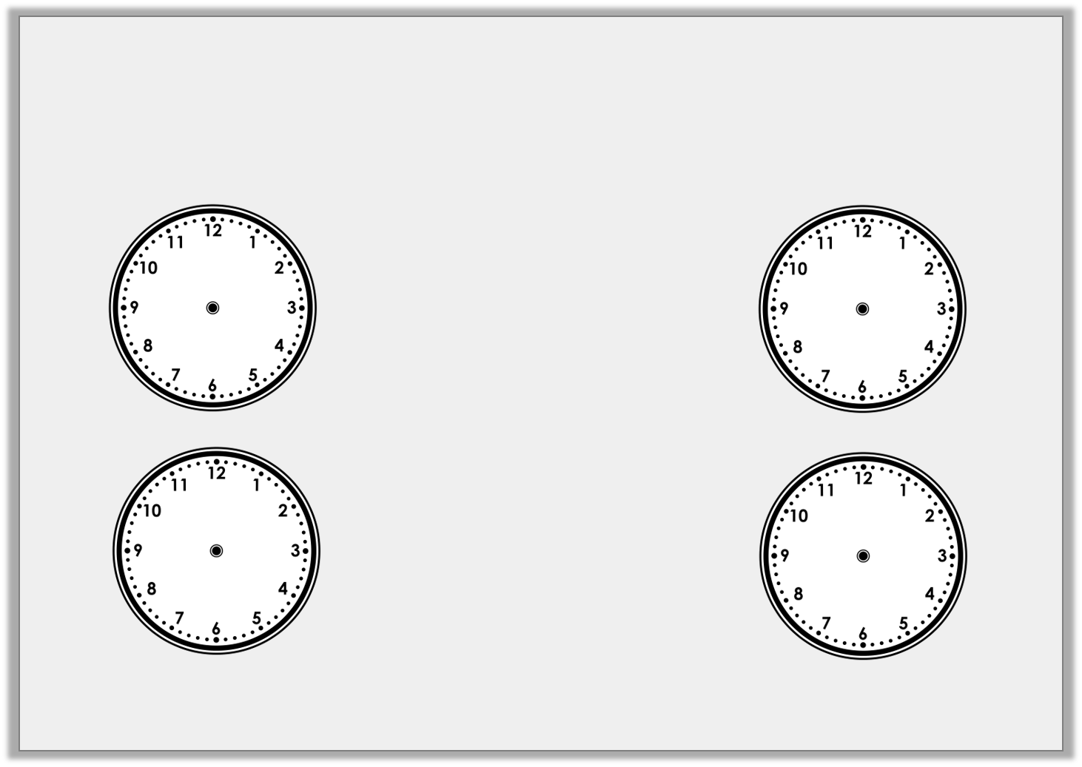
Problem Solving 1
Which is the earliest and latest time?
am
pm
06:22am
06:18am
10:24pm
09:59pm
pm
am
Y4

Slide 17
Problem Solving 1
Which is the earliest and latest time?
am
pm
earliest
06:22am
06:18am
10:24pm
09:59pm
latest
pm
am
Y4

Slide 18
Problem Solving 2
These clocks both show the same time.
What could the missing minute hand and hour be?
:53
Y4

Slide 19
Problem Solving 2
These clocks both show the same time.
What could the missing minute hand and hour be?
06:53
Y4

Slide 20
Year 3/4 – Summer Block 3 – Time
Thursday 11th June 2020
Step 6
Year 4: I can read analogue to digital
– 24 hour

Slide 21
Introduction
Match the times.
04:10
20:53
13:04
01:04
08:53
16:10
Y4

Slide 22
Introduction
Match the times.
04:10
20:53
13:04
01:04
08:53
16:10
Y4

Slide 23
Varied Fluency 1
Fill in the gaps on this 24-hour number line.
1 |  | 2 |  |  |  | 4 |  | 5 |  | 6 |  | 7 |  | 8 |  | 9 |  |  |  | 11 |  | 12
13 |  | 14 |  | 15 |  |  |  | 17 |  | 18 |  | 19 |  |  |  | 21 |  | 22 |  |  |  | 00
Y4

Slide 24
Varied Fluency 1
Fill in the gaps on this 24-hour number line.
1 |  | 2 |  | 3 |  | 4 |  | 5 |  | 6 |  | 7 |  | 8 |  | 9 |  | 10 |  | 11 |  | 12
13 |  | 14 |  | 15 |  | 16 |  | 17 |  | 18 |  | 19 |  | 20 |  | 21 |  | 22 |  | 23 |  | 00
Y4

Slide 25
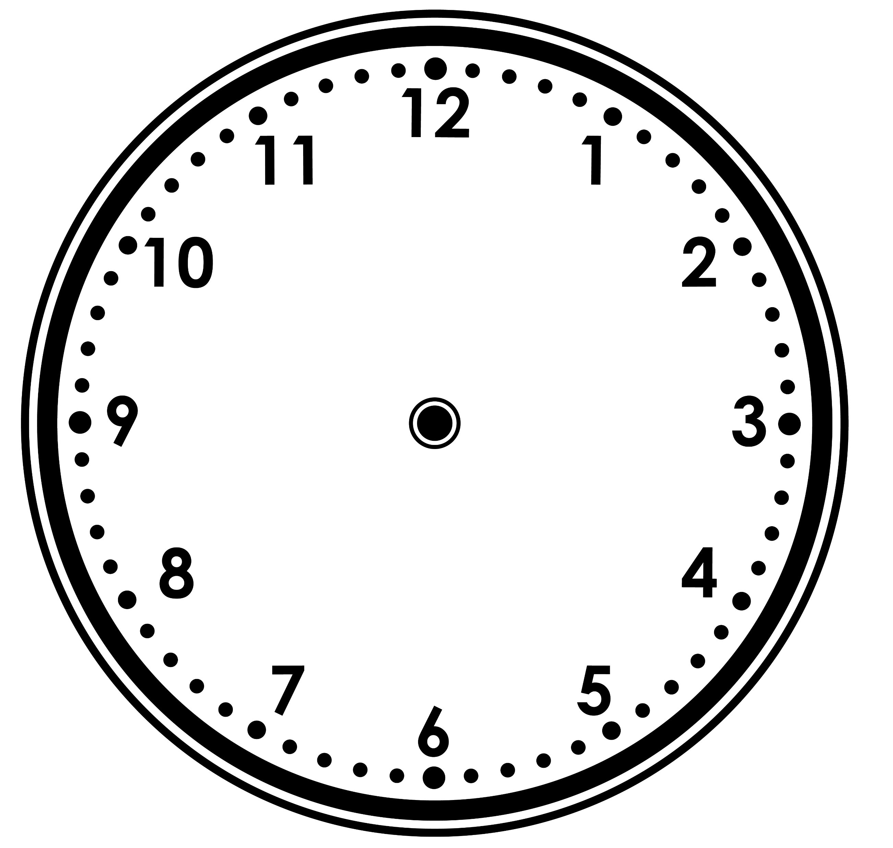
Varied Fluency 2
Which 24-hour time matches the time on the analogue clock?
03:05
15:25
14:25
15:05
Y4

Slide 26
Varied Fluency 2
Which 24-hour time matches the time on the analogue clock?
03:05
15:25
14:25
15:05
Y4

Slide 27
Varied Fluency 3
If a clock shows this time, the time could be 17:40.
True or false?
Y4

Slide 28
Varied Fluency 3
If a clock shows this time, the time could be 17:40.
True or false?
True
Y4

Slide 29
Varied Fluency 4
Look at this clock. Write the 24-hour time it would match in the morning and the evening.
Y4

Slide 30
Varied Fluency 4
Look at this clock. Write the 24-hour time it would match in the morning and the evening.
morning
evening
08:40
20:40
Y4

Slide 31
Friday 12th June 2020
Year 4: I can read analogue to digital
– 24 hour using reasoning and problem solving

Slide 32
Problem Solving 1
The town hall clock is analogue. It chimes every hour.
Billy looks at the time on his smartwatch.
If Billy waits until the next time the town hall clock chimes, how many chimes will he hear? Explain why.
20:10
Y4

Slide 33
Problem Solving 1
The town hall clock is analogue. It chimes every hour.
Billy looks at the time on his smartwatch.
If Billy waits until the next time the town hall clock chimes, how many chimes will he hear? Explain why.
9 chimes.
The next hour will be 21:00, which is 9pm, so he will hear 9 chimes.
20:10
Y4

Slide 34
Reasoning 1
Maddie and Sian were supposed to be at the restaurant at 19:25. Here are the times they arrived.
Who arrived on time? Who arrived late?
Maddie
Sian
Y4

Slide 35
Reasoning 1
Maddie and Sian were supposed to be at the restaurant at 19:25. Here are the times they arrived.
Who arrived on time? Who arrived late?
Maddie arrived on time.
Sian arrived 20 minutes late.
Maddie
Sian
Y4

Slide 36
Problem Solving 2
The school clock is stuck.
Explain who has correctly guessed the two times the clock could be showing.
Holly
Mira
10:55
10:55
22:55
Dan
20:55
11:55
23:55
Y4

Slide 37
Problem Solving 2
The school clock is stuck.
Explain who has correctly guessed the two times the clock could be showing.
Holly is correct because...
Holly
Mira
10:55
10:55
22:55
Dan
20:55
11:55
23:55
Y4

Slide 38
Problem Solving 2
The school clock is stuck.
Explain who has correctly guessed the two times the clock could be showing.
Holly is correct because both her digital times are five to eleven on an analogue clock.
Holly
Mira
10:55
10:55
22:55
Dan
20:55
11:55
23:55
Y4

