Slide 1

Year 3/4 – Summer Block 3 – Time
Tuesday 9th June 2020
Step 5
Year 3: I can use vocabulary such as o’clock, am and pm.

Slide 2
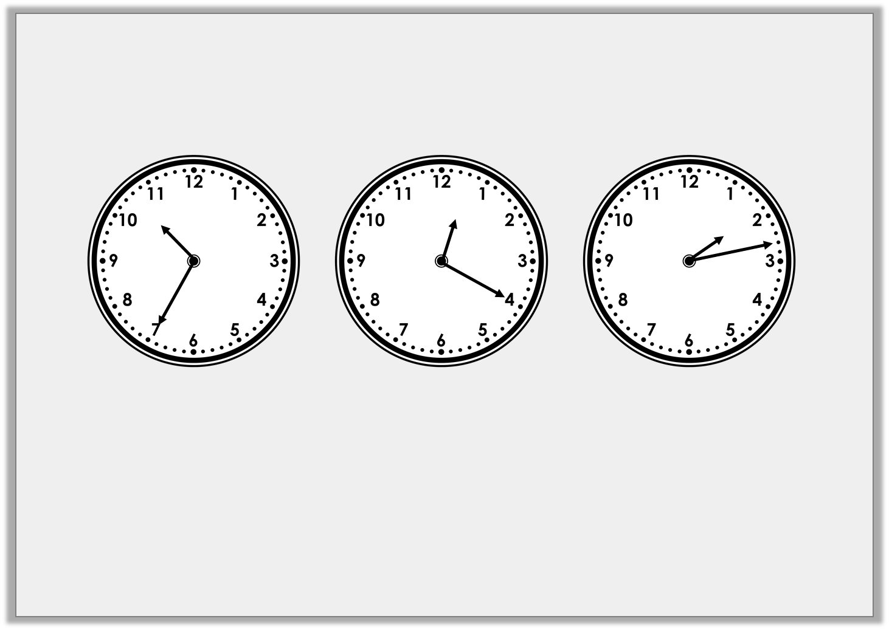
Introduction
Match the analogue and digital times.
02:13
10:35
12:20
Y3

Slide 3
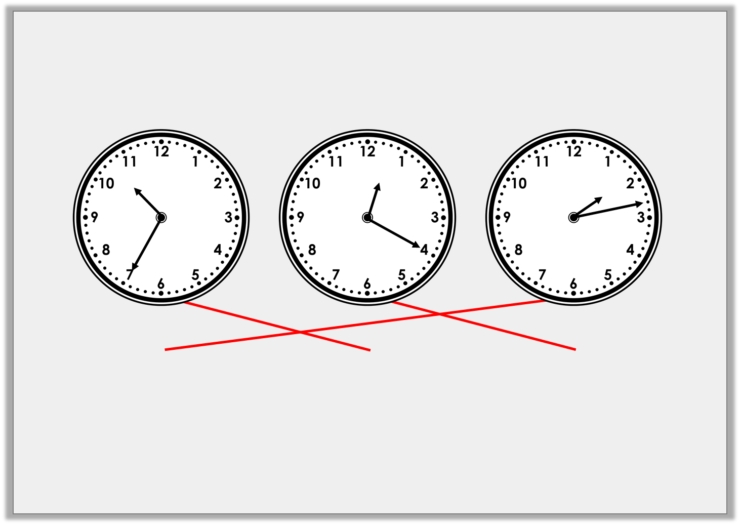
Introduction
Match the analogue and digital times.
02:13
10:35
12:20
Y3

Slide 4
Varied Fluency 1
True or false? These times are in order from earliest to latest.
8:05pm
10:30am
11:20am
10:50pm
Y3

Slide 5
Varied Fluency 1
True or false? These times are in order from earliest to latest.
False
8:05pm
10:30am
11:20am
10:50pm
10:30am
11:20am
8:05pm
10:50pm
Y3

Slide 6

Varied Fluency 2
Match the clock to the most appropriate activity.
Morning break
After school club
Sunset
8:55pm
a.m.
3:25pm
Y3

Slide 7
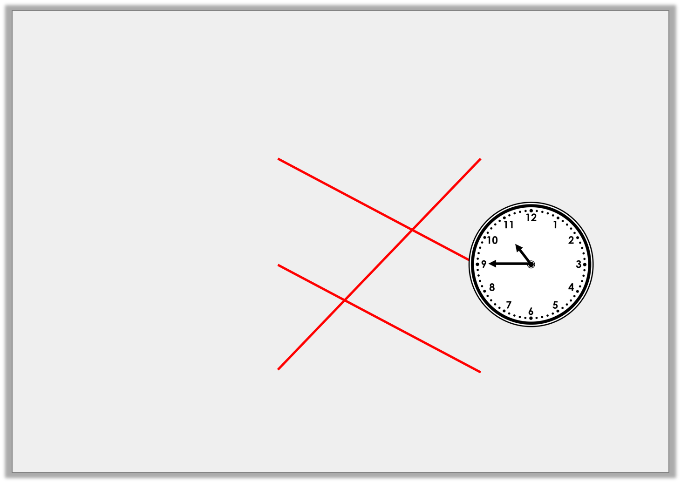
Varied Fluency 2
Match the clock to the most appropriate activity.
Morning break
After school club
Sunset
8:55pm
3:25pm
Y3

Slide 8
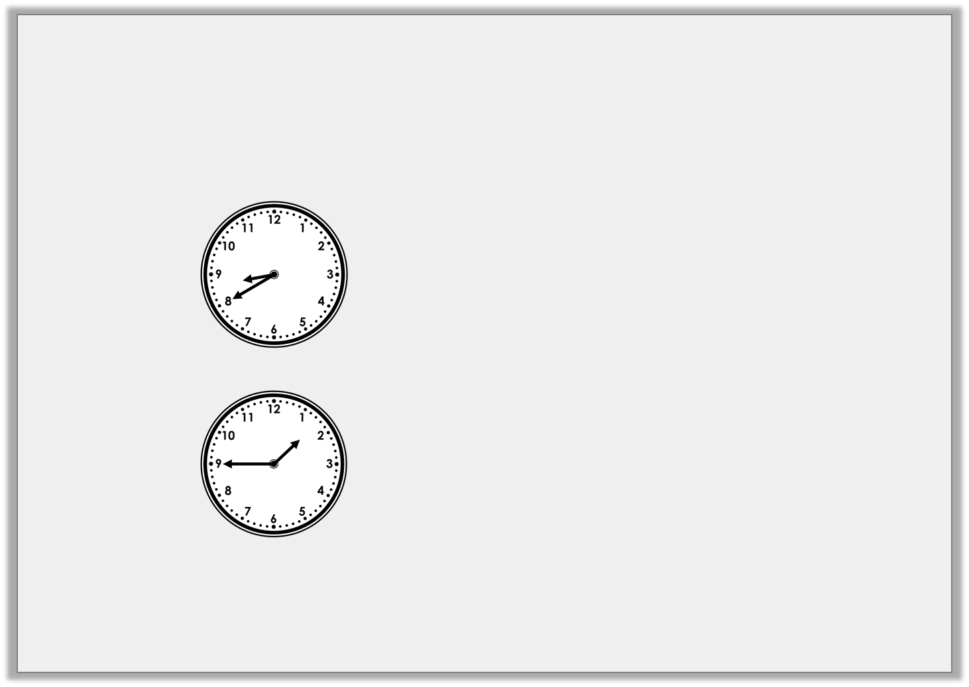
Varied Fluency 3
Write the digital time to match the analogue clocks.
Include a.m. or p.m.
in the morning
:
in the afternoon
:
Y3

Slide 9
Varied Fluency 3
Write the digital time to match the analogue clocks.
Include a.m. or p.m.
in the morning
8:40am
in the afternoon
1:45pm
Y3

Slide 10
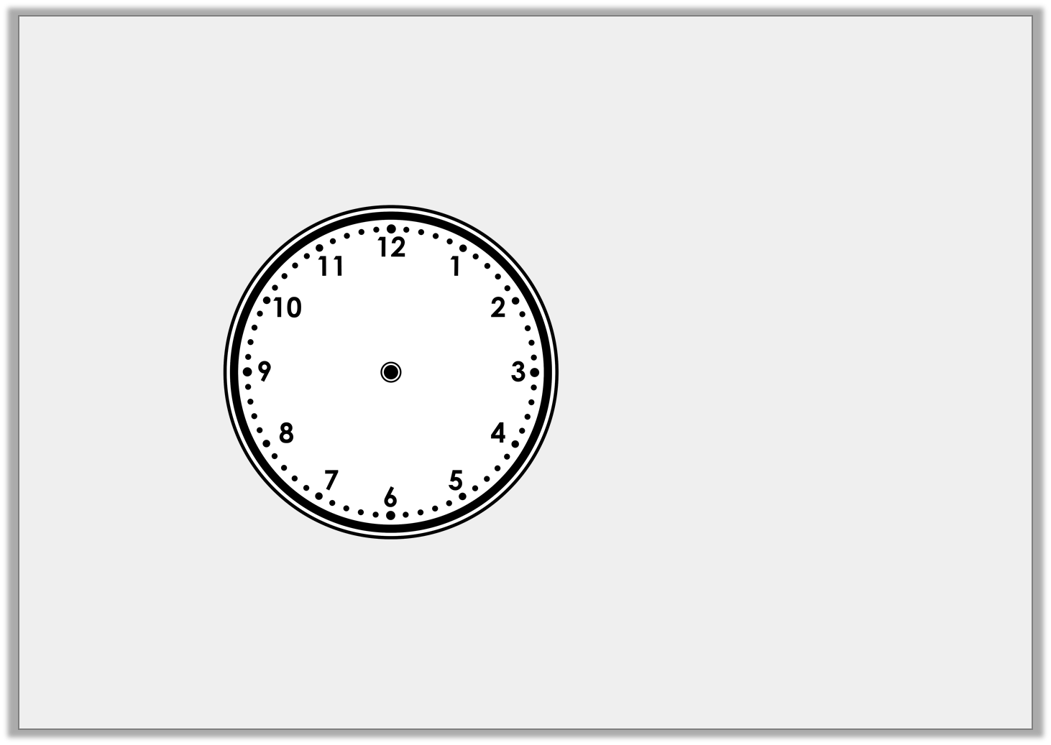
Varied Fluency 4
Complete the analogue clock time to show the time Yasmin eats her dinner.
6:05pm
Y3

Slide 11
Varied Fluency 4
Complete the analogue clock time to show the time Yasmin eats her dinner.
6:05pm
Y3

Slide 12
Wednesday 10th June 20
I can use vocabulary such as o’clock, am and pm using reasoning and problem solving .

Slide 13
Problem Solving 1
Sort the activities into the table to show whether
they would be a.m., p.m. or both.
a.m. | p.m. | Both
A. Look at the stars at 10:30. |  | B. Have a cold drink at 7:55.
C. Have a shower at 8:05. |  | D. Walk to school at 8:35.
Y3

Slide 14
Problem Solving 1
Sort the activities into the table to show whether
they would be a.m., p.m. or both.
a.m. | p.m. | Both
D | A | B and C
A. Look at the stars at 10:30. |  | B. Have a cold drink at 7:55.
C. Have a shower at 8:05. |  | D. Walk to school at 8:35.
Y3

Slide 15
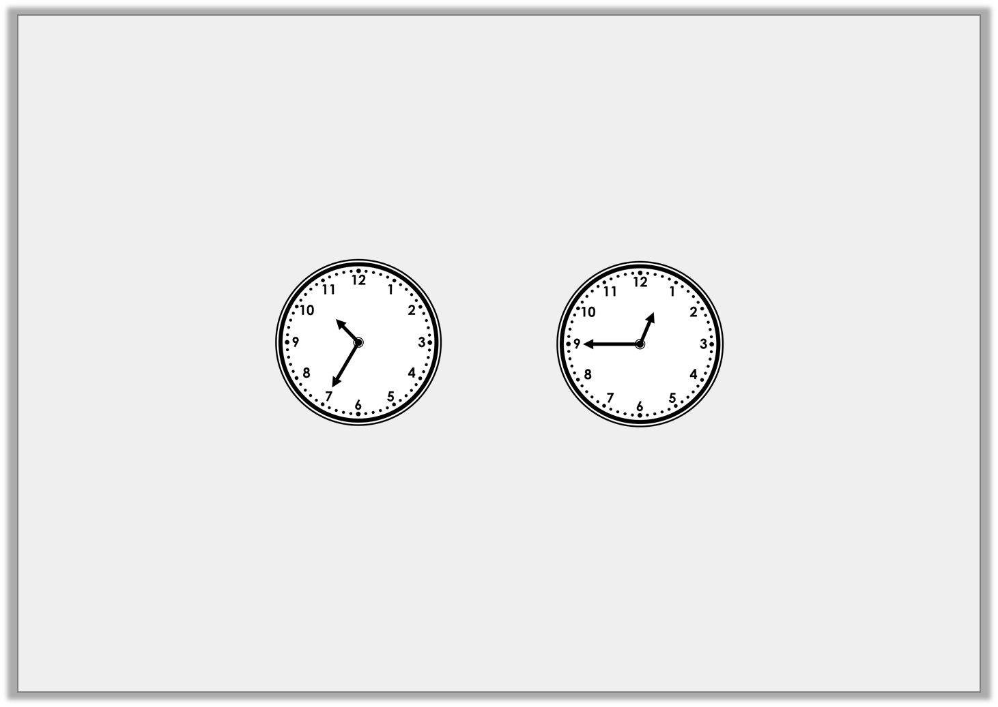
Reasoning 1
Lenny has written the digital times to match the analogue clocks below.
Is he correct? Explain how you know.
Party starts:
Party ends:
10:35am
12:45am
Y3

Slide 16
Reasoning 1
Lenny has written the digital times to match the analogue clocks below.
Is he correct? Explain how you know.
Lenny is incorrect because...
Party starts:
Party ends:
10:35am
12:45am
Y3

Slide 17
Reasoning 1
Lenny has written the digital times to match the analogue clocks below.
Is he correct? Explain how you know.
Lenny is incorrect because the party would end at 12:45pm not 12:45am.
Party starts:
Party ends:
10:35am
12:45am
Y3

Slide 18

Reasoning 2
Jen’s ballet class starts at 10:55am.
Tammy’s ballet class starts at 1:25pm.
Is Jen Correct?
Explain how you know.
My ballet class starts after Tammy’s because ten comes after one.
Jen
Y3

Slide 19
Reasoning 2
Jen’s ballet class starts at 10:55am.
Tammy’s ballet class starts at 1:25pm.
Is Jen Correct?
Explain how you know.
Jen is incorrect because...
My ballet class starts after Tammy’s because ten comes after one.
Jen
Y3

Slide 20
Reasoning 2
Jen’s ballet class starts at 10:55am.
Tammy’s ballet class starts at 1:25pm.
Is Jen Correct?
Explain how you know.
Jen is incorrect because 10:55am comes before 1:25pm.
My ballet class starts after Tammy’s because ten comes after one.
Jen
Y3

Slide 21
Thursday 11th June 20

Slide 22
Year 3/4 – Summer Block 3 – Time
Step 6
Year 3: I can read 24-hour Clock

Slide 23

Introduction
Put these times in order from earliest to latest.
04:10pm |  | 20 minutes past 2 in the afternoon |  | 11:20am
pm
Y3

Slide 24
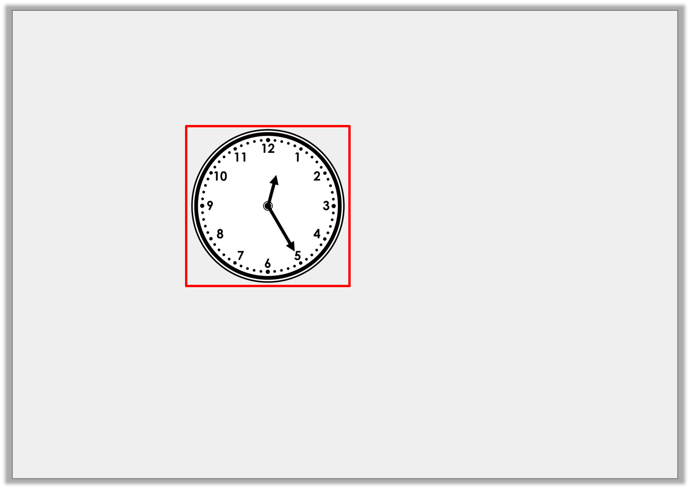
Introduction
Put these times in order from earliest to latest.
11:20am |  |  |  | 20 minutes past 2 in the afternoon |  | 04:10pm
pm
Y3

Slide 25
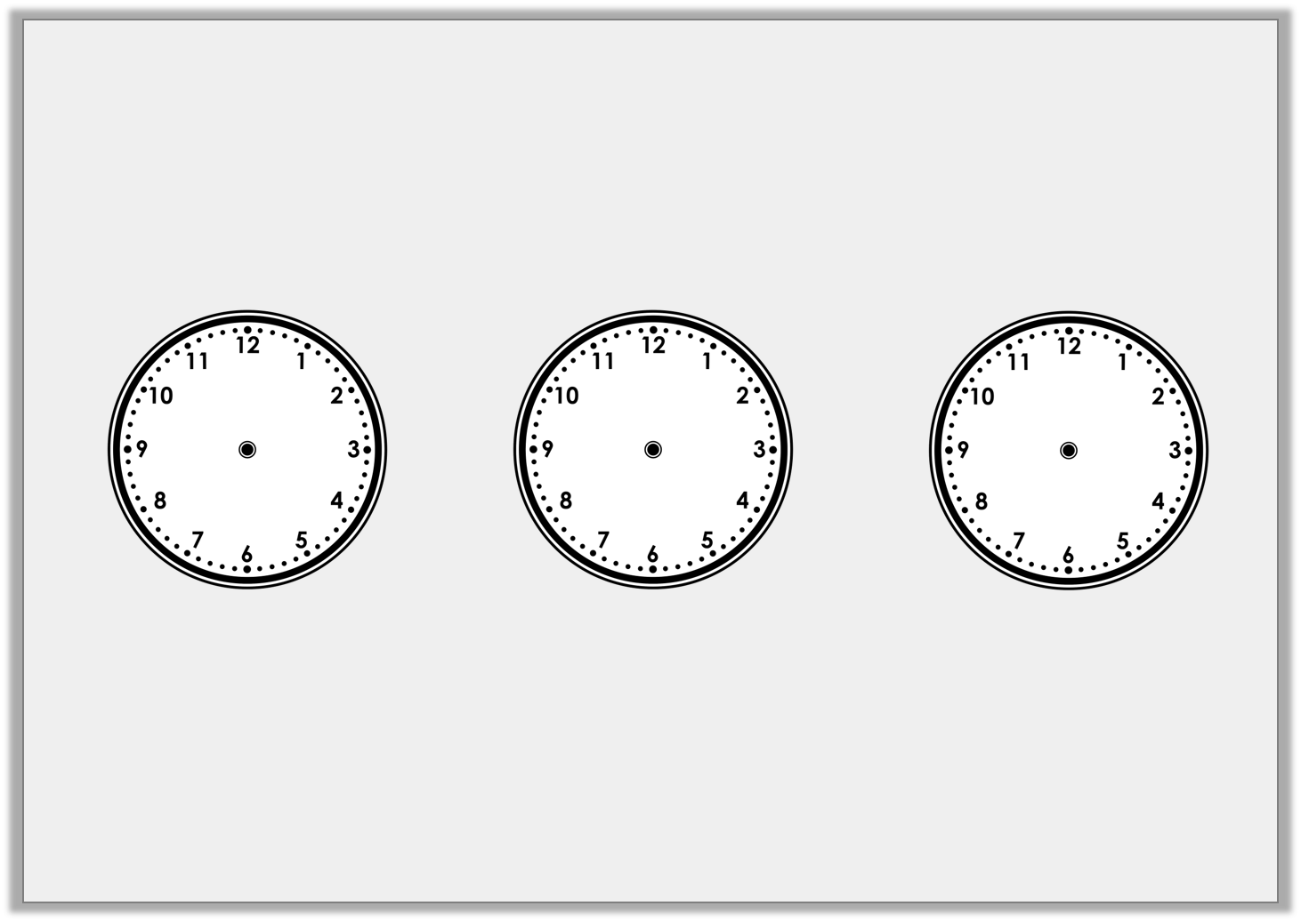
Varied Fluency 1
Match the analogue clocks and 24-hour clocks which show the same time.
A
B
C
D
E
F
06:55
13:20
16:10
Y3

Slide 26
Varied Fluency 1
Match the analogue clocks and 24-hour clocks which show the same time.
A
B
C
D
E
F
06:55
13:20
16:10
Y3

Slide 27
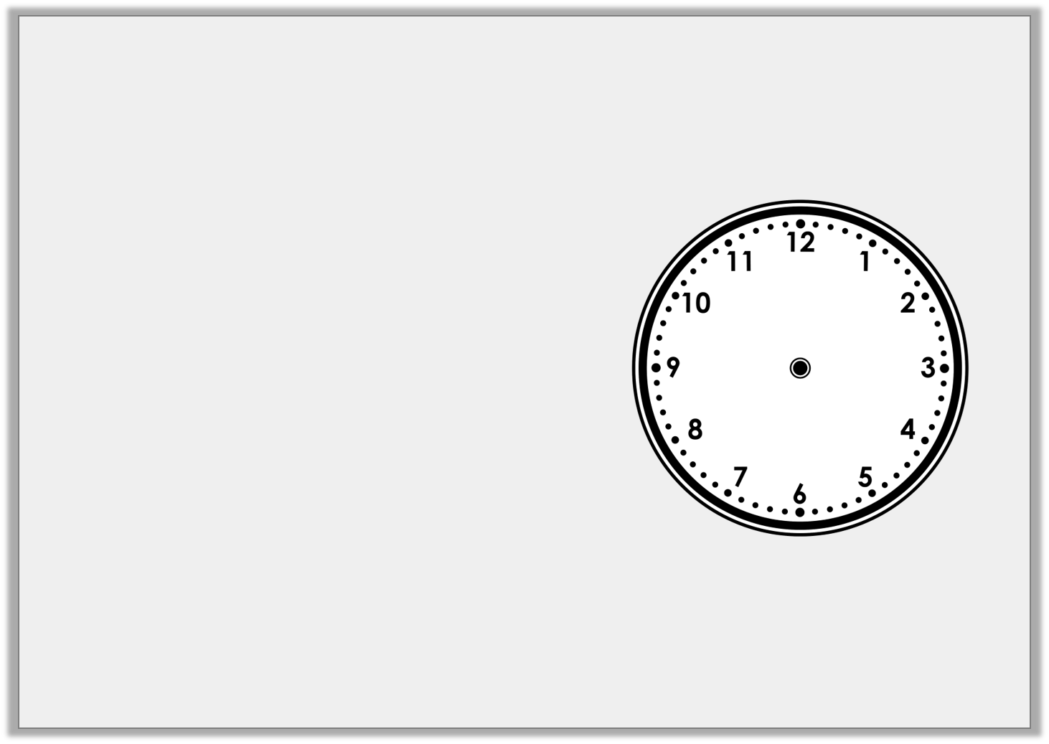
Varied Fluency 2
Choose number cards to fill in the 24-hour clocks with two times that match the analogue clock.
9 |  | 6 |  | 5
5 |  | 7 |  | 3
0 |  | : |  | 5
1 |  | : | 3
Y3

Slide 28
Varied Fluency 2
Choose number cards to fill in the 24-hour clocks with two times that match the analogue clock.
9 |  | 6 |  | 5
5 |  | 7 |  | 3
0 | 5 | : | 3 | 5
1 | 7 | : | 3 | 5
Y3

Slide 29
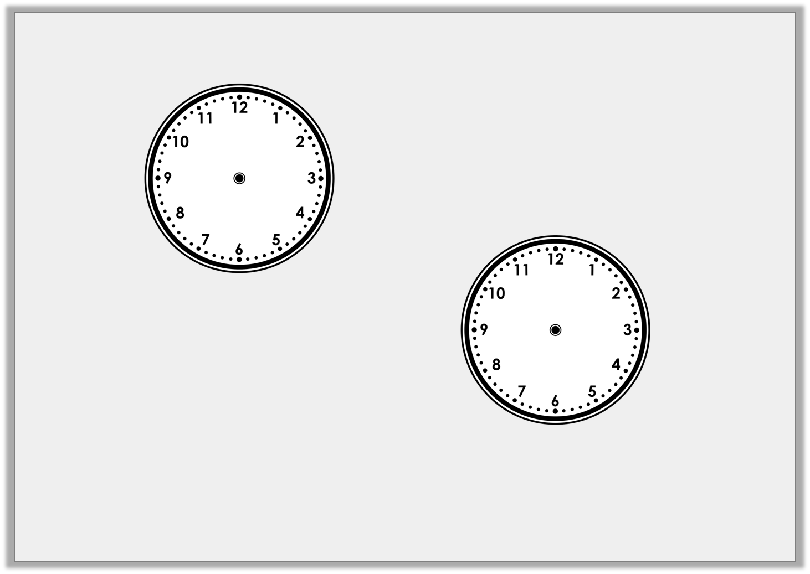
Varied Fluency 3
Which of these times is the earliest?
Which of these times is the latest?
A
B
15:05
D
(am)
C
23:50
(pm)
Y3

Slide 30
Varied Fluency 3
Which of these times is earliest? A
Which of these times is latest? C
A
B
earliest
15:05
D
(am)
C
latest
23:50
(pm)
Y3

Slide 31
Friday 12th June 20
Year 3: 24-hour Clock using reasoning and problem-solving

Slide 32
Problem Solving 1
Here is an information board at a station. It shows when trains leave.
Put the trains in order from earliest leaving to latest leaving in the day.
Train A | 12:55
Train B | 08:40
Train C | 00:10
Train D | 23:25
Train E | 21:00
Y3

Slide 33
Problem Solving 1
Here is an information board at a station. It shows when trains leave.
Put the trains in order from earliest leaving to latest leaving in the day.
Train C, Train B, Train A, Train E, Train D
Train A | 12:55
Train B | 08:40
Train C | 00:10
Train D | 23:25
Train E | 21:00
Y3

Slide 34
Reasoning 1
A shop was burgled some time after 5pm. Detective Ivor Clue knows when some criminals left the shop.
Who should Detective Clue arrest? Explain your answer.
Aidan Abett | 13:50
Colin Dacops | 08:40
Robin Fings | 00:20
Connor Patsy | 23:25
Y3

Slide 35
Reasoning 1
A shop was burgled some time after 5pm. Detective Ivor Clue knows when some criminals left the shop.
Who should Detective Clue arrest? Explain your answer.
Connor Patsy, because…
Aidan Abett | 13:50
Colin Dacops | 08:40
Robin Fings | 00:20
Connor Patsy | 23:25
Y3

Slide 36
Reasoning 1
A shop was burgled some time after 5pm. Detective Ivor Clue knows when some criminals left the shop.
Who should Detective Clue arrest? Explain your answer.
Connor Patsy, because all the other criminals left the shop before 5pm.
Aidan Abett | 13:50
Colin Dacops | 08:40
Robin Fings | 00:20
Connor Patsy | 23:25
Y3

Slide 37

Problem Solving 2
Here are some different times.
Sort them into these categories:
A
B
02:20
C
D
Twenty to one in the morning
13:50
Before noon | After noon | Can’t tell
Y3

Slide 38
Problem Solving 2
Here are some different times.
Sort them into these categories:
A
B
02:20
C
D
Twenty to one in the morning
13:50
Before noon | After noon | Can’t tell
A, C | D | B
Y3

