Slide 1
Year 1/2 – Spring Block 4 – Weight and Volume
Step 2
Year 1: Measure Mass
Year 2: Measure Mass in Grams

Slide 2
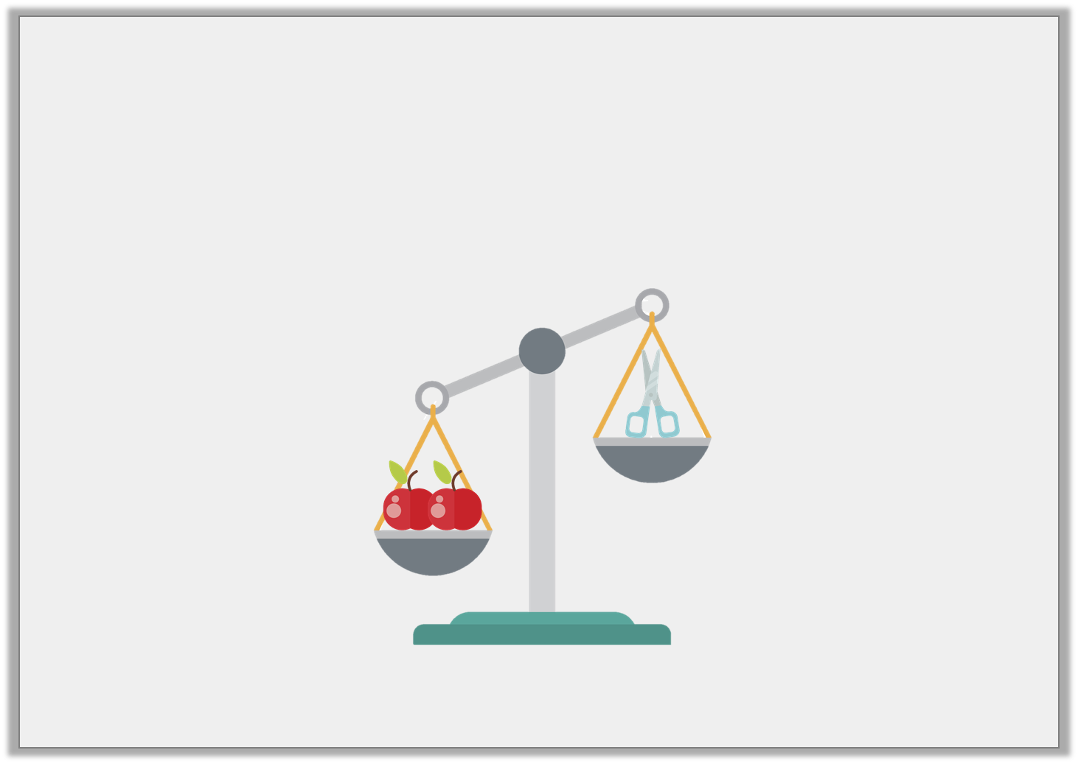
Introduction
Fill in the blanks using the words on the cards.
The scissors are _________________________________ than the apples.
The apples are _________________________________ than the scissors.
heavier
lighter
Y1

Slide 3
Introduction
Fill in the blanks using the words on the cards.
The scissors are _________________________________ than the apples.
The apples are _________________________________ than the scissors.
lighter
heavier
heavier
lighter
Y1

Slide 4
Introduction
What number each arrow pointing to?
0 | 10 |  | 30 |  | 50 |  | 70 |  | 90 | 100
0 | 2 | 4 |  | 8 | 10 | 12 |  | 16 | 18 | 20
0 | 5 | 10 |  | 20 | 25 |  | 35 | 40 |  | 50
Y2

Slide 5
Introduction
What number each arrow pointing to?
0 | 10 |  | 30 | 40 | 50 |  | 70 |  | 90 | 100
0 | 2 | 4 |  | 8 | 10 | 12 | 14 | 16 | 18 | 20
0 | 5 | 10 |  | 20 | 25 |  | 35 | 40 | 45 | 50
Y2

Slide 6
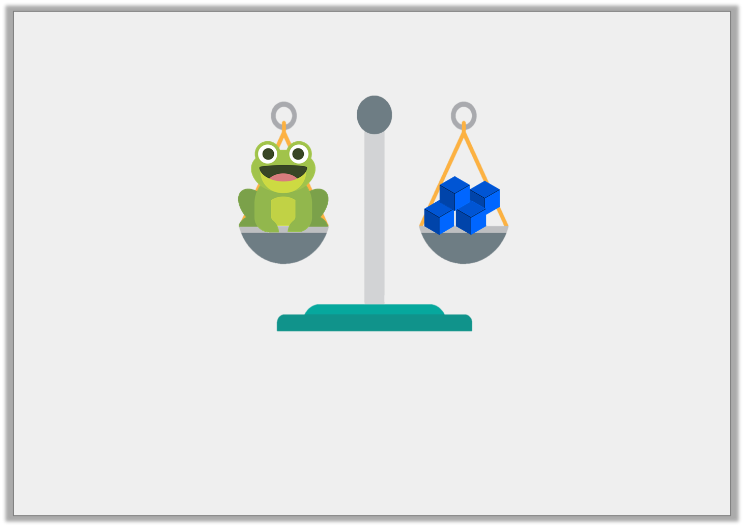
Varied Fluency 1
What is the mass of the toy frog?
cubes
Y1

Slide 7
Varied Fluency 1
What is the mass of the toy frog?
cubes
4
Y1

Slide 8
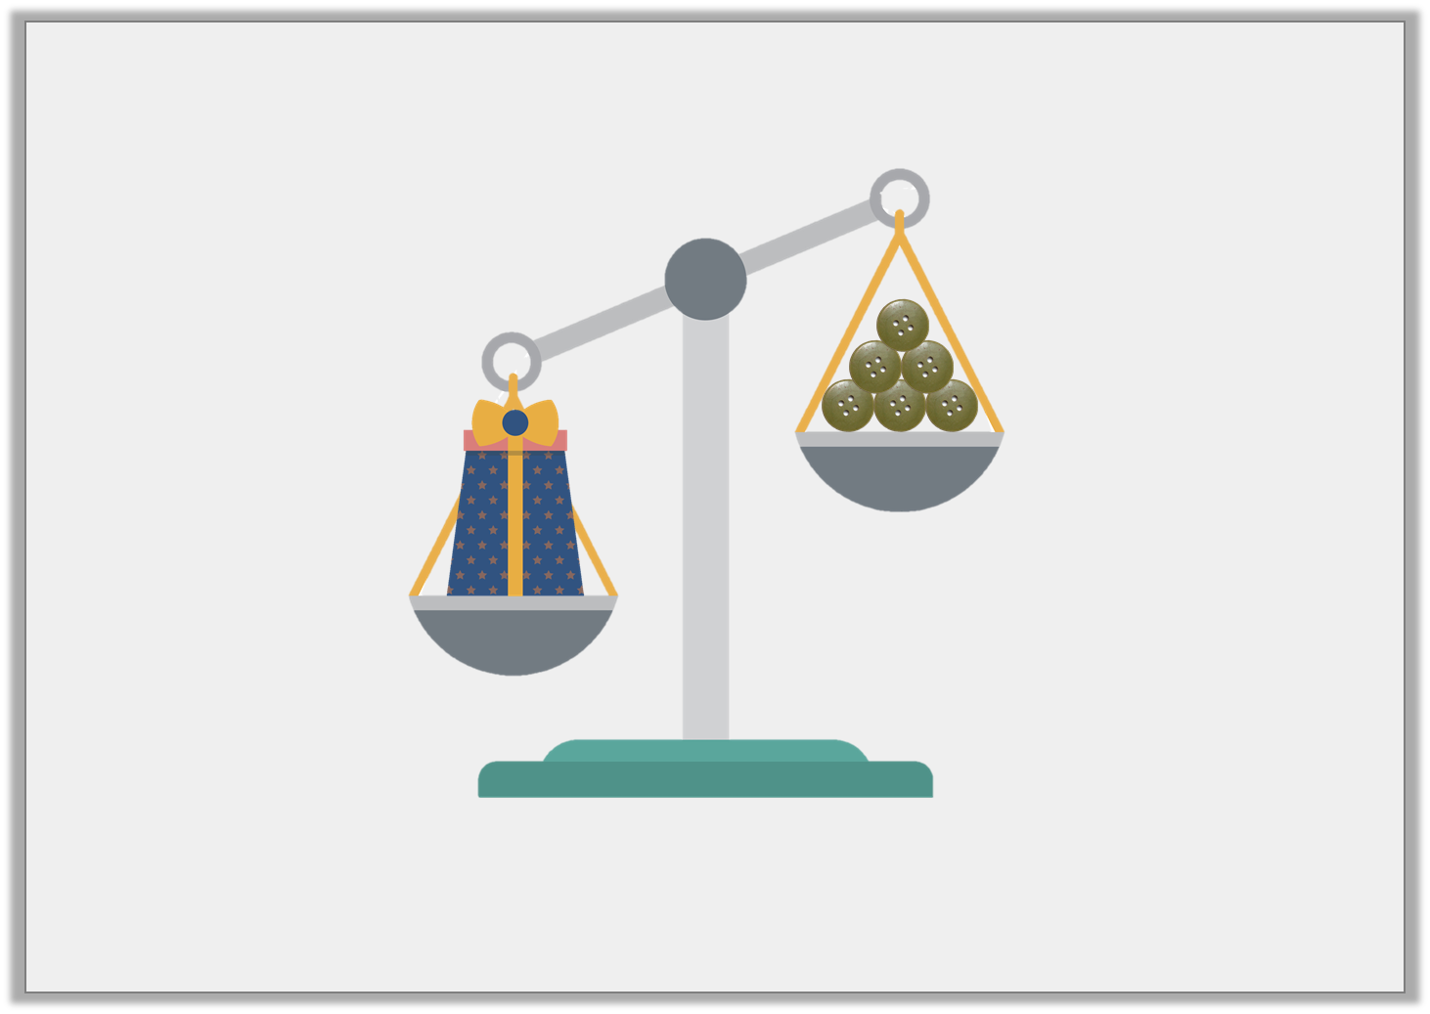
Varied Fluency 2
True or false? This box weighs less than 6 buttons.
Y1

Slide 9
Varied Fluency 2
True or false? This box weighs less than 6 buttons.
False, the box weighs more than 6 buttons.
Y1

