Slide 1
مُوَاصَلاتٌ
TRANSPORTS

Slide 2

سَيَّارَةٌ
CAR

Slide 3
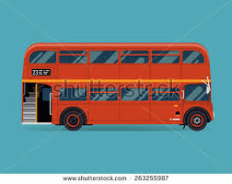
حَافِلَةٌ
BUS

Slide 4
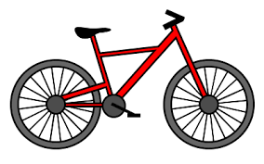
دَرَّاجَةٌ
BICYCLE

Slide 5
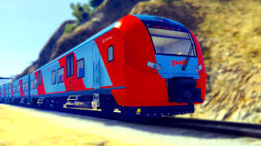
قِطَارٌ
TRAIN

Slide 6

طَاءِرَةٌ
PLANE

Slide 7

سَفِيْنَةٌ
SHIP

