Slide 1
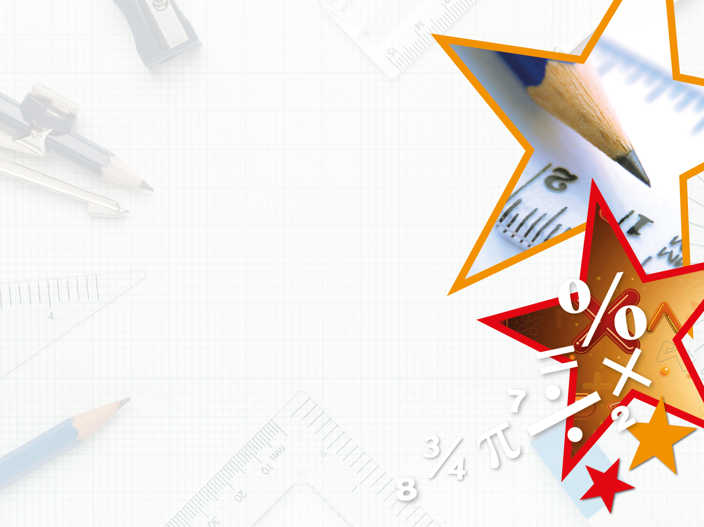
Y5-6 – Summer Block 3 – Shape – Step 1
About This Resource:
This PowerPoint has been designed to support teaching of the small steps. It includes a starter activity suitable for the year group and an example of each question from the Varied Fluency and Reasoning and Problem Solving resources also provided in the tasks. Each slide has the year group identified in the bottom right-hand corner. I recommend that you look through this PowerPoint in advance and decide whether to work through all examples provided or a selection of them depending on the needs of your child.
The PowerPoint has been dated for the week, so please work your way through it each day.

Slide 2
Y5-6 – Summer Block 3 – Shape
Tuesday 19th May 2020
Step 1
Year 5: Measuring Angles in Degrees

Slide 3
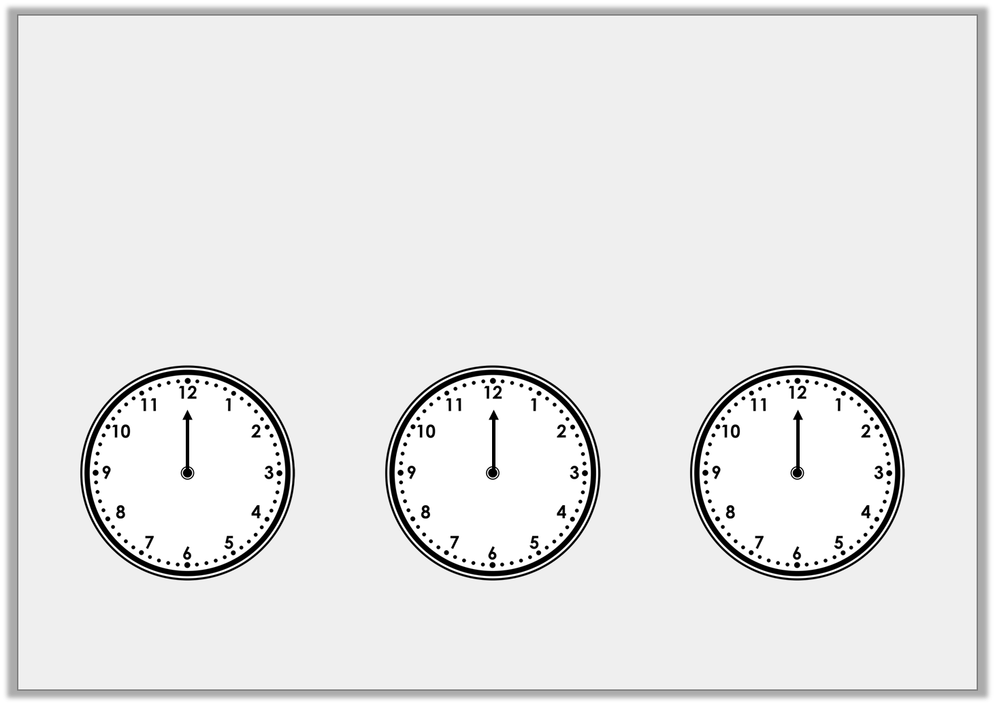
Introduction
The hour hand is stuck on 12.
Draw the minute hand on the clock so the time shown makes an acute angle:
Draw the minute hand on the clock so the time shown makes a right angle:
Draw the minute hand on the clock so the time shown makes an obtuse angle:
Y5

Slide 4
Introduction
The hour hand is stuck on 12.
Draw the minute hand on the clock so the time shown makes an acute angle:
Draw the minute hand on the clock so the time shown makes a right angle:
Draw the minute hand on the clock so the time shown makes an obtuse angle:
Any time between 12:16 – 12:29 and 12:31 – 12:44
Any time between 12:46 and 12:14
Either 12:15 or 12:45
Y5

Slide 5
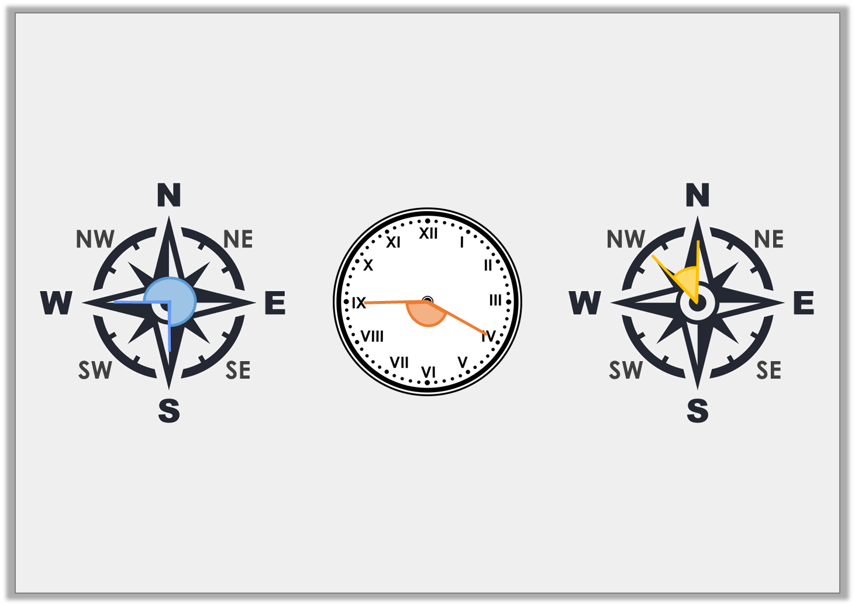
Varied Fluency 1
Label each image with the name of the angle.
A.
B.
C.
Y5

Slide 6
Varied Fluency 1
Label each image with the name of the angle.
A.
B.
C.
Reflex angle
Obtuse angle
Acute angle
Y5

Slide 7
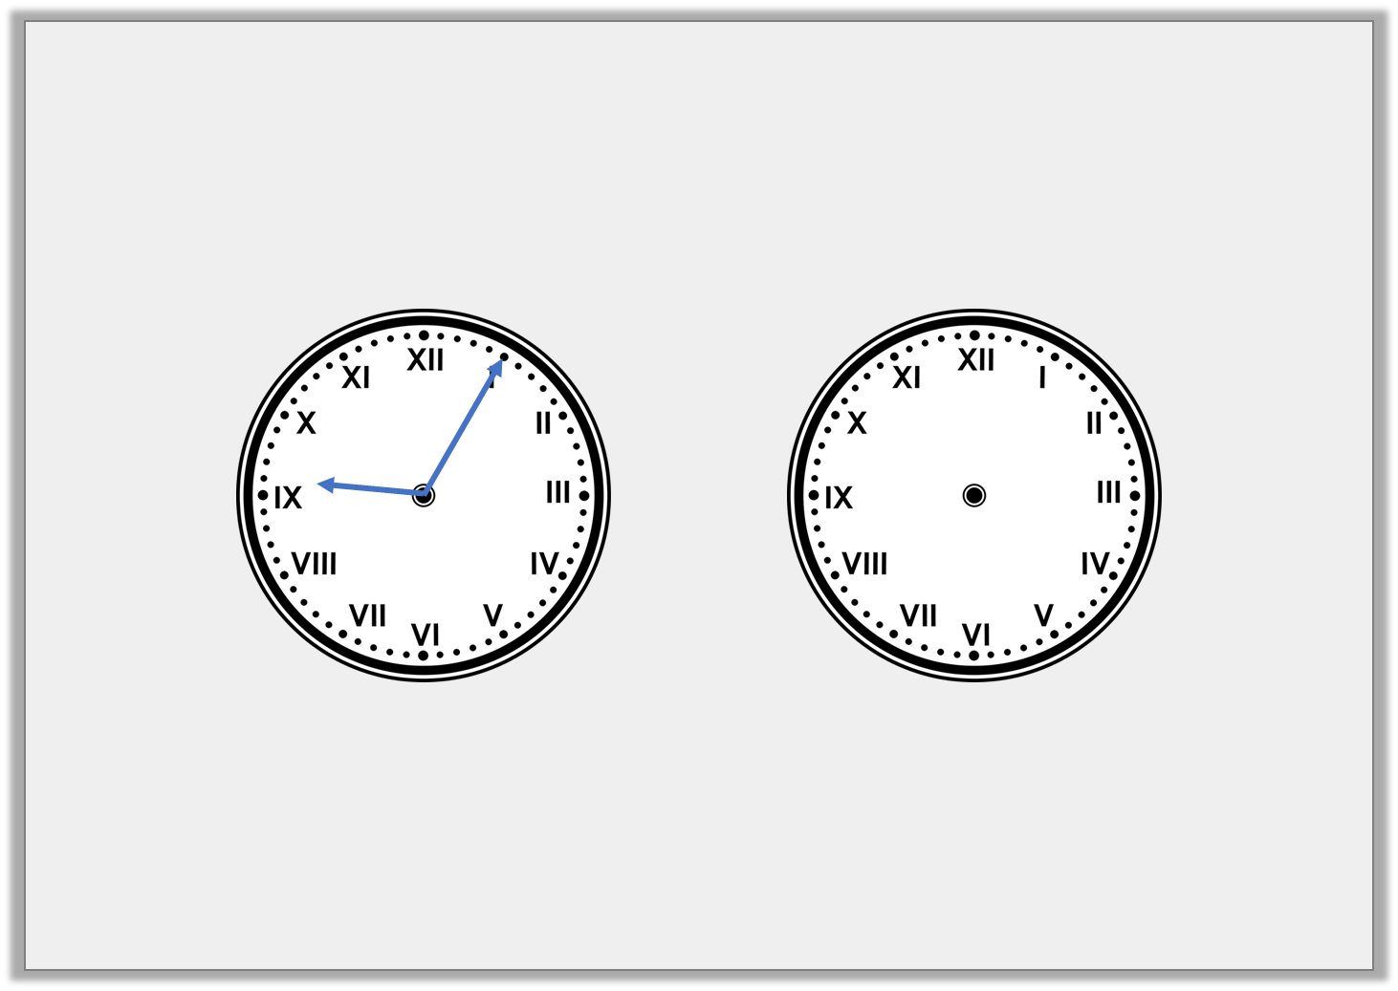
Varied Fluency 2
Look at the time on the clock. Draw where the minute hand will be after a 180° turn clockwise.
Y5

Slide 8
Varied Fluency 2
Look at the time on the clock. Draw where the minute hand will be after a 180° turn clockwise.
Y5

Slide 9
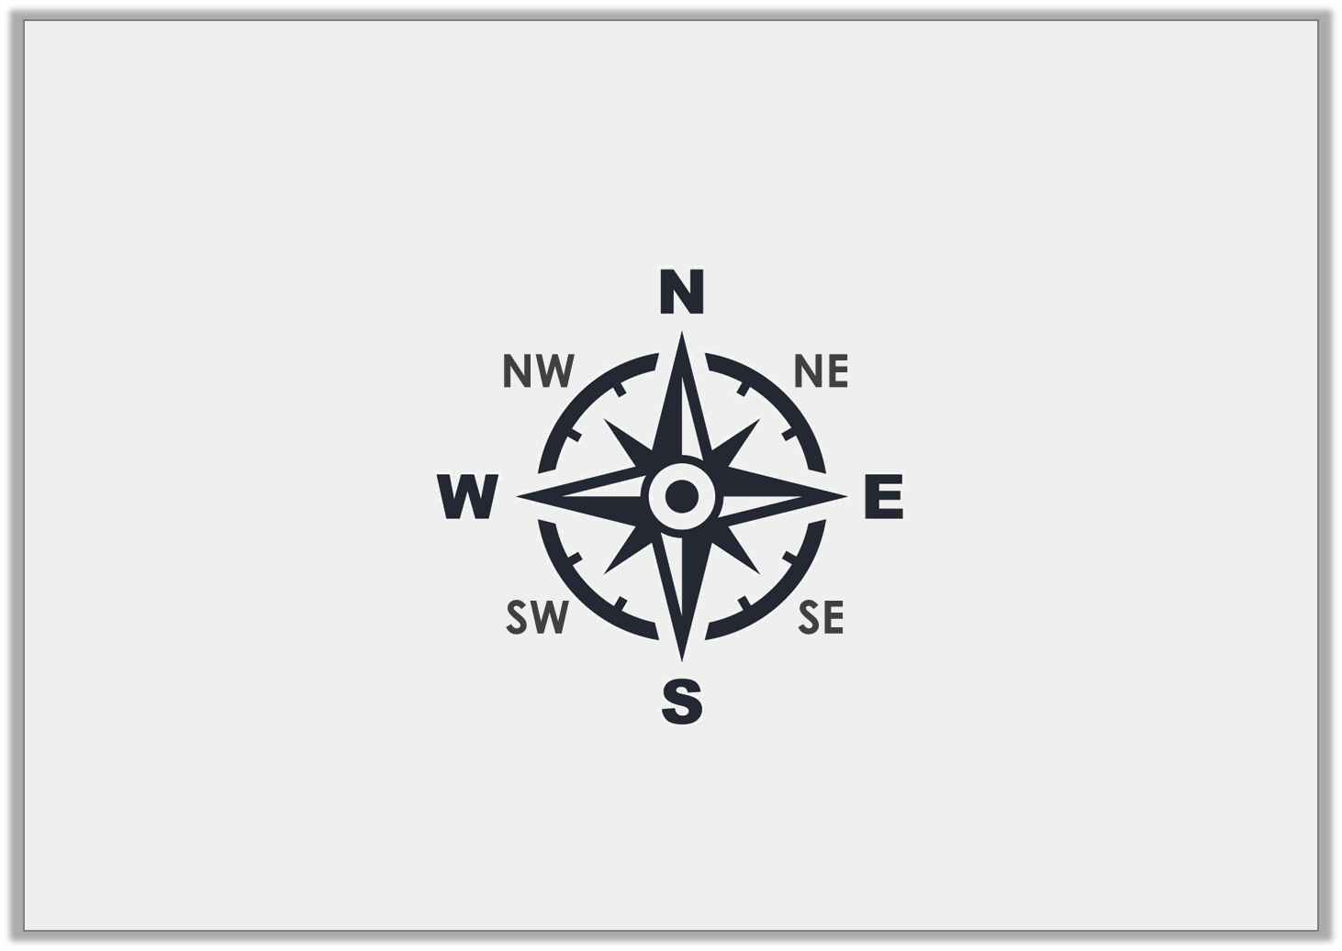
Varied Fluency 3
How many degrees will I move through if I turn from SE to N anti-clockwise?
Y5

Slide 10
Varied Fluency 3
How many degrees will I move through if I turn from SE to N anti-clockwise?
135°
Y5

Slide 11
Varied Fluency 4
How many turns are equal to 270°?
1
8
Y5

Slide 12
Varied Fluency 4
How many turns are equal to 270°?
6 turns
1
8
1
6
2
5
3
4
Y5

Slide 13
Varied Fluency 4
Use >, < or = to complete the equation.
3
4
360° |  | turn
Y5

Slide 14
Varied Fluency 4
Use >, < or = to complete the equation.
3
4
360° | > | turn
Y5

Slide 15
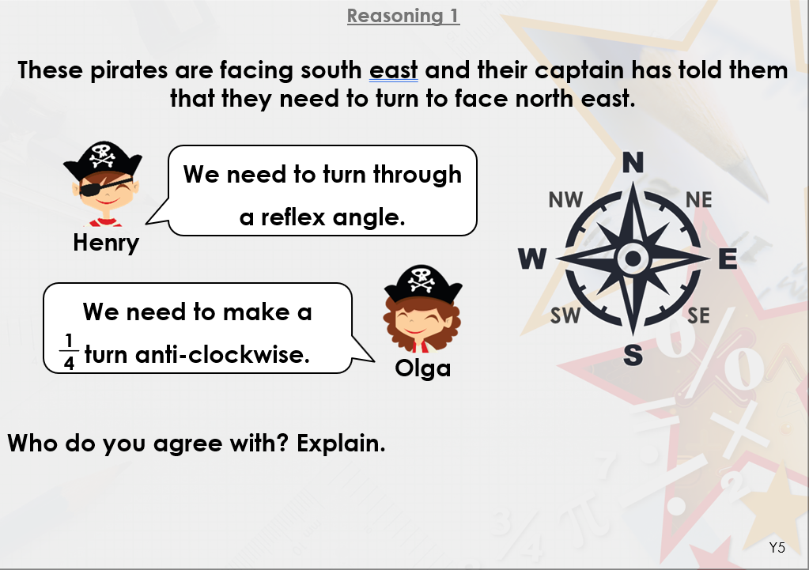
Wednesday 20th May 2020

Slide 16
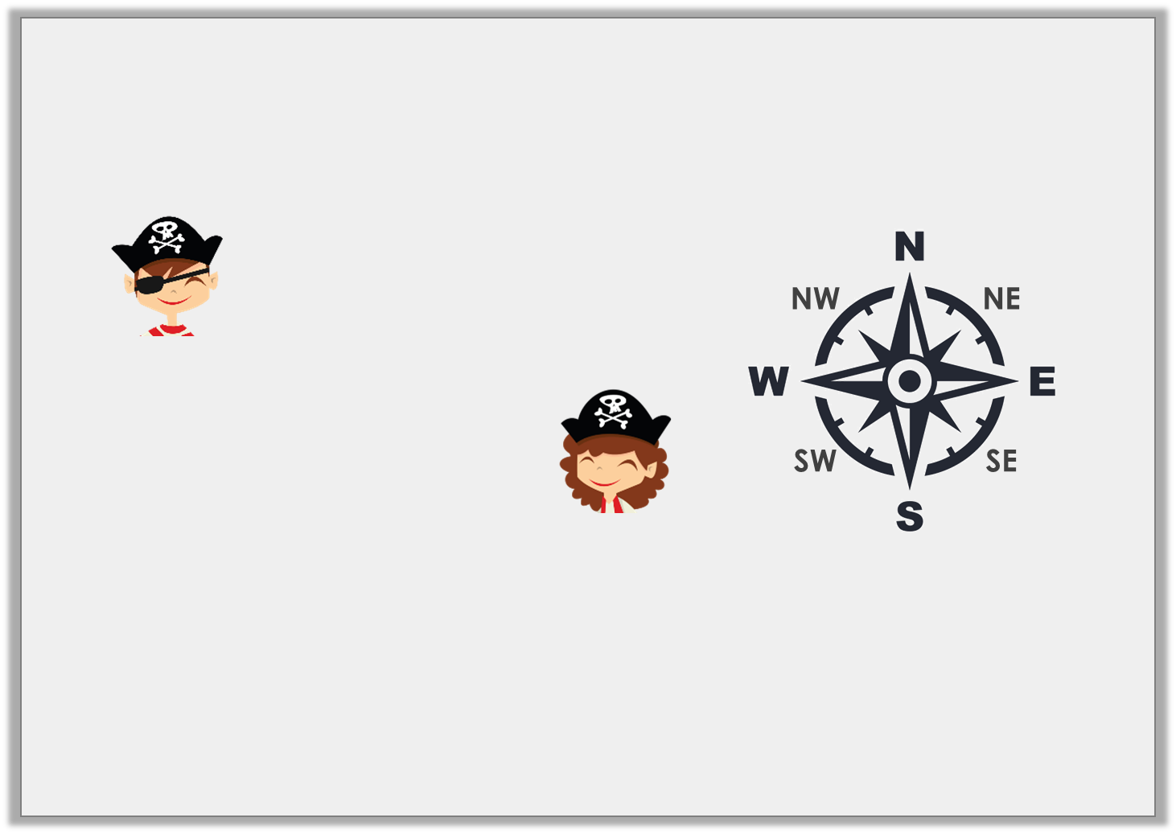
Reasoning 1
These pirates are facing south east and their captain has told them that they need to turn to face north east.
Who do you agree with? Explain.
They are both correct because…
We need to turn through
a reflex angle.
Henry
We need to make a turn anti-clockwise.
1
4
Olga
Y5

Slide 17
Reasoning 1
These pirates are facing south east and their captain has told them that they need to turn to face north east.
Who do you agree with? Explain.
They are both correct because a reflex angle of 270° clockwise will reach NE and a (90°) turn anti-clockwise will also reach NE.
We need to turn through
a reflex angle.
Henry
We need to make a turn anti-clockwise.
1
4
Olga
1
4
Y5

Slide 18
Problem Solving 1
Which of the following cards could be
used to complete the statement?
Give all of the possible answers.
N
NE
E
SE
S
SW
W
NW
A 270° turn | > | turning from NW to ______ anti-clockwise | > | a 90° turn
Y5

Slide 19
Problem Solving 1
Which of the following cards could be
used to complete the statement?
Give all of the possible answers.
S, SE and E.
N
NE
E
SE
S
SW
W
NW
A 270° turn | > | turning from NW to ______ anti-clockwise | > | a 90° turn
Y5

Slide 20
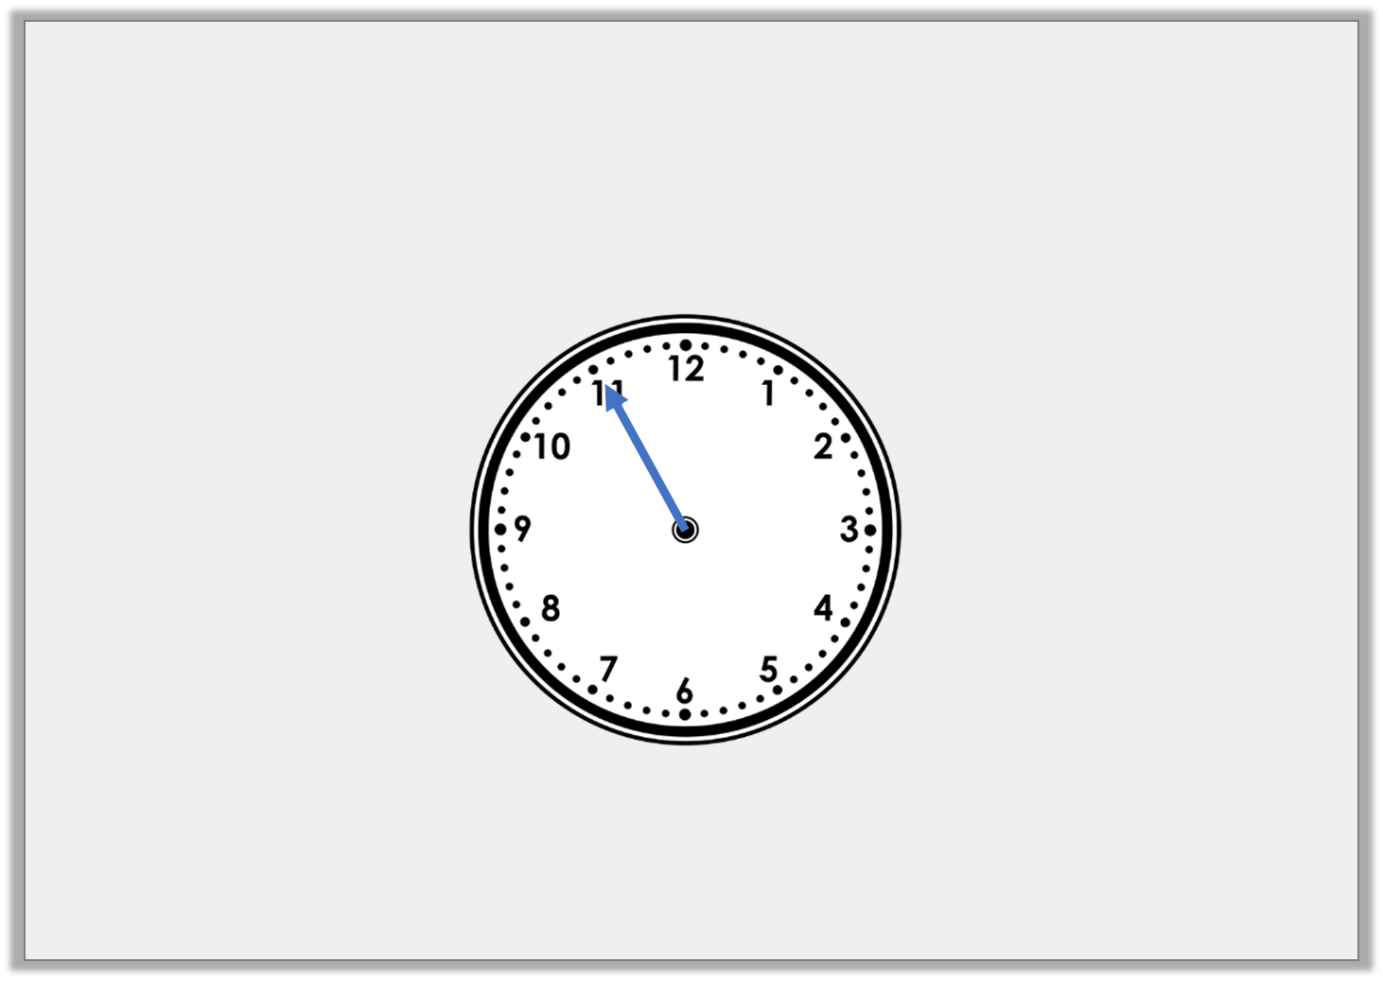
Problem Solving 2
Starting at 06:55, the minute hand makes more than 4 but
fewer than 7 quarter turns clockwise.
What times could the clock show after the turns?
Y5

Slide 21
Problem Solving 2
Starting at 06:55, the minute hand makes more than 4 but
fewer than 7 quarter turns clockwise.
What times could the clock show after the turns?
5 quarter turns clockwise – 08:10
6 quarter turns clockwise – 08:25
Y5

Slide 22
Year 5/6 – Summer Block 3 – Properties of Shape
Thursday 21st May 2020
Step 8
Year 5: Lengths and Angles in Shapes
Year 6: Angles in a
Triangle 1

Slide 23
Introduction
What do you know about the angles in this shape?
B
C
A
D
E
Y5

Slide 24
Introduction
What do you know about the angles in this shape?
Various answers, for example:
A + B + C + D + E = 360˚ A + B + C = 180˚ E + D = 180˚
B + C + D = 180˚ A + E = 180˚
B
C
A
D
E
Y5

Slide 25
Introduction
Look around your classroom.
How many straight 180˚ angles can you find?
Can you find any sets of three angles that add to make 180˚?
Y6

Slide 26
Introduction
Look around your classroom.
How many straight 180˚ angles can you find?
Possible answers: straight edge of desk, top of window or doorframe, pencil
Can you find any sets of three angles that add to make 180˚?
Possible answers: classroom door open at an angle making a triangle, bunting, any triangular figure
Y6

Slide 27
Varied Fluency 1
Calculate the length of side A and side B.
A
14cm
B
Y5

Slide 28
Varied Fluency 1
Calculate the length of side A and side B.
A = 28cm, B = 14cm
A
14cm
B
Y5

Slide 29
Varied Fluency 2
Calculate the angles of A, B, C and D.
B
C
A
D
Y5

Slide 30
Varied Fluency 2
Calculate the angles of A, B, C and D.
A = 135°; B = 90°; C = 90°; D = 45°
B
C
A
D
Y5

Slide 31
Varied Fluency 3
Side A is 16cm. True or false?
11cm
A
Y5

Slide 32
Varied Fluency 3
Side A is 16cm. True or false?
False, side A is 11cm
11cm
A
Y5

Slide 33
Varied Fluency 4
Match the angles and lengths to the shape.
A
1. 18cm
2. 135º
3. 10cm
4. 90º
B
C
D
Y5

Slide 34
Varied Fluency 4
Match the angles and lengths to the shape.
A
1. 18cm – D
2. 135º – B
3. 10cm – A
4. 90º – C
B
C
D
Y5

Slide 35
Varied Fluency 1
Which triangle has an obtuse angle?
45˚
A
50˚
30˚
B
45˚
65˚
C
65˚
Triangles not drawn to scale.
Y6

Slide 36
Varied Fluency 1
Which triangle has an obtuse angle?
45˚
A
50˚
30˚
B
45˚
65˚
C
65˚
Triangles not drawn to scale.
Y6

Slide 37
Varied Fluency 2
What kind of triangle is this?
55˚
55˚
Triangle not drawn to scale.
Y6

Slide 38
Varied Fluency 2
What kind of triangle is this?
Isosceles
55˚
55˚
Triangle not drawn to scale.
Y6

Slide 39
Varied Fluency 3
Find the missing angle.
?
30˚
Triangle not drawn to scale.
Y6

Slide 40
Varied Fluency 3
Find the missing angle.
60˚
30˚
Triangle not drawn to scale.
Y6

Slide 41
Varied Fluency 4
Which is the odd one out?
40˚
A
B
60˚
75˚
75˚
80˚
65˚
40˚
D
C
35˚
Triangles not drawn to scale.
Y6

Slide 42
Varied Fluency 4
Which is the odd one out?
B is an isosceles triangle and the rest are scalene.
40˚
A
B
60˚
75˚
75˚
80˚
65˚
40˚
D
C
35˚
Triangles not drawn to scale.
Y6

Slide 43
Reasoning 1
Friday 22nd May 2020
Adam thinks he has chosen the correct degrees for the total of angle A and angle B.
Do you agree? Explain why.
B
✓
135°
A
270°
90°
Y5

Slide 44
Reasoning 1
Adam thinks he has chosen the correct degrees for the total of angle A and angle B.
Do you agree? Explain why.
Adam is not correct because…
B
✓
135°
A
270°
90°
Y5

Slide 45
Reasoning 1
Adam thinks he has chosen the correct degrees for the total of angle A and angle B.
Do you agree? Explain why.
Adam is not correct because each angle is 45°. 45° + 45° = 90°
B
✓
135°
A
270°
90°
Y5

Slide 46
Problem Solving 1
Amélie has a rectangle with a perimeter of 34cm.
Sides A and C are 3cm shorter than sides B and D.
What length is each side?
B
A
C
D
Y5

Slide 47
Problem Solving 1
Amélie has a rectangle with a perimeter of 34cm.
Sides A and C are 3cm shorter than sides B and D.
What length is each side?
10cm
7cm
7cm
10cm
Y5

Slide 48
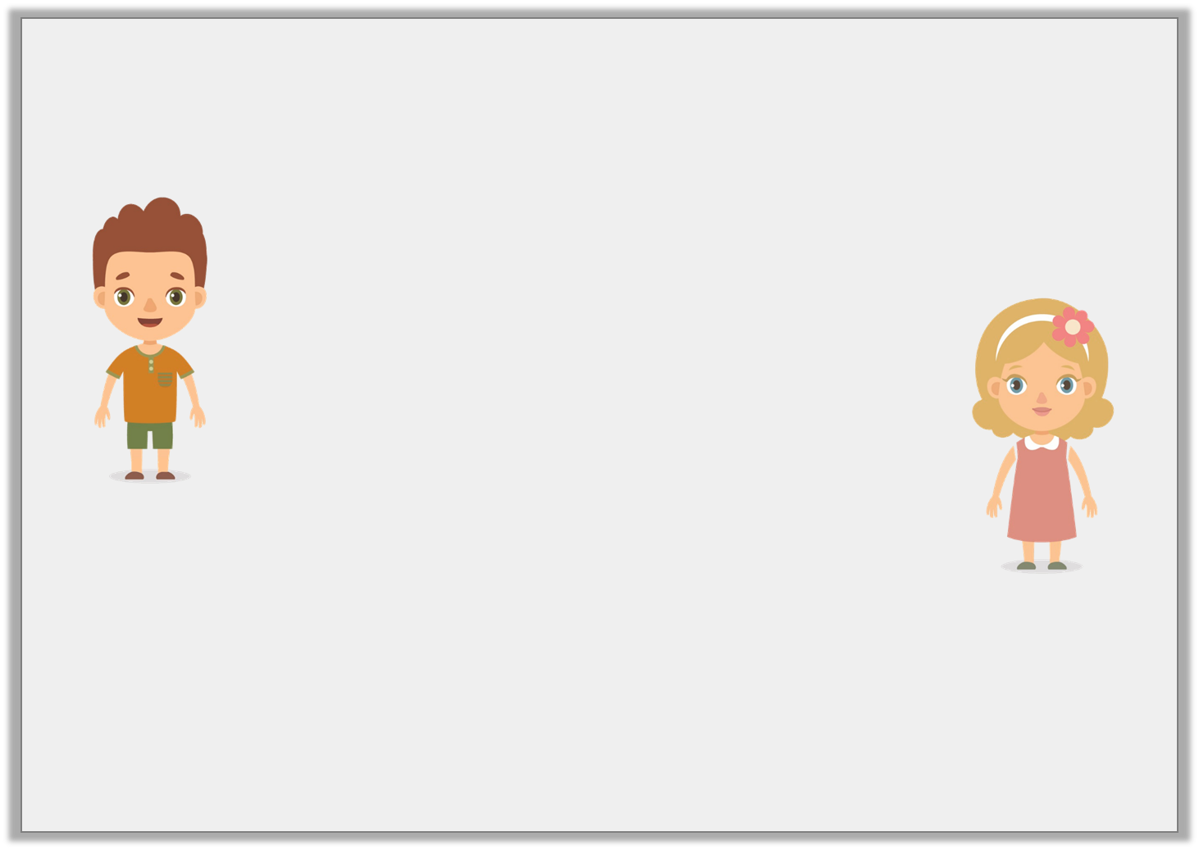
Reasoning 2
Shane and Elizabeth are calculating angles in a shape.
Who is correct? Why?
A right angle split into 3 will always have 3 angles of 30º.
A right angle split into 3 can have any 3 angles with a sum of 90º.
Shane
Elizabeth
Y5

Slide 49
Reasoning 2
Shane and Elizabeth are calculating angles in a shape.
Who is correct? Why?
Elizabeth is correct because…
Shane is not correct because…
A right angle split into 3 will always have 3 angles of 30º.
A right angle split into 3 can have any 3 angles with a sum of 90º.
Shane
Elizabeth
Y5

Slide 50
Reasoning 2
Shane and Elizabeth are calculating angles in a shape.
Who is correct? Why?
Elizabeth is correct because as long as the angles add up to 90°, the angles can be any size.
Shane is not correct because a right angle split into 3 would only have 30° angles if they were split equally.
A right angle split into 3 will always have 3 angles of 30º.
A right angle split into 3 can have any 3 angles with a sum of 90º.
Shane
Elizabeth
Y5

Slide 51
Problem Solving 1
Use these clues to draw a triangle.
The triangle has a base of 4cm.
Angle C is 80˚.
Angles A and B are the same.
What kind of triangle have you drawn?
Y6

Slide 52
Problem Solving 1
Use these clues to draw a triangle.
The triangle has a base of 4cm.
Angle C is 80˚.
Angles A and B are the same.
What kind of triangle have you drawn?
Isosceles triangle
80˚
50˚
50˚
Triangle not drawn to scale.
Y6

Slide 53
Problem Solving 2
Match each triangle to the best description.
1. This triangle has three equal sides and angles.
2. This triangle is missing an obtuse angle.
3. This triangle’s missing angle is half of it’s marked acute angle.
45˚
60˚
A
B
C
15˚
Triangles not drawn to scale.
Y6

Slide 54
Problem Solving 2
Match each triangle to the best description.
1. This triangle has three equal sides and angles. B
2. This triangle is missing an obtuse angle. A
3. This triangle’s missing angle is half of it’s marked acute angle. C
45˚
60˚
A
B
C
15˚
Triangles not drawn to scale.
Y6

Slide 55
Reasoning 1
Jameela says,
Is she correct? Explain why or why not.
I have drawn an equilateral triangle. One side is 10 centimetres long and the angles measure 35˚, 105˚ and 40˚.
Y6

Slide 56
Reasoning 1
Jameela says,
Is she correct? Explain why or why not.
Jameela is incorrect because...
I have drawn an equilateral triangle. One side is 10 centimetres long and the angles measure 35˚, 105˚ and 40˚.
Y6

Slide 57
Reasoning 1
Jameela says,
Is she correct? Explain why or why not.
Jameela is incorrect because the three angles in her triangle are different sizes. She has drawn a scalene triangle.
I have drawn an equilateral triangle. One side is 10 centimetres long and the angles measure 35˚, 105˚ and 40˚.
Y6

