Slide 1
Tuesday 19th May 2020

Slide 2
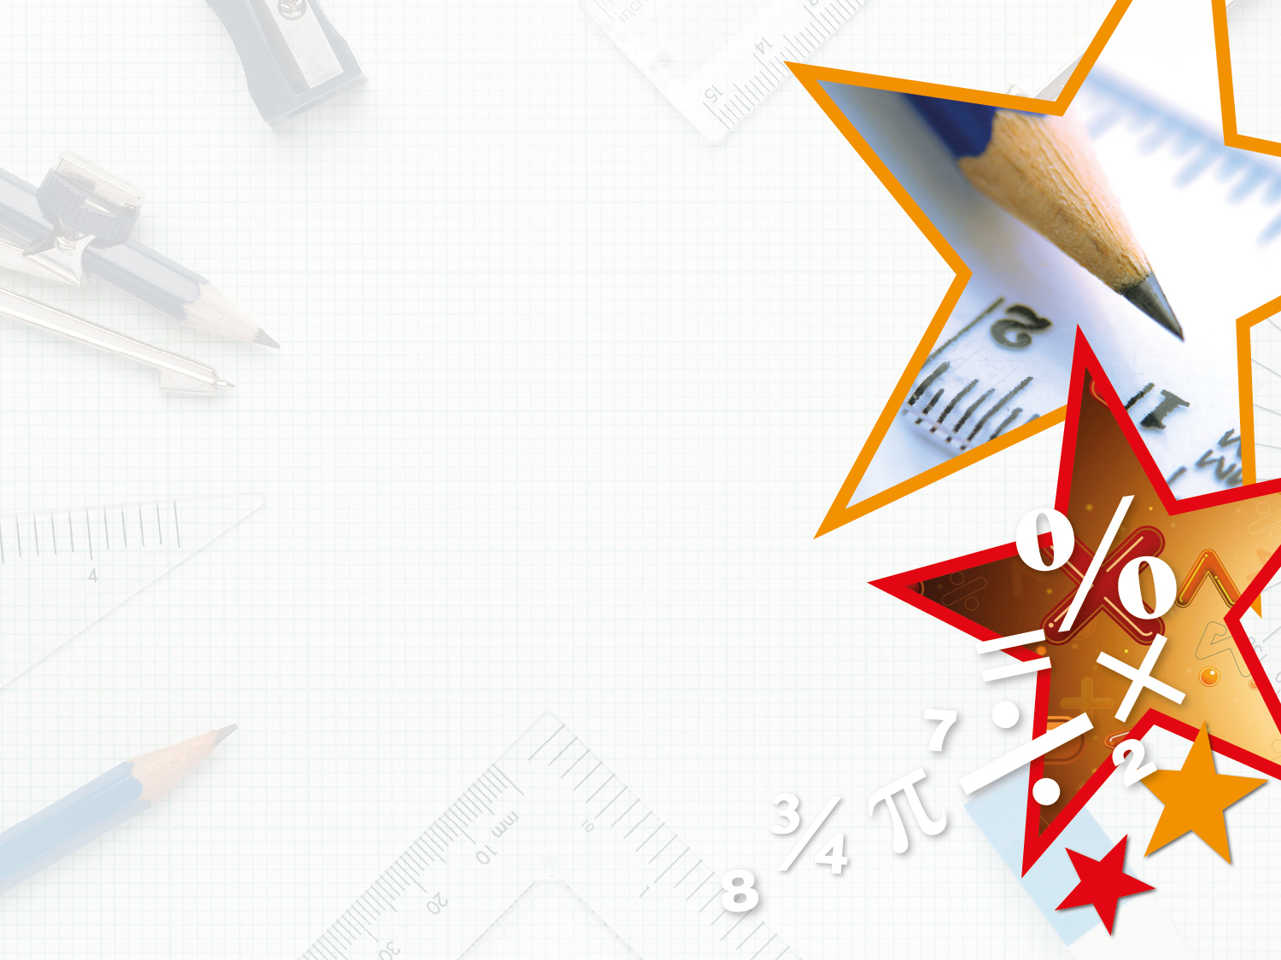
Step 1
Year 3: To know the number of seconds in a minute and the number of days in each month, year and leap year
Months and Years

Slide 3
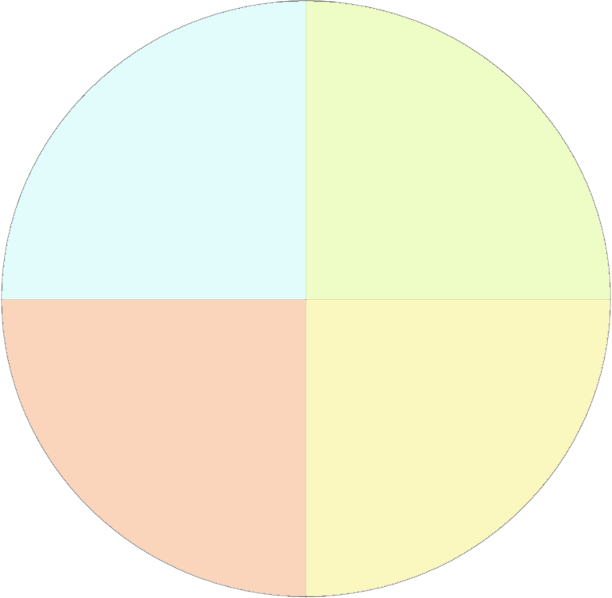
Introduction
Decide which month should go in which season and place them in the correct order.
July
Winter
Spring
November
September
March
October
December
June
Autumn
Summer
April
May
August
February
January
Y3

Slide 4
Introduction
Decide which month should go in which season and place them in the correct order.
July
Winter
Spring
November
September
December
March
March
January
April
February
May
October
December
June
Autumn
Summer
April
September
June
May
October
July
August
November
August
February
January
Y3

Slide 5
Introduction
Which months have the most days?
Which month has the fewest days?
How many months have 28 days?
How many days are in one year?
How many weeks are in two years?
How often do leap years occur?
Which month gets an extra day in a leap year?
Y4

Slide 6
Introduction
Which months have the most days?
January, March, May, July, August, October and December
Which month has the fewest days?
February
How many months have 28 days?
All of them
How many days are in one year?
365
How many weeks are in two years?
104
How often do leap years occur?
Every four years
Which month gets an extra day in a leap year?
February
Y4

Slide 7
Varied Fluency 1
Circle the month or months that do not have 30 days in total.
The eighth month of the year | April | The month before March
Y3

Slide 8
Varied Fluency 1
Circle the month or months that do not have 30 days in total.
The eighth month of the year | April | The month before March
Y3

Slide 9
Varied Fluency 2
Write the date a week later.
28th February (non-leap year)
30th December
Y3

Slide 10
Varied Fluency 2
Write the date a week later.
28th February (non-leap year) | 7th March
30th December | 6th January
Y3

Slide 11
Varied Fluency 3
Complete the table.
Number of days in the fifth month of the year
Number of days in 2019
Number of days in February in a _________ year | 29
Y3

Slide 12
Varied Fluency 3
Complete the table.
Number of days in the fifth month of the year | 31
Number of days in 2019 | 365
Number of days in February in a leap year | 29
Y3

Slide 13
Varied Fluency 4
Draw lines to match the statements to the missing parts.
There are ________ days in the 10th month of the year |  | 4
There were ________ days between August and January |  | 31
The month before March has ________ days |  | 30
Y3

Slide 14
Varied Fluency 4
Draw lines to match the statements to the missing parts.
There are ________ days in the 10th month of the year |  | 4
There were ________ days between August and January |  | 31
The month before March has ________ days |  | 30
Y3

Slide 15
Wednesday 20th May 2020
To know the number of seconds in a minute and the number of days in each month, year and leap year using reasoning and problem solving

Slide 16
Reasoning 1
Are the following statements always true, sometimes true or never true?
March has fewer days than September
A year has 366 days
January is the first month of the year
2020 will be a leap year
Explain your reasoning.
A.
B.
C.
D.
Y3

Slide 17
Reasoning 1
Are the following statements always true, sometimes true or never true?
March has fewer days than September
Never true because March has 31 days and September has 30 days.
B. A year has 366 days
Sometimes true because a leap year has 366 days but a non-leap year has 365 days.
C. January is the first month of the year
Always true.
D. 2020 will be a leap year
Always true because leap years happen every four years, and the last one was 2016.
Y3

Slide 18
Reasoning 2
Which card is the odd out one?
Explain your reasoning.
The month before September
June
The first month of the year
Y3

Slide 19
Reasoning 2
Which card is the odd out one?
Explain your reasoning.
June is the odd one out because…
The month before September
June
The first month of the year
Y3

Slide 20
Reasoning 2
Which card is the odd out one?
Explain your reasoning.
June is the odd one out because June has 30 days whereas August (the month before September) and January (the first month of the year) both have 31 days.
The month before September
June
The first month of the year
Y3

Slide 21
Problem Solving 1
Complete the table about the siblings’ dates of birth using the information below.
Jaxon’s birthday is two days after Christmas.
Harvey’s birthday is in August.
Harvey’s birthday is on the same day of the month as Jaxon’s.
Delilah’s birthday is in the month before Harvey’s.
 |  | 27 | / | 12 | / | 2012
 |  |  | / |  | / | 2008
Delilah |  | 6 | / |  | / | 2004
Y3

Slide 22
Problem Solving 1
Complete the table about the siblings’ dates of birth using the information below.
Jaxon’s birthday is two days after Christmas.
Harvey’s birthday is in August.
Harvey’s birthday is on the same day of the month as Jaxon’s.
Delilah’s birthday is in the month before Harvey’s.
Jaxon |  | 27 | / | 12 | / | 2012
Harvey |  | 27 | / | 8 | / | 2008
Delilah |  | 6 | / | 7 | / | 2004
Y3

Slide 23
Year 3/4 – Summer Block 3 – Measurement and Time
Thursday 21st May 2020
Step 2
Year 3: To know the number of seconds in a minute and the number of days in each month, year and leap year

Slide 24
Introduction
Sort the months.
There are ______ days in a year.
There are _____ days in a leap year.
There are _____ months in a year.
30 days | 31 days | 28 or 29 days
January
February
March
April
May
July
June
August
September
October
November
December
Y3

Slide 25
Introduction
Sort the months.
There are 365 days in a year.
There are 366 days in a leap year.
There are 12 months in a year.
30 days | 31 days | 28 or 29 days
April June September November | January March May July August October December | February
Y3

Slide 26
Varied Fluency 1
Match the statements to the correct number.
days in April |  | 4
hours in 3 days |  | 30
days in two weekends |  | 72
Y3

Slide 27
Varied Fluency 1
Match the statements to the correct number.
days in April |  | 4
hours in 3 days |  | 30
days in two weekends |  | 72
Y3

Slide 28
Varied Fluency 2
Put these events in the correct order from earliest to latest.
home time |  | morning registration
afternoon playtime |  | noon
Y3

Slide 29
Varied Fluency 2
Put these events in the correct order from earliest to latest.
morning registration
noon
afternoon playtime
home time
home time |  | morning registration
afternoon playtime |  | noon
Y3

Slide 30
Varied Fluency 3
Fill in the blanks:
There are _________ days in five weeks.
There are 12 ___________ in half a day.
Y3

Slide 31
Varied Fluency 3
Fill in the blanks:
There are _________ days in five weeks.
There are 12 ___________ in half a day.
35
hours
Y3

Slide 32
Varied Fluency 4
True or false?
Lunch is served around midday.
Y3

Slide 33
Varied Fluency 4
True or false?
Lunch is served around midday.
True because...
Y3

Slide 34
Varied Fluency 4
True or false?
Lunch is served around midday.
True because lunch is served in the ‘middle’ of the day – usually about 12 o’clock.
Y3

Slide 35
Friday 22nd May 2020
Year 3: To know the number of seconds in a minute and the number of days in each month, year and leap year using reasoning.

Slide 36
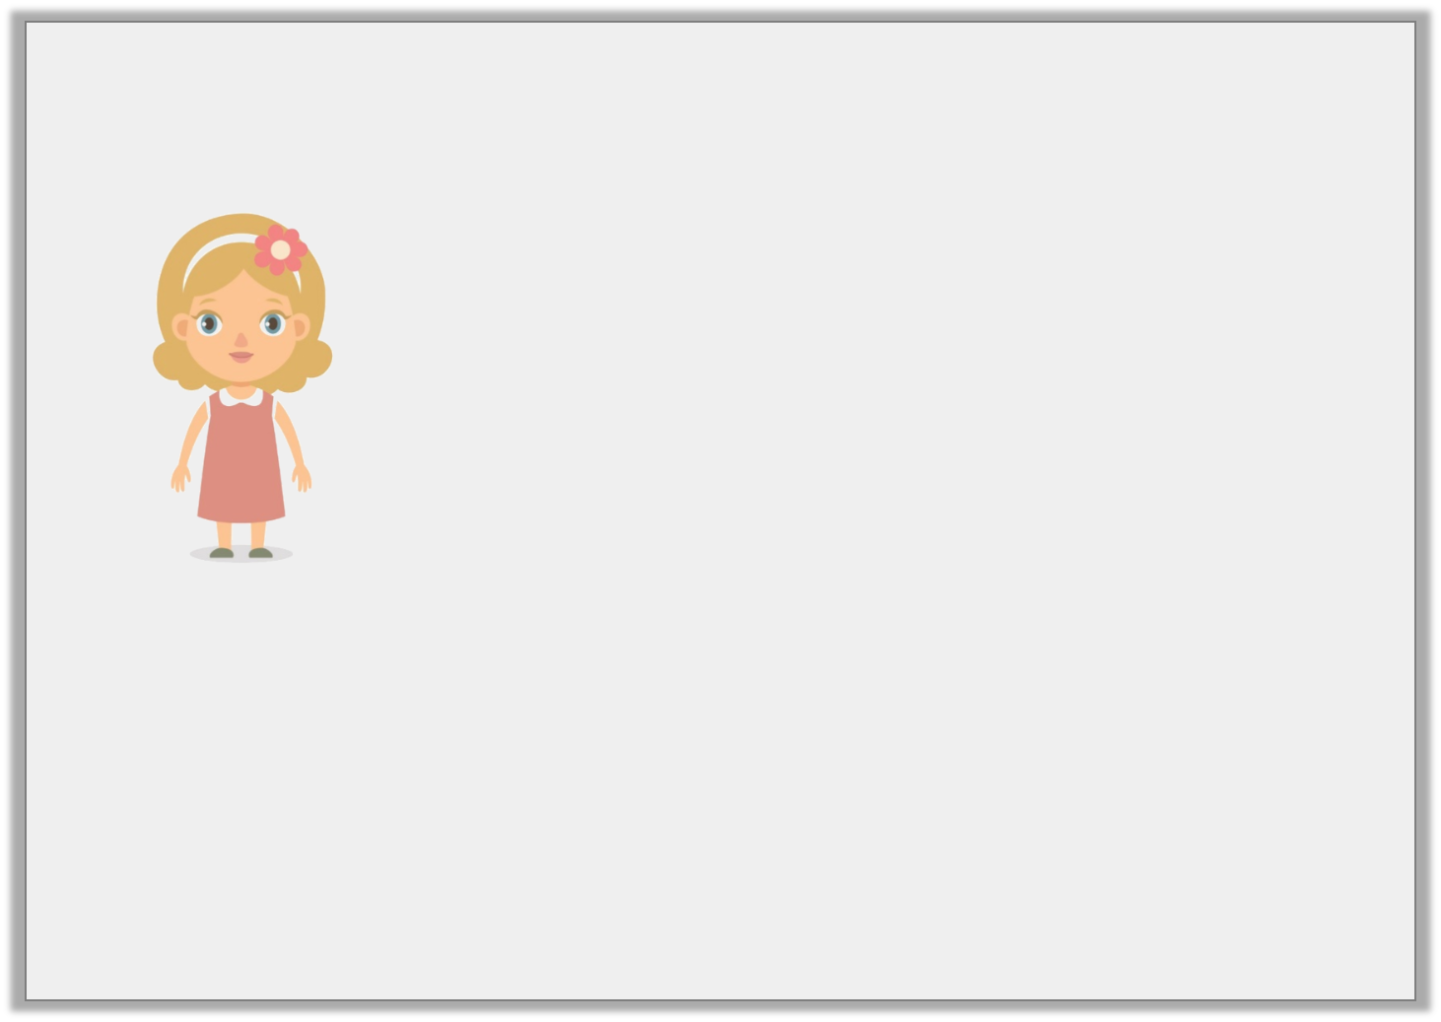
Reasoning 1
Ellie says:
Is that possible? Explain how you know.
Lunchtime is at 12 o’clock. So, whenever a clock shows 12 o’clock it has to be lunchtime.
Y3

Slide 37
Reasoning 1
Ellie says:
Is that possible? Explain how you know.
Ellie is incorrect because …
Lunchtime is at 12 o’clock. So, whenever a clock shows 12 o’clock it has to be lunchtime.
Y3

Slide 38
Reasoning 1
Ellie says:
Is that possible? Explain how you know.
Ellie is incorrect because a clock can say 12 o’clock in the middle of the night and in the middle of the day. Only one of those is lunchtime.
Lunchtime is at 12 o’clock. So, whenever a clock shows 12 o’clock it has to be lunchtime.
Y3

Slide 39
Reasoning 2
True or false?
“Today the sunset was at 8 o’clock. That means every day must finish at 8 o’clock.”
Explain how you know.
Y3

Slide 40
Reasoning 2
True or false?
“Today the sunset was at 8 o’clock. That means every day must finish at 8 o’clock.”
Explain how you know.
False because…
Y3

Slide 41
Reasoning 2
True or false?
“Today the sunset was at 8 o’clock. That means every day must finish at 8 o’clock.”
Explain how you know.
False because the sun sets at different times (depending on the season) and this doesn’t always mean the day has ended.
Y3

Slide 42
Problem Solving 1
How many days in this month are not weekend days?
Mo | Tu | We | Thu | Fri | Sa | Su
 |  |  | 1 | 2 | 3 | 4
5 | 6 | 7 | 8 | 9 | 10 | 11
12 | 13 | 14 | 15 | 16 | 17 | 18
19 | 20 | 21 | 22 | 23 | 24 | 25
26 | 27 | 28
Y3

Slide 43
Problem Solving 1
How many days in this month are not weekend days?
20 days are not weekend days
Mo | Tu | We | Thu | Fri | Sa | Su
 |  |  | 1 | 2 | 3 | 4
5 | 6 | 7 | 8 | 9 | 10 | 11
12 | 13 | 14 | 15 | 16 | 17 | 18
19 | 20 | 21 | 22 | 23 | 24 | 25
26 | 27 | 28
Y3

