Slide 1
Problem Solving 1
Zak has dropped paint on his book.
How many marbles could be covered by the paint? There cannot be more than 20.
most
least
Y1

Slide 2
Problem Solving 1
Zak has dropped paint on his book.
How many marbles could be covered by the paint? There cannot be more than 20.
There could be 15, 16, 17, 18, 19 or 20 marbles covered by the paint.
most
least
Y1

Slide 3
Reasoning 1
Emma is comparing Base 10.
A.
B.
She writes:
Is she correct? Prove it.
A is more than B
Y2

Slide 4
Reasoning 1
Emma is comparing Base 10.
A.
B.
She writes:
Is she correct? Prove it.
No. Emma is incorrect because…
A is more than B
Y2

Slide 5
Reasoning 1
Emma is comparing Base 10.
A.
B.
She writes:
Is she correct? Prove it.
No. Emma is incorrect because set A has 47 and set B has 48. 47 is less than 48.
A is more than B
Y2

Slide 6
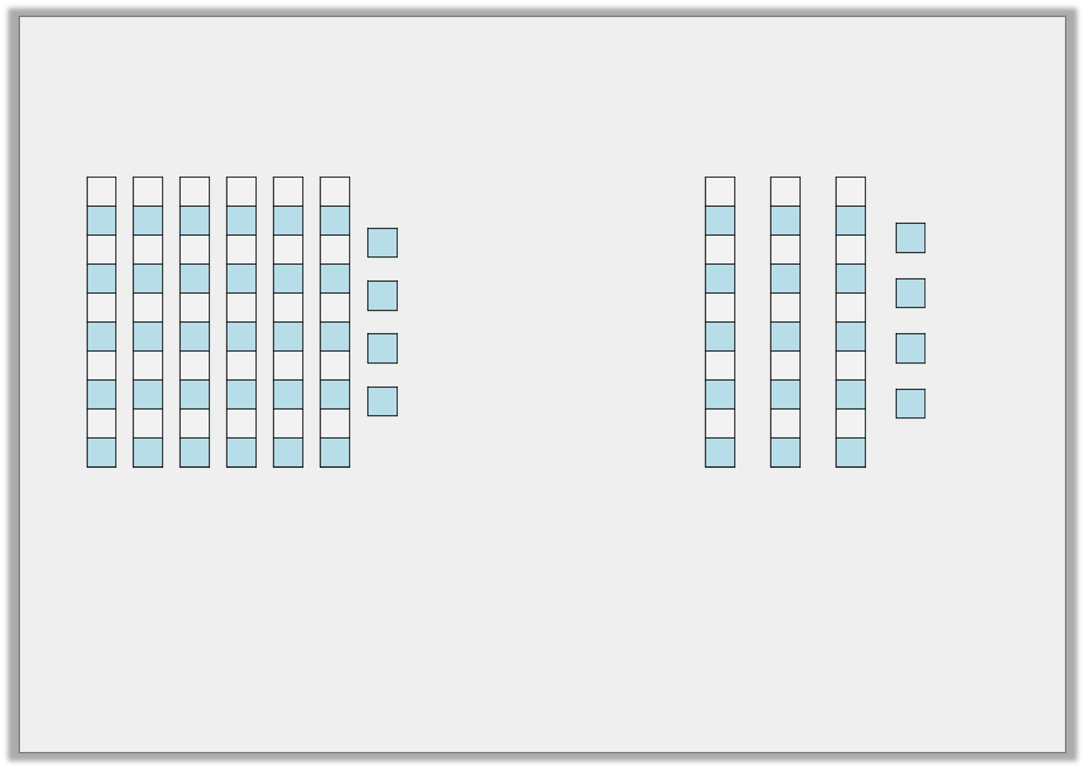
Reasoning 2
Mark and Samantha are collecting cubes.
Mark
Samantha
How many more does Samantha need so that she has more than Mark? Explain your answer.
Y2

Slide 7
Reasoning 2
Mark and Samantha are collecting cubes.
Mark
Samantha
How many more does Samantha need so that she has more than Mark? Explain your answer.
Samantha needs 31 more cubes because…
Y2

Slide 8
Reasoning 2
Mark and Samantha are collecting cubes.
Mark
Samantha
How many more does Samantha need so that she has more than Mark? Explain your answer.
Samantha needs 31 more cubes because Mark has 64 and Samantha has 34. 31 more than 34 is 65.
Y2

Slide 9
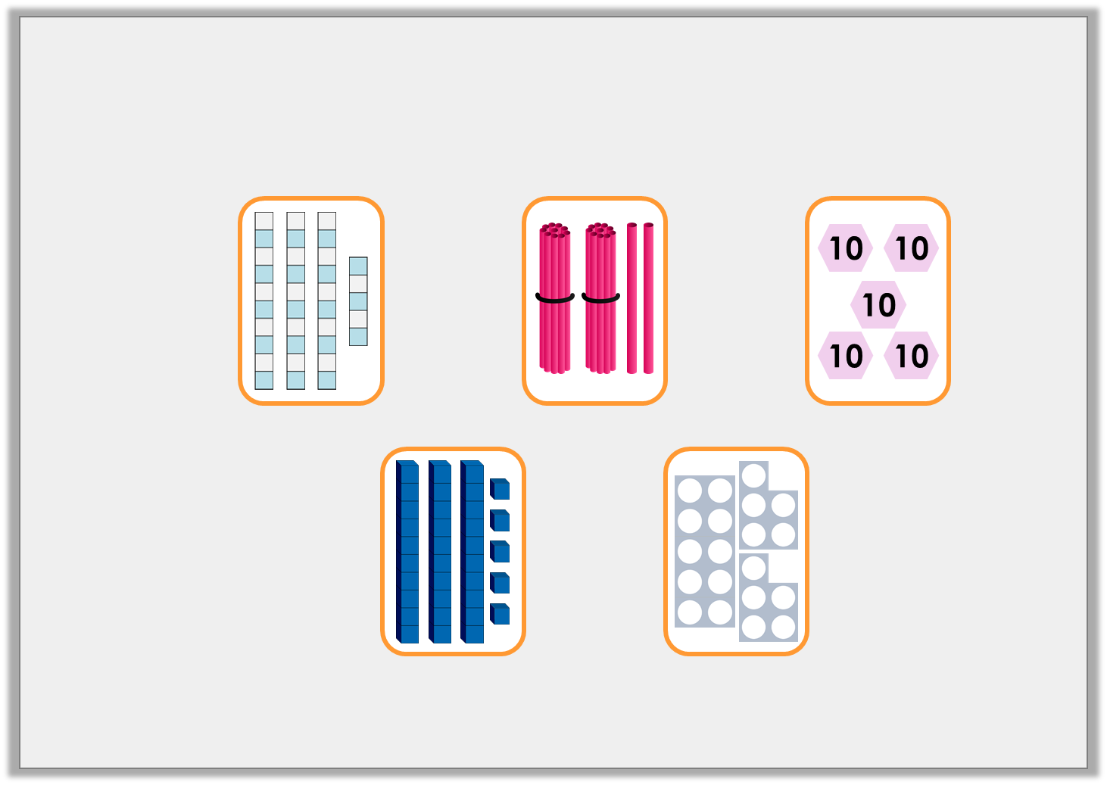
Problem Solving 1
Use two cards at a time to create four different number sentences using >, < or =.
A.
B.
C.
D.
E.
Y2

Slide 10
Problem Solving 1
Use two cards at a time to create four different number sentences using >, < or =.
A.
B.
C.
D.
E.
Various answers, for example: A > E; B < C; A = D.
Y2

