Slide 1

Year 3/4 – Summer Block 1 – Money
Tuesday 12th May 2020
Step 5
Year 3/4: I can subtract amount of money

Slide 2
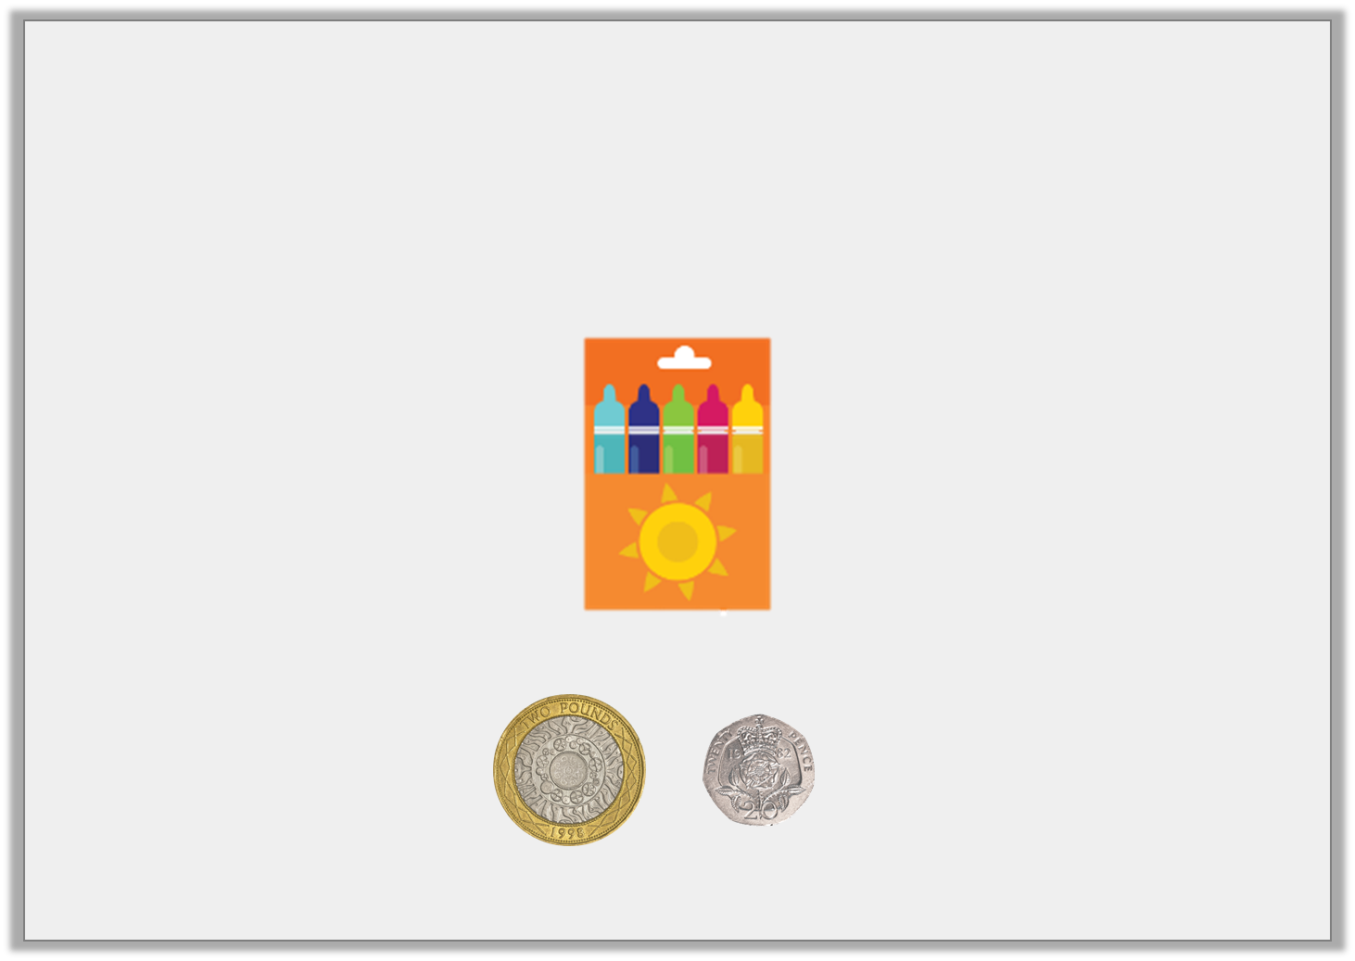
Introduction
Jack is saving to buy a packet of felt tips.
How much more money does he need to save?
£3 and 35p
Y3

Slide 3
Introduction
Jack is saving to buy a packet of felt tips.
How much more money does he need to save?
He needs to save another £1 and 15p
£3 and 35p
Y3

Slide 4
Varied Fluency 1
Complete the missing numbers on the number line.
100p
5p
30p
 |  |  |  |  |  | 550p
Y3

Slide 5
Varied Fluency 1
Complete the missing numbers on the number line.
100p
5p
30p
415p |  | 420p |  | 450p |  | 550p
Y3

Slide 6
Varied Fluency 2
Complete the subtraction below.
 | £16 and 50p
– | £12 and 25p
Y3

Slide 7
Varied Fluency 2
Complete the subtraction below.
 | £16 and 50p
– | £12 and 25p
 | £4 and 25p
Y3

Slide 8
Varied Fluency 3
Complete the part whole model.
£7 and 85p
£3 and 50p
Y3

Slide 9
Varied Fluency 3
Complete the part whole model.
£7 and 85p
£3 and 50p
£4 and 35p
Y3

Slide 10
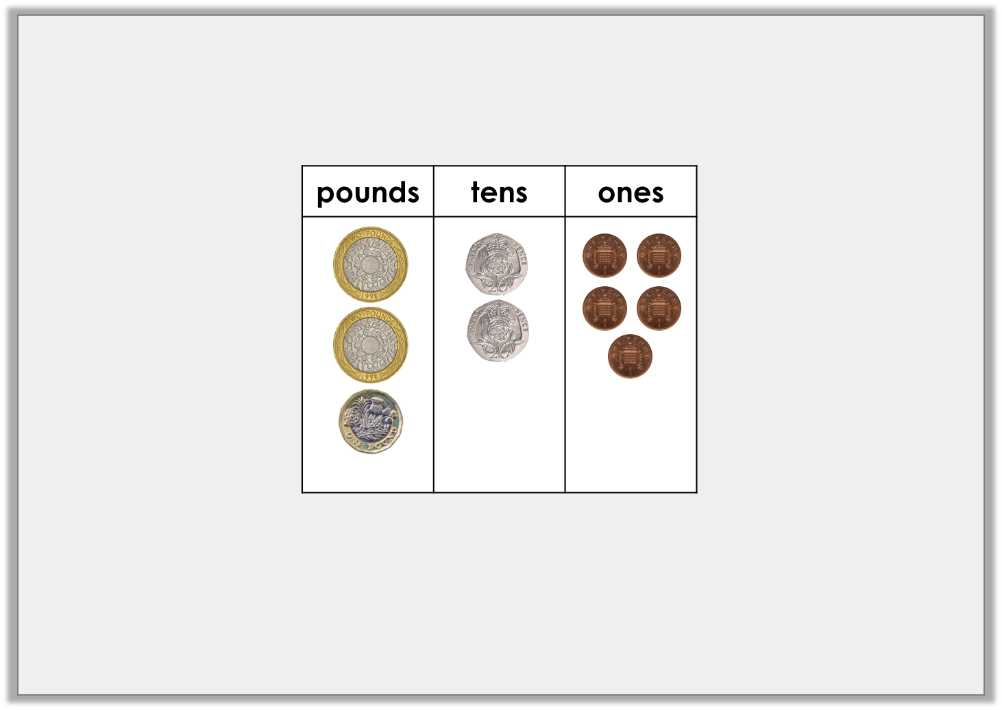
Varied Fluency 4
Take away £2 and 65p from the amount below. How much is left?
Y3

Slide 11
Varied Fluency 4
Take away £2 and 65p from the amount below. How much is left?
£2 and 80p
Y3

Slide 12
Wednesday 13th May 2020
Year 3/4: I can subtract amount of money using reasoning and problem-solving

Slide 13
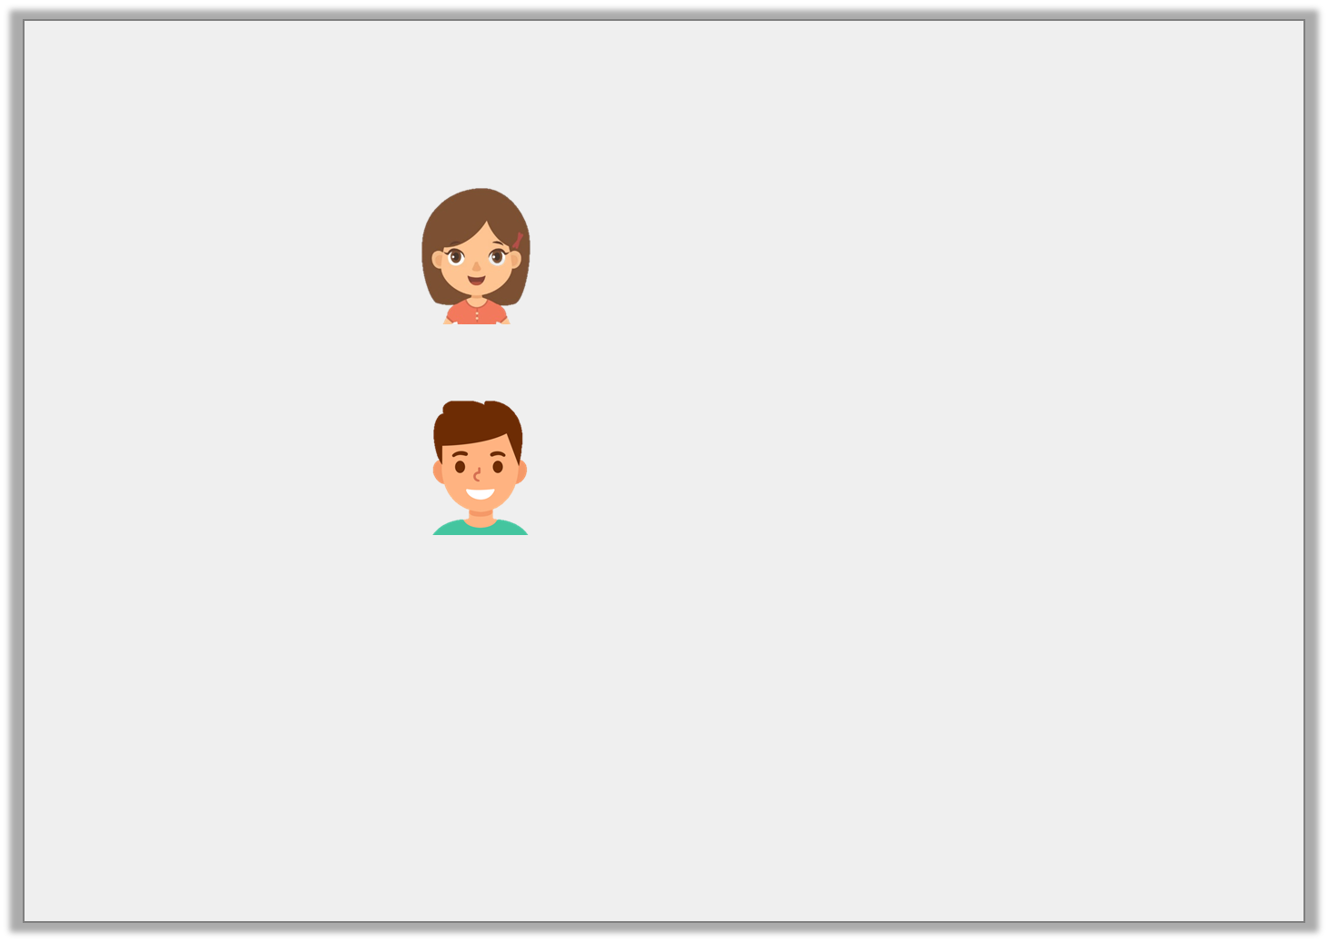
Reasoning 1
Jenny and Sam have saved some money.
How much more money does Jenny have than Sam?
Explain how you know.
I have £13 and 80p
Jenny
I have £11 and 45p
Sam
Y3

Slide 14
Reasoning 1
Jenny and Sam have saved some money.
How much more money does Jenny have than Sam?
Explain how you know.
Jenny has £2 and 35p more than Sam because…
I have £13 and 80p
Jenny
I have £11 and 45p
Sam
Y3

Slide 15
Reasoning 1
Jenny and Sam have saved some money.
How much more money does Jenny have than Sam?
Explain how you know.
Jenny has £2 and 35p more than Sam because
£13 and 80p ― £11 and 45p = £2 and 35p.
I have £13 and 80p
Jenny
I have £11 and 45p
Sam
Y3

Slide 16
Reasoning 2
Find and explain the error in this subtraction.
 | 2 | 5 | 5 | p
_ |  | 8 | 0 | p
 | 2 | 3 | 5 | p
Y3

Slide 17
Reasoning 2
Find and explain the error in this subtraction.
The error is in the tens column because…
 | 2 | 5 | 5 | p
_ |  | 8 | 0 | p
 | 2 | 3 | 5 | p
Y3

Slide 18
Reasoning 2
Find and explain the error in this subtraction.
The error is in the tens column because 5 has been taken away from 8. The correct answer is 175p.
 | 2 | 5 | 5 | p
_ |  | 8 | 0 | p
 | 2 | 3 | 5 | p
Y3

Slide 19
Problem Solving 1
Complete the number sentence using 4 of the cards below.
Find 2 possible solutions.
7
6
5
3
2
1
 |  |  |  |  | 5 | p
– |  |  |  |  | 0 | p
 | 4 |  | 3 |  | 5 | p
Y3

Slide 20
Problem Solving 1
Complete the number sentence using 4 of the cards below.
Find 2 possible solutions.
7
6
5
3
2
1
 | 7 |  | 5 |  | 5 | p
– | 3 |  | 2 |  | 0 | p
 | 4 |  | 3 |  | 5 | p
 |  | 5 |  | 6 |  | 5 | p
– |  | 1 |  | 3 |  | 0 | p
 |  | 4 |  | 3 |  | 5 | p
Y3

Slide 21
Year 3/4 – Summer Block 1 – Money
Thursday 14th May 2020
Step 6
Year 3/4:
I can add and subtract amounts of money to give change

Slide 22

Introduction
A robot costs £7 and 90p.
If you give the shop keeper a £10 note, what will your change be?
How could you work out the answer?
Y3

Slide 23
Introduction
A robot costs £7 and 90p.
If you give the shop keeper a £10 note, what will your change be?
How could you work out the answer?
The change will be £2 and 10p
There are various ways to work this out.
You could subtract £7 and 90 from £10, or count on from £7 and 90p to £10 on a number line.
Y3

Slide 24
Varied Fluency 1
Amy buys a book for £7 and 68p. She pays with a £10 note.
Complete the number line to work out his change.
?
£7 and 68p |  | £7 and 70p |  | £8 |  | £10
?
?
Y3

Slide 25
Varied Fluency 1
Amy buys a book for £7 and 68p. She pays with a £10 note.
Complete the number line to work out his change.
The change will be £2 and 32p
£2
£7 and 68p |  | £7 and 70p |  | £8 |  | £10
2p
30p
Y3

Slide 26
Varied Fluency 2
Sophie goes swimming. It costs £3 and 75p. She pays with a £5 note.
What will her change be?
£5
£3 and 75p | ?
Y3

Slide 27
Varied Fluency 2
Sophie goes swimming. It costs £3 and 75p. She pays with a £5 note.
What will her change be?
Her change will be £1 and 25p.
£5
£3 and 75p | £1 and 25p
Y3

Slide 28
Varied Fluency 3
Joe buys an ice-cream for 87p. He pays with a £2 coin.
Calculate his change.
£2
?
87p
Y3

Slide 29
Varied Fluency 3
Joe buys an ice-cream for 87p. He pays with a £2 coin.
Calculate his change.
His change will be £1 and 13p
£2
£1 and 13p
87p
Y3

Slide 30

Varied Fluency 4
If you buy the ball and the yoyo, what will your change be if you pay with a £10 note?
£2 and 30p |  | £3 and 65p
Y3

Slide 31
Varied Fluency 4
If you buy the ball and the yoyo, what will your change be if you pay with a £10 note?
The ball and the yoyo cost £5 and 95p altogether.
The change will be £4 and 5p
£2 and 30p |  | £3 and 65p
Y3

Slide 32
Friday 15th May 2020
Step 6
Year 3/4:
I can add and subtract amounts of money to give change using reasoning

Slide 33

Reasoning 1
A chocolate bar costs £1 and 44p. Joe buys 2 bars. He gives the shop keeper a £5 note. Who is correct? Prove it.
I think the change will be £2 and 2p.
Joe
I think the change will be £2 and 12p.
Evie
Y3

Slide 34
Reasoning 1
A chocolate bar costs £1 and 44p. Joe buys 2 bars. He gives the shop keeper a £5 note. Who is correct? Prove it.
Evie is correct because…
I think the change will be £2 and 2p.
Joe
I think the change will be £2 and 12p.
Evie
Y3

Slide 35
Reasoning 1
A chocolate bar costs £1 and 44p. Joe buys 2 bars. He gives the shop keeper a £5 note. Who is correct? Prove it.
Evie is correct because two chocolate bars cost £1 and 44p + £1 and 44 = £2 and 88p.
I think the change will be £2 and 2p.
Joe
I think the change will be £2 and 12p.
Evie
£2
2p
10p
£2 and 88p |  | £2 and 90p |  | £3 |  | £5
Y3

Slide 36

Problem Solving 1
Matt bought an ice-cream. He paid with a £2 coin. He got £1 and 26p change. How much did the ice-cream cost?
Show your working.
?
Y3

Slide 37
Problem Solving 1
Matt bought an ice-cream. He paid with a £2 coin. He got £1 and 26p change. How much did the ice-cream cost?
Show your working.
The ice-cream cost 74p.
?
£2
£1 and 26p | 74p
Y3

Slide 38
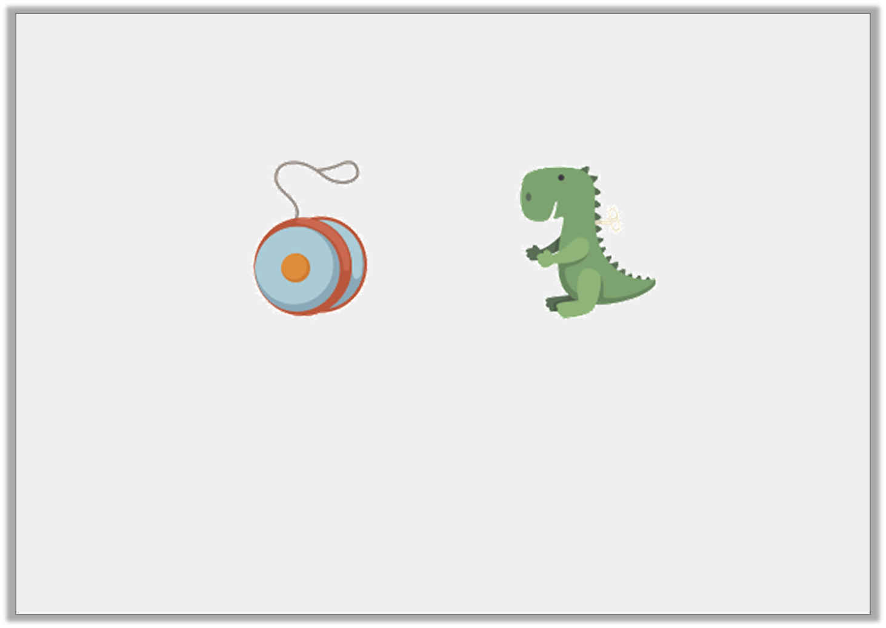
Problem Solving 2
Amy bought a yoyo and a wind up toy. She paid with a £10 note.
Which coins might she get in her change? Give 3 possible answers.
£3 and 34p
£3 and 52p
Y3

Slide 39
Problem Solving 2
Amy bought a yoyo and a wind up toy. She paid with a £10 note.
Which coins might she get in her change? Give 3 possible answers.
Various possible answers that equal £3 and 14p, including:
£2 + £1 + 10p + 2p +2p
£2 + £1 + 10p + 2p +1p +1p
£1 + £1 + £1 + 10p + 2p +2p
£3 and 34p
£3 and 52p
Y3

