Slide 1

Year 6 – Summer Block 1 – Converting Units – Step 4
About This Resource:
This PowerPoint has been designed to support teaching of the small steps. It includes a starter activity suitable for the year group and an example of each question from the Varied Fluency and Reasoning and Problem Solving resources also provided in the tasks. Each slide has the year group identified in the bottom right-hand corner. I recommend that you look through this PowerPoint in advance and decide whether to work through all examples provided or a selection of them depending on the needs of your child.
The PowerPoint has been dated for the week, so please work your way through it each day.

Slide 2
Year 5/6 – Summer Block 1 – Converting Units
Tuesday 5th May 2020
Step 4
Year 6: Miles and Kilometres

Slide 3
Introduction
Which is further: 1 mile or 1km?
Where have you seen miles?
Where have you seen km?
Y6

Slide 4
Introduction
Which is further: 1 mile or 1km?
1 mile
Where have you seen miles?
Various answers, examples include: maps, road signs
Where have you seen km?
Various answers, examples include: European road signs or maps.
Y6

Slide 5
Varied Fluency 1
Calculate the missing conversions.
5 miles |  |  | ≈ | 8km
 |  |  | ≈ | 2.4km
2.5 miles |  |  | ≈
 |  |  | ≈ | 80km
Y6

Slide 6
Varied Fluency 1
Calculate the missing conversions.
5 miles |  |  | ≈ | 8km
 | 1.5m |  | ≈ | 2.4km
2.5 miles |  |  | ≈ |  | 4km
 | 50m |  | ≈ | 80km
Y6

Slide 7
Varied Fluency 2
True or false?
4.5 miles is equivalent to 8km.
Y6

Slide 8
Varied Fluency 2
True or false?
4.5 miles is equivalent to 8km.
False.
4.5miles is equivalent to 7.2km
Y6

Slide 9
Varied Fluency 3
Two children are taking part in a long distance walk.
Lily walked 72km.
Frankie walked 55 miles.
Who walked further?
Y6

Slide 10
Varied Fluency 3
Two children are taking part in a long distance walk.
Lily walked 72km.
Frankie walked 55 miles.
Who walked further?
Frankie
Y6

Slide 11
Varied Fluency 4
Match the equivalent distances.
2.5 miles |  |  |  | 2.4km
5 miles |  |  |  | 4km
1.5 miles |  |  |  | 7.2km
4.5 miles |  |  |  | 8km
Y6

Slide 12
Varied Fluency 4
Match the equivalent distances.
2.5 miles |  |  |  | 2.4km
5 miles |  |  |  | 4km
1.5 miles |  |  |  | 7.2km
4.5 miles |  |  |  | 8km
Y6

Slide 13
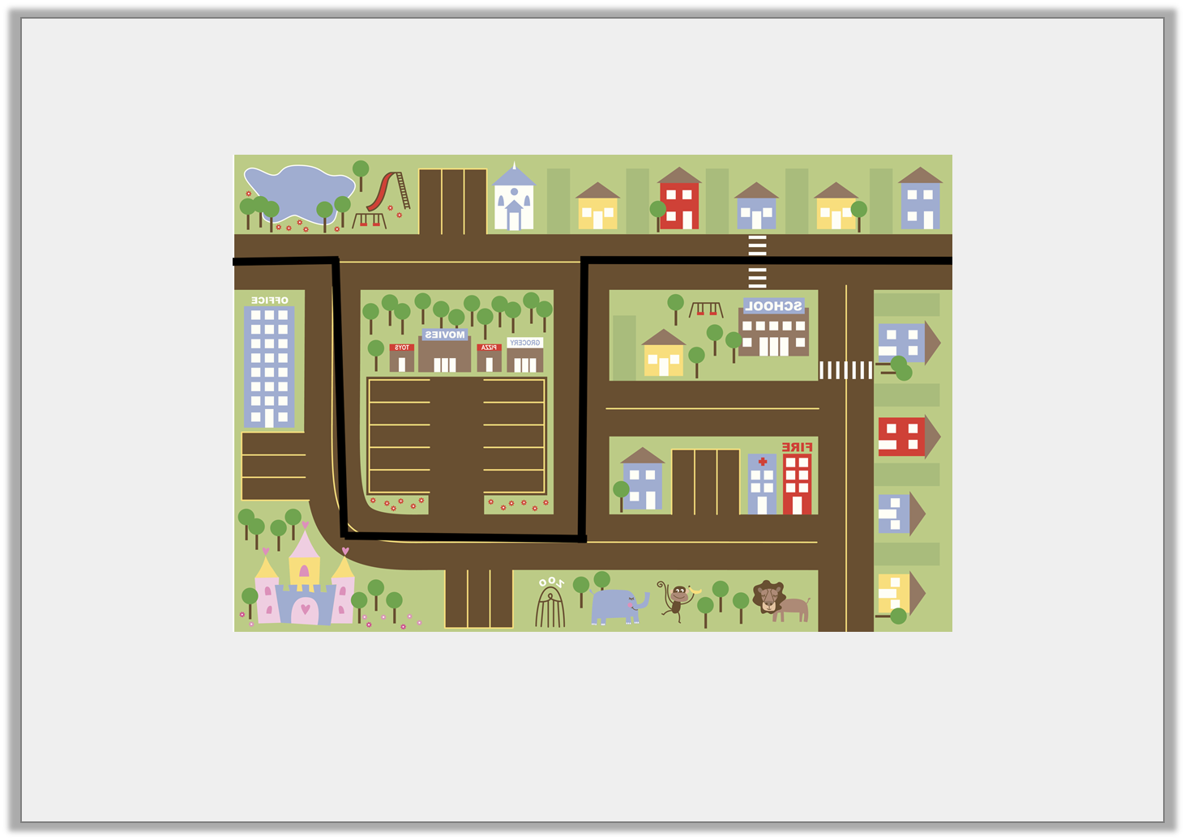
Problem Solving 1
Wednesday 6th May 2020
Bianca has planned her route through town on this map.
Approximately how far does she travel in kilometres?
0.5 miles
2.5 miles
2 miles
2 miles
1.5 miles
Y6

Slide 14
Problem Solving 1
Bianca has planned her route through town on this map.
Approximately how far does she travel in kilometres?
Bianca travels approximately 13.6 kilometres.
0.5 miles
2.5 miles
2 miles
2 miles
1.5 miles
Y6

Slide 15

Reasoning 1
Chad says,
Is he correct? Explain your answer.
10 kilometres is equal to 16 miles.
Y6

Slide 16
Reasoning 1
Chad says,
Is he correct? Explain your answer.
Chad is incorrect because…
10 kilometres is equal to 16 miles.
Y6

Slide 17
Reasoning 1
Chad says,
Is he correct? Explain your answer.
Chad is incorrect because he has mixed up the units in the conversion. 10 miles is approximately 16 kilometres; 10 kilometres is approximately 6.2 miles.
10 kilometres is equal to 16 miles.
Y6

Slide 18
Problem Solving 2
Ivy is planning a cycling trip.
She wants to arrive in Manchester, which is 50 miles from her starting point, by 2:00pm.
She starts her journey at 10:00am and has travelled 56 kilometres by 1:30pm.
How many miles does she have left?
Y6

Slide 19
Problem Solving 2
Ivy is planning a cycling trip.
She wants to arrive in Manchester, which is 50 miles from her starting point, by 2:00pm.
She starts her journey at 10:00am and has travelled 56 kilometres by 1:30pm.
How many miles does she have left?
Ivy has travelled 56 km, or 35 miles. She has 15 miles to go.
Y6

Slide 20
Year 6 – Summer Block 1 – Measurement: Converting Units
Thursday 7th May 2020
Step 5
Year 6: Imperial Measures

Slide 21
Introduction
8 pints
1 foot
0.56 litres
1 gallon
12 inches
1 inch
2.5 centimetres
1 pint
16 ounces
1 stone
14 pounds
1 ounce
28 grams
1 pound
Y6

Slide 22
Introduction
8 pints
1 foot
0.56 litres
1 gallon
12 inches
1 inch
2.5 centimetres
1 pint
16 ounces
1 stone
14 pounds
1 ounce
28 grams
1 pound
Y6

Slide 23
Varied Fluency 1
Will and Rhys are comparing the heights of their dogs.
Will’s dog is 1 foot 2 inches tall.
Rhys’ dog is 18 inches tall.
Who has the tallest dog?
Y6

Slide 24
Varied Fluency 1
Will and Rhys are comparing the heights of their dogs.
Will’s dog is 1 foot 2 inches tall.
Rhys’ dog is 18 inches tall.
Who has the tallest dog?
Rhys
Y6

Slide 25
Varied Fluency 2
Are the following statements true or false?
gallon = 1 pint
10 inches = 0.25cm
280g = 2 ounces
1
8
Y6

Slide 26
Varied Fluency 2
Are the following statements true or false?
gallon = 1 pint
10 inches = 0.25cm
280g = 2 ounces
A. True B. False C. False
1
8
Y6

Slide 27
Varied Fluency 3
Match the measurements to their conversions.
5 pounds |  | 25cm |  | 1.12 litres
2 pints |  | 80 ounces |  | 10 inches
Y6

Slide 28
Varied Fluency 3
Match the measurements to their conversions.
5 pounds = 80 ounces, 25cm = 10 inches, 1.12 litres = 2 pints
5 pounds |  | 25cm |  | 1.12 litres
2 pints |  | 80 ounces |  | 10 inches
Y6

Slide 29
Varied Fluency 4
Fill in the missing measurements.
inches | = | 100 feet
100 pints | = | litres
pints | = | 0.5 gallon
Y6

Slide 30
Varied Fluency 4
Fill in the missing measurements.
1,200 inches | = | 100 feet
100 pints | = | 56 litres
4 pints | = | 0.5 gallon
Y6

Slide 31
Reasoning 1
Friday 8th May 2020
True or false?
0.25 of a gallon is the
same as 4 pints.
Explain your answer.
Y6

Slide 32
Reasoning 1
True or false?
0.25 of a gallon is the
same as 4 pints.
Explain your answer.
False because…
Y6

Slide 33
Reasoning 1
True or false?
0.25 of a gallon is the
same as 4 pints.
Explain your answer.
False because 1 gallon = 8 pints, so 0.25 = 2 pints
Y6

Slide 34

Reasoning 2
Suzie is converting the volume of her bath.
She says:
Is Suzie correct? Explain your answer.
My bath has a volume of 100 pints which is the same as 560 litres.
Y6

Slide 35
Reasoning 2
Suzie is converting the volume of her bath.
She says:
Is Suzie correct? Explain your answer.
Suzie has multiplied 0.56 litres by 1,000 instead of 100. 1 pint = 0.56 litres so 100 pints = 56 litres.
My bath has a volume of 100 pints which is the same as 560 litres.
Y6

Slide 36
Problem Solving 1
Yusuf is ordering material for a project. He must convert the measurements to cm as they each cost £2 per 10cm.
How much will the material cost?
Amount Needed
8 inches blue
4 inches flowery
1 foot white
Y6

Slide 37
Problem Solving 1
Yusuf is ordering material for a project. He must convert the measurements to cm as they each cost £2 per 10cm.
How much will the material cost?
Blue: 20cm = £4. Flowery: 10cm = £2. White: 30cm = £6
Total cost = £12
Amount Needed
8 inches blue
4 inches flowery
1 foot white
Y6

