Slide 1
Year 3/4 – Summer Block 3 – Measurement and Time
Tuesday 2nd June 2020
Step 3
Year 3/4: I can tell the time to 5 minutes

Slide 2
Introduction
Roman numerals are sometimes used on clock faces.
Let’s recap them:
1 | = | I
2 | = | II
3 | = | III
4 | = | IV
5 | = | V
6 | = | VI
7 | = | VII
8 | = | VIII
9 | = | IX
10 | = | X
11 | = | XI
12 | = | XII
Y3

Slide 3
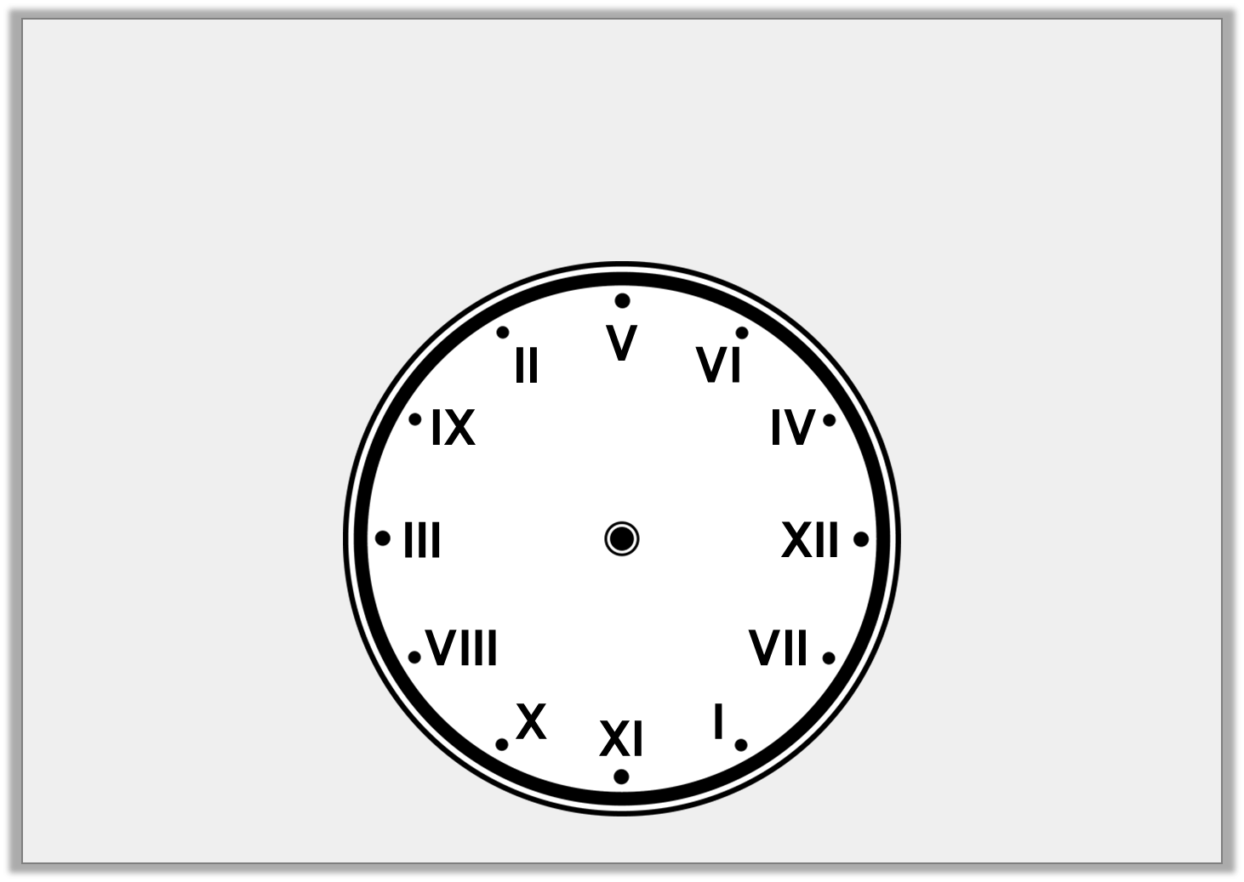
Introduction
The Roman numerals on the clock face have been muddled up.
Put them back into the correct order.
Y3

Slide 4
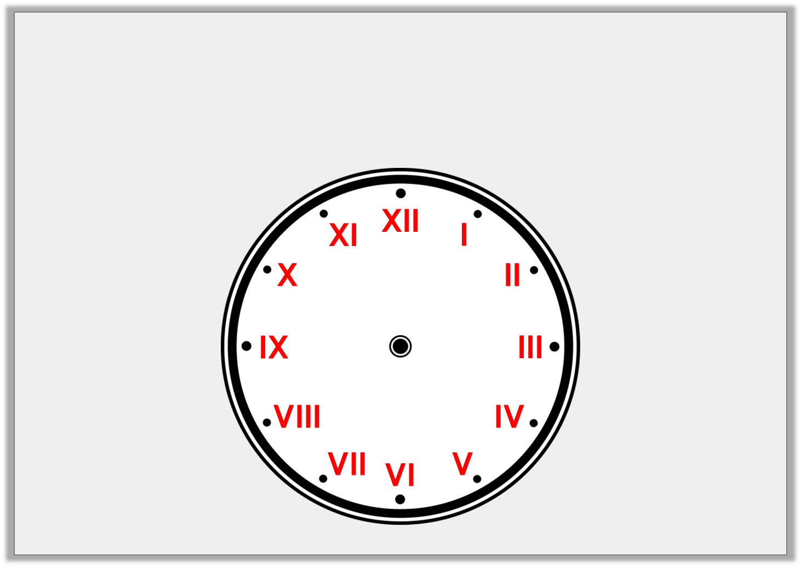
Introduction
The Roman numerals on the clock face have been muddled up.
Put them back into the correct order.
Y3

Slide 5
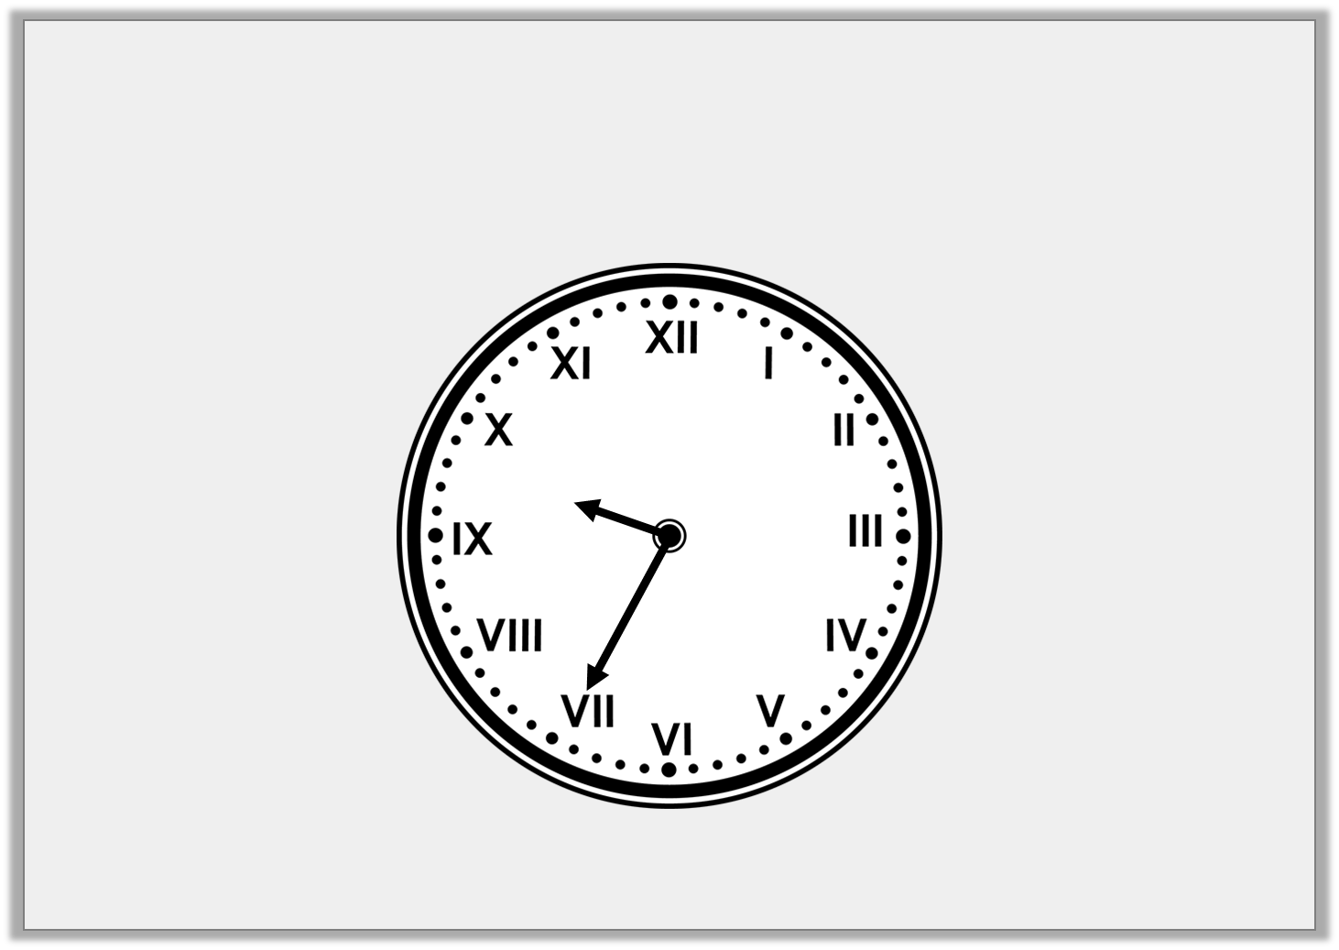
Varied Fluency 1
What time is shown on the clock?
Y3

Slide 6
Varied Fluency 1
What time is shown on the clock?
Twenty-five minutes to ten
Y3

Slide 7
Varied Fluency 2
A clock shows the time twenty minutes past eight.
What number is the minute hand pointing at?
VIII
III
V
Y3

Slide 8
Varied Fluency 2
A clock shows the time twenty minutes past eight.
What number is the minute hand pointing at?
VIII
III
V
Y3

Slide 9
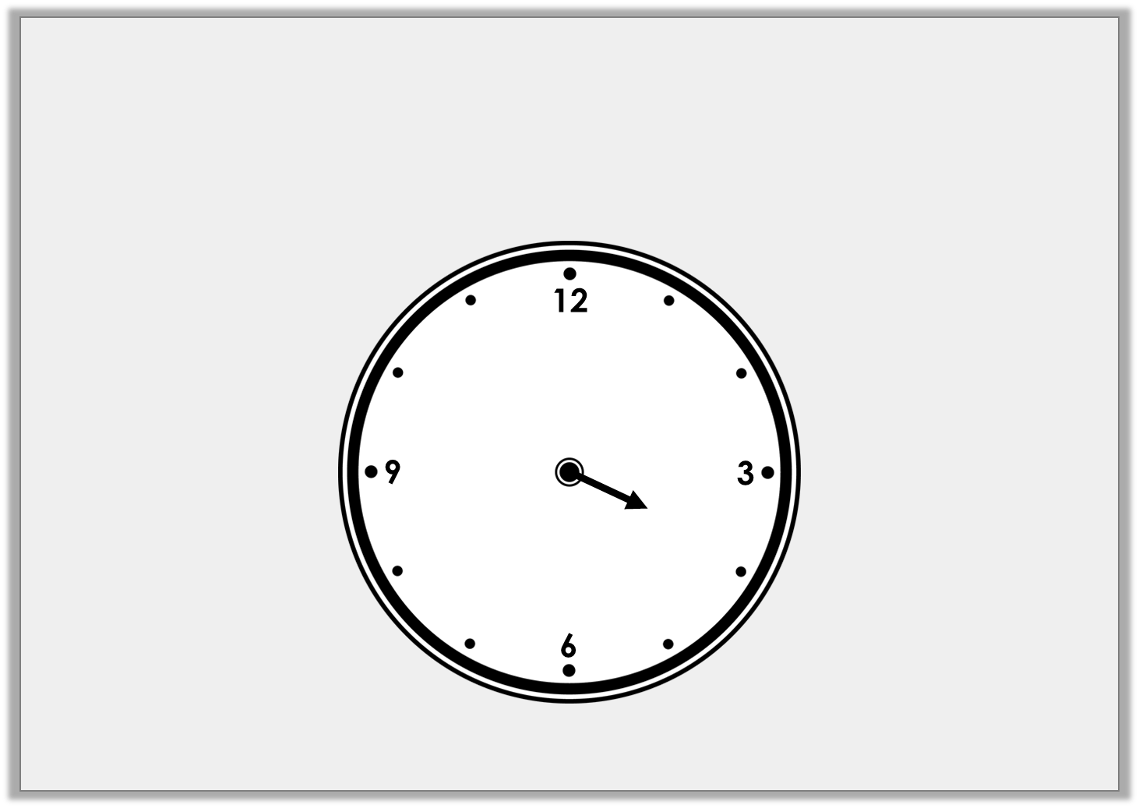
Varied Fluency 3
Draw the missing hand on the clock
so that it reads twenty minutes to four.
Y3

Slide 10
Varied Fluency 3
Draw the missing hand on the clock
so that it reads twenty minutes to four.
Y3

Slide 11
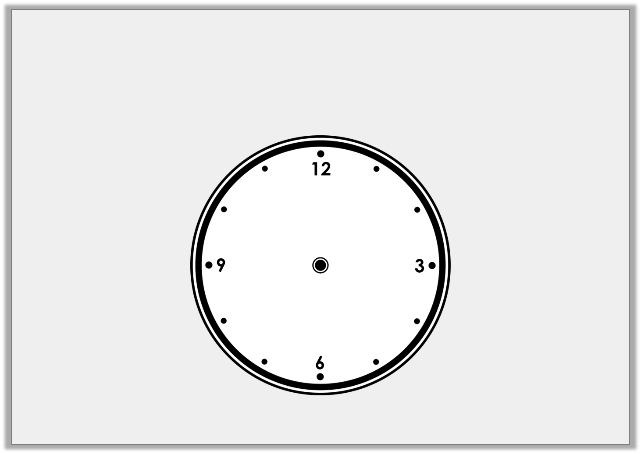
Varied Fluency 4
Draw hands on the clock so that it
reads twenty-five minutes past six.
Y3

Slide 12
Varied Fluency 4
Draw hands on the clock so that it
reads twenty-five minutes past six.
Y3

Slide 13
Wednesday 3rd June 2020
Year 3/4 Lo: I can tell the time to 5 minutes using reasoning and problem solving

Slide 14
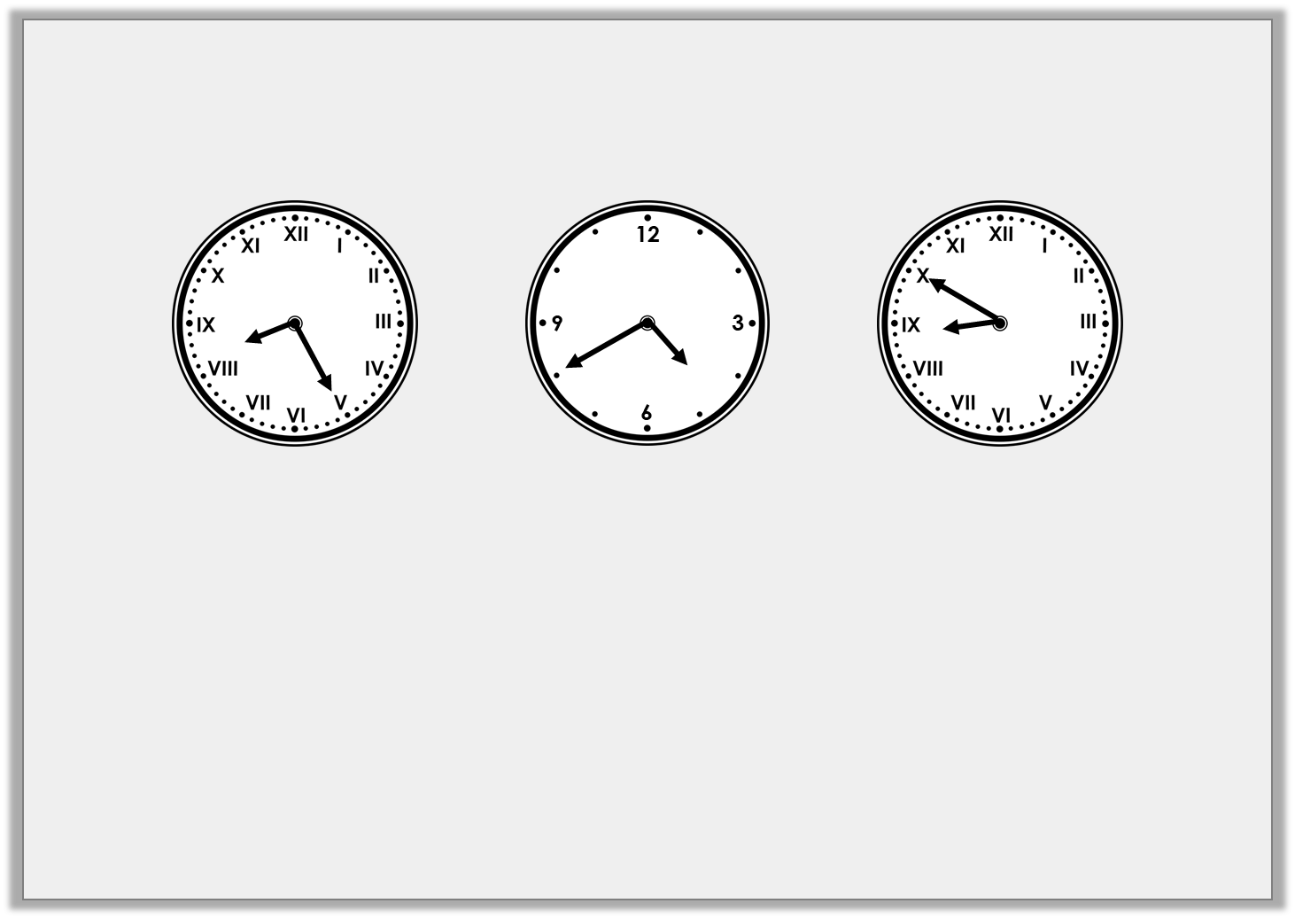
Problem Solving 1
Find the odd one out.
Ten minutes to nine
Twenty-five minutes past eight
Twenty minutes to five
Twenty minutes to four
Y3

Slide 15
Problem Solving 1
Find the odd one out.
Ten minutes to nine
Twenty-five minutes past eight
Twenty minutes to five
Twenty minutes to four
B
C
A
Y3

Slide 16
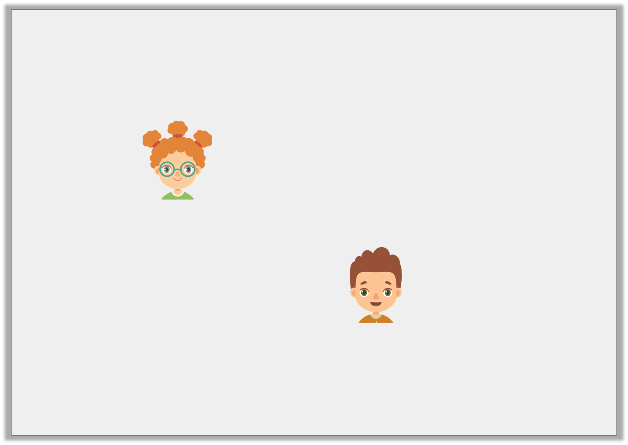
Reasoning 1
Fay and Nick are drawing twenty-five minutes past nine on a clock.
Fay says,
Nick says,
Who is correct? Explain why.
The minute hand
will point at V.
The minute hand
will point at IX.
Y3

Slide 17
Reasoning 1
Fay and Nick are drawing twenty-five minutes past nine on a clock.
Fay says,
Nick says,
Who is correct? Explain why.
Fay is correct because…
The minute hand
will point at V.
The minute hand
will point at IX.
Y3

Slide 18
Reasoning 1
Fay and Nick are drawing twenty-five minutes past nine on a clock.
Fay says,
Nick says,
Who is correct? Explain why.
Fay is correct because the minute hand needs to point at the V or 5 for 25 minutes past. Nick is describing quarter to.
The minute hand
will point at V.
The minute hand
will point at IX.
Y3

Slide 19
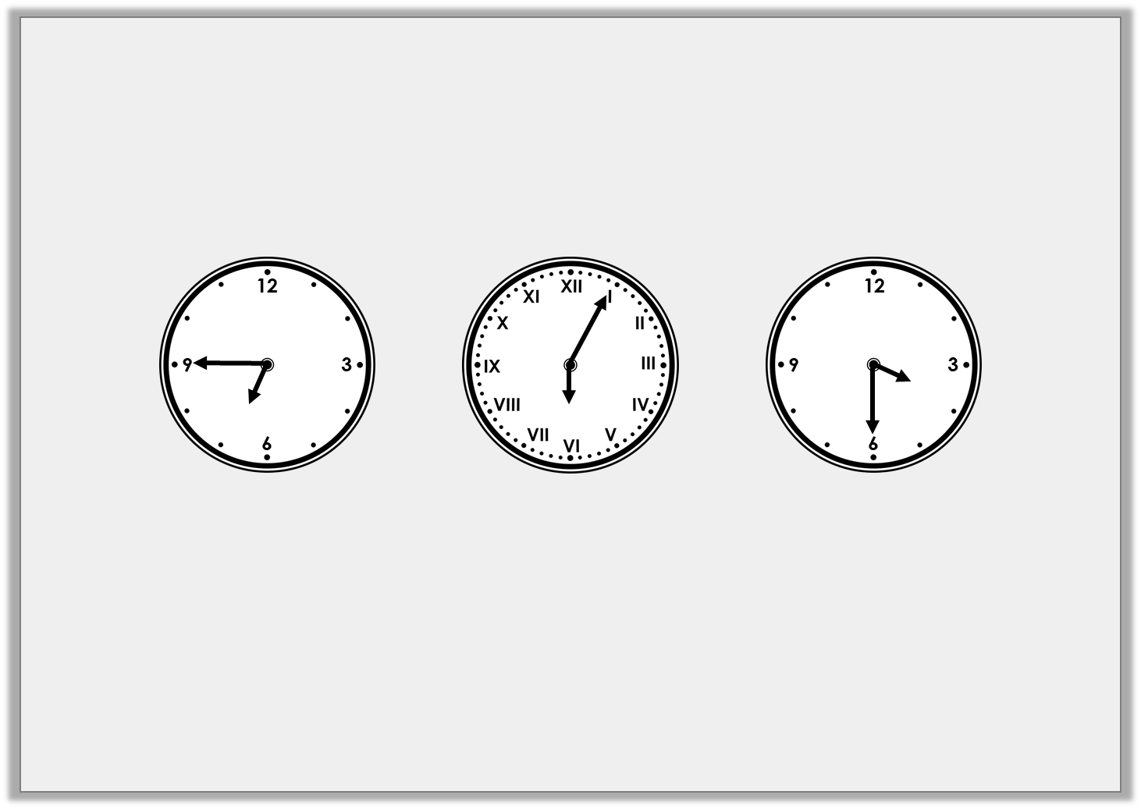
Reasoning 2
Yolanda is seeing a movie that starts at quarter past six.
What is the best time for her to arrive?
Explain why.
A
B
C
Y3

Slide 20
Reasoning 2
Yolanda is seeing a movie that starts at quarter past six.
What is the best time for her to arrive?
Explain why.
B because…
A
B
C
Y3

Slide 21
Reasoning 2
Yolanda is seeing a movie that starts at quarter past six.
What is the best time for her to arrive?
Explain why.
B because she will arrive 10 minutes before the film. She will be half an hour late if she gets there at quarter to seven (A) and too early if she gets there at half past three (C).
A
B
C
Y3

Slide 22
Thursday 4th June 2020

Slide 23
Year 3/4 – Summer Block 3 – Measurement and Time
Step 4
Year 3/4: Telling the Time to the Minute
© Classroom Secrets Limited 2019

Slide 24
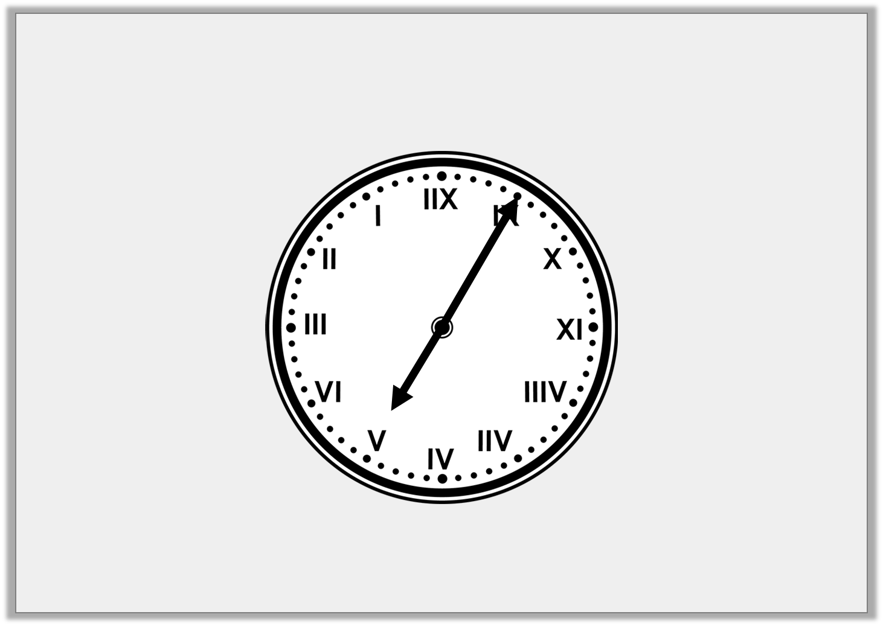
Introduction
What time is shown on the clock?
HINT: Look closely at the Roman numerals...
Y3

Slide 25
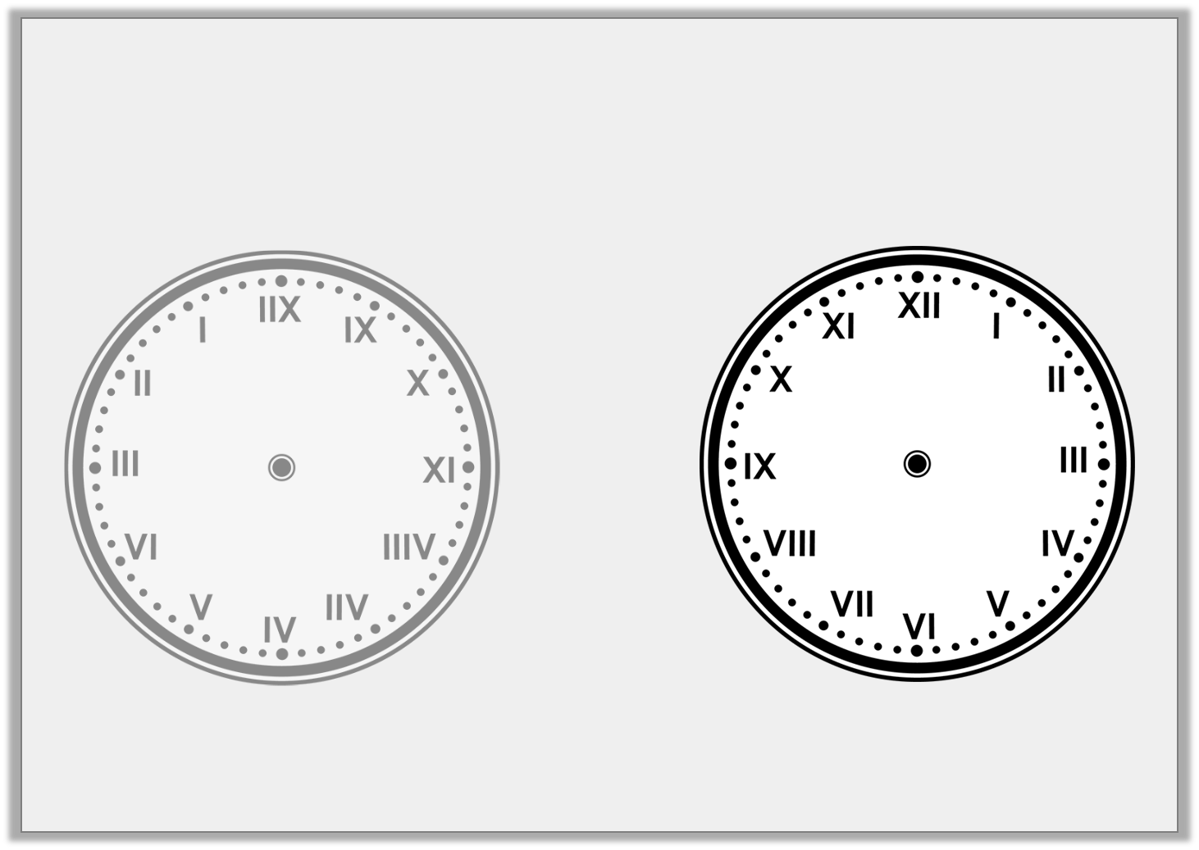
Introduction
What time is shown on the clock?
HINT: Look closely at the Roman numerals...
It shows five minutes to five.
The clock face was reversed, as if it was reflected in a mirror.
Y3

Slide 26
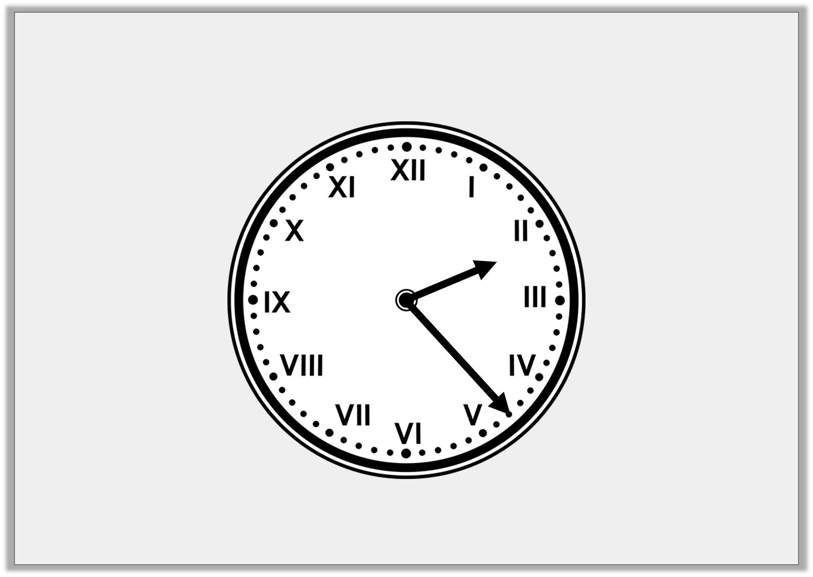
Varied Fluency 1
What time is shown on the clock?
Y3

Slide 27
Varied Fluency 1
What time is shown on the clock?
Twenty-three minutes past two
Y3

Slide 28
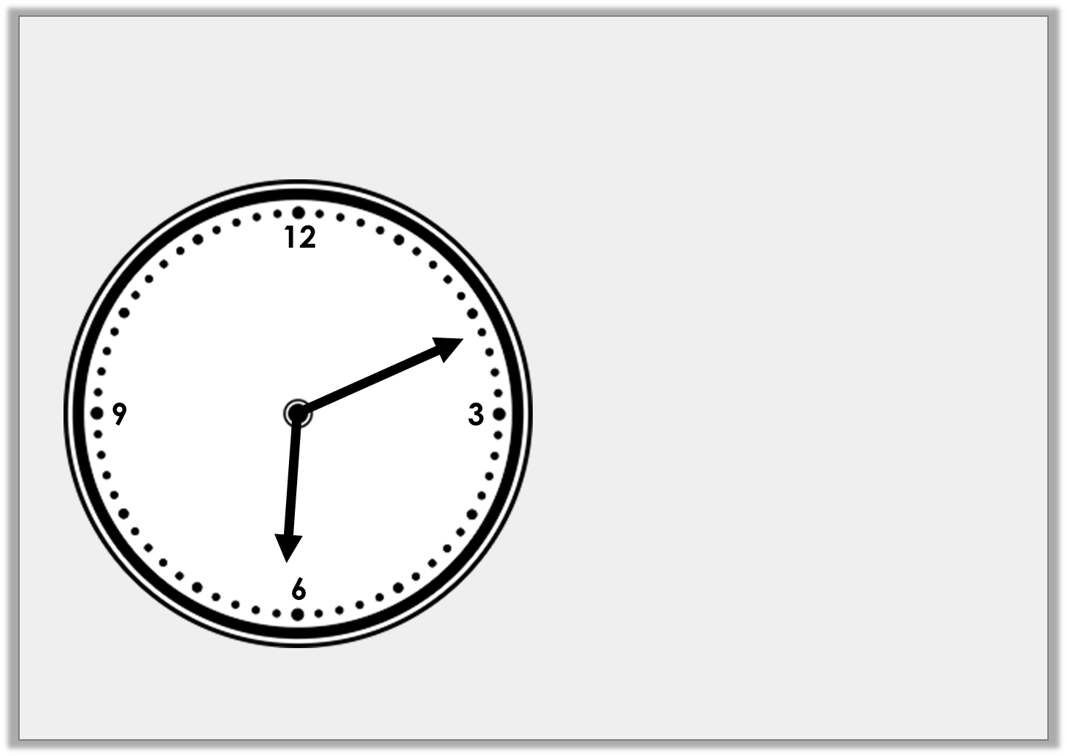
Varied Fluency 2
Tick the correct time shown on the clock.
Twenty-nine minutes to 3
Nine minutes to 6
Eleven minutes past 6
Y3

Slide 29
Varied Fluency 2
Tick the correct time shown on the clock.
Twenty-nine minutes to 3
Nine minutes to 6
✓
Eleven minutes past 6
Y3

Slide 30
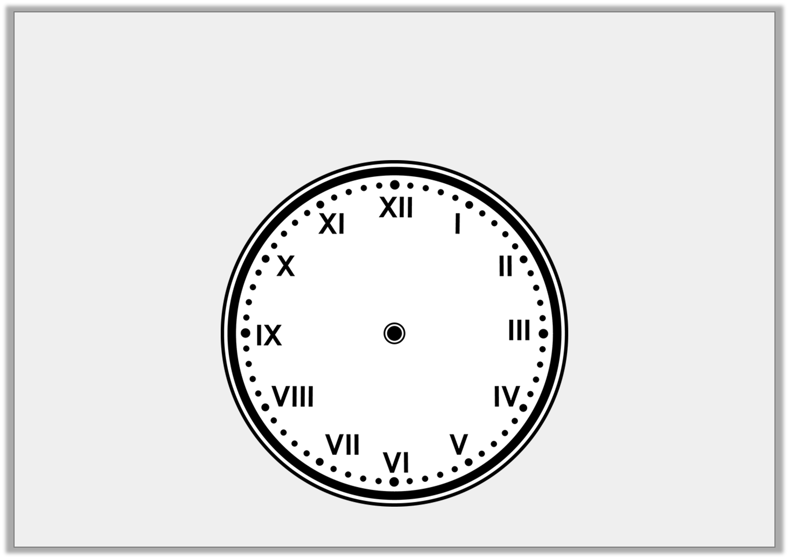
Varied Fluency 3
Draw hands on the clock so that it reads
three minutes to one.
Y3

Slide 31
Varied Fluency 3
Draw hands on the clock so that it reads
three minutes to one.
Y3

Slide 32
Varied Fluency 4
True or false?
At eleven minutes past six, the minute hand is pointing between the two and the three.
Y3

Slide 33
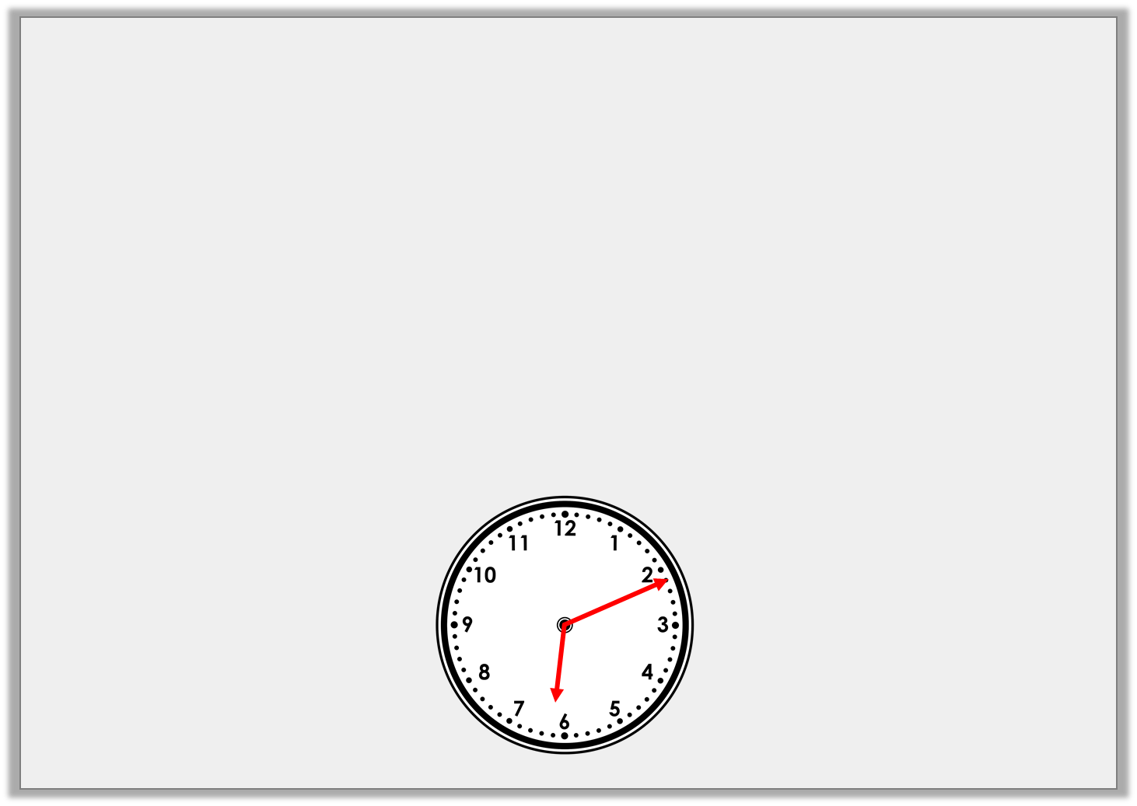
Varied Fluency 4
True or false?
True
At eleven minutes past six, the minute hand is pointing between the two and the three.
Y3

Slide 34
Friday 5th June 2020 Year 3/4: Telling the Time to the Minute using reasoning and problem solving

Slide 35
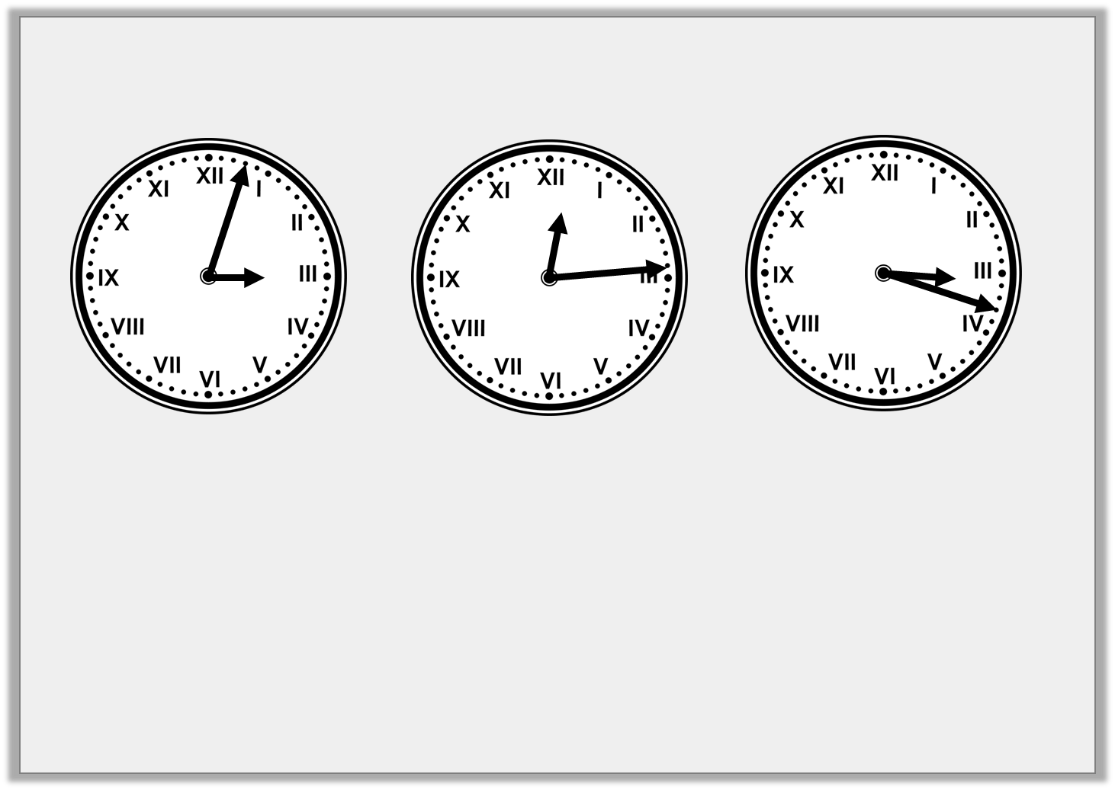
Problem Solving 1
Match the clocks to the correct statement.
A
B
C
1. Fourteen minutes past twelve
2. Three minutes past three
3. Eighteen minutes past three
Y3

Slide 36
Problem Solving 1
Match the clocks to the correct statement.
A
B
C
1. Fourteen minutes past twelve | B
2. Three minutes past three | A
3. Eighteen minutes past three | C
Y3

Slide 37
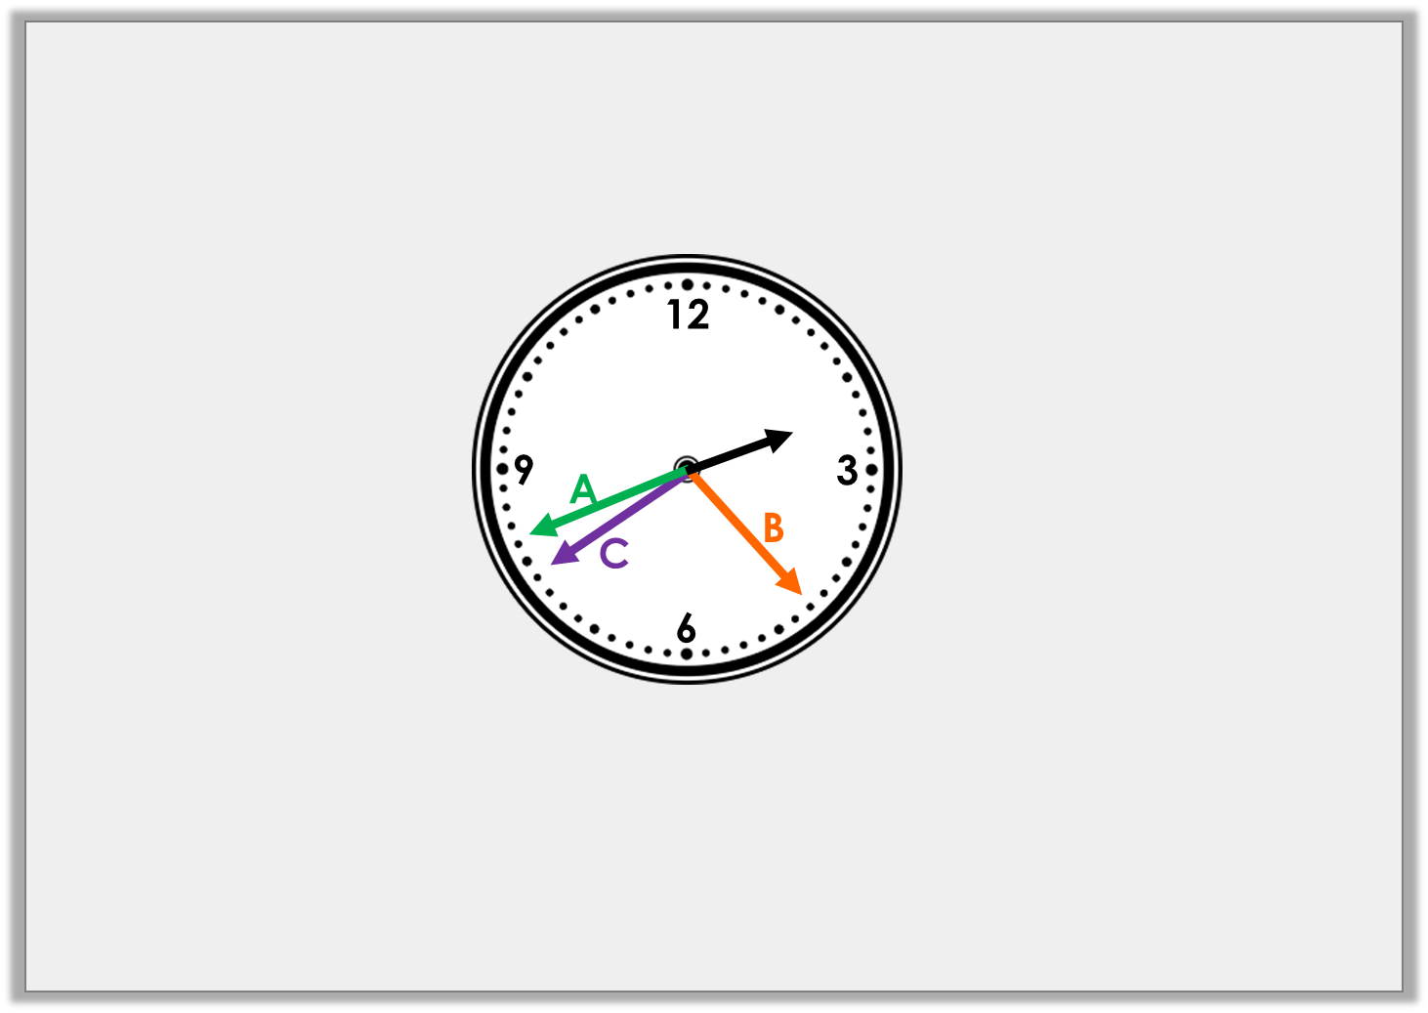
Reasoning 1
The time is twenty-one minutes to three.
Which arrow is the correct minute hand?
Explain why.
Y3

Slide 38
Reasoning 1
The time is twenty-one minutes to three.
Which arrow is the correct minute hand?
Explain why.
C because…
Y3

Slide 39
Reasoning 1
The time is twenty-one minutes to three.
Which arrow is the correct minute hand?
Explain why.
C because it is ‘to’ the hour so the minute hand is after the 6 and there are 21 minutes until the minute hand gets to the twelve for the next hour.
Y3

Slide 40
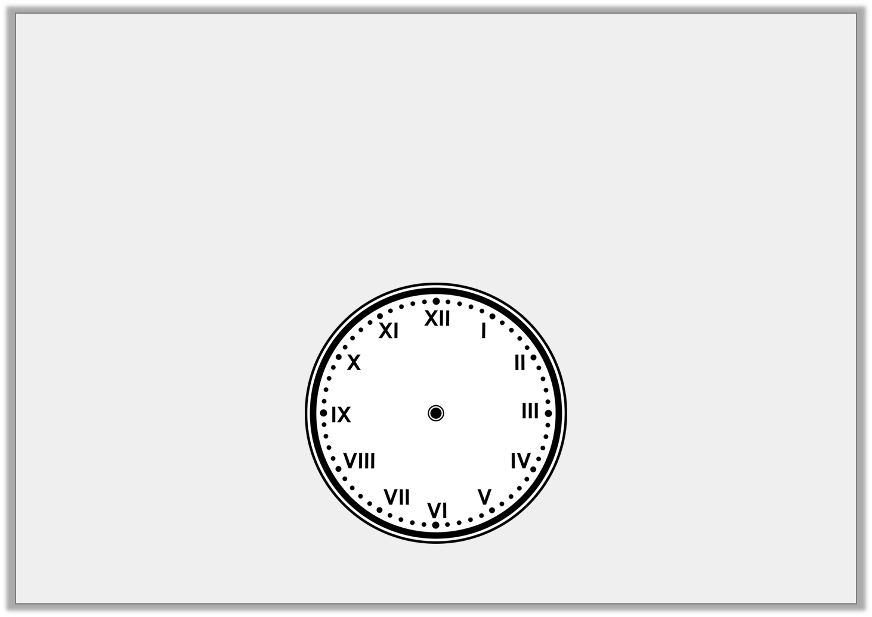
Problem Solving 2
It takes Amit 36 minutes to drive to the shops.
He sets off from home at five past one.
What time does he get to the shops?
Where would the hands be on the clock
at the time he arrives at the shops?
Y3

Slide 41
Problem Solving 2
It takes Amit 36 minutes to drive to the shops.
He sets off from home at five past one.
What time does he get to the shops?
Where would the hands be on the clock
at the time he arrives at the shops?
He arrives at the shops at nineteen minutes to two.
Y3

