Slide 1
Year 1/2 – Spring Block 4 – Weight and Volume
Step 1
Year 1: Introduce Weight and Mass
Year 2: Compare Mass

Slide 2
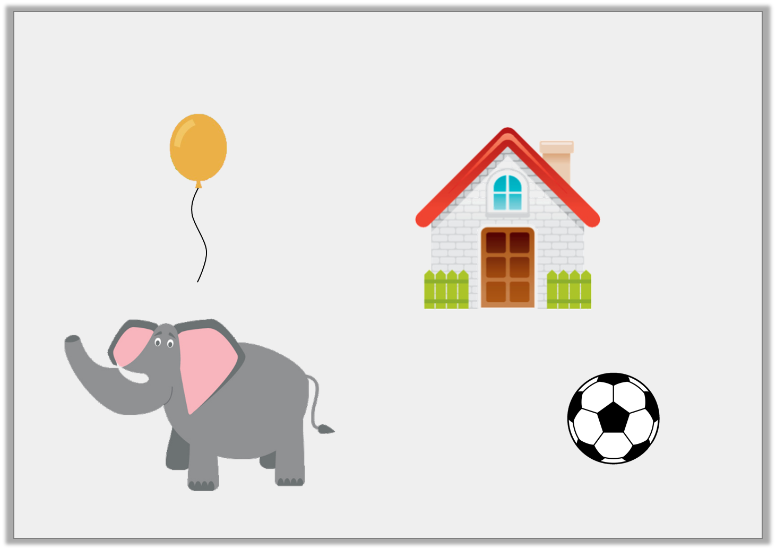
Introduction
Which items do you think are too heavy for you to pick up?
Y1

Slide 3
Introduction
Which items do you think are too heavy for you to pick up?
Y1

Slide 4
Introduction
Complete the sentences.
Word bank: more less same
The pumpkin weighs the as the melon.
The lemon weighs than the apple.
The sweetcorn weighs than the tomato.
Y2

Slide 5
Introduction
Complete the sentences.
Word bank: more less same
The pumpkin weighs the as the melon.
same
less
The lemon weighs than the apple.
more
The sweetcorn weighs than the tomato.
Y2

Slide 6
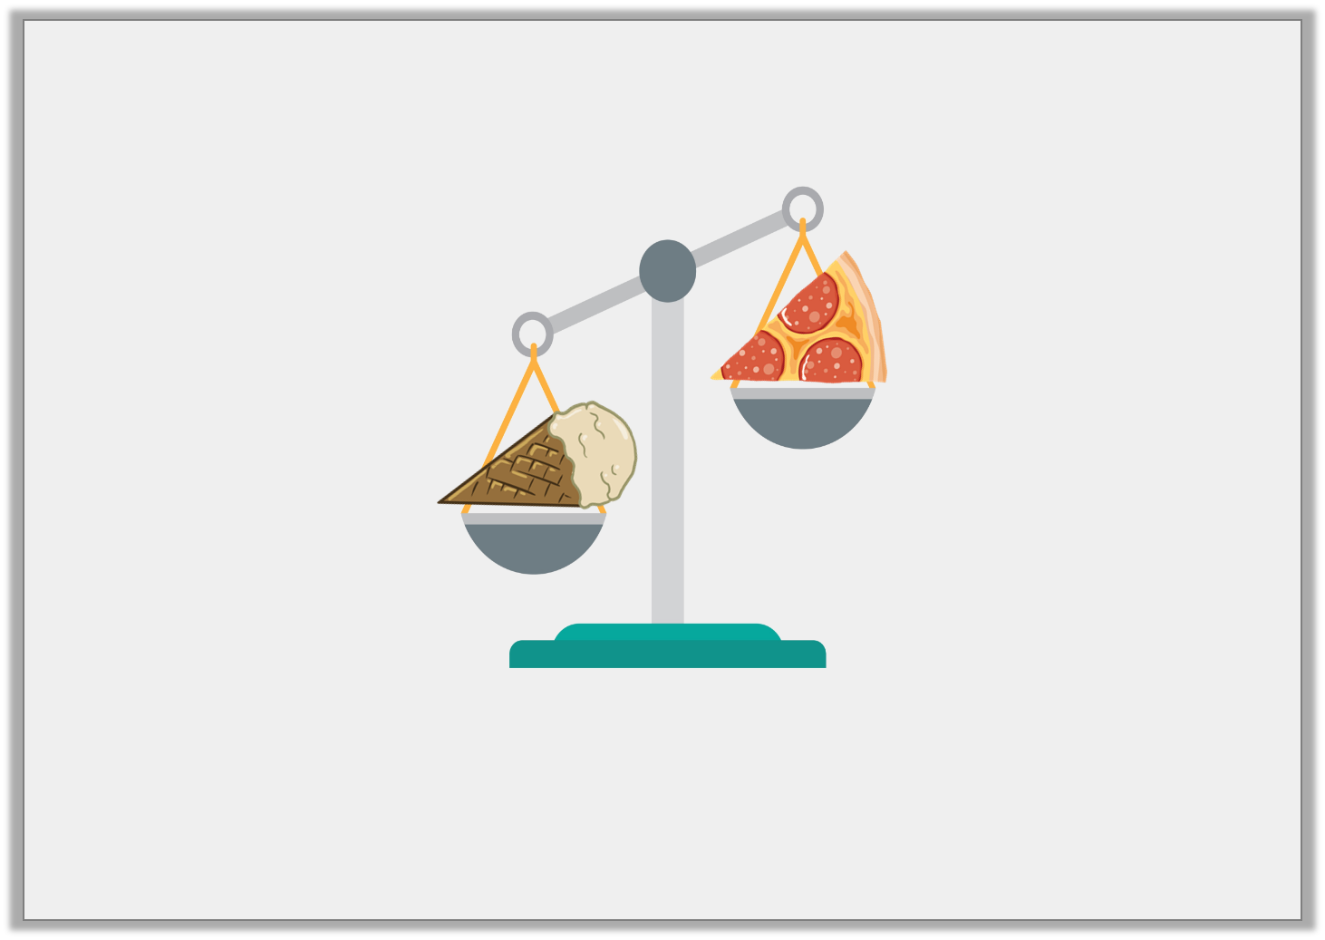
Varied Fluency 1
True or false? The pizza is heavier than the ice cream.
Y1

Slide 7
Varied Fluency 1
True or false? The pizza is heavier than the ice cream.
False.
The pizza is lighter than the ice cream.
Y1

Slide 8
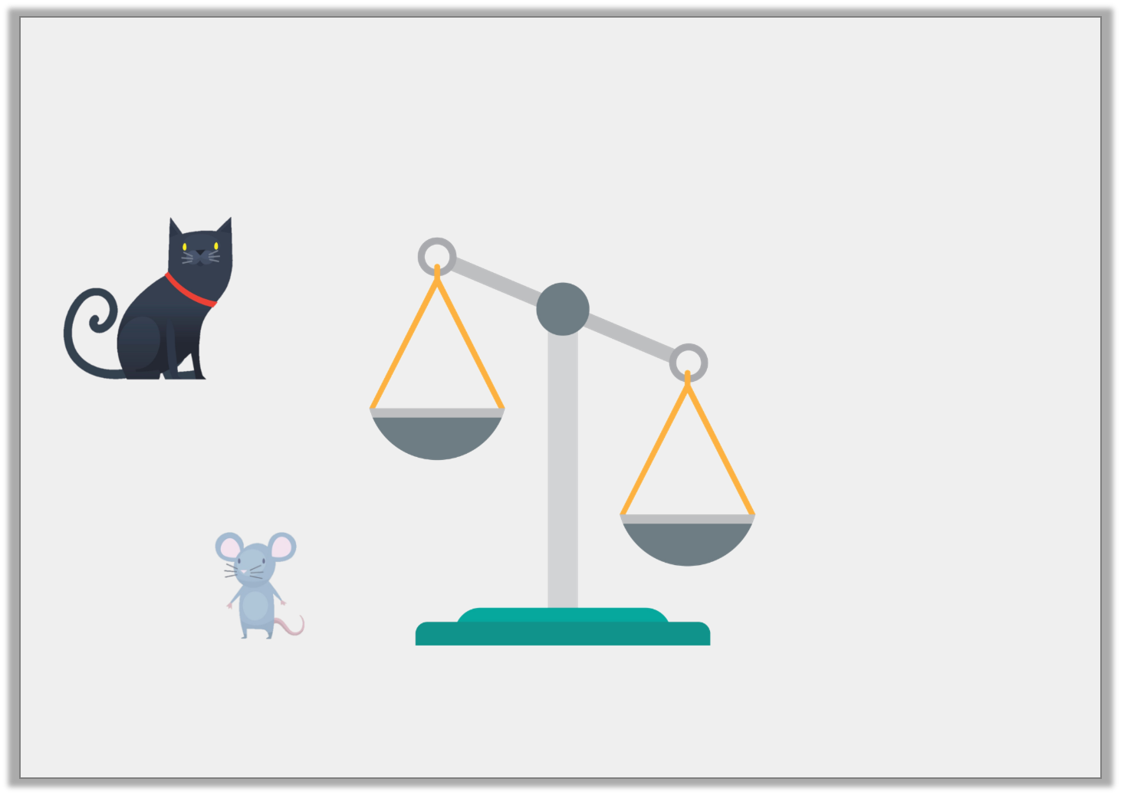
Varied Fluency 2
The cat is heavier than the mouse.
Draw them in the correct place on the scales.
Y1

Slide 9
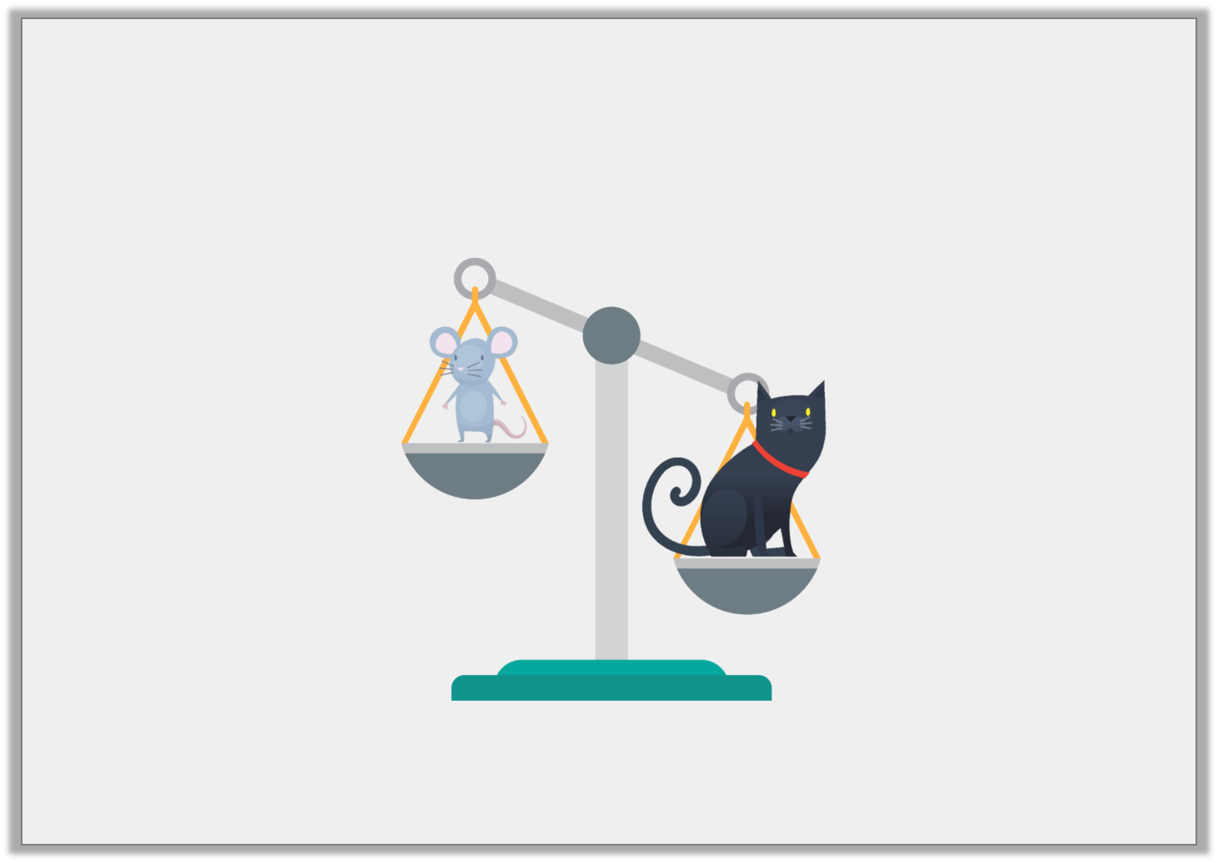
Varied Fluency 2
The cat is heavier than the mouse.
Draw them in the correct place on the scales.
Y1

