Slide 1
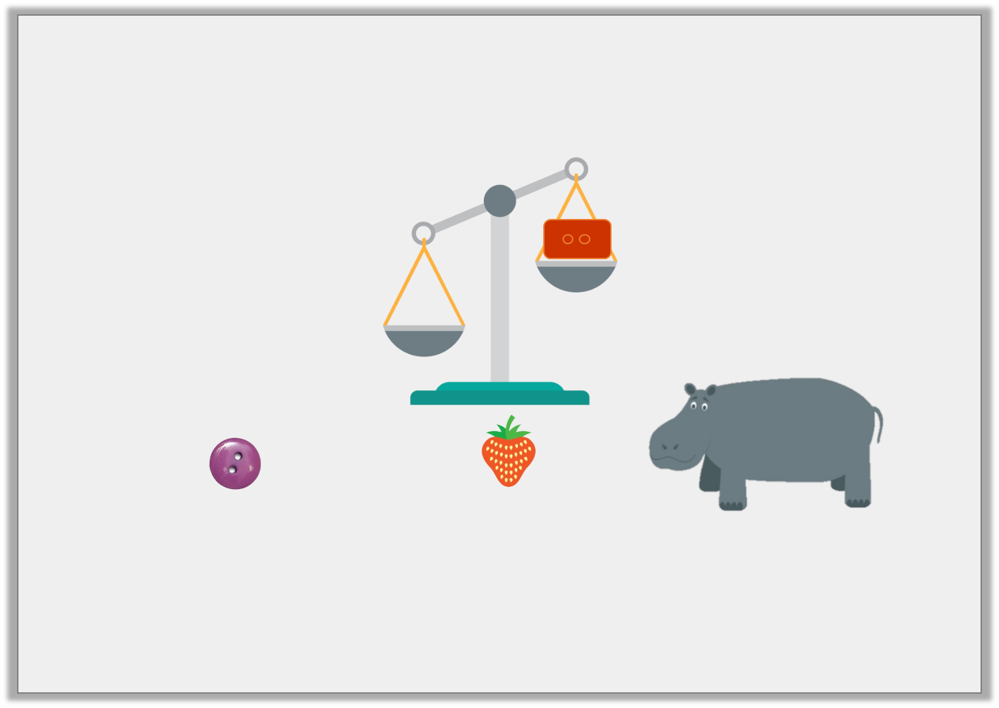
Reasoning 2
Isla wants an object that will be heavier than the brick.
Which item should she choose and why?
A | B | C
Y1

Slide 2
Reasoning 2
Isla wants an object that will be heavier than the brick.
Which item should she choose and why?
Isla should choose C because…
A | B | C
Y1

Slide 3
Reasoning 2
Isla wants an object that will be heavier than the brick.
Which item should she choose and why?
Isla should choose C because a hippo would be the heaviest out of all of the items.
A | B | C
Y1

Slide 4
Reasoning 1
True or false?
Explain your answer.
Y2

Slide 5
Reasoning 1
True or false?
Explain your answer.
True, because...
Y2

Slide 6
Reasoning 1
True or false?
Explain your answer.
True, because the scale shows the backpack is heavier than the camera. A backpack full of equipment would be heavier than one camera.
Y2

Slide 7
Problem Solving 1
Look at the scales below.
Use one item from each scale above to make the scale below correct. Which item goes in place of each letter?
Y2

Slide 8
Problem Solving 1
Look at the scales below.
Use one item from each scale above to make the scale below correct. Which item goes in place of each letter?
Y2

Slide 9
Reasoning 2
Ishmael looks at the items on the scales. He writes,
Is he correct? Explain your answer.
Y2

Slide 10
Reasoning 2
Ishmael looks at the items on the scales. He writes,
Is he correct? Explain your answer.
Ishmael is wrong because...
Y2

Slide 11
Reasoning 2
Ishmael looks at the items on the scales. He writes,
Is he correct? Explain your answer.
Ishmael has used the wrong symbol, he has written the shovel is less than the torch. The shovel is actually heavier than the torch so he should have written, a shovel > a torch.
Y2

