Slide 1
Year 3/4 – Spring Block 4 – Fractions and Decimals
Step 12
24.04.20
Year 4: To divide 1 or 2-digits by 100 using reasoning and problem – solving

Slide 2
Problem Solving 1
Sol makes a 2-digit number on the place value chart using 5 counters and divides it by 100.
What could his calculation have be?
Write down 5 possible calculations including the answer.
10 | 1 | 0.1 | 0.01
Y4

Slide 3
Problem Solving 1
Sol makes a 2-digit number on the place value chart using 5 counters and divides it by 100.
What could his calculation have be?
Write down 5 possible calculations including the answer.
Accept any 5 of the following answers:
14 ÷ 100 = 0.14 41 ÷ 100 = 0.41
23 ÷ 100 = 0.23 32 ÷ 100 = 0.32
50 ÷ 100 = 0.5 5 ÷ 100 = 0.05
10 | 1 | 0.1 | 0.01
Y4

Slide 4
Reasoning 1
Rikki has used the chart below to make a number. He has covered his number with counters.
He divides it by 100.
What will Rikki’s answer be?
Explain how you know.
10 | 20 | 30 | 40 | 50 | 60 | 70 | 80 | 90
1 | 2 | 3 | 4 | 5 | 6 | 7 | 8 | 9
0.1 | 0.2 | 0.3 | 0.4 | 0.5 | 0.6 | 0.7 | 0.8 | 0.9
0.01 | 0.02 | 0.03 | 0.04 | 0.05 | 0.06 | 0.07 | 0.08 | 0.09
Y4

Slide 5
Reasoning 1
Rikki has used the chart below to make a number. He has covered his number with counters.
He divides it by 100.
What will Rikki’s answer be?
Explain how you know.
Rikki’s answer will be 0.58 because…
10 | 20 | 30 | 40 | 50 | 60 | 70 | 80 | 90
1 | 2 | 3 | 4 | 5 | 6 | 7 | 8 | 9
0.1 | 0.2 | 0.3 | 0.4 | 0.5 | 0.6 | 0.7 | 0.8 | 0.9
0.01 | 0.02 | 0.03 | 0.04 | 0.05 | 0.06 | 0.07 | 0.08 | 0.09
Y4

Slide 6
Reasoning 1
Rikki has used the chart below to make a number. He has covered his number with counters.
He divides it by 100.
What will Rikki’s answer be?
Explain how you know.
Rikki’s answer will be 0.58 because you can move each counter down two places to divide by 100.
10 | 20 | 30 | 40 | 50 | 60 | 70 | 80 | 90
1 | 2 | 3 | 4 | 5 | 6 | 7 | 8 | 9
0.1 | 0.2 | 0.3 | 0.4 | 0.5 | 0.6 | 0.7 | 0.8 | 0.9
0.01 | 0.02 | 0.03 | 0.04 | 0.05 | 0.06 | 0.07 | 0.08 | 0.09
Y4

Slide 7
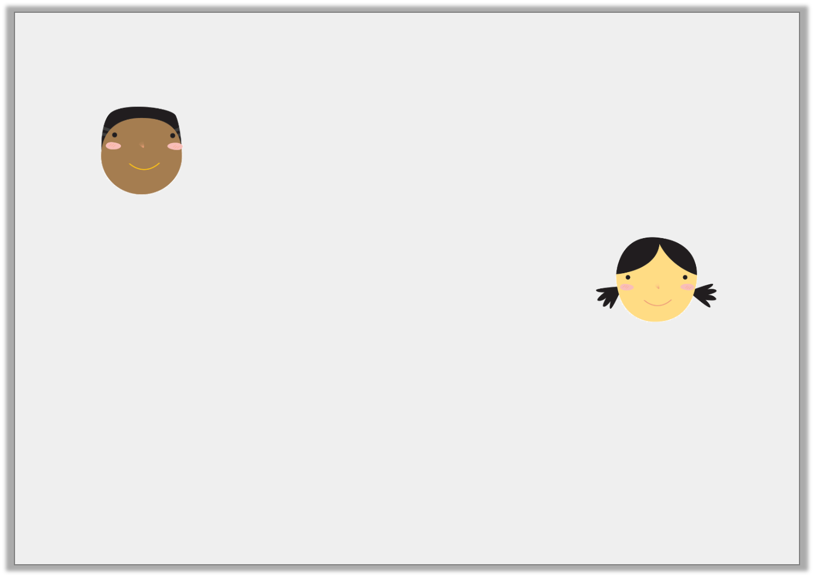
Reasoning 2
True or false? Fahad and Maya’s statements are correct.
Convince me!
64 ÷ 100 = 6.4
Fahad
0.64 is 100 times smaller than 64.
Maya
Y4

Slide 8
Reasoning 2
True or false? Fahad and Maya’s statements are correct.
Convince me!
I know that Fahad’s statement is false because…
I know that Maya’s statement is true because…
64 ÷ 100 = 6.4
Fahad
0.64 is 100 times smaller than 64.
Maya
Y4

Slide 9
Reasoning 2
True or false? Fahad and Maya’s statements are correct.
Convince me!
I know that Fahad’s statement is false because he has only moved the digits one place right so he has divided by 10 instead of 100. His answer should be 0.64.
I know that Maya’s statement is true because both digits move 2 places right so the number is 100 times smaller and 64 ÷ 100 = 0.64.
64 ÷ 100 = 6.4
Fahad
0.64 is 100 times smaller than 64.
Maya
Y4

