Slide 1
Year 3/4 – Summer Block 5 – Mass and Capacity
Step 6
22.04.20
Year 3: Lo: I can compare, measure volume and capacity (l/ml using reasoning and problem – solving

Slide 2
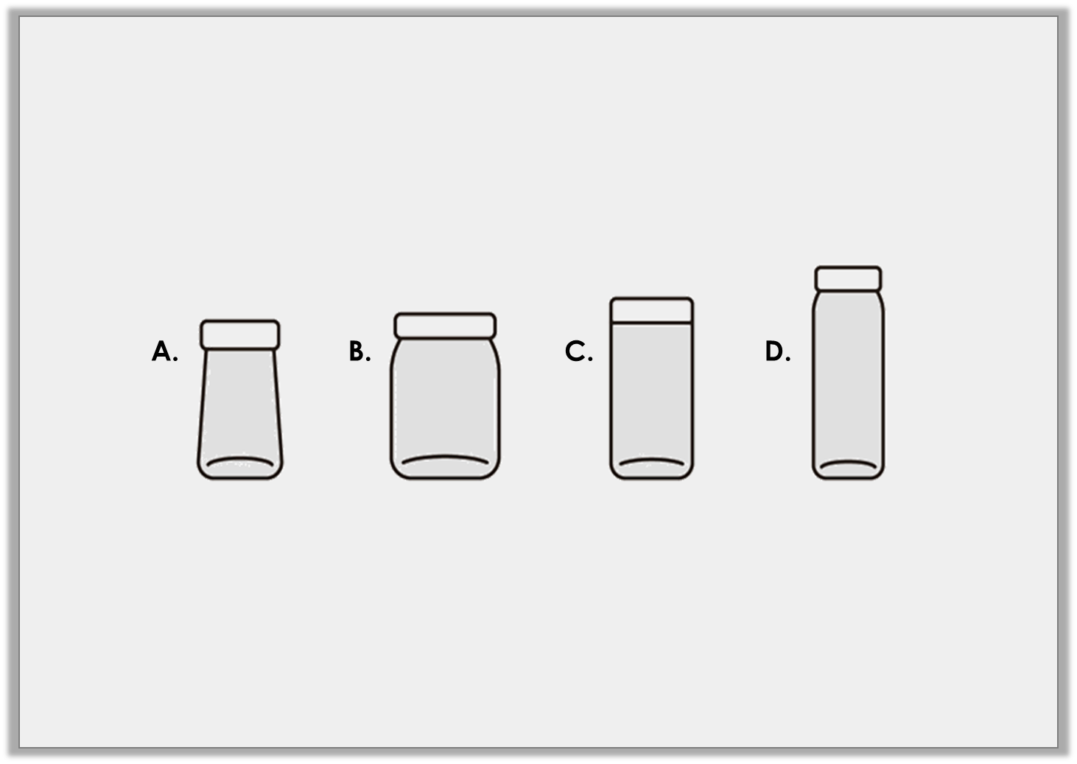
Problem Solving 1
Carl fills the measuring cylinder with liquid. The volume is more than 1L and 400ml but less than 1L and 600ml. Which of these containers could he fill exactly?
1L and 200ml
1L and 650ml
1L and 900ml
1L and 500ml
Y3
© Classroom Secrets Limited 2018

Slide 3
Problem Solving 1
Carl fills the measuring cylinder with liquid. The volume is more than 1L and 400ml but less than 1L and 600ml. Which of these containers could he fill exactly?
✓
1L and 200ml
1L and 650ml
1L and 900ml
1L and 500ml
Y3

Slide 4
Reasoning 1
Maisie is measuring water. She says,
Explain her mistake.
One is nearly 1L and 600ml and the other is 2L so there is 3L and 600ml in total.
ml
2L
1L 800ml
1L 600ml
1L 400ml
1L 200ml
1L
800ml
600ml
400ml
200ml
ml
2L
1L 800ml
1L 600ml
1L 400ml
1L 200ml
1L
800ml
600ml
400ml
200ml
Y3

Slide 5
Reasoning 1
Maisie is measuring water. She says,
Explain her mistake.
Maisie hasn’t read the scale accurately on…
One is nearly 1L and 600ml and the other is 2L so there is 3L and 600ml in total.
ml
2L
1L 800ml
1L 600ml
1L 400ml
1L 200ml
1L
800ml
600ml
400ml
200ml
ml
2L
1L 800ml
1L 600ml
1L 400ml
1L 200ml
1L
800ml
600ml
400ml
200ml
Y3

Slide 6
Reasoning 1
Maisie is measuring water. She says,
Explain her mistake.
Maisie hasn’t read the scale accurately on the first measuring cylinder. It actually reads 1L and 500ml, so there is 3L and 500ml in total.
One is nearly 1L and 600ml and the other is 2L so there is 3L and 600ml in total.
ml
2L
1L 800ml
1L 600ml
1L 400ml
1L 200ml
1L
800ml
600ml
400ml
200ml
ml
2L
1L 800ml
1L 600ml
1L 400ml
1L 200ml
1L
800ml
600ml
400ml
200ml
Y3

Slide 7
Reasoning 2
Carson says,
Do you agree? Explain your answer.
Container B has the least amount of liquid as the scale only goes up to 500ml.
ml
500
400
300
200
100
ml
1L
800
600
400
200
ml
2L
1L 500ml
1L
500
A.
B.
C.
Y3

Slide 8
Reasoning 2
Carson says,
Do you agree? Explain your answer.
Carson is correct because…
Container B has the least amount of liquid as the scale only goes up to 500ml.
ml
500
400
300
200
100
ml
1L
800
600
400
200
ml
2L
1L 500ml
1L
500
A.
B.
C.
Y3

Slide 9
Reasoning 2
Carson says,
Do you agree? Explain your answer.
Carson is correct because container B only has 450ml, which is less than in containers A and C, although his reasoning is incorrect.
Container B has the least amount of liquid as the scale only goes up to 500ml.
ml
500
400
300
200
100
ml
1L
800
600
400
200
ml
2L
1L 500ml
1L
500
A.
B.
C.
Y3

