Slide 1
Year 3/4 – Summer Block 5 – Mass and Capacity
Step 6
21.04.20
Year 3: Lo: I can compare, measure volume and capacity (l/ml

Slide 2
Introduction
What is the volume in each container?
L
1
9
8
7
6
5
4
3
2
1
ml
1000
900
800
700
600
500
400
300
200
100
ml
1000
800
600
400
200
L
10
8
6
4
2
Y3

Slide 3
Introduction
What is the volume in each container?
L
1
9
8
7
6
5
4
3
2
1
ml
1000
900
800
700
600
500
400
300
200
100
ml
1000
800
600
400
200
L
10
8
6
4
2
4 Litres | 950ml | 750ml | 5 Litres
Y3

Slide 4
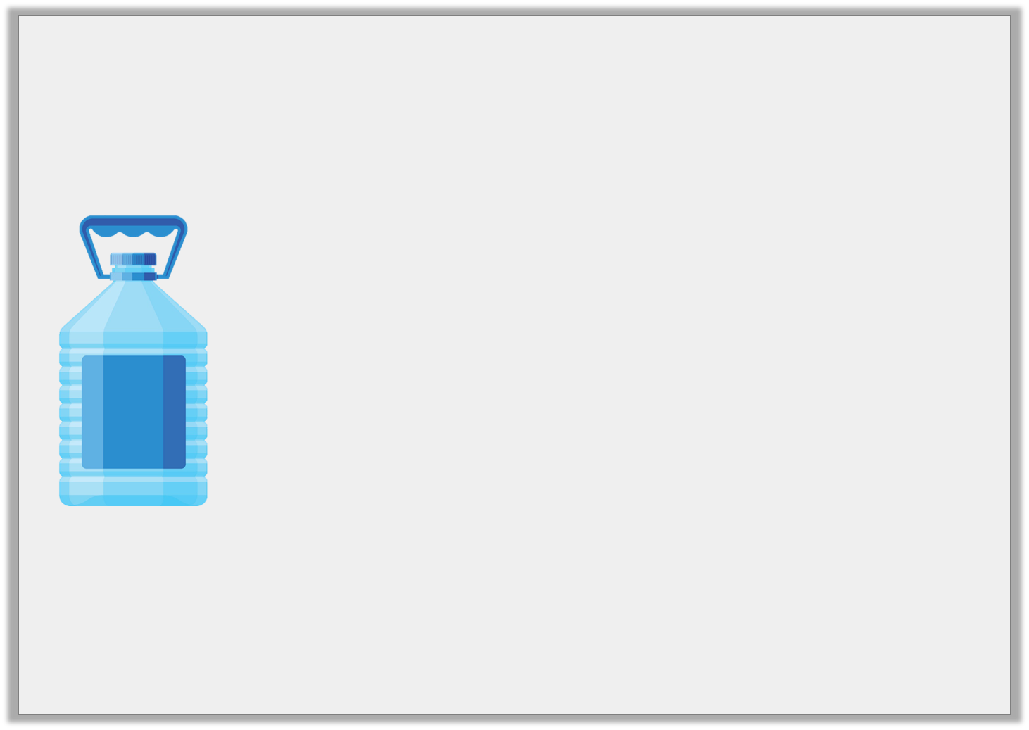
Varied Fluency 1
What is the capacity of the water bottle?
ml
1L
800
600
400
200
ml
1L
800
600
400
200
ml
1L
800
600
400
200
ml
1L
800
600
400
200
ml
1L
800
600
400
200
Y3

Slide 5
Varied Fluency 1
What is the capacity of the water bottle?
ml
1L
800
600
400
200
ml
1L
800
600
400
200
ml
1L
800
600
400
200
ml
1L
800
600
400
200
ml
1L
800
600
400
200
4L and 150ml
Y3

Slide 6
Varied Fluency 2
Colour the containers to show the given volume.
2L and 950ml
ml
1L
800
600
400
200
ml
1L
800
600
400
200
ml
1L
800
600
400
200
ml
1L
800
600
400
200
ml
1L
800
600
400
200
Y3

Slide 7
Varied Fluency 2
Colour the containers to show the given volume.
2L and 950ml
ml
1L
800
600
400
200
ml
1L
800
600
400
200
ml
1L
800
600
400
200
ml
1L
800
600
400
200
ml
1L
800
600
400
200
Y3

Slide 8
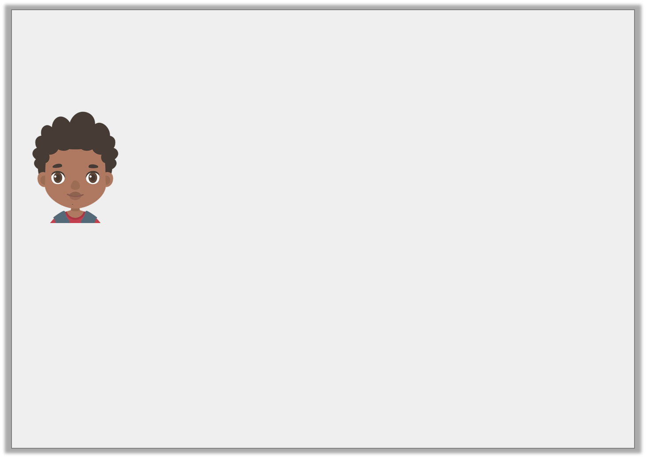
Varied Fluency 3
True or false?
ml
2L
1L 800ml
1L 600ml
1L 400ml
1L 200ml
1L
800ml
600ml
400ml
200ml
0
I have 1L and 600ml of pea soup for the school dinner hall.
Y3

Slide 9
Varied Fluency 3
True or false?
False. He has 1L and 500ml.
ml
2L
1L 800ml
1L 600ml
1L 400ml
1L 200ml
1L
800ml
600ml
400ml
200ml
0
I have 1L and 600ml of pea soup for the school dinner hall.
Y3

Slide 10
Varied Fluency 4
How much fluid is there in total?
ml
2L
1L 800ml
1L 600ml
1L 400ml
1L 200ml
1L
800ml
600ml
400ml
200ml
ml
2L
1L 800ml
1L 600ml
1L 400ml
1L 200ml
1L
800ml
600ml
400ml
200ml
ml
2L
1L 800ml
1L 600ml
1L 400ml
1L 200ml
1L
800ml
600ml
400ml
200ml
Y3

Slide 11
Varied Fluency 4
How much fluid is there in total?
ml
2L
1L 800ml
1L 600ml
1L 400ml
1L 200ml
1L
800ml
600ml
400ml
200ml
ml
2L
1L 800ml
1L 600ml
1L 400ml
1L 200ml
1L
800ml
600ml
400ml
200ml
ml
2L
1L 800ml
1L 600ml
1L 400ml
1L 200ml
1L
800ml
600ml
400ml
200ml
400ml | 600ml | 1L and 200ml
400ml + 600ml + 1L and 200ml = 2L and 200ml
Y3

