Slide 1
Year 3/4 – Summer Block 5 – Mass and Capacity
Step 7
23/04/20
Year 3: I can compare Capacities

Slide 2
Introduction
Put the bottles on the number line.
0ml
500ml
1L
1L and 500ml
Y3

Slide 3
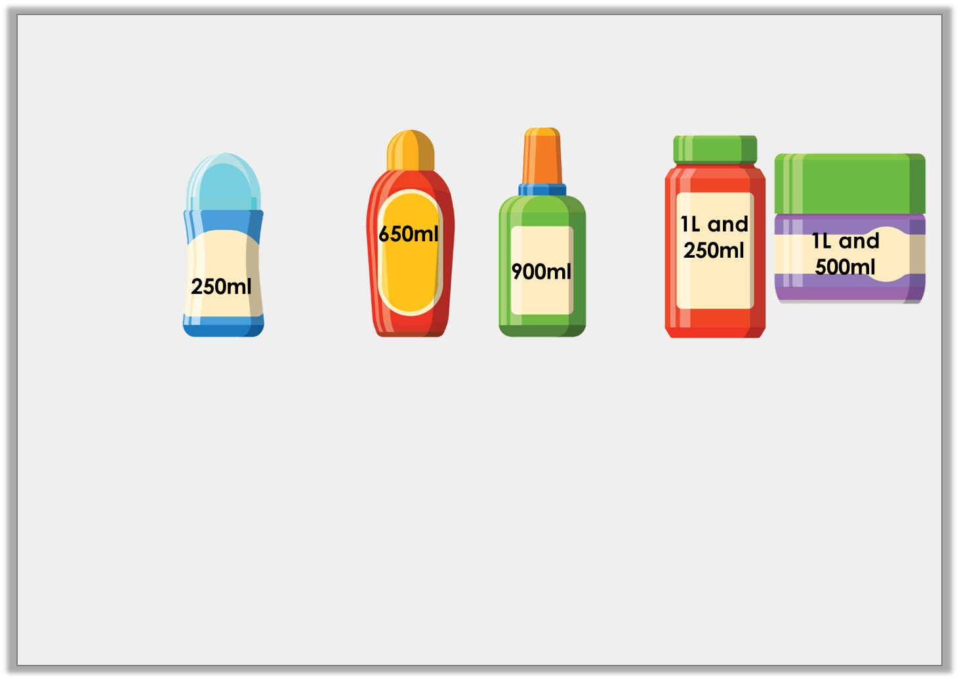
Introduction
Put the bottles on the number line.
0ml
500ml
1L
1L and 500ml
Y3

Slide 4
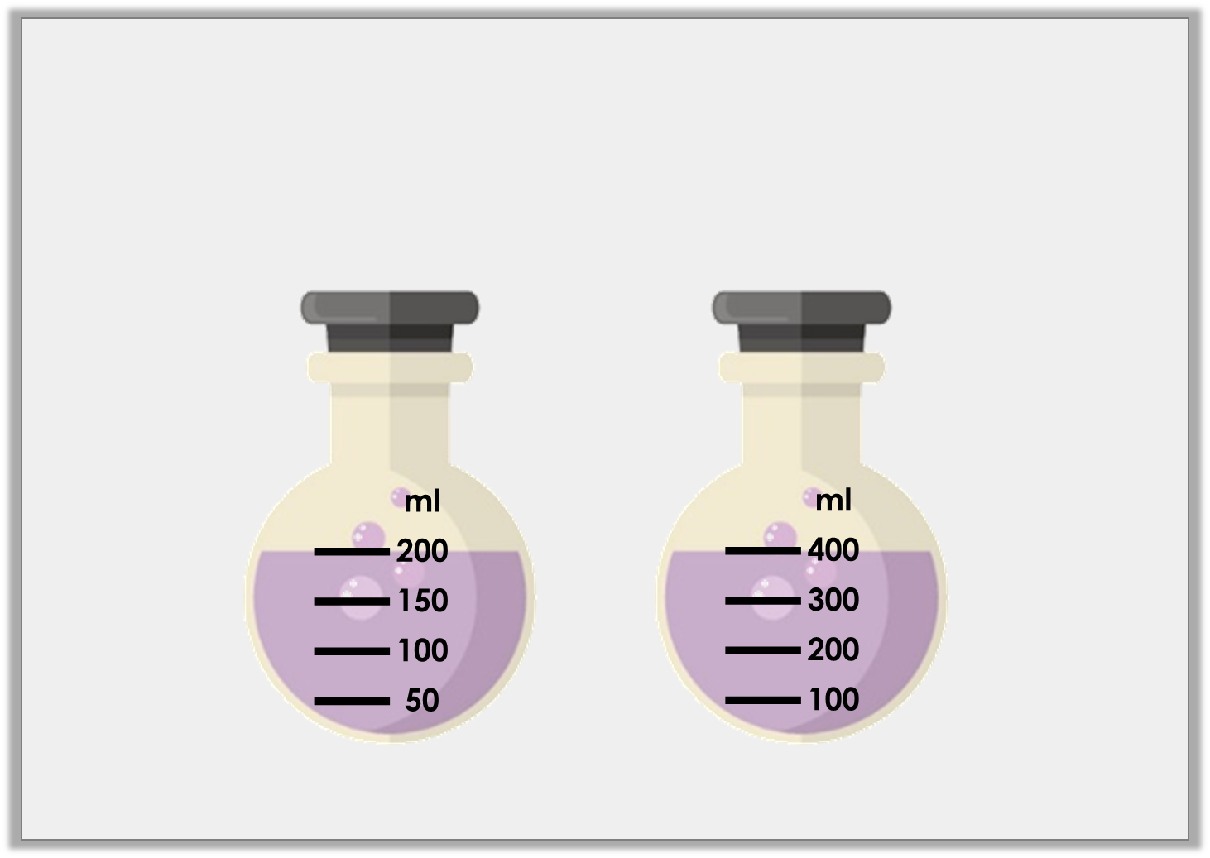
Varied Fluency 1
Which container holds the least amount of liquid?
A | B
Y3

Slide 5
Varied Fluency 1
Which container holds the least amount of liquid?
A | B
Y3

Slide 6
Varied Fluency 2
Use < or > to complete the sentences.
1L |  | 10ml
750ml |  | 2L
Y3

Slide 7
Varied Fluency 2
Use < or > to complete the sentences.
1L | > | 10ml
750ml | < | 2L
Y3

Slide 8
Varied Fluency 3
Is the statement true or false?
Beaker B contains the most liquid.
A
B
L
10
8
6
4
2
ml
400
300
200
100
Y3

Slide 9
Varied Fluency 3
Is the statement true or false?
False – Beaker B is holding 200ml but beaker A is holding 6L.
Beaker B contains the most liquid.
A
B
L
10
8
6
4
2
ml
400
300
200
100
Y3

Slide 10
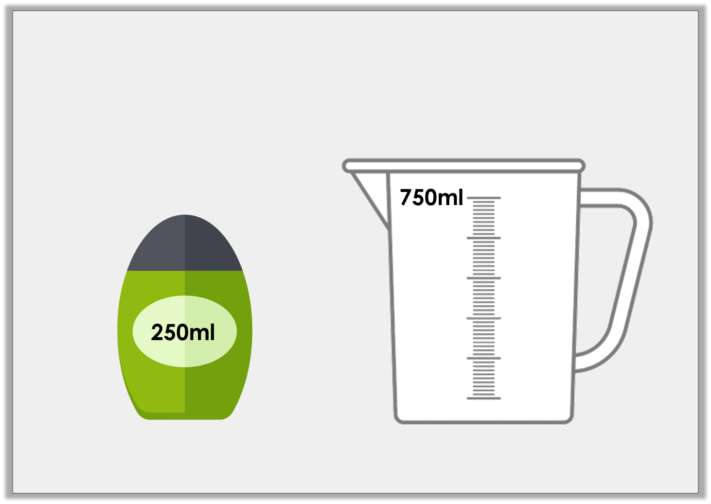
Varied Fluency 4
One bottle has a capacity of 250ml. How many bottles equal the capacity of the jug?
Y3

Slide 11
Varied Fluency 4
One bottle has a capacity of 250ml. How many bottles equal the capacity of the jug?
3 bottles
Y3

Slide 12
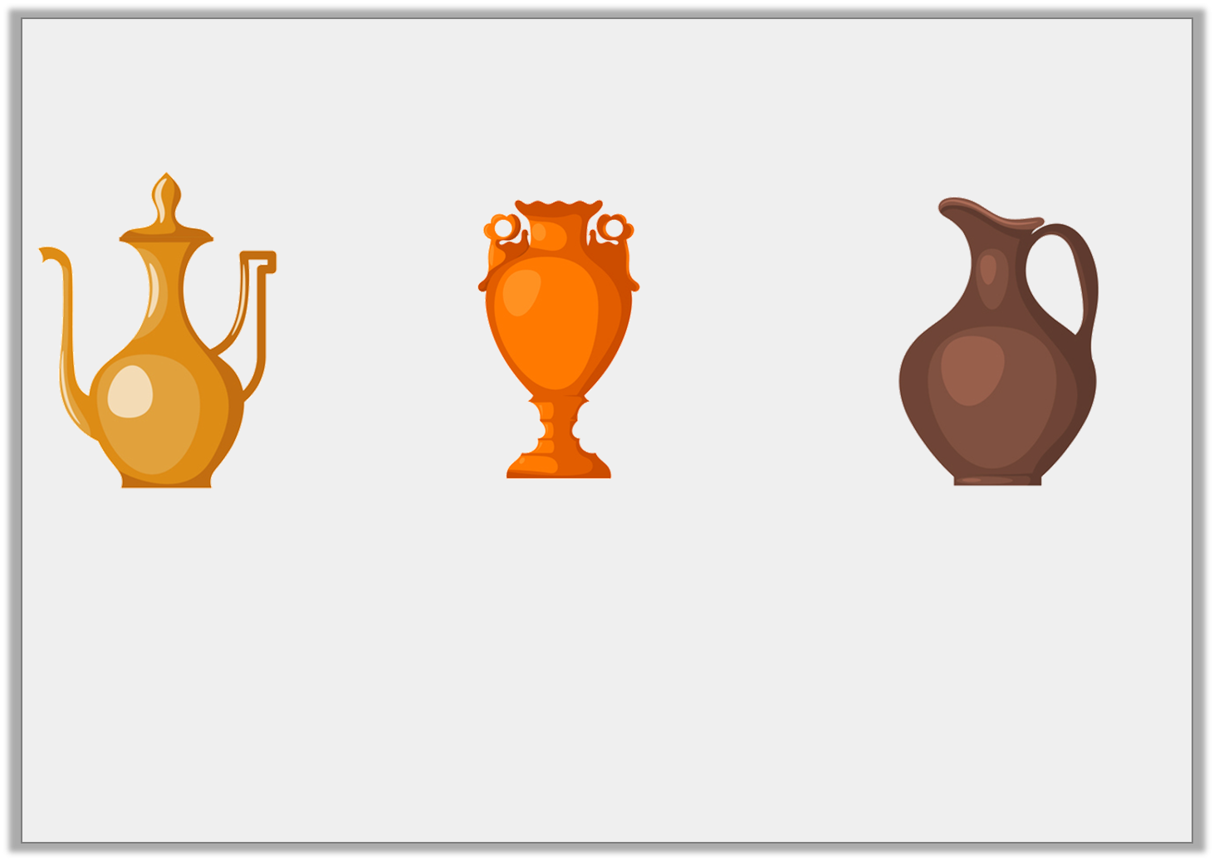
Problem Solving 1
You have 65L of water to share between the containers below.
All containers hold multiples of 5L. Pot A can only hold 5L and Pot B has a maximum capacity of 15L.
What volume of water could you pour in each?
<
<
A
B
C
Y3

Slide 13
Problem Solving 1
You have 65L of water to share between the containers below.
All containers hold multiples of 5L. Pot A can only hold 5L and Pot B has a maximum capacity of 15L.
What volume of water could you pour in each?
Various answers, for example:
A = 5L; B = 10L; C = 50L
<
<
A
B
C
Y3

Slide 14
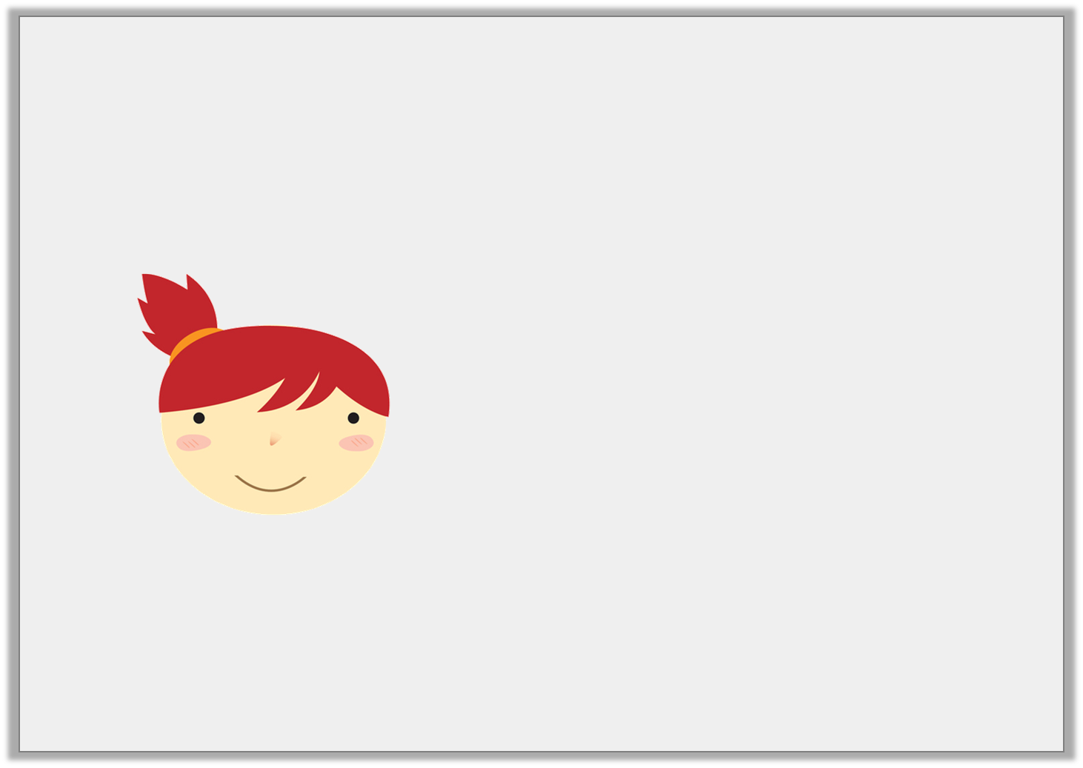
Reasoning 1
A 1L bucket holds ten times the amount of water held by a jar. Emma says:
Is Emma correct? Explain your answer.
A jar holds 200ml of water.
Y3

Slide 15
Reasoning 1
A 1L bucket holds ten times the amount of water held by a jar. Emma says:
Is Emma correct? Explain your answer.
Emma is incorrect because…
A jar holds 200ml of water.
Y3

Slide 16
Reasoning 1
A 1L bucket holds ten times the amount of water held by a jar. Emma says:
Is Emma correct? Explain your answer.
Emma is incorrect because 10 times less than 1L is 100ml.
A jar holds 200ml of water.
Y3

Slide 17
Reasoning 2
Sandi thinks that container A has a larger capacity than container B because 750 has a bigger value than 50.
Is she correct? Explain why.
ml
750
600
450
300
150
L
50
40
30
20
10
Y3

Slide 18
Reasoning 2
Sandi thinks that container A has a larger capacity than container B because 750 has a bigger value than 50.
Is she correct? Explain why.
Sandi is incorrect because…
ml
750
600
450
300
150
L
50
40
30
20
10
Y3

Slide 19
Reasoning 2
Sandi thinks that container A has a larger capacity than container B because 750 has a bigger value than 50.
Is she correct? Explain why.
Sandi is incorrect because container A is measured in ml and container B is measured in L.
ml
750
600
450
300
150
L
50
40
30
20
10
Y3

