Slide 1
Year 3/4 – Summer Block 5 – Mass and Capacity
Step 7
24/04/20
Year 3: I can compare Capacities answering reasoning and problem-solving questions

Slide 2
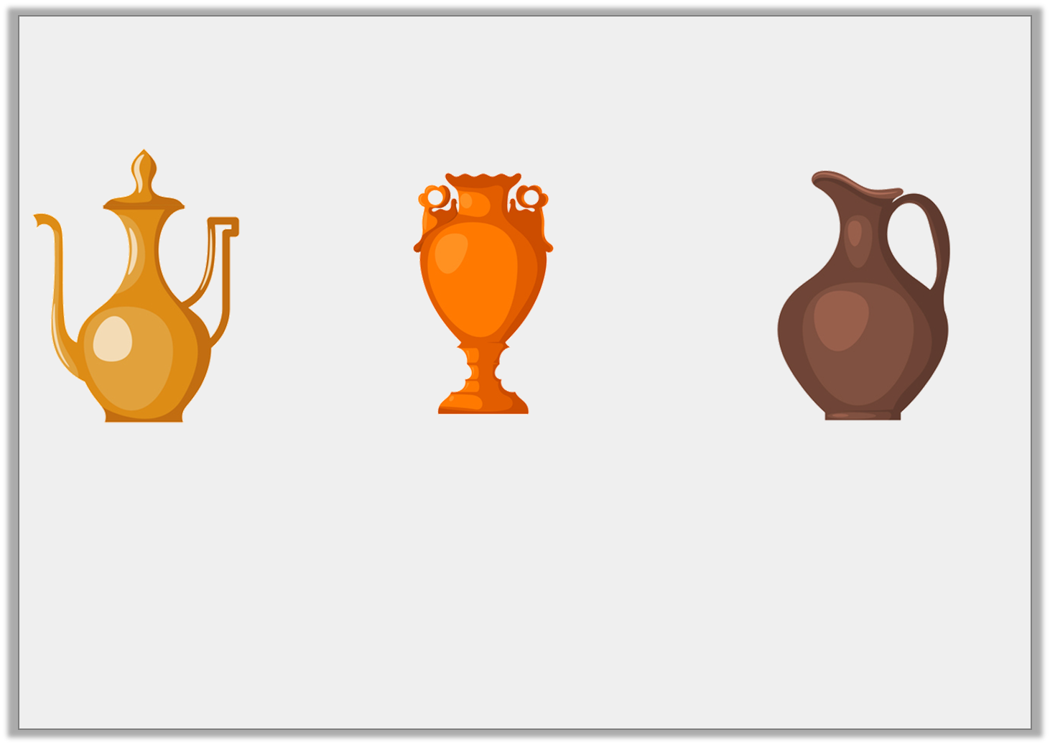
Problem Solving 1
You have 65L of water to share between the containers below.
All containers hold multiples of 5L. Pot A can only hold 5L and Pot B has a maximum capacity of 15L.
What volume of water could you pour in each?
<
<
A
B
C
Y3

Slide 3
Problem Solving 1
You have 65L of water to share between the containers below.
All containers hold multiples of 5L. Pot A can only hold 5L and Pot B has a maximum capacity of 15L.
What volume of water could you pour in each?
Various answers, for example:
A = 5L; B = 10L; C = 50L
<
<
A
B
C
Y3

Slide 4
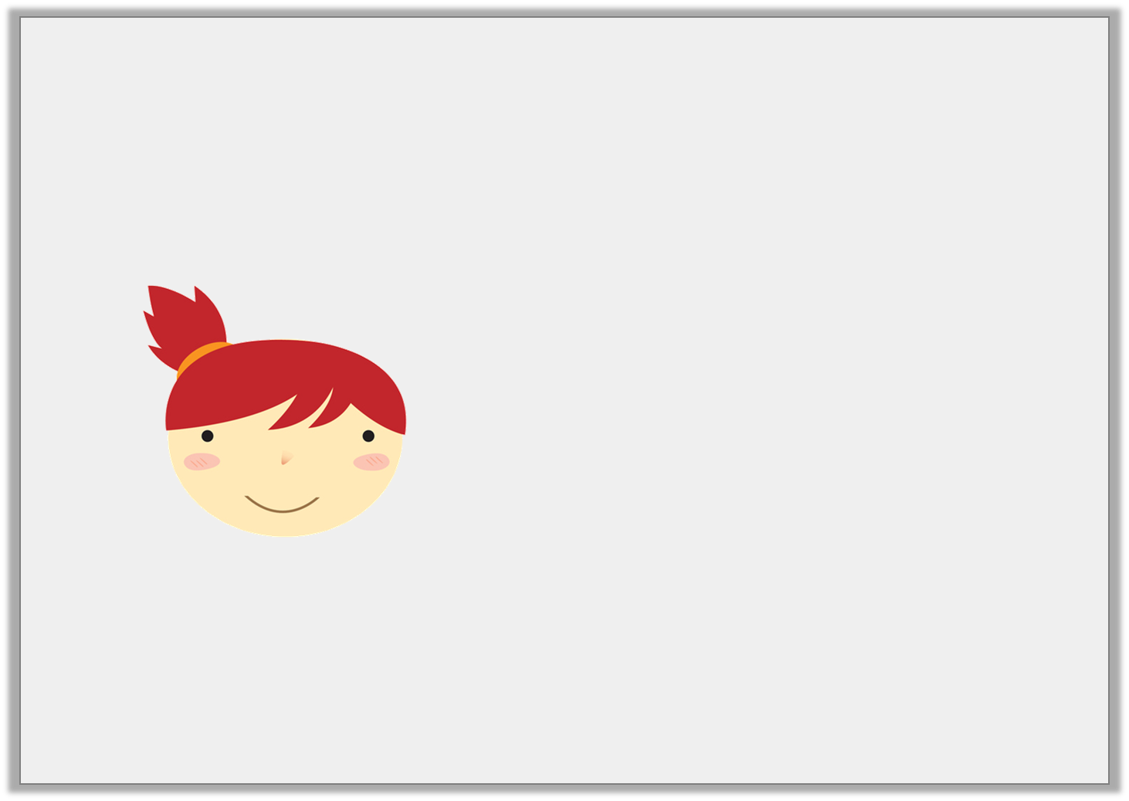
Reasoning 1
A 1L bucket holds ten times the amount of water held by a jar. Emma says:
Is Emma correct? Explain your answer.
A jar holds 200ml of water.
Y3

Slide 5
Reasoning 1
A 1L bucket holds ten times the amount of water held by a jar. Emma says:
Is Emma correct? Explain your answer.
Emma is incorrect because…
A jar holds 200ml of water.
Y3

Slide 6
Reasoning 1
A 1L bucket holds ten times the amount of water held by a jar. Emma says:
Is Emma correct? Explain your answer.
Emma is incorrect because 10 times less than 1L is 100ml.
A jar holds 200ml of water.
Y3

Slide 7
Reasoning 2
Sandi thinks that container A has a larger capacity than container B because 750 has a bigger value than 50.
Is she correct? Explain why.
ml
750
600
450
300
150
L
50
40
30
20
10
Y3

Slide 8
Reasoning 2
Sandi thinks that container A has a larger capacity than container B because 750 has a bigger value than 50.
Is she correct? Explain why.
Sandi is incorrect because…
ml
750
600
450
300
150
L
50
40
30
20
10
Y3

Slide 9
Reasoning 2
Sandi thinks that container A has a larger capacity than container B because 750 has a bigger value than 50.
Is she correct? Explain why.
Sandi is incorrect because container A is measured in ml and container B is measured in L.
ml
750
600
450
300
150
L
50
40
30
20
10
Y3

