Slide 1
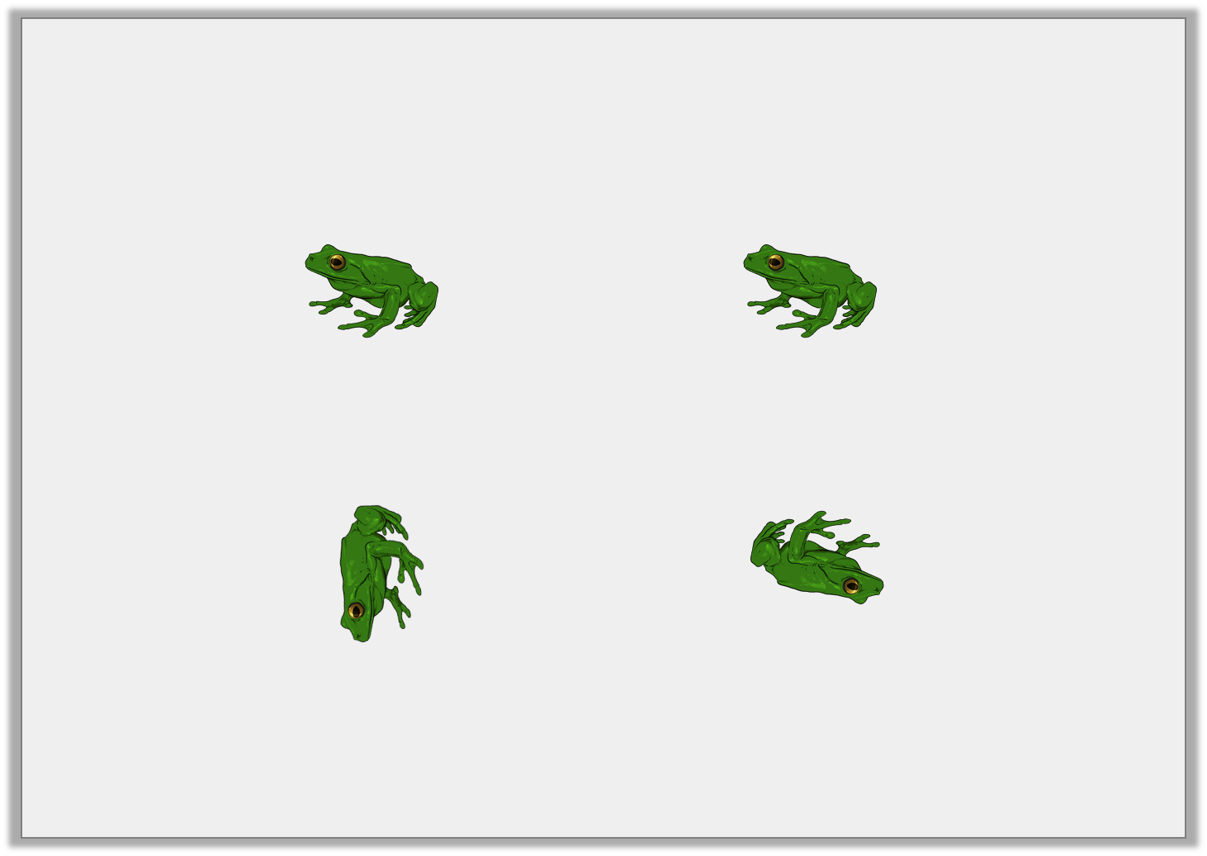
Reasoning 1
Two frogs start in the same position.
They want to turn the same amount in the same direction.
What did they get wrong? Explain.
Before
After
Y2

Slide 2

Reasoning 1
Two frogs start in the same position.
They want to turn the same amount in the same direction.
What did they get wrong? Explain.
The first frog has…
Before
After
Y2

Slide 3
Reasoning 1
Two frogs start in the same position.
They want to turn the same amount in the same direction.
What did they get wrong? Explain.
The first frog has made a three quarter turn clockwise and the second has made a half turn clockwise.
Before
After
Y2

