Slide 1
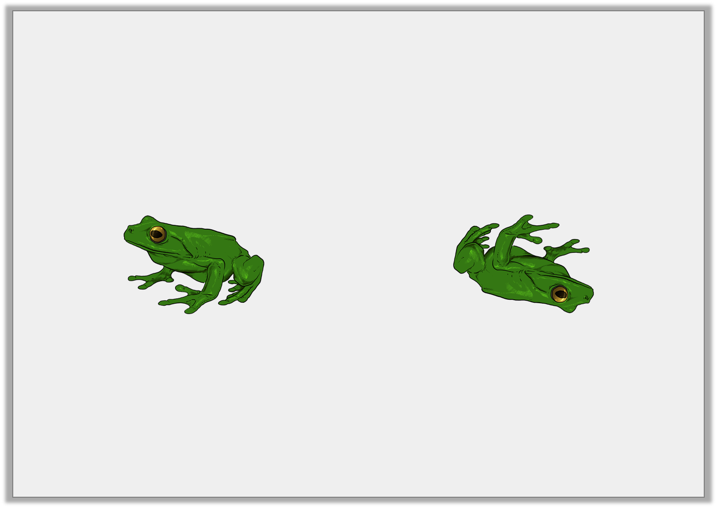
Varied Fluency 2
True or false?
The frog has made a quarter turn clockwise.
Y2

Slide 2
Varied Fluency 2
True or false?
The frog has made a quarter turn clockwise.
False, the frog has made a half turn clockwise.
Y2

Slide 3
Varied Fluency 3
The triangle makes a three quarter turn anti-clockwise.
Which one is it now?
a
b
c
Y2

Slide 4
Varied Fluency 3
The triangle makes a three quarter turn anti-clockwise.
Which one is it now?
a
b
c
Y2

Slide 5
Varied Fluency 4
True or false?
The shape could have made a whole turn to get to its new position.
New position:
Y2

Slide 6
Varied Fluency 4
True or false?
The shape could have made a whole turn to get to its new position.
False, the shape has made a quarter turn anti-clockwise or
a three quarter turn clockwise to get to its new position.
New position:
Y2

