Slide 1
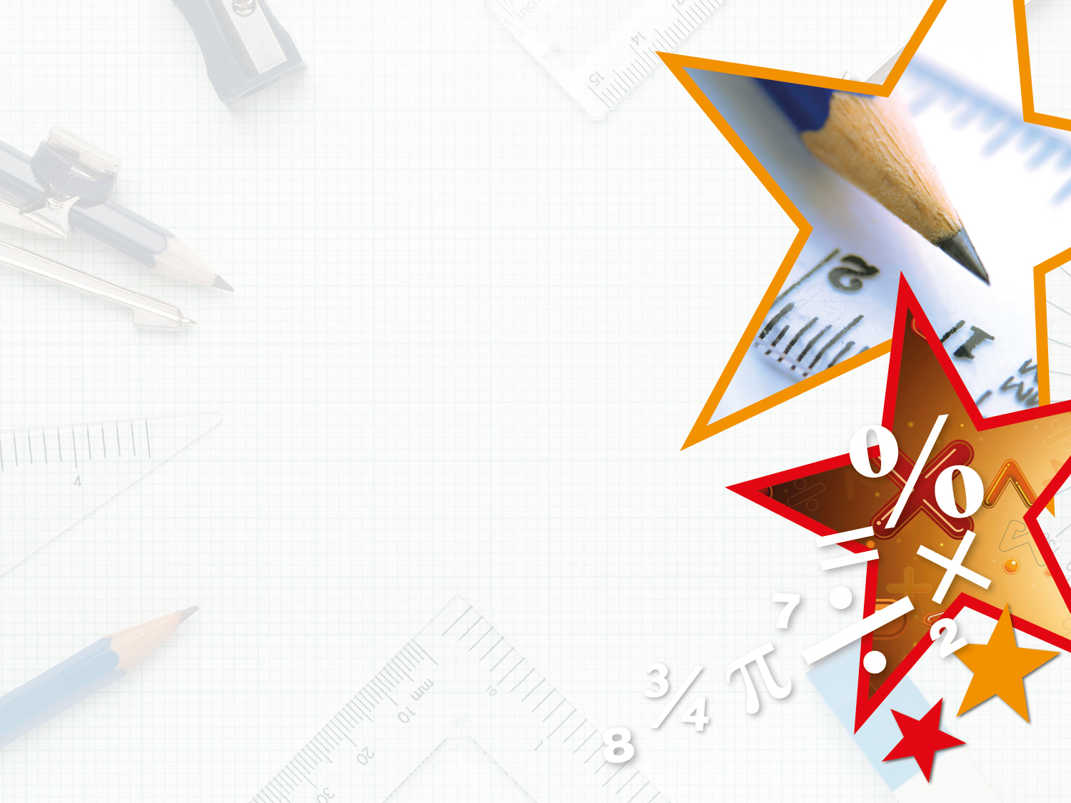
Y2
Step 2
Year 2: Describe Turns

Slide 2
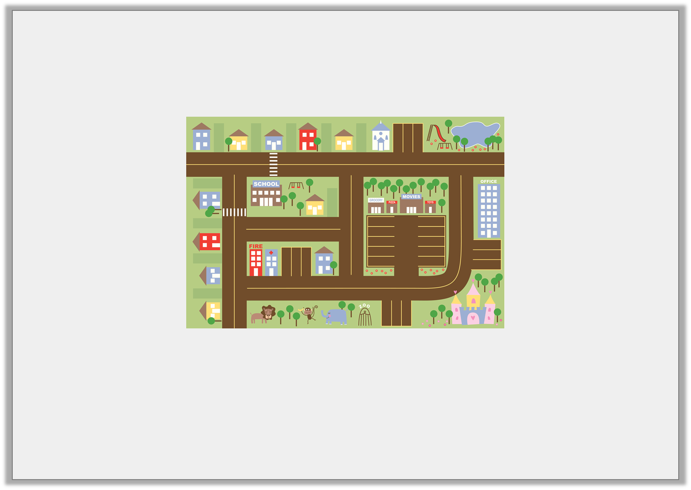
Introduction
Meredith’s class is having a cinema party.
How can they get from the school to the cinema and back?
Y2

Slide 3
Introduction
Meredith’s class is having a cinema party.
How can they get from the school to the cinema and back?
Various possible answers, for example: Leave school and make a quarter turn anti-clockwise. Walk straight then make a quarter turn clockwise. Walk straight then a quarter turn anti-clockwise. Walk straight then make another quarter turn anti-clockwise and walk through the cark park to the cinema.
Y2
© Classroom Secrets Limited 2019

Slide 4
Varied Fluency 1
Draw what the shape would look like after a half turn anti-clockwise.
Y2
© Classroom Secrets Limited 2018

Slide 5
Varied Fluency 1
Describe how the triangle has turned.
Various possible answers, for example:
The triangle has made a three quarter turn.
Y2

