Slide 1
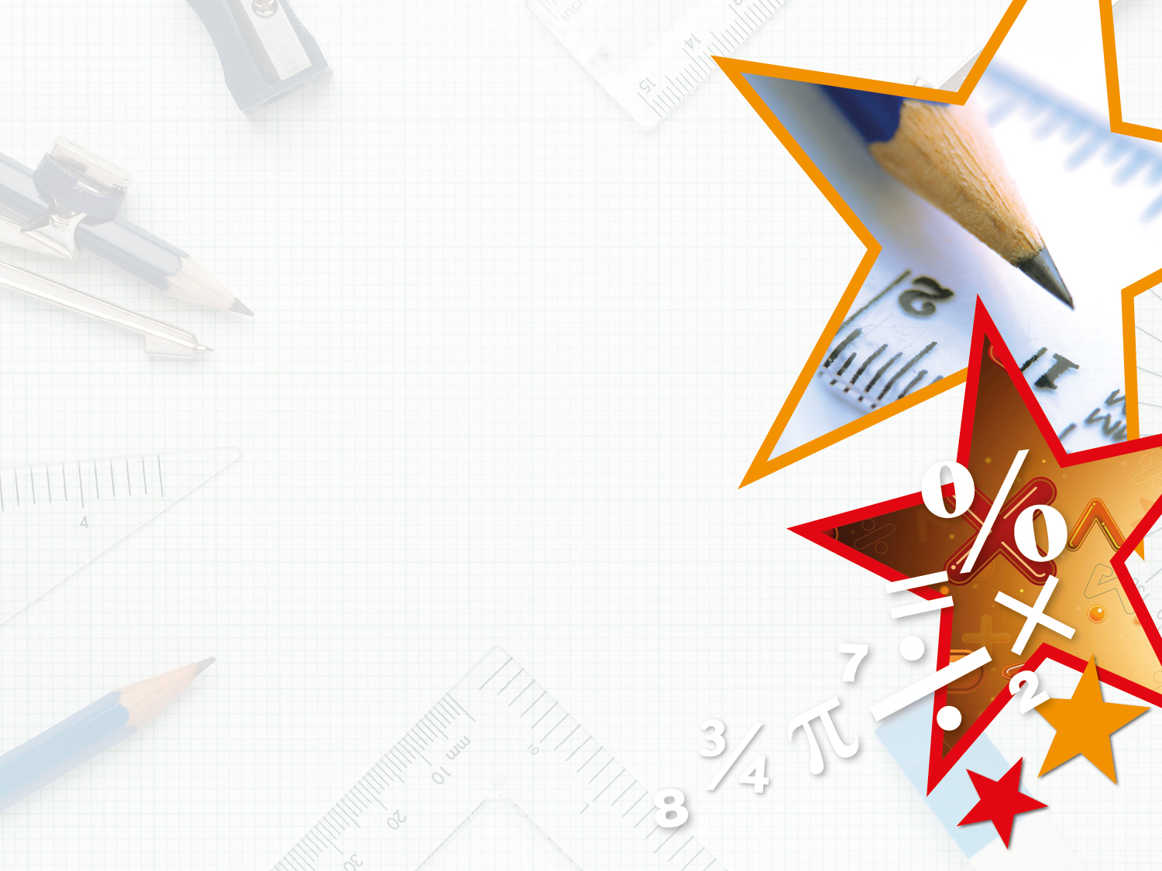
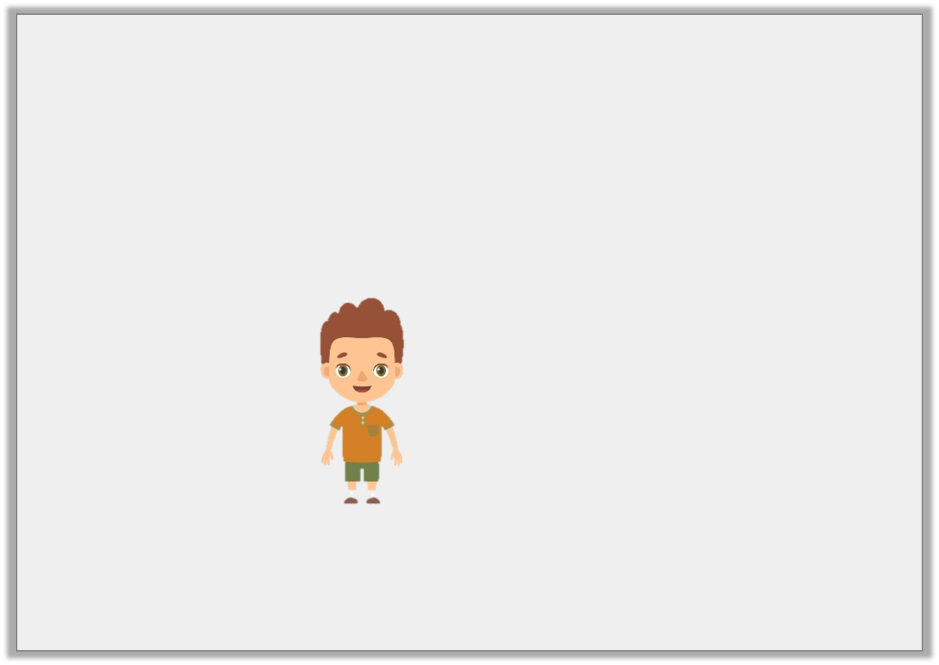
Reasoning 2
A triangle has been turned.
Jared says,
Is Jared correct? Explain why.
The shape has made a three quarter turn clockwise.
Y2

Slide 2
Reasoning 2
A triangle has been turned.
Jared says,
Is Jared correct? Explain why.
Jared is not correct because…
The shape has made a three quarter turn clockwise.
Y2

Slide 3
Reasoning 2
A triangle has been turned.
Jared says,
Is Jared correct? Explain why.
Jared is not correct because the shape has made a three quarter turn anti-clockwise.
The shape has made a three quarter turn clockwise.
Y2

Slide 4
Problem Solving 1
How many different ways could Shape A
have turned to get to the position of Shape B?
Shape A
Shape B
Y2

Slide 5
Problem Solving 1
How many different ways could Shape A
have turned to get to the position of Shape B?
2 ways: a three quarter turn clockwise
or a quarter turn anti-clockwise.
Shape A
Shape B
Y2

