Slide 1
Varied Fluency 4
Circle the shapes which have made a 3 quarter turn.
Y1

Slide 2
Varied Fluency 4
Circle the shapes which have made a 3 quarter turn.
Think about which way the shapes could turn.
Y1

Slide 3
Varied Fluency 1
Draw what the shape would look like after a half turn anti-clockwise.
Y2

Slide 4
Varied Fluency 1
Describe how the triangle has turned.
Various possible answers, for example:
The triangle has made a three quarter turn.
Y2

Slide 5
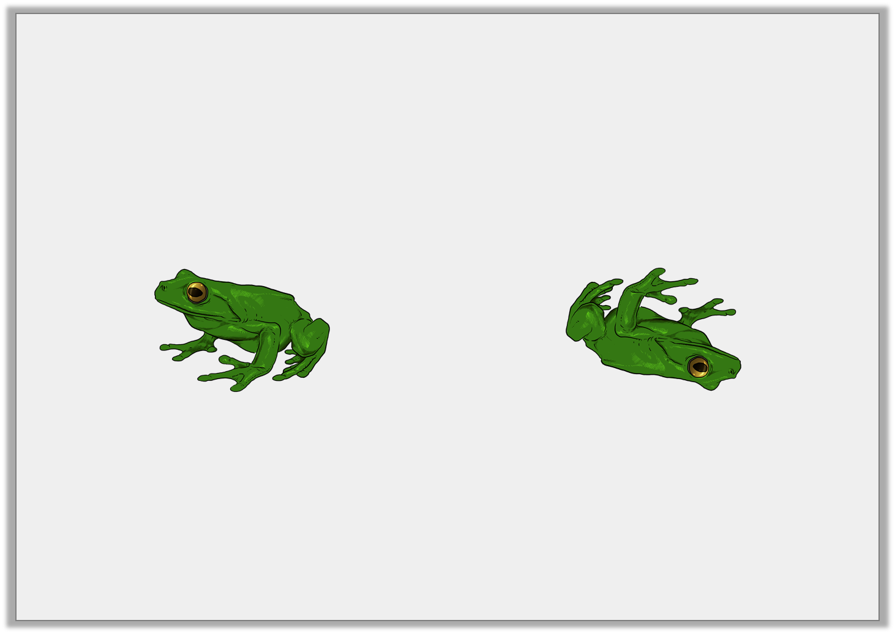
Varied Fluency 2
True or false?
The frog has made a quarter turn clockwise.
Y2

Slide 6
Varied Fluency 2
True or false?
The frog has made a quarter turn clockwise.
False, the frog has made a half turn clockwise.
Y2

Slide 7
Varied Fluency 3
The triangle makes a three quarter turn anti-clockwise.
Which one is it now?
a
b
c
Y2

Slide 8
Varied Fluency 3
The triangle makes a three quarter turn anti-clockwise.
Which one is it now?
a
b
c
Y2

Slide 9
Varied Fluency 4
True or false?
The shape could have made a whole turn to get to its new position.
New position:
Y2

Slide 10
Varied Fluency 4
True or false?
The shape could have made a whole turn to get to its new position.
New position:
Y2

