Slide 1
Y1/2 – Summer Block 2 – Position and Direction
Step 2
Year 1: Describe Turns

Slide 2
Introduction
Stand up and face the front of the classroom. Follow these instructions. Which ones make one full turn?
 | Instructions | Full turn?
1 | Make a quarter turn. Make a half turn in the same direction. Make another half turn in the same direction.
2 | Make a half turn. Make a quarter turn in the same direction. Make another quarter turn in the same direction.
3 | Make a three quarter turn. Make a half turn in the same direction.
Y1

Slide 3
Introduction
Stand up and face the front of the classroom. Follow these instructions. Which ones make one full turn?
 | Instructions | Full turn?
1 | Make a quarter turn. Make a half turn in the same direction. Make another half turn in the same direction. | X
2 | Make a half turn. Make a quarter turn in the same direction. Make another quarter turn in the same direction. | ✓
3 | Make a three quarter turn. Make a half turn in the same direction. | X
Y1

Slide 4
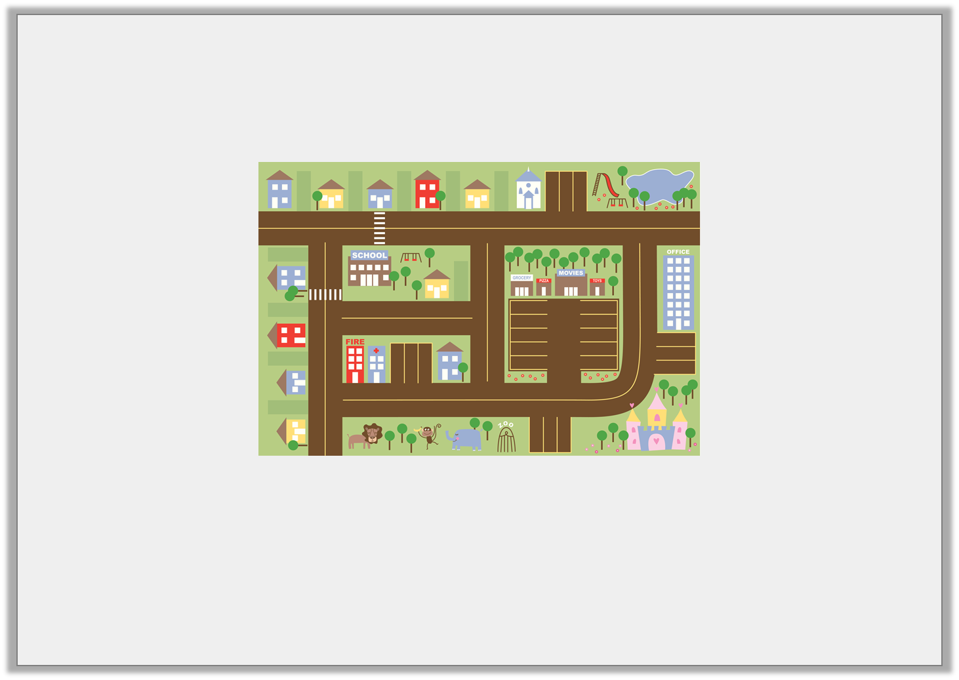
Introduction
Meredith’s class is having a cinema party.
How can they get from the school to the cinema and back?
Y2

Slide 5
Introduction
Meredith’s class is having a cinema party.
How can they get from the school to the cinema and back?
Various possible answers, for example: Leave school and make a quarter turn anti-clockwise. Walk straight then make a quarter turn clockwise. Walk straight then a quarter turn anti-clockwise. Walk straight then make another quarter turn anti-clockwise and walk through the cark park to the cinema.
Y2

Slide 6
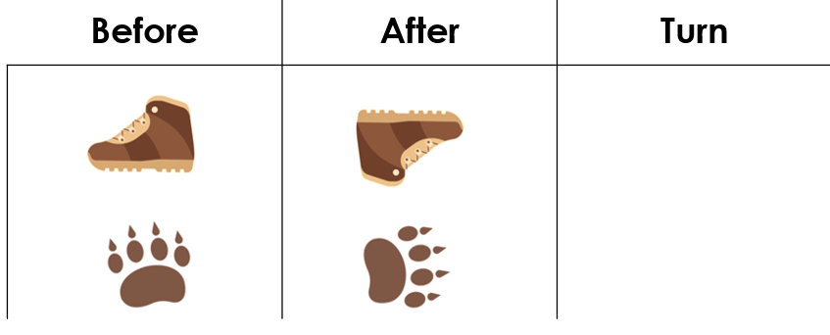
Varied Fluency 1
Look at the objects below. How have they moved?
Write the correct turn for each object.
Y1

Slide 7
Varied Fluency 1
Look at the objects below. How have they moved?
The paw print may also make a three quarter turn to the left.
Half turn
Quarter
turn
Y1

Slide 8
Varied Fluency 2
How will this shape look after a quarter turn. Circle your answer.
a
b
Y1

Slide 9
Varied Fluency 2
How will this shape look after a quarter turn. Circle your answer.
a
b
Y1

Slide 10
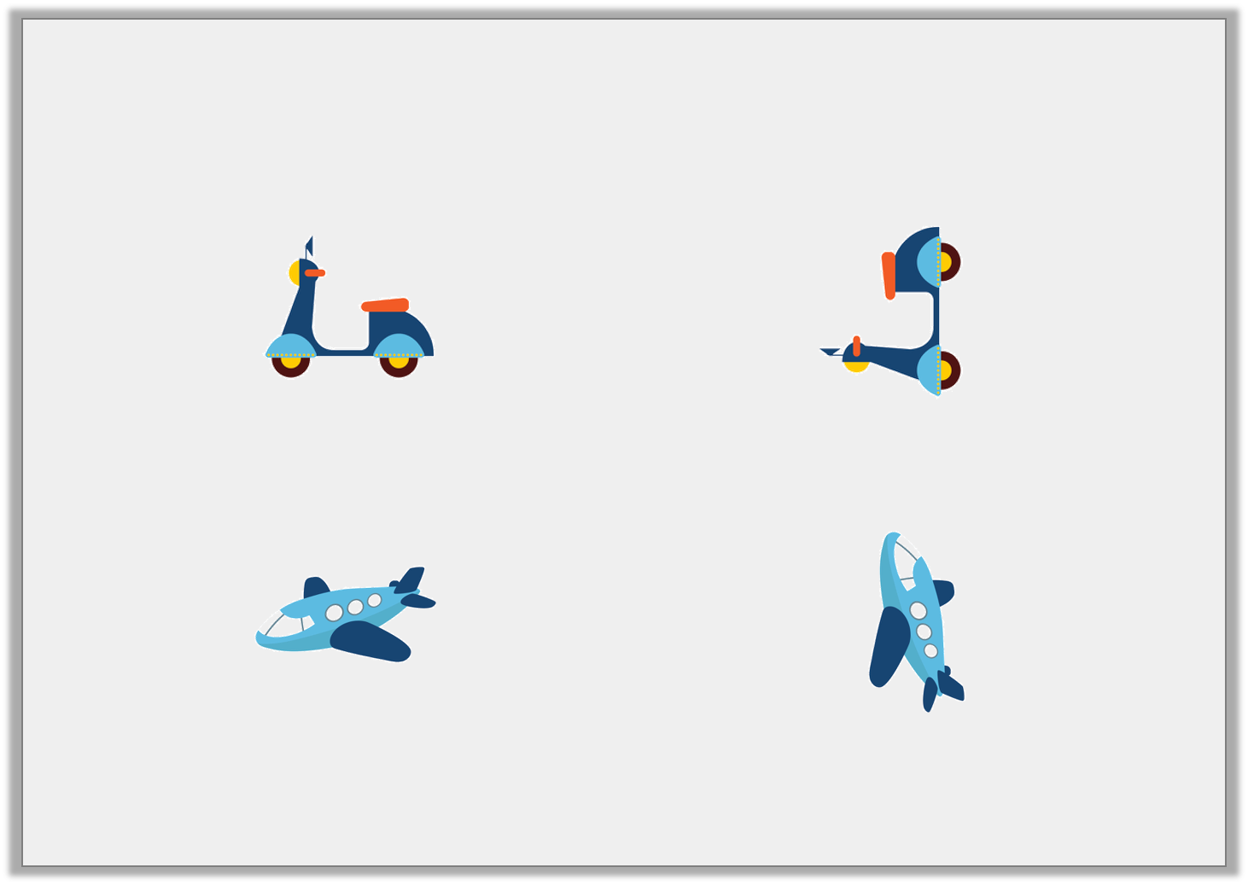
Varied Fluency 3
Draw an arrow in the box to show
the direction each object has turned.
Describe the turn each object has made.
z
Y1

Slide 11
Varied Fluency 3
Draw an arrow in the box to show
the direction each object has turned.
A quarter turn
A quarter turn
Describe the turn each object has made.
Y1

