Slide 1
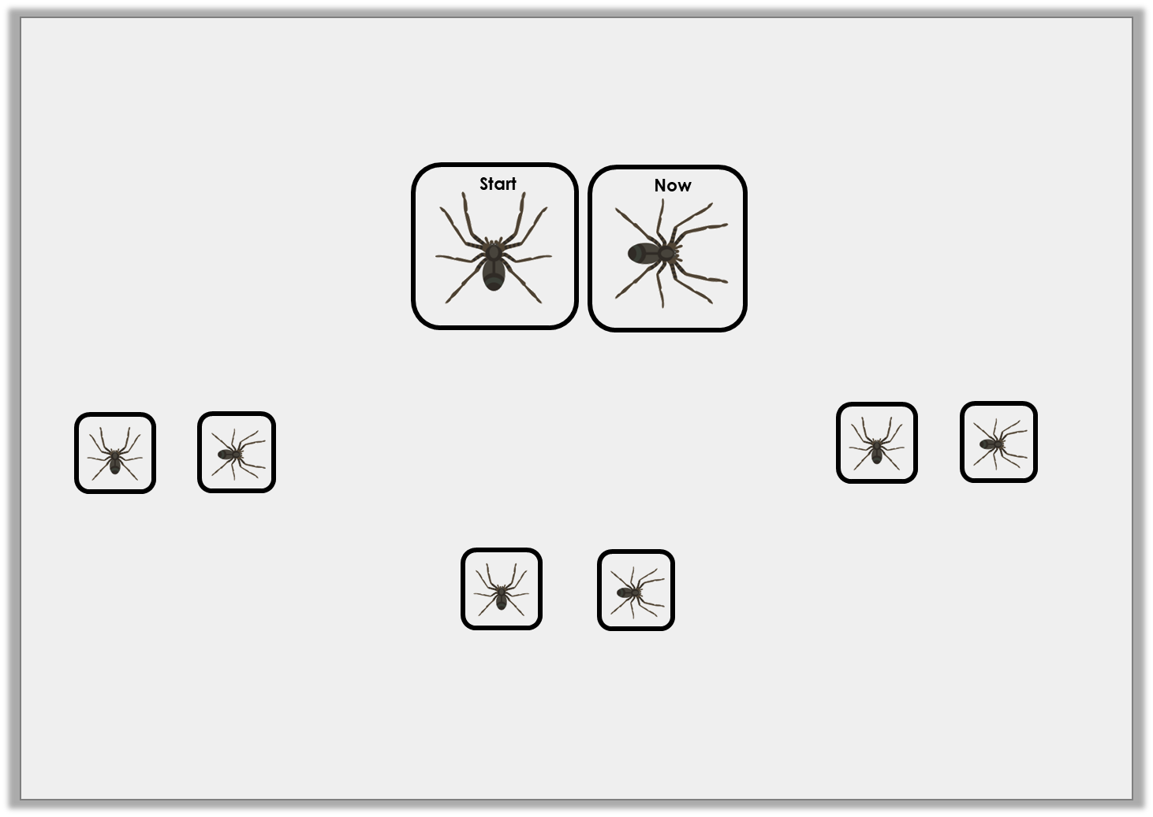
Problem Solving 1
Joseph has turned his game piece twice, in the same direction.
Which two turns could leave him facing this way?
One full turn and one quarter turn
One half turn and one quarter turn
One three quarter turn and one half turn
Y1

Slide 2
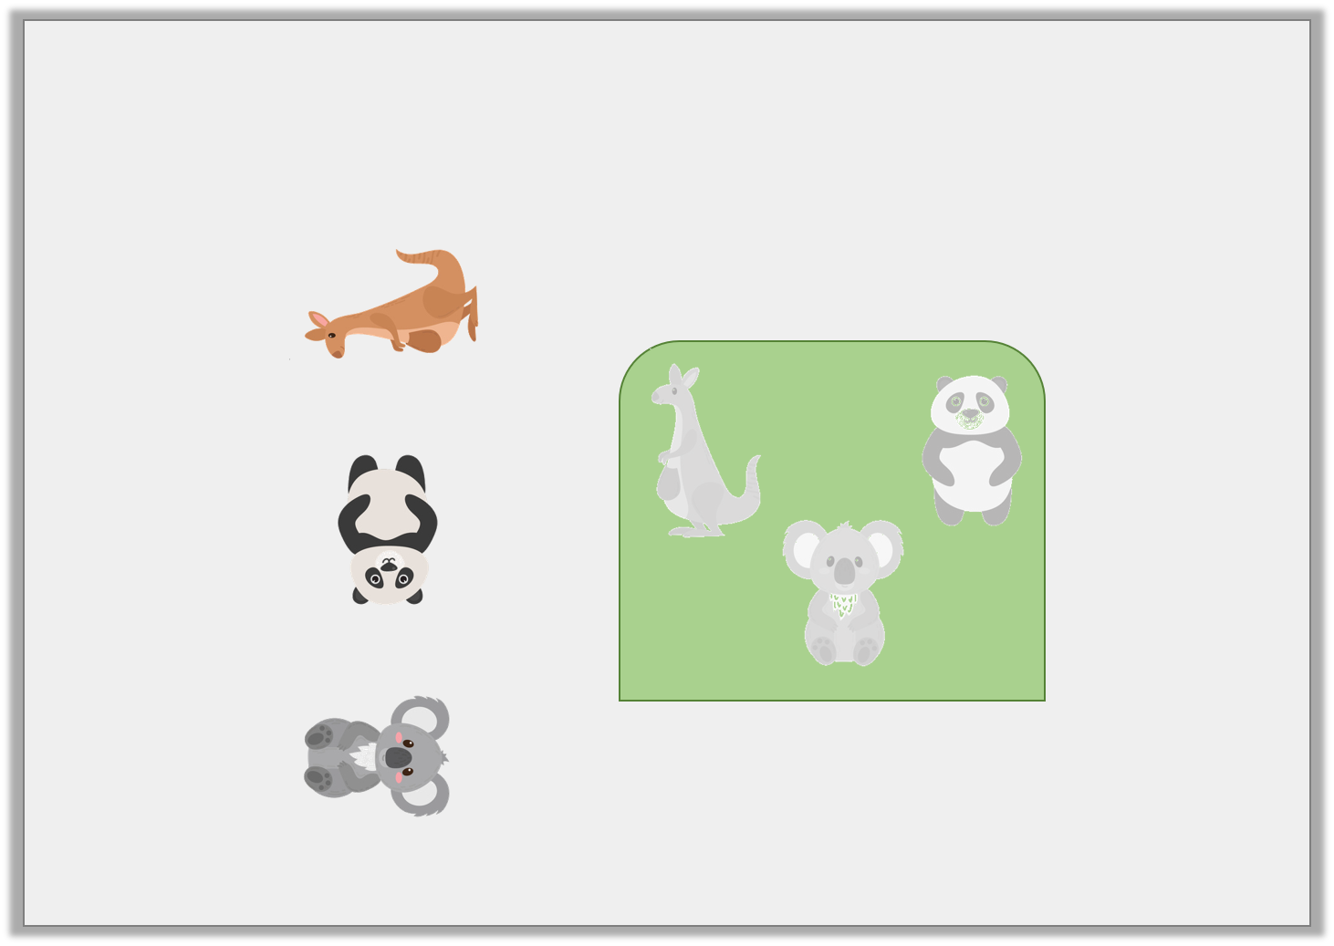
Problem Solving 2
The jigsaw pieces need to turn to fit their space.
How should they each turn?
Y1

Slide 3
Problem Solving 2
The jigsaw pieces need to turn to fit their space.
How should they each turn?
a quarter turn
a half turn
a quarter turn
Y1

Slide 4
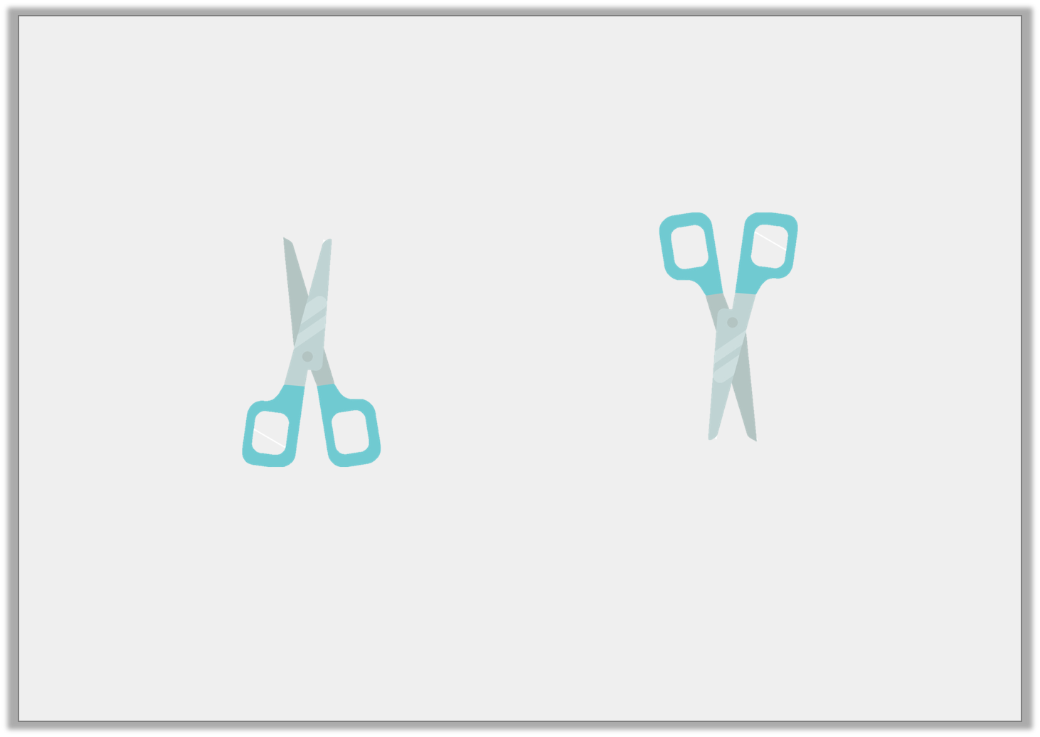
Reasoning 1
Emily was asked to turn the scissors one quarter turn and one half turn.
Did she follow the instructions? Explain and correct any mistakes you find.
Y1

Slide 5
Reasoning 1
Emily was asked to turn the scissors one quarter turn and one half turn.
Did she follow the instructions? Explain and correct any mistakes you find.
Emily has not followed the instructions...
Y1

Slide 6
Reasoning 1
Emily was asked to turn the scissors one quarter turn and one half turn.
Did she follow the instructions? Explain and correct any mistakes you find.
Emily has not followed the instructions. She turned the scissors one half turn. She needs to turn them one quarter turn more.
Y1

