Slide 1
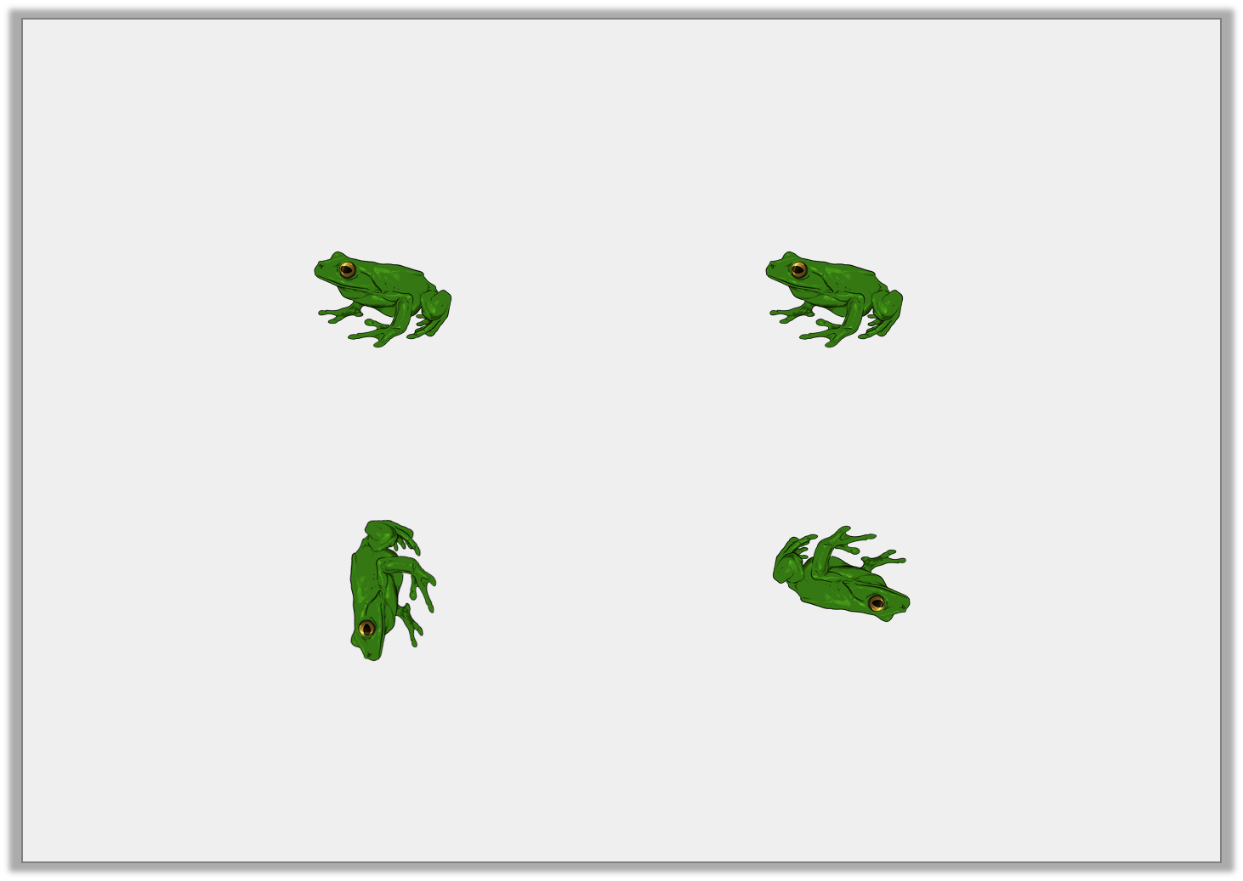
Reasoning 1
Two frogs start in the same position.
They want to turn the same amount in the same direction.
What did they get wrong? Explain.
Before
After
Y2

Slide 2
Reasoning 1
Two frogs start in the same position.
They want to turn the same amount in the same direction.
What did they get wrong? Explain.
The first frog has…
Before
After
Y2

Slide 3
Reasoning 1
Two frogs start in the same position.
They want to turn the same amount in the same direction.
What did they get wrong? Explain.
The first frog has made a three quarter turn clockwise and the second has made a half turn clockwise.
Before
After
Y2

Slide 4
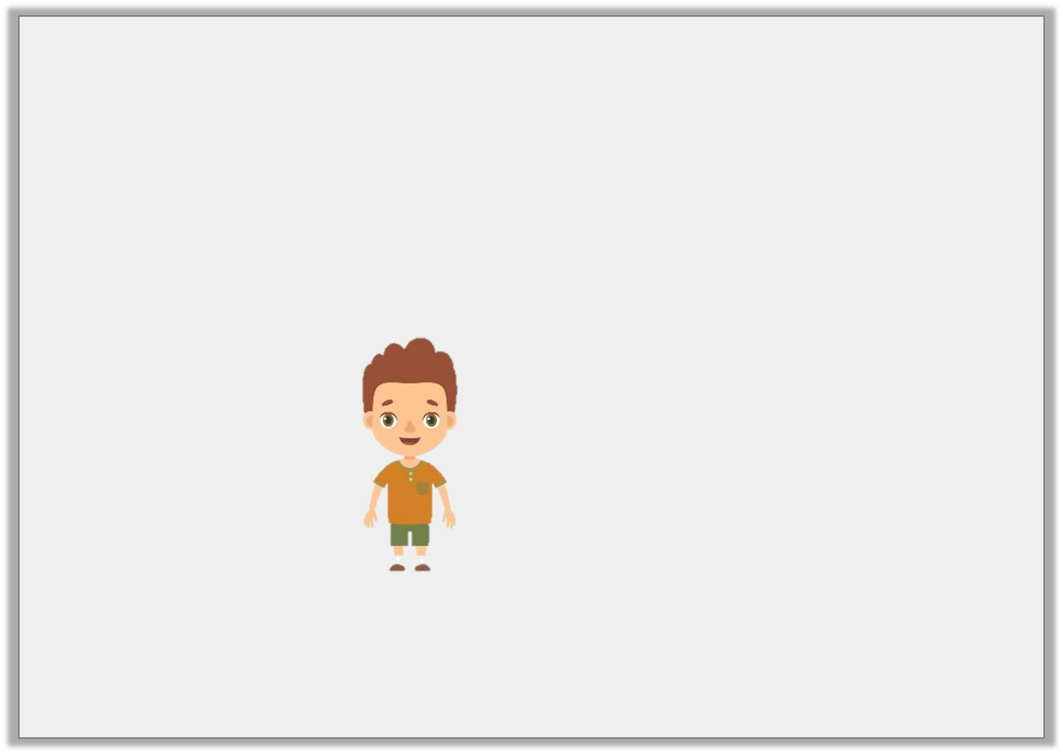
Reasoning 2
A triangle has been turned.
Jared says,
Is Jared correct? Explain why.
The shape has made a three quarter turn clockwise.
Y2

Slide 5
Reasoning 2
A triangle has been turned.
Jared says,
Is Jared correct? Explain why.
Jared is not correct because…
The shape has made a three quarter turn clockwise.
Y2

Slide 6
Reasoning 2
A triangle has been turned.
Jared says,
Is Jared correct? Explain why.
Jared is not correct because the shape has made a three quarter turn anti-clockwise.
The shape has made a three quarter turn clockwise.
Y2

Slide 7
Problem Solving 1
How many different ways could Shape A
have turned to get to the position of Shape B?
Shape A
Shape B
Y2

Slide 8
Problem Solving 1
How many different ways could Shape A
have turned to get to the position of Shape B?
2 ways: a three quarter turn clockwise
or a quarter turn anti-clockwise.
Shape A
Shape B
Y2

