Slide 1
Year 6 – Summer Block 1 – Converting Units – Step 2
About This Resource:
This PowerPoint has been designed to support teaching of the small steps. It includes a starter activity suitable for the year group and an example of each question from the Varied Fluency and Reasoning and Problem Solving resources also provided in the tasks. Each slide has the year group identified in the bottom right-hand corner. I recommend that you look through this PowerPoint in advance and decide whether to work through all examples provided or a selection of them depending on the needs of your child.
The PowerPoint has been dated for the week, so please work your way through it each day.

Slide 2
Year 6 – Summer Block 1 – Converting Units
Tuesday 27th April 2020
Step 2
Year 6: Convert Metric Measures

Slide 3
Introduction
Match the item to the most appropriate unit of measurement.
Weight of a sack of potatoes |  | L
Volume of water in a glass |  | mm
Length of a park |  | cm
Length of a finger |  | m
Weight of an apple |  | ml
Volume of water in a bucket |  | g
Length of an ant’s leg |  | kg
Y6

Slide 4
Introduction
Match the item to the most appropriate unit of measurement.
Weight of a sack of potatoes |  | kg
Volume of water in a glass |  | ml
Length of a park |  | m
Length of a finger |  | cm
Weight of an apple |  | g
Volume of water in a bucket |  | L
Length of an ant’s leg |  | mm
Y6

Slide 5
Varied Fluency 1
True or false?
20% of 3,500ml is larger than 0.8L.
Y6

Slide 6
Varied Fluency 1
True or false?
False, 20% of 3,500ml is 700ml.
700ml is smaller than 800ml.
20% of 3,500ml is larger than 0.8L.
Y6

Slide 7
Varied Fluency 2
Put these measurements in order from smallest to largest.
155cm
2.6m
0.6m
1,050mm
155mm
165cm
Y6

Slide 8
Varied Fluency 2
Put these measurements in order from smallest to largest.
155mm; 0.6m; 1,050mm; 155cm; 165cm; 2.6m
155cm
2.6m
0.6m
1,050mm
155mm
165cm
Y6

Slide 9
Varied Fluency 3
Complete the missing operation and measurement to convert between g and kg.
285g |  | = |  | kg
Y6

Slide 10
Varied Fluency 3
Complete the missing operation and measurement to convert between g and kg.
285g | ÷ 1,000 | = | 0.285 | kg
Y6

Slide 11
Varied Fluency 4
Find and correct the errors in these conversions:
a. | 1,565g | = | 1.565kg
b. | 2.35L | = | 235ml
c. | 15cm | = | 150mm
d. | 1,500mm | = | 1.05m
Y6

Slide 12
Varied Fluency 4
Find and correct the errors in these conversions:
a. | 1,565g | = | 1.565kg
b. | 2.35L | = | 2,350ml
c. | 15cm | = | 150mm
d. | 1,500mm | = | 1.5m
Y6

Slide 13
Reasoning 1
Wednesday 28th April 2020
Roland thinks that he walked the farthest on Wednesday.
Do you agree? Explain why.
 | 9am | 12pm | 3pm
Mon | 3.565km | 2,425m | 2,475m
Tue | 1.5km | 1,050m | 5,255m
Wed | 6,065m | 2km | 500m
Thu | 4,650m | 3.05km | 1,455m
Fri | 2.075km | 50m | 3,615m
Y6

Slide 14
Reasoning 1
Roland thinks that he walked the farthest on Wednesday.
Do you agree? Explain why.
Roland is incorrect because…
 | 9am | 12pm | 3pm
Mon | 3.565km | 2,425m | 2,475m
Tue | 1.5km | 1,050m | 5,255m
Wed | 6,065m | 2km | 500m
Thu | 4,650m | 3.05km | 1,455m
Fri | 2.075km | 50m | 3,615m
Y6

Slide 15
Reasoning 1
Roland thinks that he walked the farthest on Wednesday.
Do you agree? Explain why.
Roland is incorrect because he walked 9.155km (9,155m) on Thursday, which is farther than any other day.
 | 9am | 12pm | 3pm
Mon | 3.565km | 2,425m | 2,475m
Tue | 1.5km | 1,050m | 5,255m
Wed | 6,065m | 2km | 500m
Thu | 4,650m | 3.05km | 1,455m
Fri | 2.075km | 50m | 3,615m
total
8.465km
7.805km
8.565km
9.155km
5.74km
Y6

Slide 16
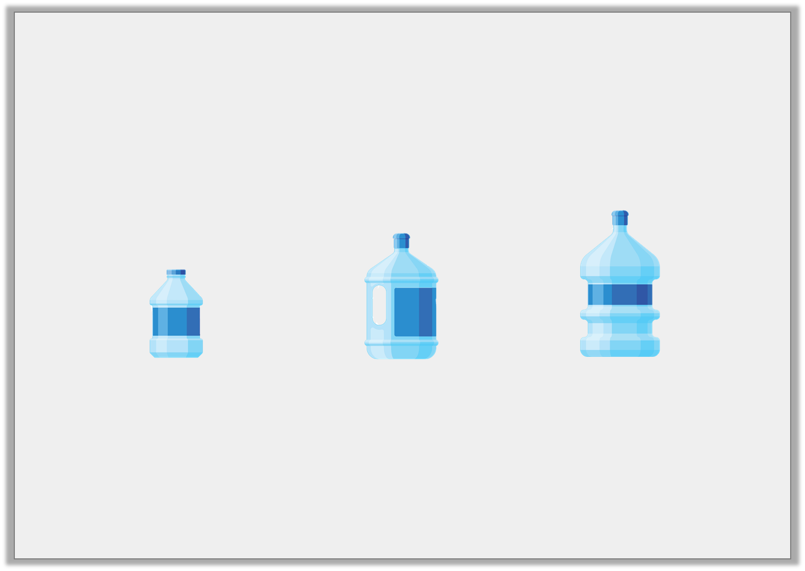
Problem Solving 1
A garden pond has a maximum water allowance of 24.865L
Josie uses 6 bottles in total and fills her pond to capacity. How many of each size did she use?
Small 2.485L |  | Medium 4,625ml |  | Large 6,020ml
Y6

Slide 17
Problem Solving 1
A garden pond has a maximum water allowance of 24.865L
Josie uses 6 bottles in total and fills her pond to capacity. How many of each size did she use?
2x Small; 3x Medium; 1x Large
Small 2.485L |  | Medium 4,625ml |  | Large 6,020ml
Y6

Slide 18
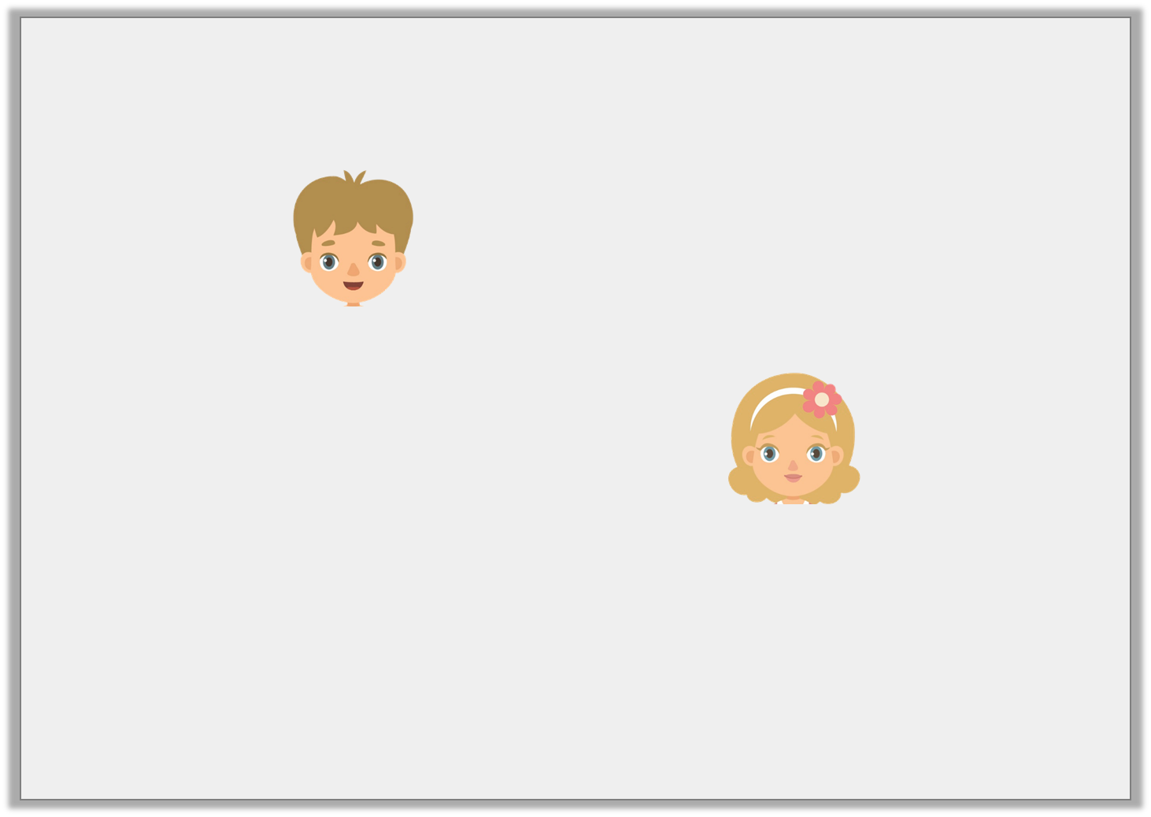
Reasoning 2
Olly and Annie are converting 21,865cm into metres.
Who is correct? Explain why.
The answer is 21.865m.
Olly
The answer is 218.65m.
Annie
Y6

Slide 19
Reasoning 2
Olly and Annie are converting 21,865cm into metres.
Who is correct? Explain why.
Annie is correct because…
The answer is 21.865m.
Olly
The answer is 218.65m.
Annie
Y6

Slide 20
Reasoning 2
Olly and Annie are converting 21,865cm into metres.
Who is correct? Explain why.
Annie is correct because to convert cm to m, you need to divide by 100.
21,865 ÷ 100 = 218.65
The answer is 21.865m.
Olly
The answer is 218.65m.
Annie
Y6

Slide 21
Year 6 – Summer Block 1 – Converting Units
Thursday 30th April 2020
Step 3
Year 6: Calculate with Metric Measures

Slide 22
Introduction
Match the measurements to the most appropriate units of measure.
The weight of an elephant.
ml
seconds
How long it takes to brush your teeth.
m
The amount of milk needed to
make a Yorkshire pudding mixture.
minutes
The duration of a film.
hours, minutes
The length of a school book.
kg
mm
The height of a giraffe.
cm
Y6

Slide 23
Introduction
Match the measurements to the most appropriate units of measure.
The weight of an elephant.
ml
seconds
How long it takes to brush your teeth.
m
The amount of milk needed to
make a Yorkshire pudding mixture.
minutes
The duration of a film.
hours, minutes
The length of a school book.
kg
mm
The height of a giraffe.
cm
Y6

Slide 24
Varied Fluency 1
Adam, Rachael and John have been growing sunflowers.
Adam’s is the tallest, Rachael’s is of the height of Adam’s.
John’s grew the least at only half the size of Rachael’s, measuring 56.25cm
How tall is Adam’s flower in cm?
3
4
Y6

Slide 25
Varied Fluency 1
Adam, Rachael and John have been growing sunflowers.
Adam’s is the tallest, Rachael’s is of the height of Adam’s.
John’s grew the least at only half the size of Rachael’s, measuring 56.25cm
How tall is Adam’s flower in cm?
150 cm
3
4
Y6

Slide 26
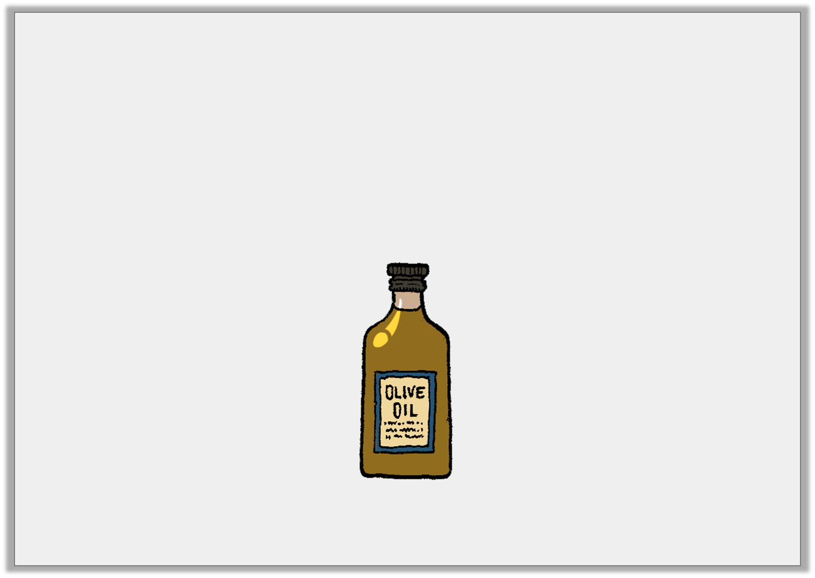
Varied Fluency 2
True or false?
Esme is filling eighty 20ml bottles using 1 litres of oil.
She will not have enough oil to fill all eighty bottles.
3
4
Y6

Slide 27
Varied Fluency 2
True or false?
Esme is filling eighty 20ml bottles using 1 litres of oil.
She will not have enough oil to fill all eighty bottles.
False, 80 x 20ml is 1,600ml which is less than 1,750ml.
3
4
Y6

Slide 28
Varied Fluency 3
Amanda is timing how long it takes her two daughters to tidy their rooms.
Emily’s is tidy after 2 hours, then she spends 17 minutes dusting and vacuuming.
Charlotte has finished everything after 3.25 hours.
How many minutes quicker was Emily than Charlotte?
1
4
Y6

Slide 29
Varied Fluency 3
Amanda is timing how long it takes her two daughters to tidy their rooms.
Emily’s is tidy after 2 hours, then she spends 17 minutes dusting and vacuuming.
Charlotte has finished everything after 3.25 hours.
How many minutes quicker was Emily than Charlotte?
43 minutes
1
4
Y6

Slide 30
Varied Fluency 4
Victoria weighs her puppy every month and keeps a record in the table.
How much heavier in grams was her puppy in May, compared to January?
January | February | March | April | May
0.04kg | 54g | 0.13kg | 390g | kg
1
2
Y6

Slide 31
Varied Fluency 4
Victoria weighs her puppy every month and keeps a record in the table.
How much heavier in grams was her puppy in May, compared to January?
460g
January | February | March | April | May
0.04kg | 54g | 0.13kg | 390g | kg
1
2
Y6

Slide 32
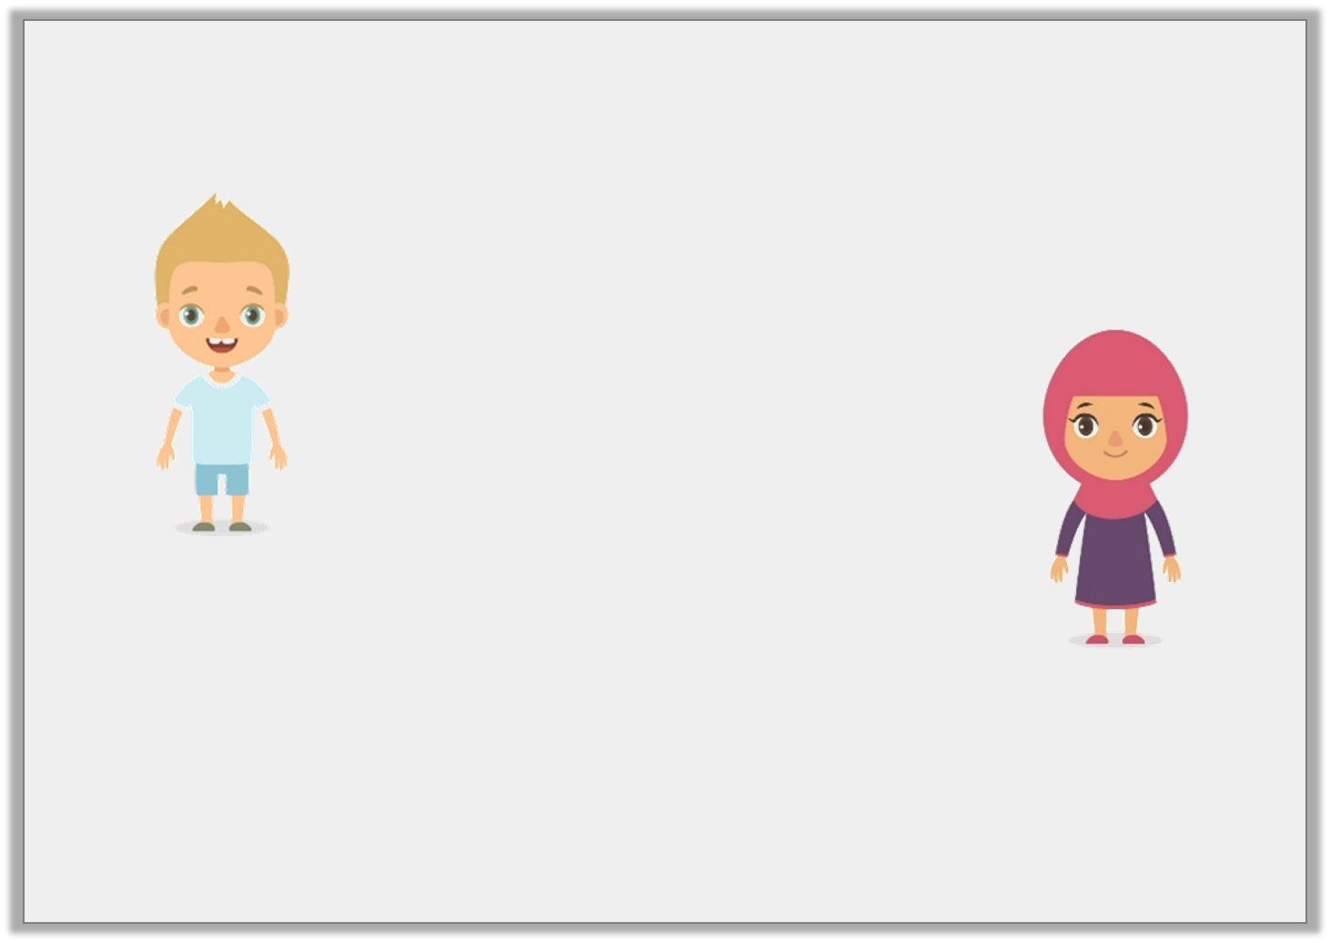
Reasoning 2
Friday 1st May 2020
Francis and Ariel are converting millimetres to centimetres.
Who is correct? Why?
Ariel is correct because you have to divide by 1,000 to convert from millimetres to metres.
1,260mm ÷ 1,000 = 1.26m
1,260 millimetres is the same as 126 metres.
1,260 millimetres is the same as 1.26 metres.
Francis
Ariel

Slide 33
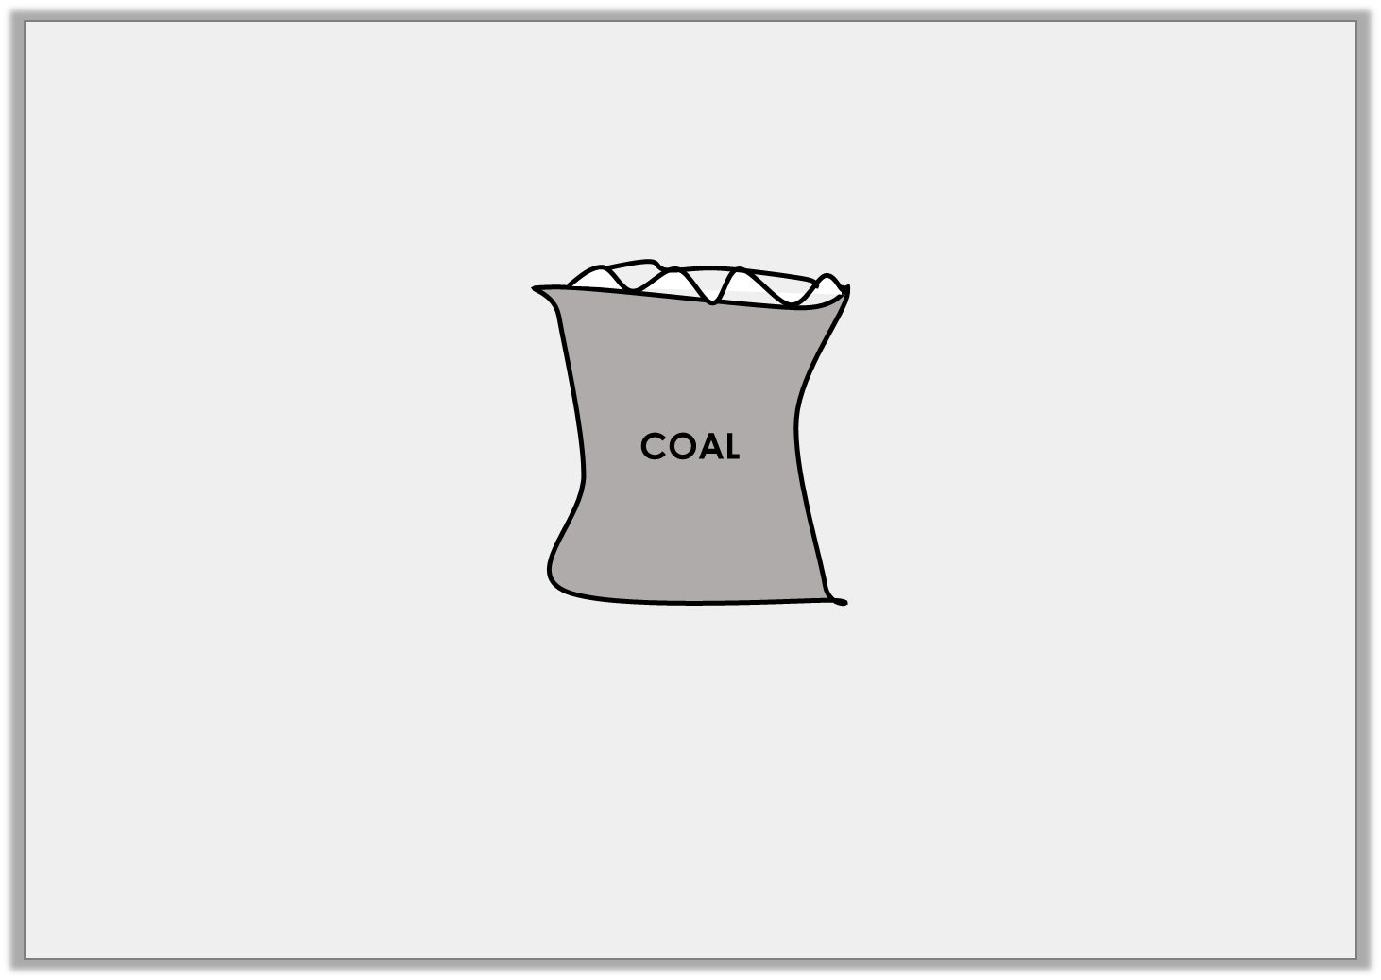
Problem Solving 1
The weight of one sack of coal is 4,050g. The lorry load has 25 coal sacks altogether.
What is the total weight of coal in kg?
Y6

Slide 34
Problem Solving 1
The weight of one sack of coal is 4,050g. The lorry load has 25 coal sacks altogether.
What is the total weight of coal in kg?
101.25kg
Y6

Slide 35
Problem Solving 2
The length of a train carriage is 20.06m. The length of a van is only 405cm. Arrange the digit cards to make the following statement match.
2
0
?
6
?
.
0
?
m
cm
>
4
5
0
Y6

Slide 36
Problem Solving 2
The length of a train carriage is 20.06m. The length of a van is only 405cm. Arrange the digit cards to make the following statement match. 2,006cm > 4.05m
2
0
0
6
4
.
0
5
m
cm
>
4
5
0
Y6

Slide 37
Reasoning 1
A petrol tank holds 45 litres. Dave puts 12 litres of fuel in his car and says,
Is he correct? Explain your answer.
3
4
I have space for 30 litres left in the tank.
Y6

Slide 38
Reasoning 1
A petrol tank holds 45 litres. Dave puts 12 litres of fuel in his car and says,
Is he correct? Explain your answer.
No, Dave is incorrect because...
3
4
I have space for 30 litres left in the tank.
Y6

Slide 39
Reasoning 1
A petrol tank holds 45 litres. Dave puts 12 litres of fuel in his car and says,
Is he correct? Explain your answer.
No, Dave is incorrect because 45L – 12.75L = 32.25L.
3
4
I have space for 30 litres left in the tank.
Y6

