Slide 1
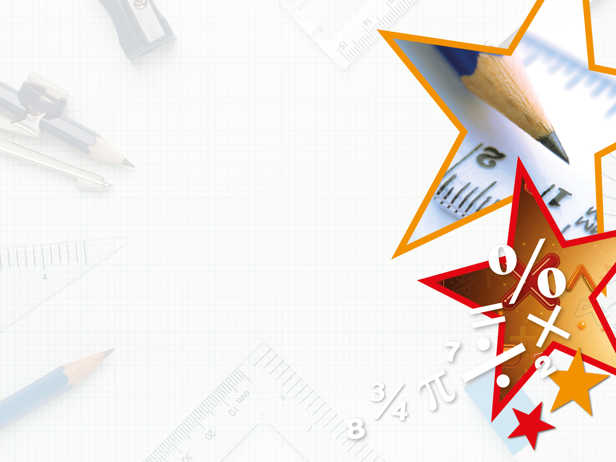
Year 5– Summer Block 1 – Converting Units – Step 2
About This Resource:
This PowerPoint has been designed to support teaching of the small steps. It includes a starter activity suitable for the year group and an example of each question from the Varied Fluency and Reasoning and Problem Solving resources also provided in the tasks. Each slide has the year group identified in the bottom right-hand corner. I recommend that you look through this PowerPoint in advance and decide whether to work through all examples provided or a selection of them depending on the needs of your child.
The PowerPoint has been dated for the week, so please work your way through it each day.

Slide 2
Year 5 – Summer Block 1 – Converting Units
Tuesday 28th April 2020
Step 2
Year 5: Millimetres and Millilitres

Slide 3
Introduction
Draw a line to match these converted units of measure.
7,000ml
1,000ml
5,000mm
1L
1m
3L
5m
7L
9m
3,000ml
9,000mm
1,000mm
Y5

Slide 4
Introduction
Draw a line to match these converted units of measure.
7,000ml
1,000ml
5,000mm
1L
1m
3L
5m
7L
9m
3,000ml
9,000mm
1,000mm
Y5

Slide 5
Varied Fluency 1
Show you know how to convert the measurement by completing these statements.
To convert 7.1m into millimetres __________________ by 1,000. The answer is __________________ .
To convert 1,250ml into litres __________________ by 1,000. The answer is __________________ .
To convert 2,800ml into litres __________________ by 1,000. The answer is __________________ .
Y5

Slide 6
Varied Fluency 1
Show you know how to convert the measurement by completing these statements.
To convert 7.1m into millimetres __________________ by 1,000. The answer is __________________ .
To convert 1,250ml into litres __________________ by 1,000. The answer is __________________ .
To convert 2,800ml into litres __________________ by 1,000. The answer is __________________ .
multiply
7,100mm
divide
1.25L
divide
2.8L
Y5

Slide 7
Varied Fluency 2
Complete the table.
 | ml | L
 | 40
 |  | 0.55
1
1000
70
1000
Y5

Slide 8
Varied Fluency 2
Complete the table.
 | ml | L
 | 70 | 0.07
 | 40 | 0.04
 | 550 | 0.55
1
1000
70
1000
40
1000
550
1000
Y5

Slide 9
Varied Fluency 3
Order these mixed measurements from smallest to largest.
50ml
5.0L
5.5L
0.5L
550ml
Y5

Slide 10
Varied Fluency 3
Order these mixed measurements from smallest to largest.
50ml
5.0L
5.5L
0.5L
550ml
50ml
0.5L
550ml
5.0L
5.5L
Y5

Slide 11
Varied Fluency 4
Draw lines to match the equivalent measurements.
2,750ml |  |  | 1,400ml
 |  |  | 4,750mm
1.4L |  |  | 2.75L
 |  |  | 3,750mm
3 | 3 | m
 | 4
4 | 3 | m
 | 4
Y5

Slide 12
Varied Fluency 4
Draw lines to match the equivalent measurements.
2,750ml |  |  | 1,400ml
 |  |  | 4,750mm
1.4L |  |  | 2.75L
 |  |  | 3,750mm
3 | 3 | m
 | 4
4 | 3 | m
 | 4
Y5

Slide 13
Problem Solving 1
Wednesday 29th April 2020
Which 3 measurements combine to make 5.3m?
0.8m
880mm
3,200mm
1.3m
700mm
Y5

Slide 14
Problem Solving 1
Which 3 measurements combine to make 5.3m?
3,200mm ÷ 1,000 = 3.2m
3.2m + 1.3m + 0.8m = 5.3m
0.8m
880mm
3,200mm
1.3m
700mm
Y5

Slide 15
Reasoning 1
Is the following statement correct?
Explain your answer.
8 | L
1000
<
80ml
=
0.08L
Y5

Slide 16
Reasoning 1
Is the following statement correct?
Explain your answer.
Yes, it correct because I know…
8 | L
1000
<
80ml
=
0.08L
Y5

Slide 17
Reasoning 1
Is the following statement correct?
Explain your answer.
Yes, it correct because I know
= 8ml
8ml < 80ml
0.08l x 1000 = 80ml; 80ml = 0.08L
8 | L
1000
<
80ml
=
0.08L
8 | L
1000
Y5

Slide 18
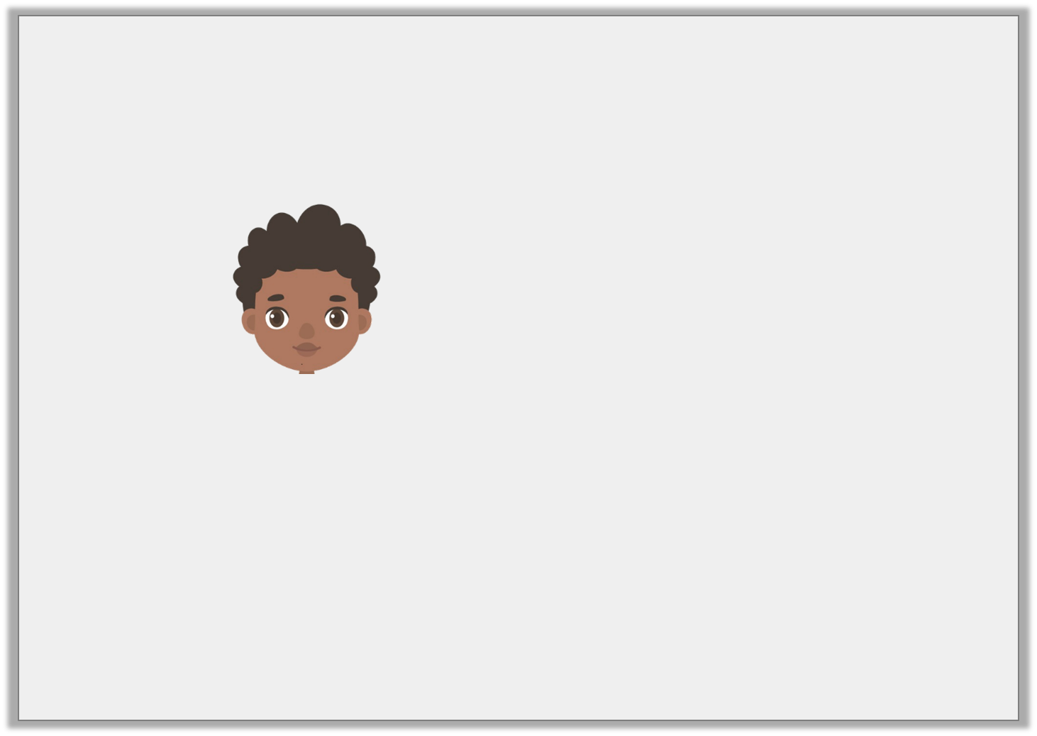

Reasoning 2
Elijah’s bucket can hold 3,500ml. Mason’s bucket can hold 4.2L. Both fill their buckets half way. Elijah adds an extra 850ml and Mason adds an extra 400ml.
Elijah says:
Is he right? Explain how you know.
My bucket has the least water.
Y5

Slide 19
Reasoning 2
Elijah’s bucket can hold 3,500ml. Mason’s bucket can hold 4.2L. Both fill their buckets half way. Elijah adds an extra 850ml and Mason adds an extra 400ml.
Elijah says:
Is he right? Explain how you know.
No Elijah is incorrect because…
My bucket has the least water.
Y5

Slide 20
Reasoning 2
Elijah’s bucket can hold 3,500ml. Mason’s bucket can hold 4.2L. Both fill their buckets half way. Elijah adds an extra 850ml and Mason adds an extra 400ml.
Elijah says:
Is he right? Explain how you know.
No Elijah is incorrect because he has 3,500ml ÷ 2 = 1,750ml.
1,750ml + 850ml = 2,600ml.
Mason has 4.2l ÷ 2 = 2.1L.
2.1L x 1,000 = 2,100ml.
2,100ml + 400ml = 2,500ml.
So Elijah’s bucket has 100ml more than Mason’s bucket.
My bucket has the least water.
Y5

Slide 21
Year 5 – Summer Block 1 – Converting Units
Thursday 30th April 2020
Step 3
Year 5: Metric Units

Slide 22
Introduction
Multiply or divide the following numbers.
 | Thousands | Hundreds | Tens | Ones
x 10 |  |  |  | 7
x 100 |  |  |  | 5
x 1000 |  |  |  | 4
 | Thousands | Hundreds | Tens | Ones
÷ 10 |  |  | 2 | 0
÷ 100 |  | 6 | 0 | 0
÷ 1000 | 3 | 0 | 0 | 0
Y5

Slide 23
Introduction
Multiply or divide the following numbers.
 | Thousands | Hundreds | Tens | Ones
x 10 |  |  | 7 | 0
x 100 |  | 5 | 0 | 0
x 1000 | 4 | 0 | 0 | 0
 | Thousands | Hundreds | Tens | Ones
÷ 10 |  |  |  | 2
÷ 100 |  |  |  | 6
÷ 1000 |  |  |  | 3
Y5

Slide 24

Varied Fluency 1
Convert the height of the flower to millimetres.
37cm
Y5

Slide 25
Varied Fluency 1
Convert the height of the flower to millimetres.
37cm x 10 = 370mm
Y5

Slide 26
Varied Fluency 2
True or false:
72m = 720cm
Y5

Slide 27
Varied Fluency 2
True or false:
72m = 720cm
False:
72m > 720cm
Y5

Slide 28
Varied Fluency 3
Fill in the missing symbol to make the statement correct.
7 | 1 | km |  |  | 7,500m
 | 2
Y5

Slide 29
Varied Fluency 3
Fill in the missing symbol to make the statement correct.
7 | 1 | km |  | = | 7,500m
 | 2
Y5

Slide 30
Varied Fluency 4
Find the difference between the longest line
and the shortest line.
Give your answer in centimetres.
A
150cm
B
1400mm
C
3m
Y5

Slide 31
Varied Fluency 4
Find the difference between the longest line
and the shortest line.
Give your answer in centimetres.
3m (300cm) – 1400mm (140cm) = 160cm
A
150cm
B
1400mm
C
3m
Y5

Slide 32
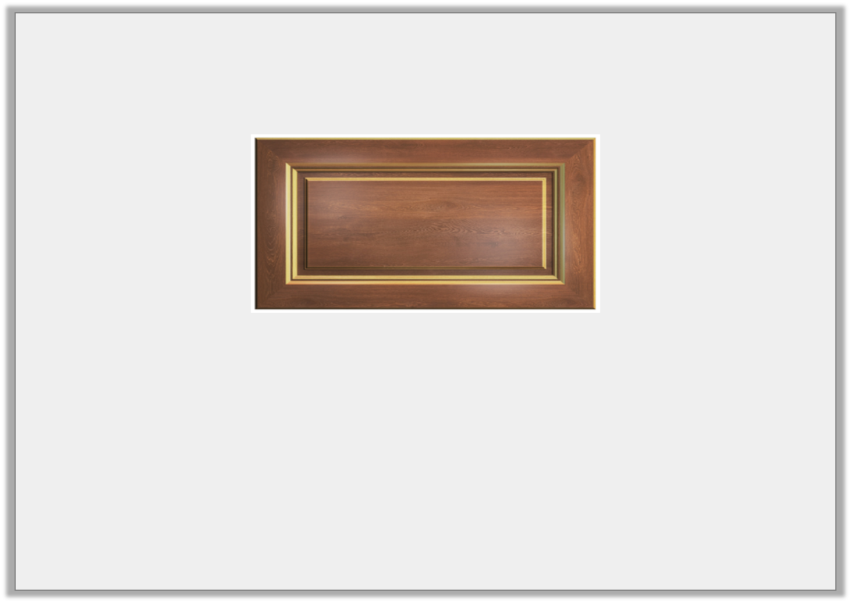
Problem Solving 1
Friday 1st May 2020
Kaleb needs to fit seven 6cm cereal boxes in his cupboard.
Will the cereal boxes fit?
How many cm are spare/needed?
0.5m
Y5

Slide 33
Problem Solving 1
Kaleb needs to fit seven 6cm cereal boxes in his cupboard.
Will the cereal boxes fit?
How many cm are spare/needed?
Yes they will fit, as seven cereal boxes will be 42cm. The cupboard measures 50cm so there will be 8cm spare.
0.5m
Y5

Slide 34
Reasoning 1
Clay is converting millimetres to metres using the table.
Explain and correct his mistakes.
mm | cm | m
250 | 25 | 2.5
1,560 | 156 | 1.56
3,140 | 31.4 | 3.14
Y5

Slide 35
Reasoning 1
Clay is converting millimetres to metres using the table.
Explain and correct his mistakes.
mm | cm | m
250 | 25 | 0.25
1,560 | 156 | 1.56
3,140 | 314 | 3.14
Divided by 10 instead of 100.
Divided by 100 instead of 10.
Y5

Slide 36
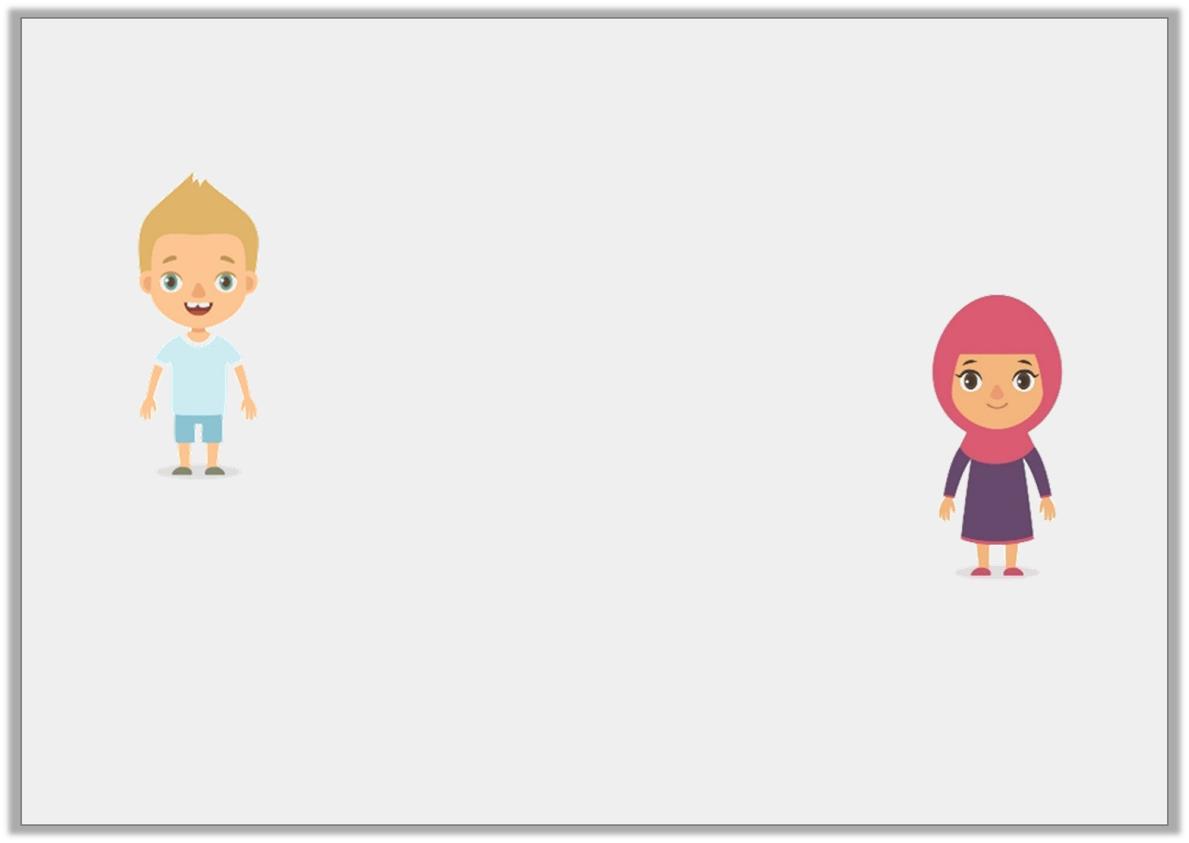
Reasoning 2
Francis and Ariel are converting millimetres to centimetres.
Who is correct? Why?
1,260 millimetres is the same as 126 metres.
1,260 millimetres is the same as 1.26 metres.
Francis
Ariel
Y5

Slide 37
Reasoning 2
Francis and Ariel are converting millimetres to centimetres.
Who is correct? Why?
Ariel is correct because…
1,260 millimetres is the same as 126 metres.
1,260 millimetres is the same as 1.26 metres.
Francis
Ariel
Y5

