Slide 1
Week 6 Tuesday 28th April 2020

Slide 2
Year 3/4 – Summer Block 1 – Money
28.04.20
Step 1
Year 4: I can add pounds and pence

Slide 3
Varied Fluency 1
Complete the table.
£ | p | £ and p
2 | 26
9 | 7
 |  | £3.55
Y4

Slide 4
Varied Fluency 1
Complete the table.
£ | p | £ and p
2 | 26 | £2.26
9 | 7 | £9.07
3 | 55 | £3.55
Y4

Slide 5
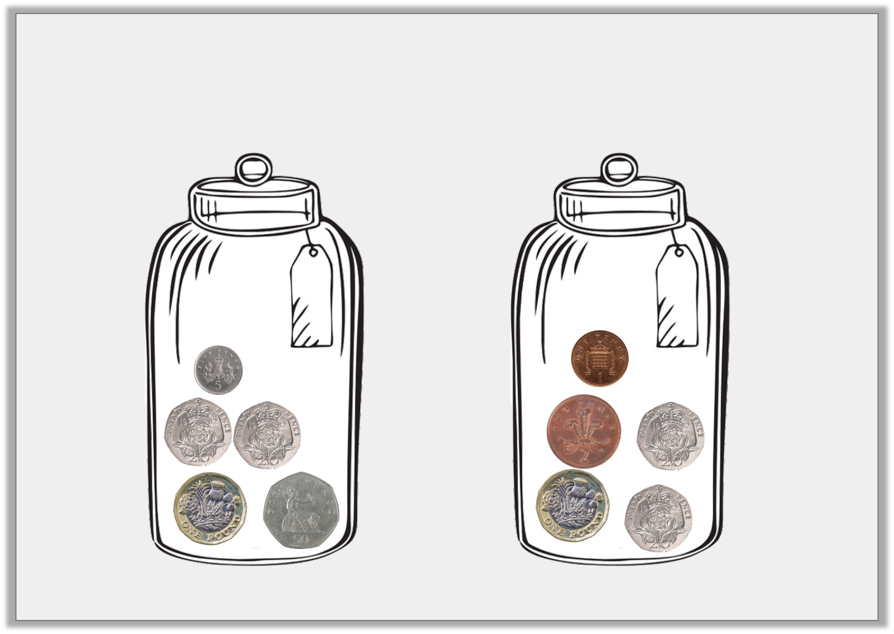
Varied Fluency 2
How much money is in each jar?
A
B
Y4

Slide 6
Varied Fluency 2
How much money is in each jar?
A
B
£1.95
£1.43
Y4

Slide 7
Varied Fluency 3
I have five pound coins, a fifty pence coin and 2 ten pence coins. How much money do I have altogether?
Y4

Slide 8
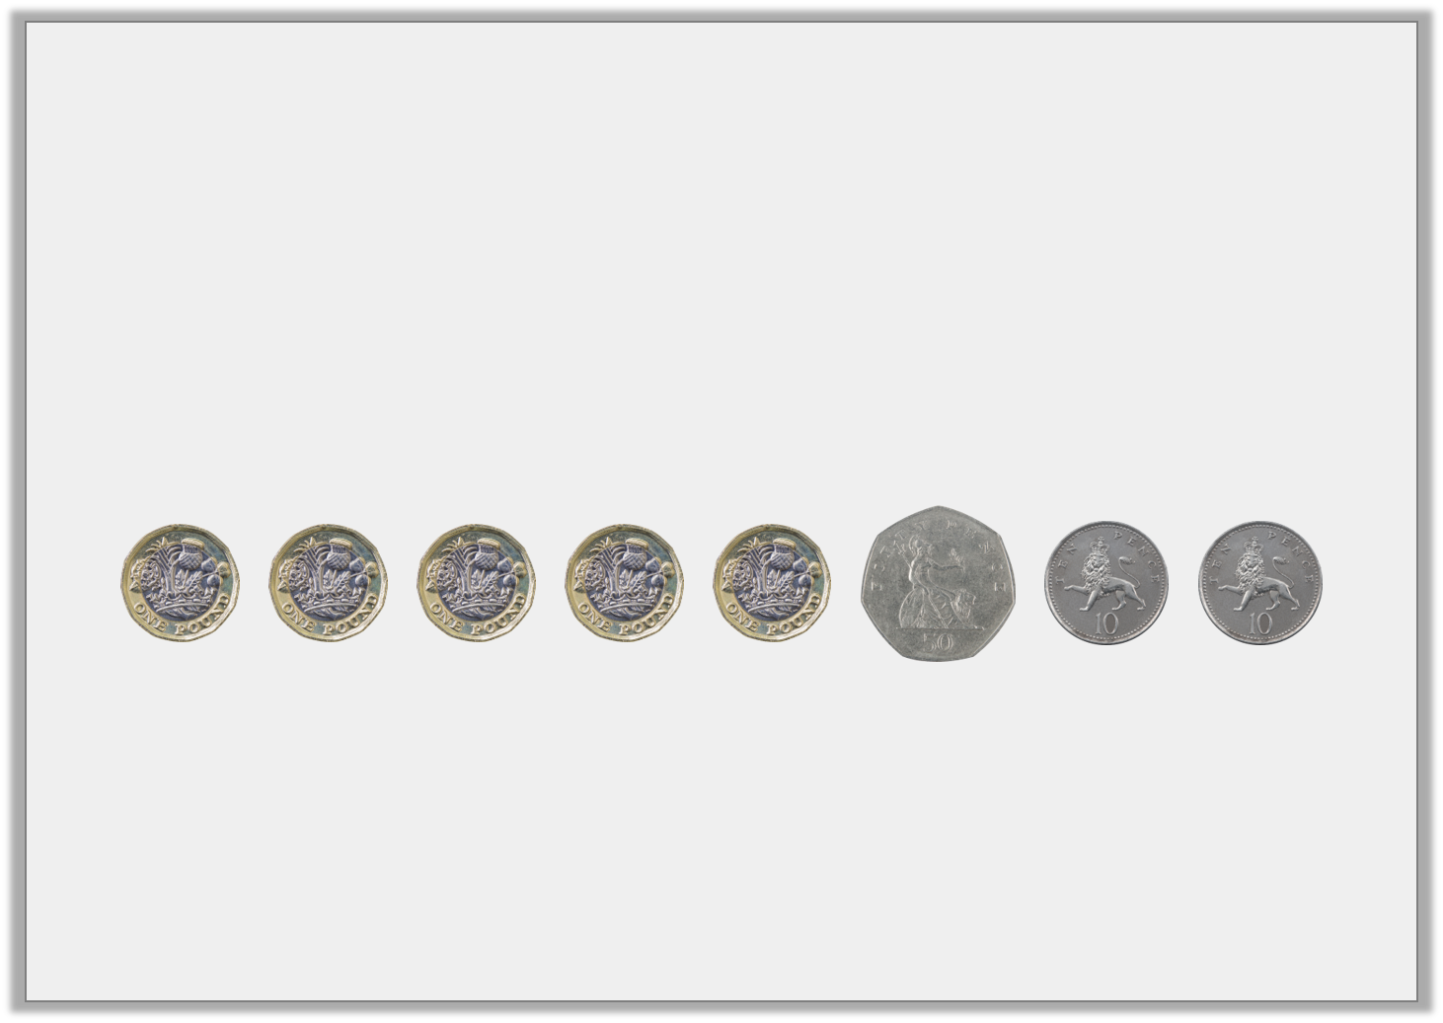
Varied Fluency 3
I have five pound coins, a fifty pence coin and 2 ten pence coins. How much money do I have altogether?
£5.70
Y4

Slide 9
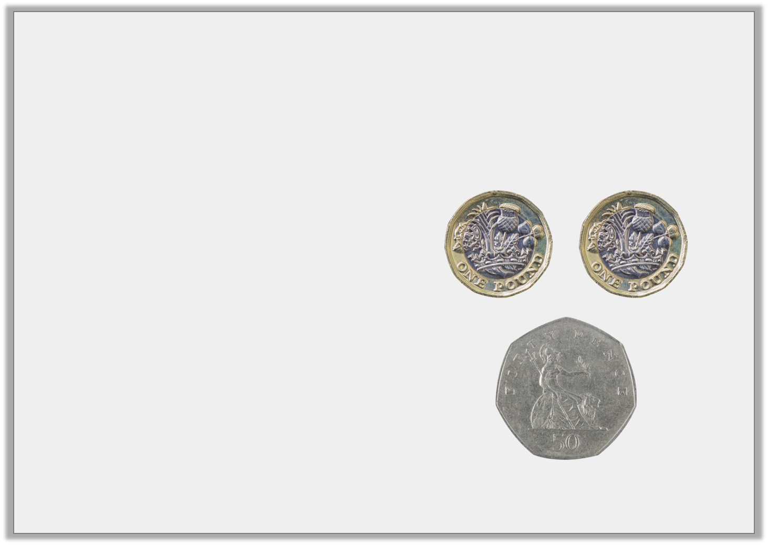
Varied Fluency 4
Which is the correct written version for the amount of coins shown?
A) £2.05
B) £2.5
C) £2.50
Y4

Slide 10
Varied Fluency 4
Which is the correct written version for the amount of coins shown?
A) £2.05
B) £2.5
C) £2.50
Y4

Slide 11
Varied Fluency 5
What is the value of the underlined digit?
a) £11.65 | b) £4.09 | c) £11.20
Y4

Slide 12
Varied Fluency 5
What is the value of the underlined digit?
a) £11.65 60p | b) £4.09 9p | c) £11.20 £10
Y4

Slide 13
Wednesday 29th April 2020 Lo: Year 4: I can add pounds and pence using reasoning and problem – solving

Slide 14
Reasoning 1
Imran and Beth both want to buy a burger.
A burger costs £1.60.
Imran says, “I have a £1 coin, two 20p coins and two 5p coins.”
Beth says, “I have a £1 coin, two 20p coins and two 10p coins.”
Who can afford to buy a burger?
Explain how you know.
Y4

Slide 15
Reasoning 1
Imran and Beth both want to buy a burger.
A burger costs £1.60.
Imran says, “I have a £1 coin, two 20p coins and two 5p coins.”
Beth says, “I have a £1 coin, two 20p coins and two 10p coins.”
Who can afford to buy a burger?
Explain how you know.
Beth can afford it because…
Y4

Slide 16
Reasoning 1
Imran and Beth both want to buy a burger.
A burger costs £1.60.
Imran says, “I have a £1 coin, two 20p coins and two 5p coins.”
Beth says, “I have a £1 coin, two 20p coins and two 10p coins.”
Who can afford to buy a burger?
Explain how you know.
Beth can afford it because she has £1.60. Imran only has £1.50.
Y4

Slide 17
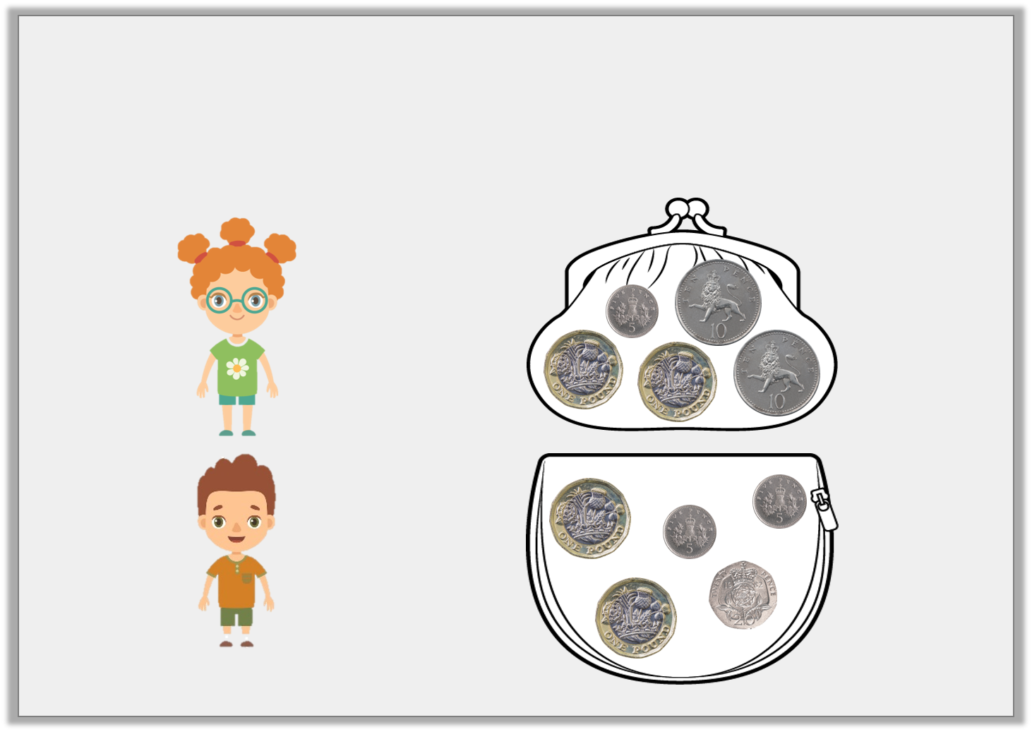
Problem Solving 1
Emma has £2.30. Ross has £2.25. Match each child to their correct money purse.
Emma
Ross
Y4

Slide 18
Problem Solving 1
Emma has £2.30. Ross has £2.25. Match each child to their correct money purse.
Emma
Ross
Y4

Slide 19
Problem Solving 2
Andrew has £2.10 in his wallet. He has four coins.
What coins could Andrew have?
Y4

Slide 20
Problem Solving 2
Andrew has £2.10 in his wallet. He has four coins.
What coins could Andrew have?
Various answers, for example:
2 x £1 coin and 2 x 5p coin
A £1 coin, 2 x 50p coin and a 10p coin
Y4

Slide 21
Thursday 30th April 2020

Slide 22
Year 3/4 – Summer Block 1 – Money
Step 2
Year 4: I can order amounts of money

Slide 23
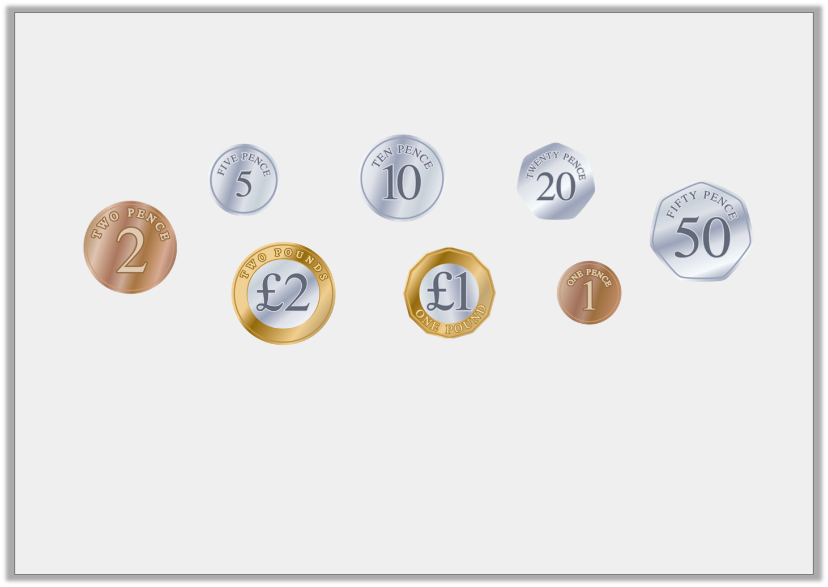
Introduction
Order these coins from lowest to highest value.
How many 10p coins are in £1?
How many 50p coins are in £1?
How many 20p coins are in £1?
How many 5p coins are in £1?
Y4

Slide 24
Introduction
Order these coins from lowest to highest value.
How many 10p coins are in £1? 10
How many 50p coins are in £1? 2
How many 20p coins are in £1? 5
How many 5p coins are in £1? 20
Y4

Slide 25
Varied Fluency 1
Order these amounts from smallest to largest.
6,932p |  | 2,135p
4,863p |  | 3,921p
Y4

Slide 26
Varied Fluency 1
Order these amounts from smallest to largest.
2,135p, 3,921p, 4,863p, 6,932p
6,932p |  | 2,135p
4,863p |  | 3,921p
Y4

Slide 27
Varied Fluency 2
Order these amounts from smallest to largest.
£45.60 |  | £34.09
£29.56 |  | £53.12
Y4

Slide 28
Varied Fluency 2
Order these amounts from smallest to largest.
£29.56, £34.09, £45.60, £53.12
£45.60 |  | £34.09
£29.56 |  | £53.12
Y4

Slide 29
Varied Fluency 3
Use >, < and = to compare these amounts.
2,456p |  | 1,452p
1,897p |  | 4,231p
3,543p |  | 3,267p
Y4

Slide 30
Varied Fluency 3
Use >, < and = to compare these amounts.
2,456p | > | 1,452p
1,897p | < | 4,231p
3,543p | > | 3,267p
Y4

Slide 31
Varied Fluency 4
Use >, < and = to compare these amounts.
£23.79 |  | 2,452p
£16.56 |  | 1,656p
£45.10 |  | 3,634p
Y4

Slide 32
Varied Fluency 4
Use >, < and = to compare these amounts.
£23.79 | < | 2,452p
£16.56 | = | 1,656p
£45.10 | > | 3,634p
Y4

Slide 33
Friday 1st May 2020 Year 4: I can order amounts of money using reasoning and problem-solving

Slide 34
Problem Solving 1
Holly has been saving 50p coins.
She has more than £36.50 but less than £39.00.
How much could Holly have?
Y4

Slide 35
Problem Solving 1
Holly has been saving 50p coins.
She has more than £36.50 but less than £39.00.
How much could Holly have?
£37.00, £37.50, £38.00 or £38.50
Y4

Slide 36
Problem Solving 2
How many ways can you make this statement true? Use the digit cards below.
6
3
5
1
£5.61 >
3
Y4

Slide 37
Problem Solving 2
How many ways can you make this statement true? Use the digit cards below.
12:
£3.13, £3.15, £3.16, £3.31, £3.35, £3.36,
£3.51, £3.53, £3.56, £3.61, £3.63, £3.65
6
3
5
1
£5.61 >
3
Y4

Slide 38
Reasoning 1
Who has the most money? Explain why.
I have two 50p coins.
I have six 20p coins.
Lee
Milo
Y4

Slide 39
Reasoning 1
Who has the most money? Explain why.
I have two 50p coins.
I have six 20p coins.
Lee
Milo has the most because…
Milo
Y4

Slide 40
Reasoning 1
Who has the most money? Explain why.
I have two 50p coins.
I have six 20p coins.
Lee
Milo has the most because
6 x 20p = 120p whereas
2 x 50p = 100p.
Milo
Y4

