Slide 1
Tuesday 28th April 2020

Slide 2
Year 3/4 – Summer Block 1 – Money
28.04.20
Step 1
Year 3: I can add pounds and pence

Slide 3
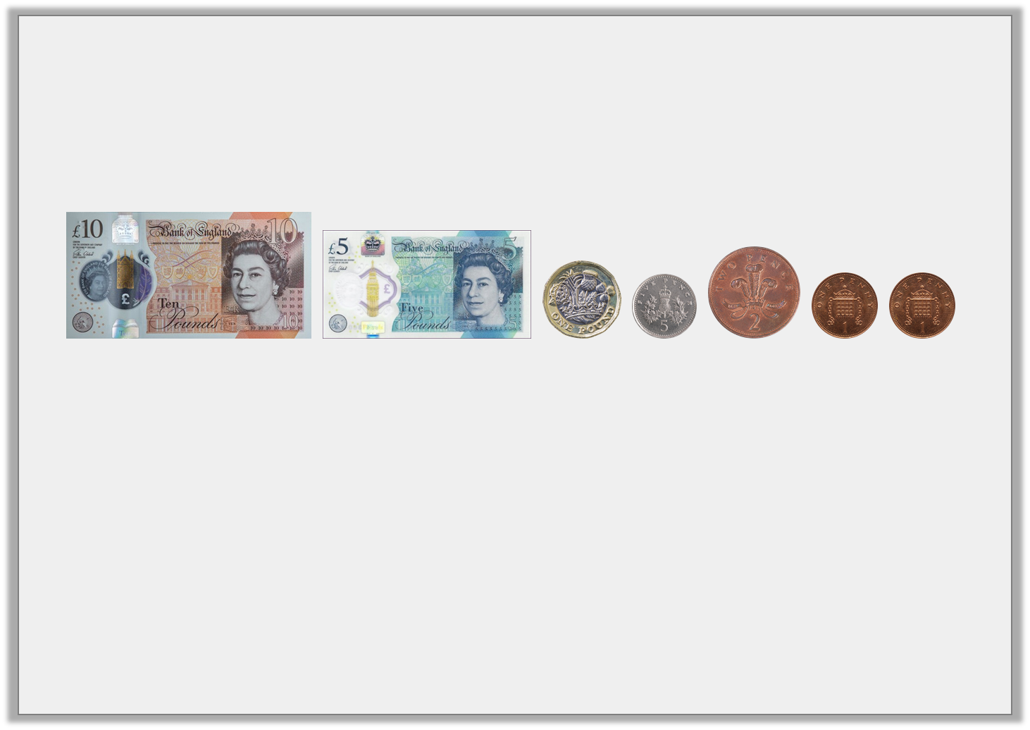
Introduction
What is the total?
£16.10 |  | £16.9 |  | £16.09
Y3

Slide 4
Introduction
What is the total?
£16.10 |  | £16.9 |  | £16.09
Y3

Slide 5
Introduction
Make 10p using only bronze coins.
Make 50p using only silver coins.
Make £1 using only silver coins.
Is there more than one way of doing it?
Y4

Slide 6
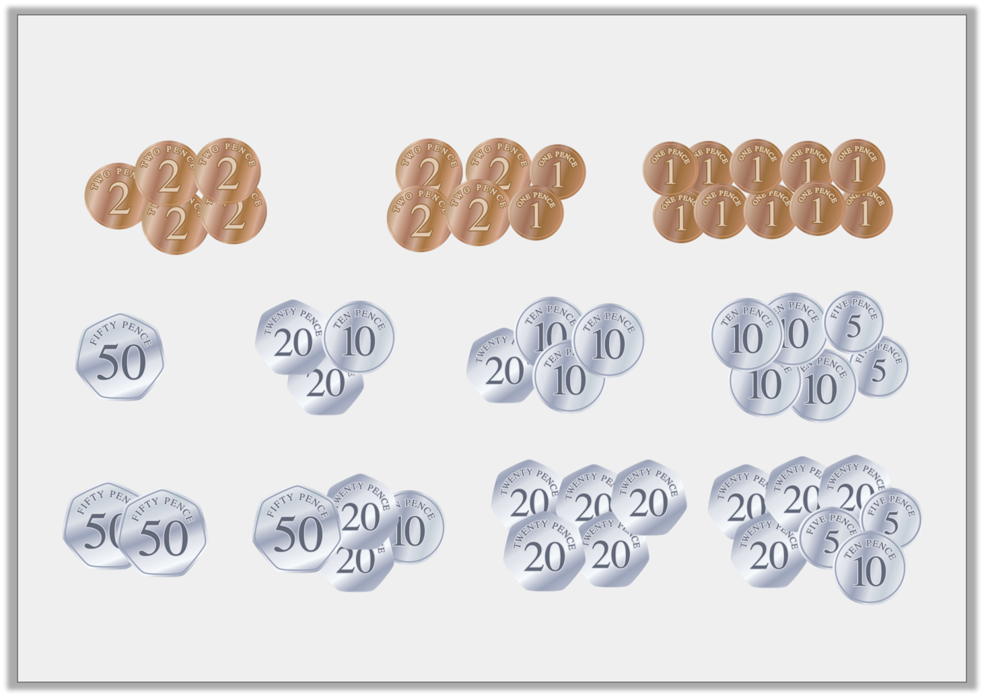
Introduction
Make 10p using only bronze coins.
Make 50p using only silver coins.
Make £1 using only silver coins.
Here is a selection of answers.
Y4

Slide 7
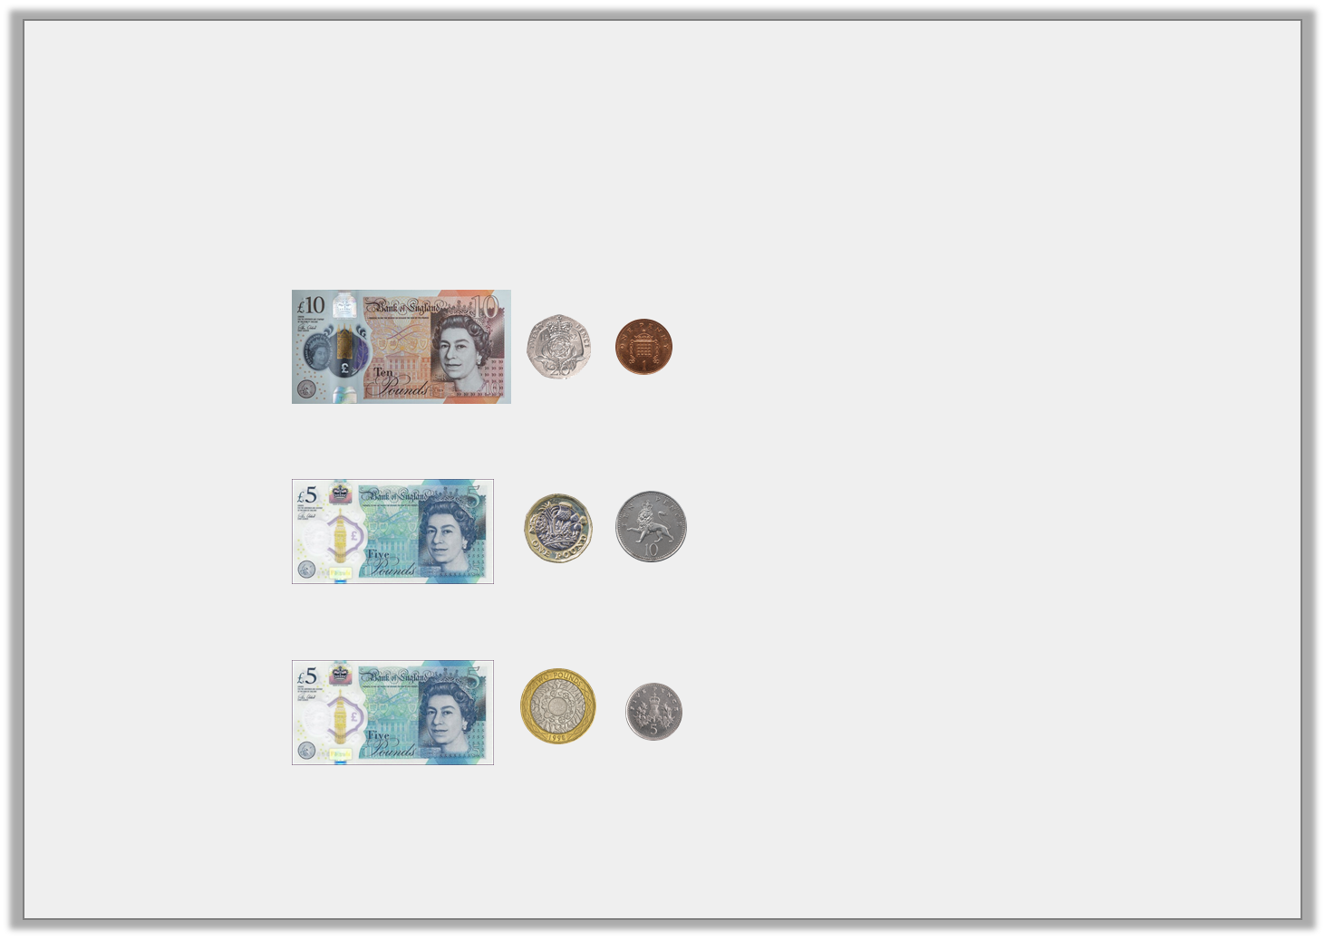
Varied Fluency 1
Match the notes and coins to the correct amounts.
A £6 and 10p
B £10 and 21p
C £7 and 5p
Y3

Slide 8
Varied Fluency 1
Match the notes and coins to the correct amounts.
A £6 and 10p
B £10 and 21p
C £7 and 5p
Y3

Slide 9
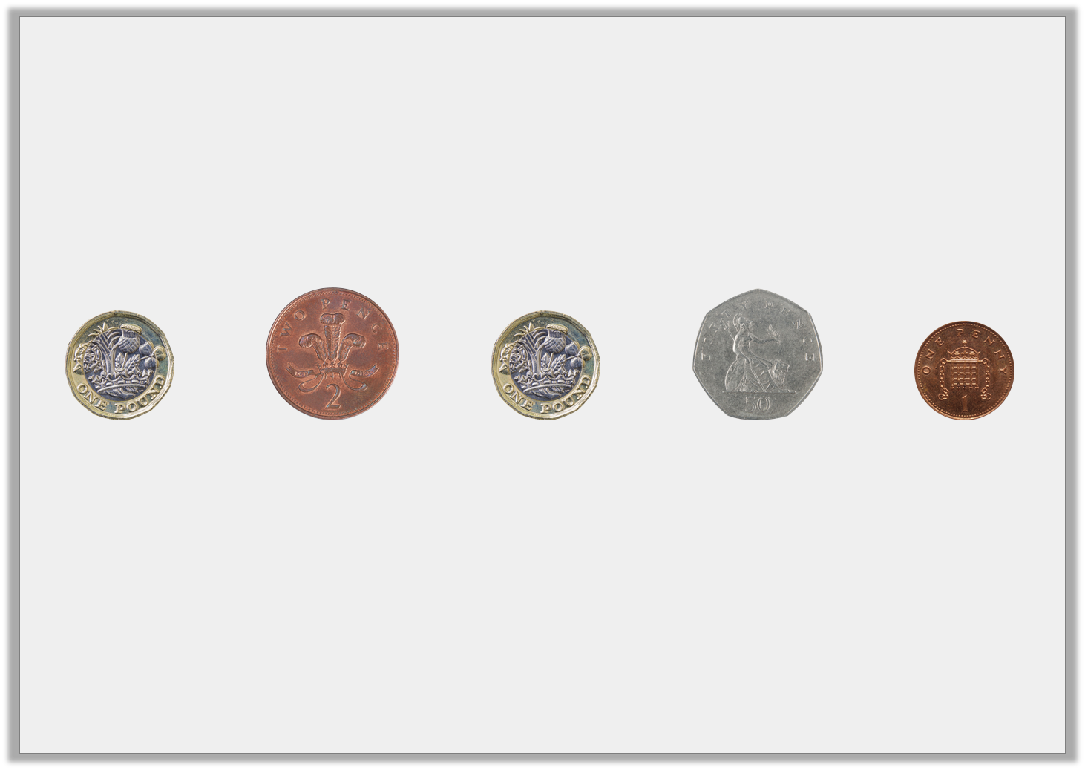
Varied Fluency 2
Circle the coins that make £2 and 51p.
Y3

Slide 10
Varied Fluency 2
Circle the coins that make £2 and 51p.
Y3

Slide 11
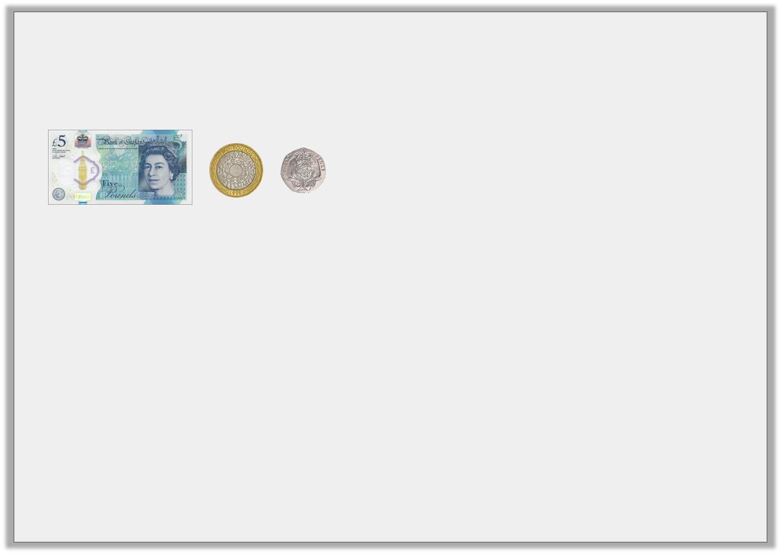
Varied Fluency 3
Which has the greatest value?
A.
B. 740 pence
C. £8 and 20p
Y3

Slide 12
Varied Fluency 3
Which has the greatest value?
A.
B. 740 pence
C. £8 and 20p
C has the greatest value
Y3

Slide 13
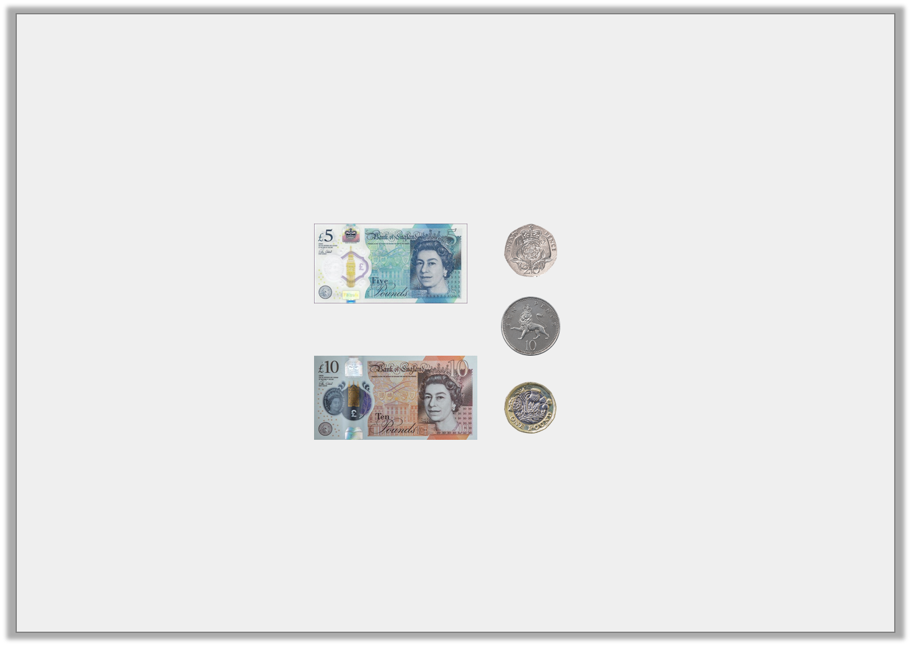
Varied Fluency 4
True or false?
The amount shown is £16 and 30p.
Y3

Slide 14
Varied Fluency 4
True or false?
The amount shown is £16 and 30p.
True
Y3

Slide 15
Wednesday 29th April 2020 Lo: I can add pounds and pence using reasoning and problem-solving

Slide 16
Problem Solving 1
Look at the pricelist below.
What combination of 1 note and 2 coins could you use to buy some flip flops?
What combination of 1 note and 2 coins could you use to buy some goggles?
Flip Flops | £10 and 40p
Goggles | £12 and 10p
Y3

Slide 17
Problem Solving 1
Look at the pricelist below.
What combination of 1 note and 2 coins could you use to buy some flip flops? £10 note, 20p and 20p
What combination of 1 note and 2 coins could you use to buy some goggles? £10 note, £2 and 10p
Flip Flops | £10 and 40p
Goggles | £12 and 10p
Y3

Slide 18
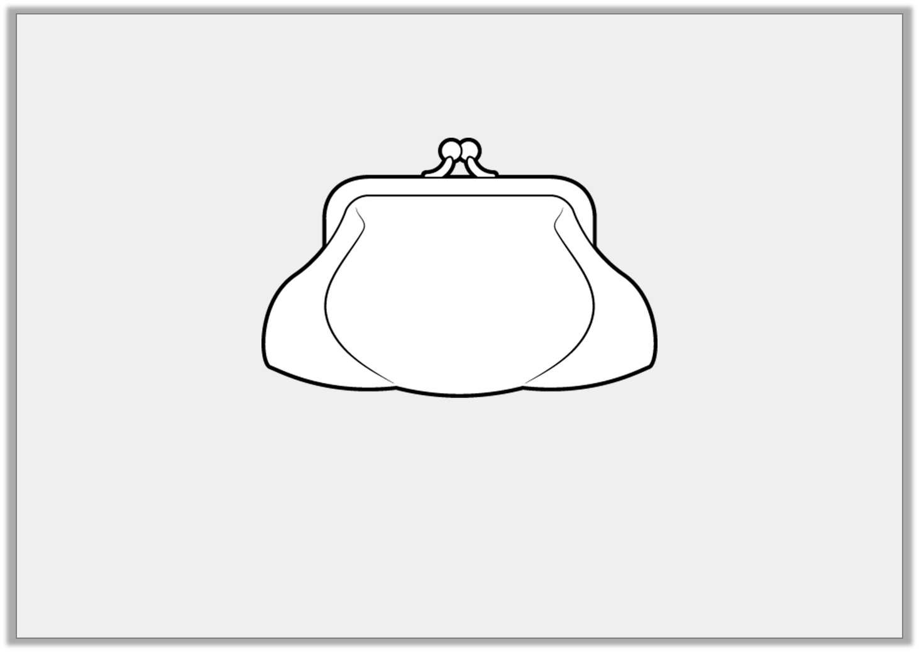
Problem Solving 2
Draw £16 and 10p in the purse, using one note and up to five coins.
Find another combination that make this total.
Y3

Slide 19
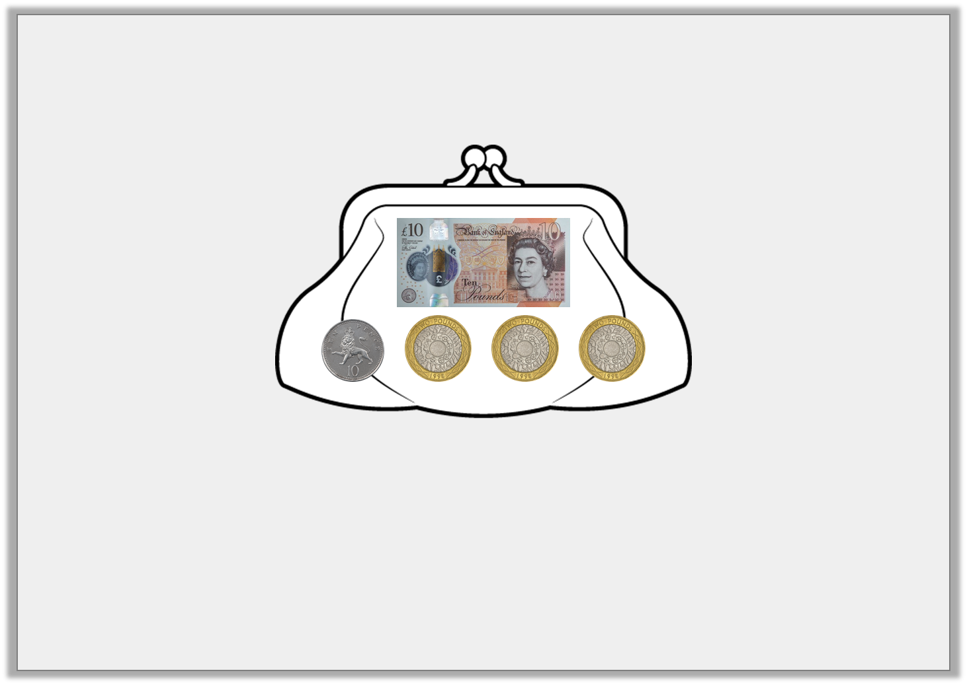
Problem Solving 2
Draw £16 and 10p in the purse, using one note and up to five coins.
Find another combination that make this total.
Possible answers:
£10 note, £2, £2, £2 and 10p
£10 note, £2, £2, £1, £1 and 10p.
Y3

Slide 20
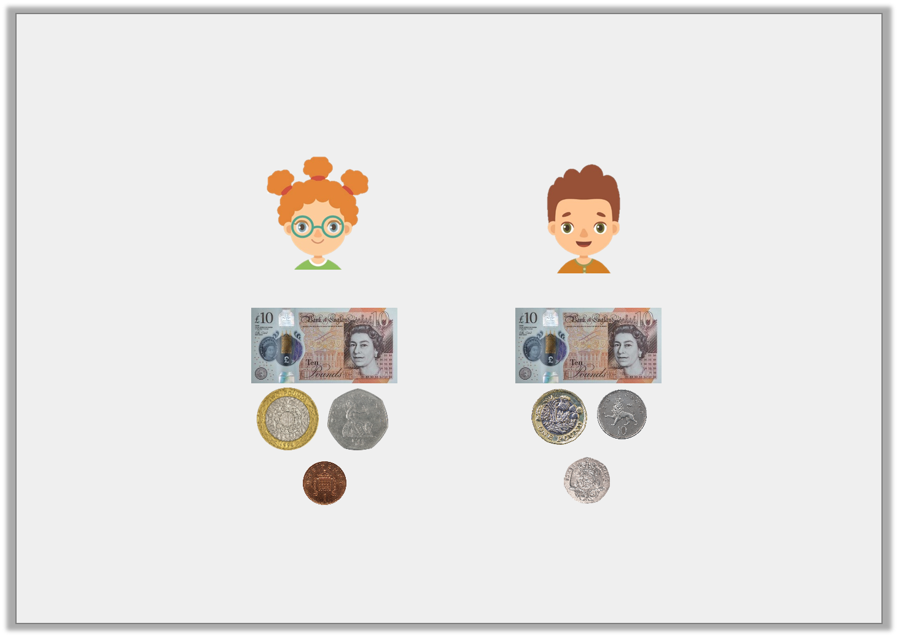
Reasoning 1
Which child has the highest total of money?
Explain your answer.
Freya
Niles
Y3

Slide 21
Reasoning 1
Which child has the highest total of money?
Explain your answer.
Freya has the most because…
Freya
Niles
Y3

Slide 22
Reasoning 1
Which child has the highest total of money?
Explain your answer.
Freya has the most because she has £12 and 51p and Niles has £11 and 30p.
Freya
Niles
Y3

Slide 23
Thursday 30th April 2020

Slide 24
Year 3/4 – Summer Block 1 – Money
Step 2
Year 3: I can convert pounds and pence

Slide 25
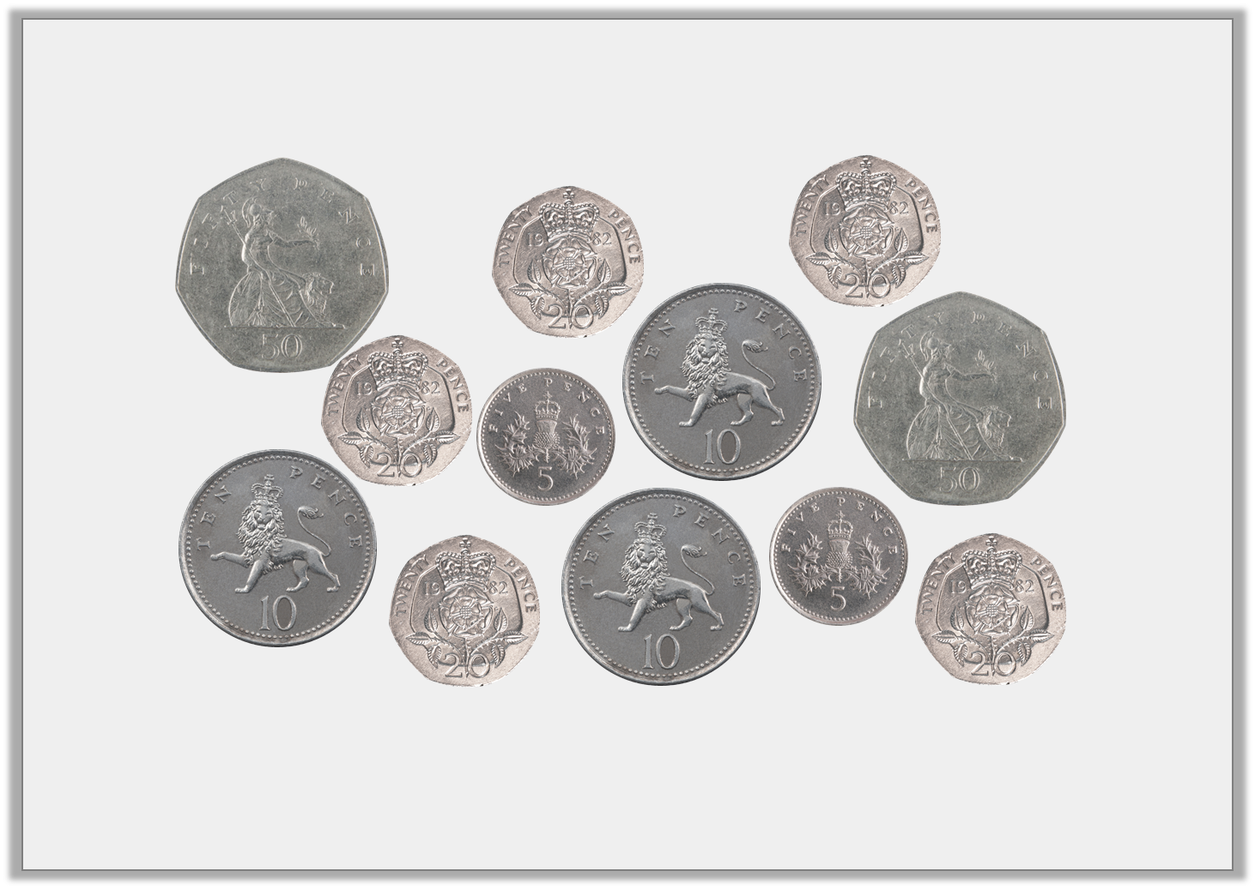
Introduction
Find 4 different ways to make £1
Y3

Slide 26
Introduction
Find 4 different ways to make £1
Various answers, for example:
50p + 50p = £1; 20p + 20p + 20p + 20p + 20p = £1;
50p + 20p + 10p + 10p + 10p = £1; 50p + 20p + 20p + 10p = £1
Y3

Slide 27
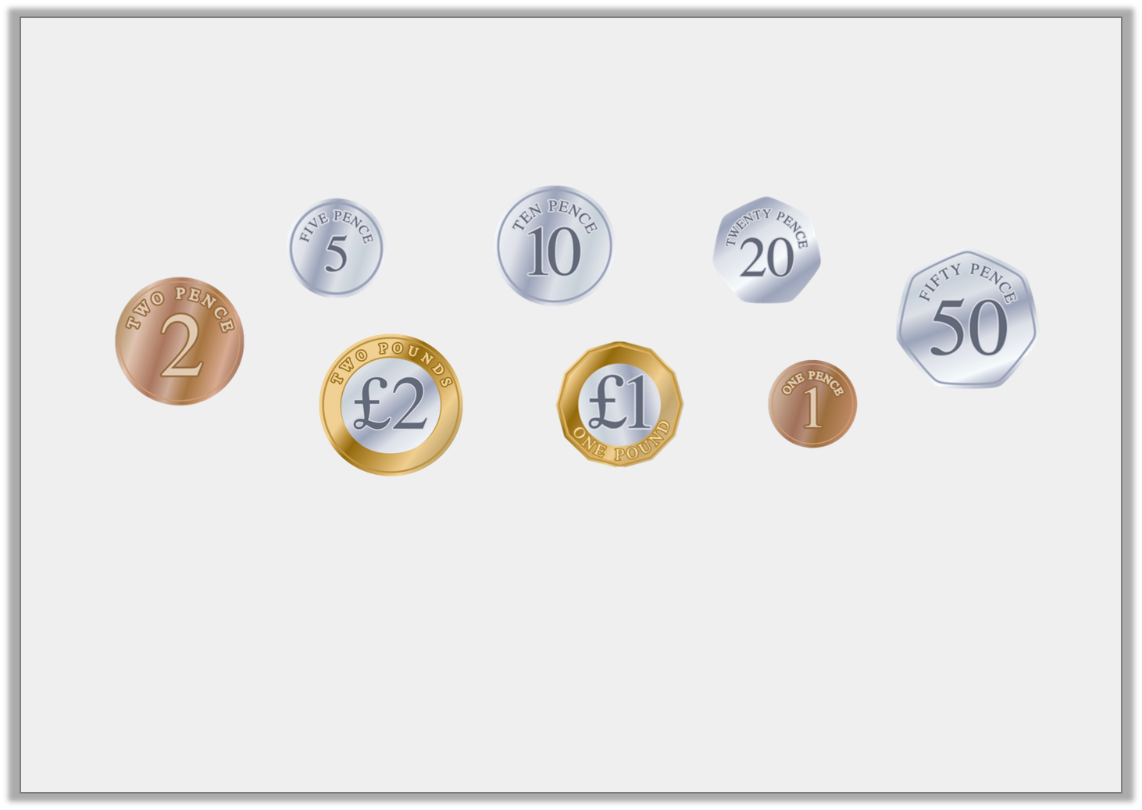
Introduction
Order these coins from lowest to highest value.
How many 10p coins are in £1?
How many 50p coins are in £1?
How many 20p coins are in £1?
How many 5p coins are in £1?
Y4

Slide 28
Introduction
Order these coins from lowest to highest value.
How many 10p coins are in £1? 10
How many 50p coins are in £1? 2
How many 20p coins are in £1? 5
How many 5p coins are in £1? 20
Y4

Slide 29
Varied Fluency 1
Match the equal amounts.
345p |  | 654p
£4 and 58p |  | £3 and 45p
£6 and 54p |  | £5 and 53p
553p |  | 458p
Y3

Slide 30
Varied Fluency 1
Match the equal amounts.
345p |  | 654p
£4 and 58p |  | £3 and 45p
£6 and 54p |  | £5 and 53p
553p |  | 458p
Y3

Slide 31
Varied Fluency 2
Complete the statements using <, > or = symbols.
518p |  | £5 and 82p |  | 554p
£8 and 72p |  | 837p |  | £8 and 29p
Y3

Slide 32
Varied Fluency 2
Complete the statements using <, > or = symbols.
518p | < | £5 and 82p | > | 554p
£8 and 72p | > | 837p | > | £8 and 29p
Y3

Slide 33
Varied Fluency 3
Put these amounts in order from the smallest to the largest.
£6 and 38p |  | 883p
836p |  | £8 and 63p
Y3

Slide 34
Varied Fluency 3
Put these amounts in order from the smallest to the largest.
£6.38; 836p; £8.63; 883p
£6 and 38p |  | 883p
836p |  | £8 and 63p
Y3

Slide 35
Varied Fluency 4
Complete the conversion table.
Pounds and Pence | Pence
£2 and 56p
 | 763p
£5 and 10p
 | 484p
£9 and 38p
Y3

Slide 36
Varied Fluency 4
Complete the conversion table.
Pounds and Pence | Pence
£2 and 56p | 256p
£7 and 63p | 763p
£5 and 10p | 510p
£4 and 84p | 484p
£9 and 38p | 938p
Y3

Slide 37
Friday 1st May 2020 Year 3: I can convert pounds and pence using reasoning and problem-solving

Slide 38
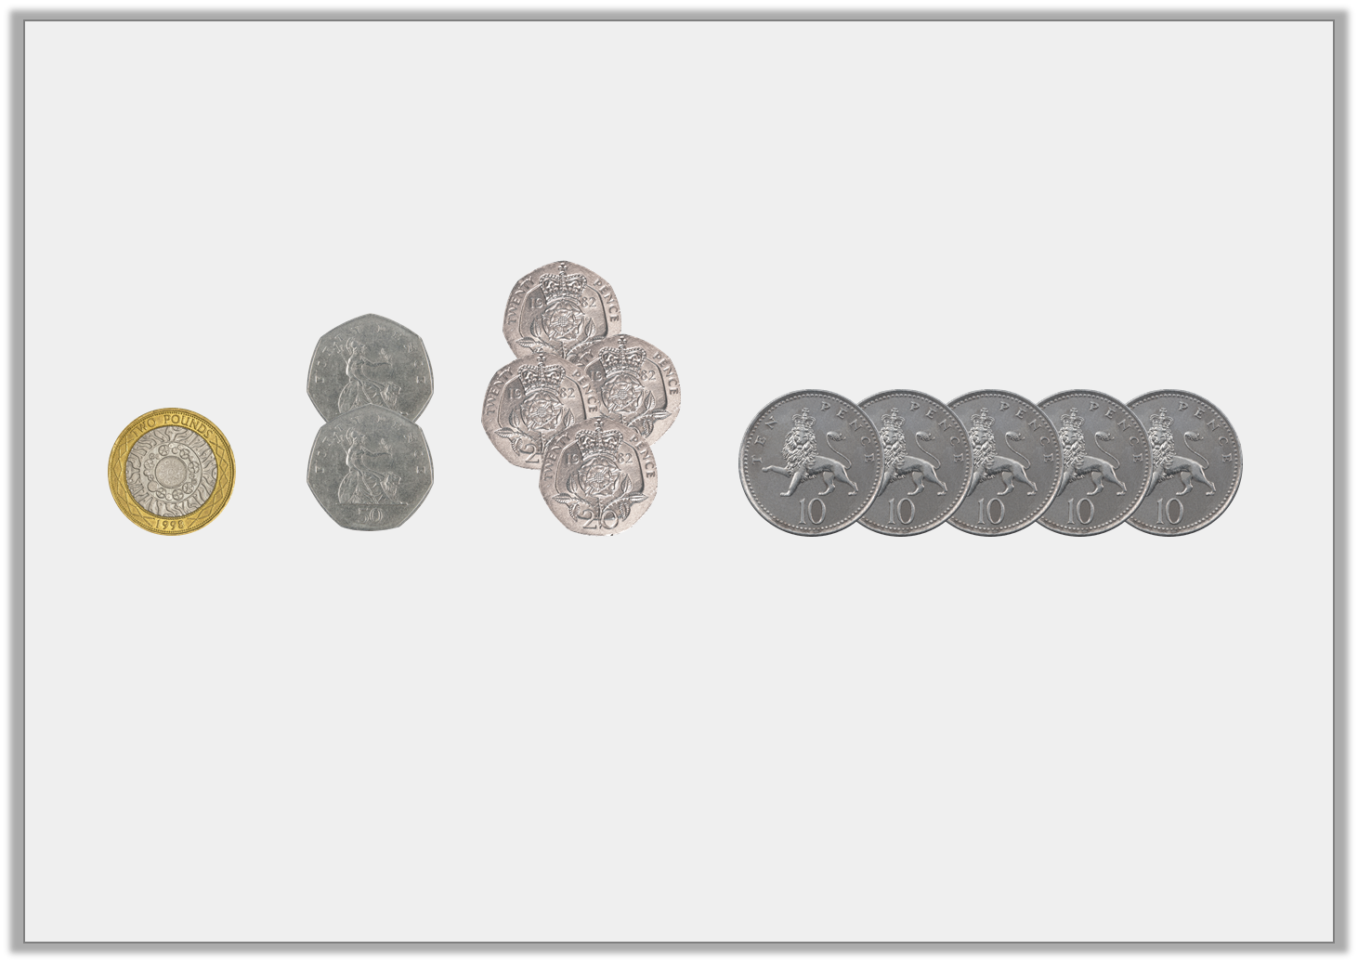
Reasoning 1
Fay has these coins in her pocket. Does she have enough money to buy a pencil case that costs £4 and 50p?
Convince me.
Y3

Slide 39
Reasoning 1
Fay has these coins in her pocket. Does she have enough money to buy a pencil case that costs £4 and 50p?
Convince me.
Fay does not have enough money to buy the pencil case because…
Y3

Slide 40
Reasoning 1
Fay has these coins in her pocket. Does she have enough money to buy a pencil case that costs £4 and 50p?
Convince me.
Fay does not have enough money to buy the pencil case because £2 + 50p + 50p + 20p + 20p + 20p + 20p + 10p + 10p + 10p + 10p +10p = £4 and 30p.
£4 and 30p is less than £4 and 50p.
Y3

Slide 41
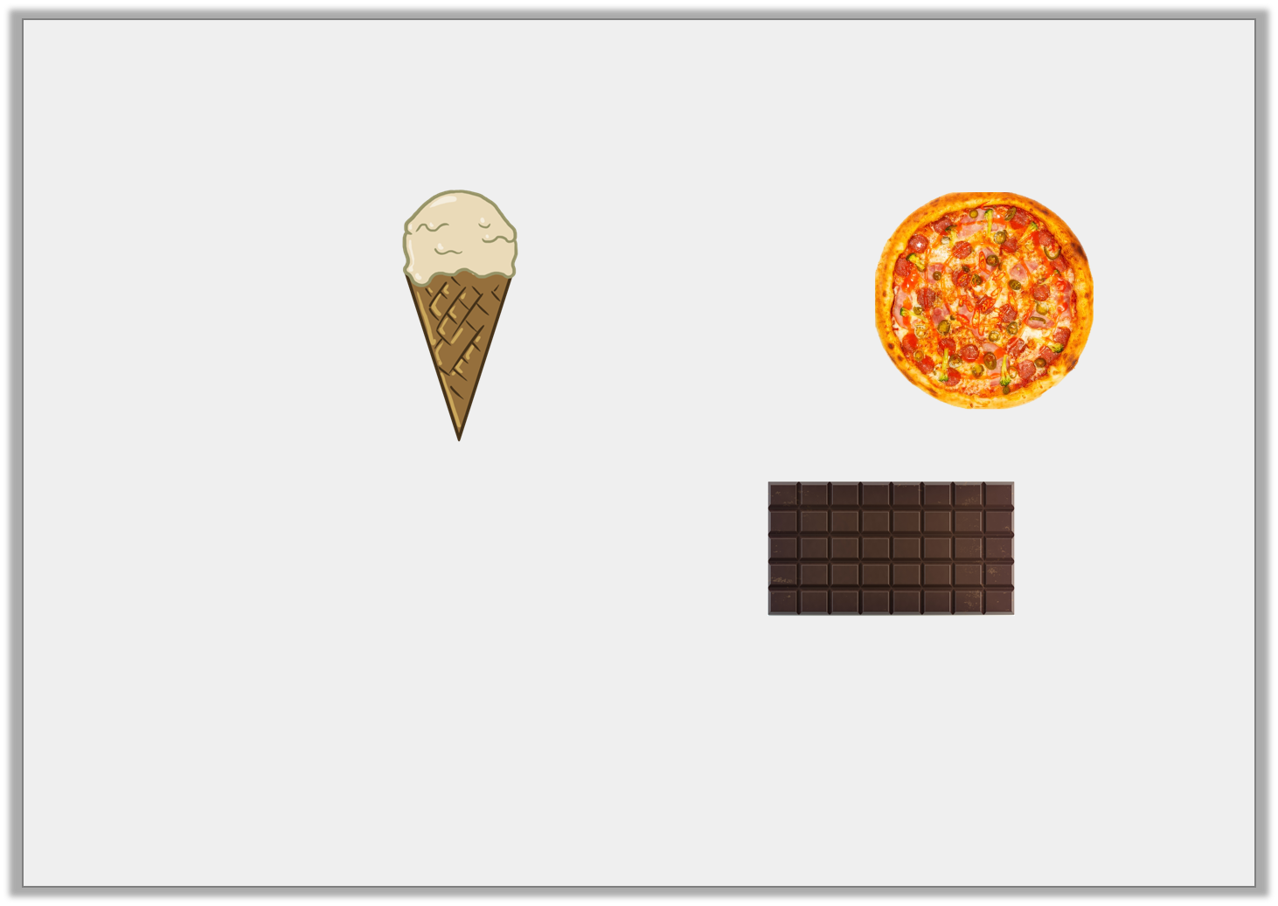
Reasoning 2
Which item is the cheapest?
Explain how you know.
£2 and 95p
259p
£2 and 75p
Y3

Slide 42
Reasoning 2
Which item is the cheapest?
Explain how you know.
The ice cream is the cheapest because…
£2 and 95p
259p
£2 and 75p
Y3

Slide 43
Reasoning 2
Which item is the cheapest?
Explain how you know.
The ice cream is the cheapest because 259p is the same as £2 and 59p, which is less than both £2 and 95p and £2 and 75p.
£2 and 95p
259p
£2 and 75p
Y3

Slide 44
Problem Solving 1
There are 2 different silver coins and a £1 coin in a purse.
How much money could be in the purse?
Write 3 possible answers.
Written in pounds | Written in pence
Y3

Slide 45
Problem Solving 1
There are 2 different silver coins and a £1 coin in a purse.
How much money could be in the purse?
Write 3 possible answers.
Various possible answers, for example:
Or £1 and 30p and 130p; £1 and 25p and 125p; £1 and 15p and 115p
Written in pounds and pence | Written in pence
£1 and 70p | 170p
£1 and 60p | 160p
£1 and 55p | 155p
Y3

